Slide 1
ECE:5995 Applied ML Air Sensor Project (Part 2 – Unsupervised)
Evan Bradley – Group 7
April 28, 2022

Slide 2
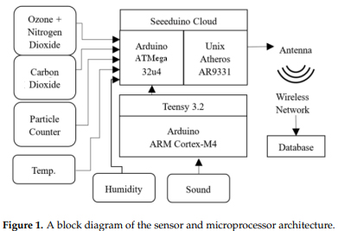
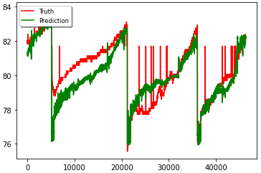
Recap of Part 1

Slide 3
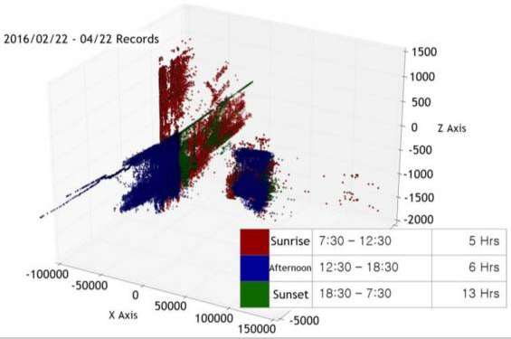
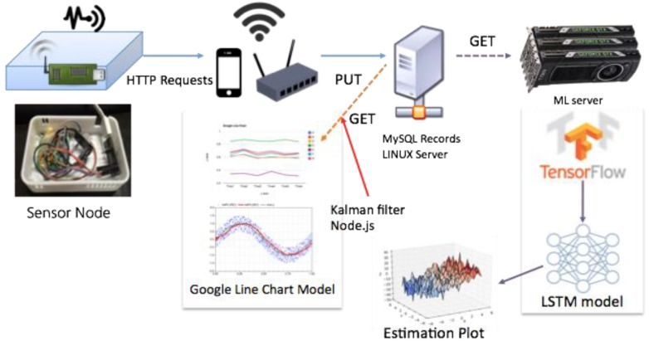
Existing Work
“Low-Cost, Distributed Environmental Monitors for Factory Worker Health” - 2018
“Indoor Air Quality Analysis Using Deep Learning with Sensor Data” - 2017

Slide 4
Proposal for Part 2 – Unsupervised
The current implementation of the air sensor network utilizes a threshold approach for each individual feature to detect unsafe conditions
Taking the input data, can each sample be classified as either a safe, risky, or unsafe working condition?
Goal - Use an Autoencoder, train a model to classify device measurements into three categories

Slide 5
Training Process

Slide 6
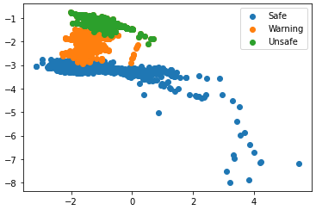
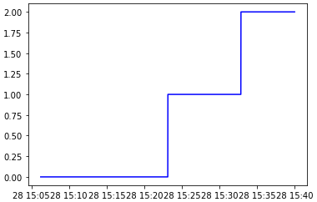
Results
Three distinct clusters of samples
Hard to measure accuracy

Slide 7
Conclusion
This method of classifying the safety of working condition is promising
More data over a longer time period is necessary
Without information on what exposures to hazards would be considered dangerous it is hard to measure accuracy of classifications

Slide 8
Thank You!

