Slide 1
ECE:5995 Applied ML Air Sensor Project
Evan Bradley – Group 7
April 8, 2022

Slide 2
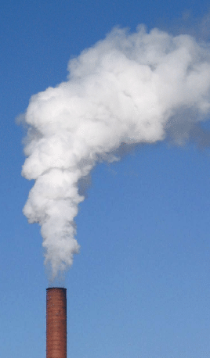
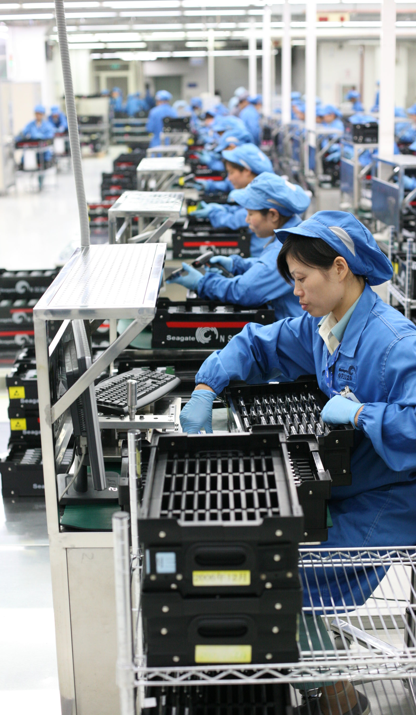

Problem Statement
Exposure to air pollutants and physical agents is the cause for various health risks in many working environments
VOCs, Carbon Monoxide, Particulate Matter, Extreme Temperatures and Sound can be harmful to workers
A distributed network of environmental monitors to measure airborne hazards in a manufacturing facility has been developed by the GROK lab at the University of Iowa

Slide 3
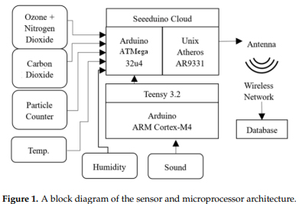
Issues / Improvements
Real deployments of environmental nodes range from 10-150 nodes per factory
Reliability issues
Cutting down on node cost
Remove second microcontroller?
Remove other sensors?

Slide 4
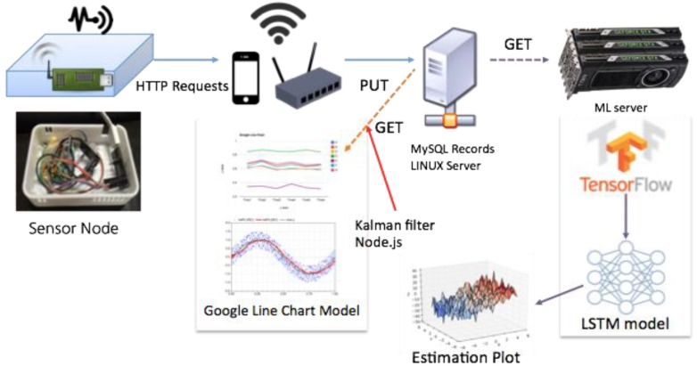
Existing Work
“Low-Cost, Distributed Environmental Monitors for Factory Worker Health” - 2018
“Indoor Air Quality Analysis Using Deep Learning with Sensor Data” - 2017

Slide 5
Proposal
Which feature measurements are necessary?
There might be some hidden relationships in the data that is collected, when machines are running many hazard will likely rise synchronously.
Could certain sensors be removed, and measurements accurately replaced by output from a deep learning model?
Main goals
Using data from past deployments of the air sensor network to train a model to predict sound levels from an input of time, VOC, CO, PM, Temp, and Humidity
Train models using other features as labels to see if other hazards could be predicted using less sensor data as input

Slide 6
Data Available
Data available – 462,799 samples from a previous deployment of a network of nodes
A sample consists of
Time of sample (Year, Month, Day, Hour, Minute, Second)
VOC measurement
CO2 measurement
Temperature measurement
PM measurement (1, 2.5 and 10)
Sound level measurement

Slide 7
Creating Features/Labels From Data
With the goal of making the sample time feature appear cyclical to the model the time sample feature was replaced with a sin transform of the day of the week, hour and minute.
Ex) hour_transform = sin(2π(hour-0)/24)
Sklearn StandardScaler was used to scale all data
Input feature
Sin transform of day of week
Sin transform of hour
Sin transform of minute
PM (1, 2.5, 10)
VOC
Humidity
Temperature
Sound Level

Slide 8
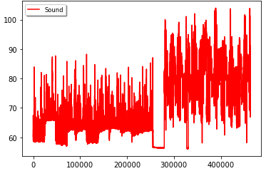
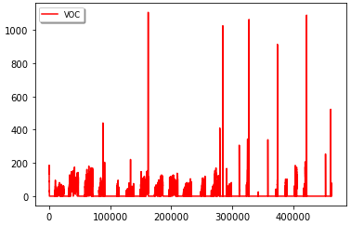
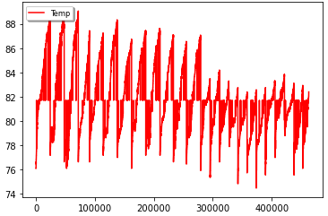
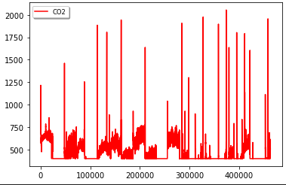
Input Data

Slide 9
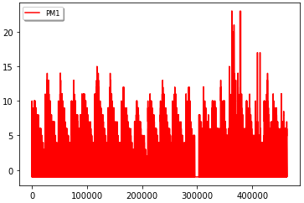
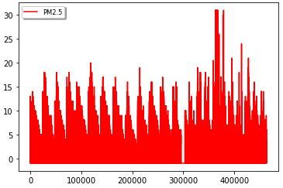
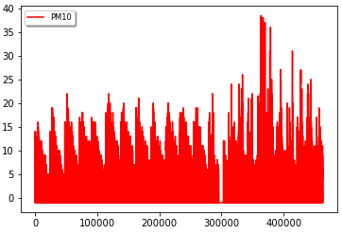
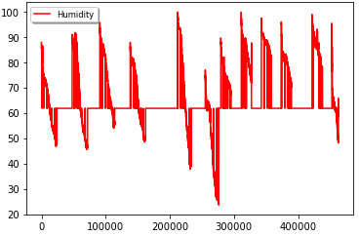
Input Data

Slide 10
Testing / Validation plan
Using the sklearn train_test_split function the data was first split into test/train data with a split of 80% train, 20% test.
The train_test_split function was then used again on the train data to generate validation data with a split of 80% train, 20% validation
Validation data was used to evaluate performance during training, test data was used to evaluate the model after training was comlpete
This resulted in a split of
64% training data
20% testing data
16% validation data

Slide 11
RNN Approach

Slide 12
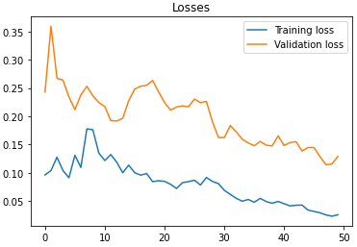
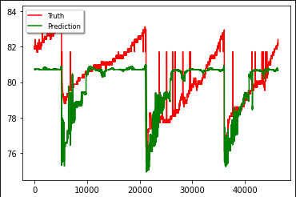
RNN Results – Predicting Temperature

Slide 13
LSTM Approach

Slide 14
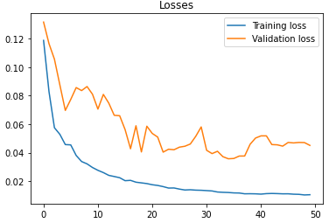
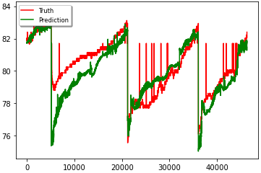
LSTM Results – Predicting Temperature

Slide 15
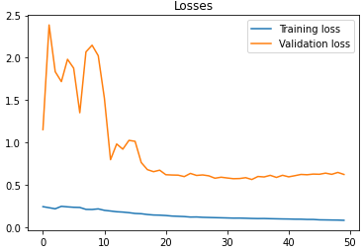
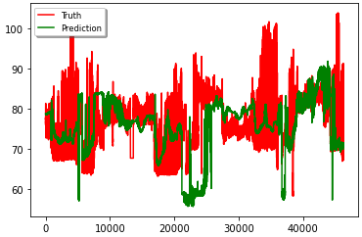
LSTM Results – Predicting Sound Levels

Slide 16
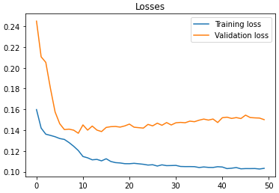
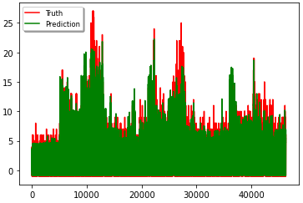
LSTM Results – Predicting PM10 Levels

Slide 17
Conclusion
Some features are easier to predict than others
More data over a longer time period is necessary
Better sound data would help in training

Slide 18
Thank You!

