Slide 1

Spillovers in Price volatility across bitcoin/usd exchanges

Slide 2

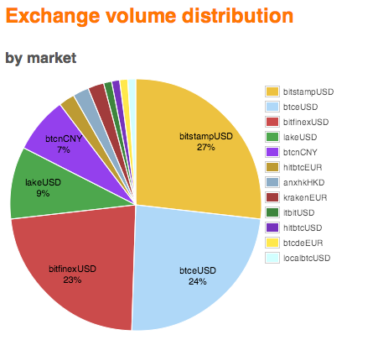


MANY places to exchange your bitcoins

Slide 3
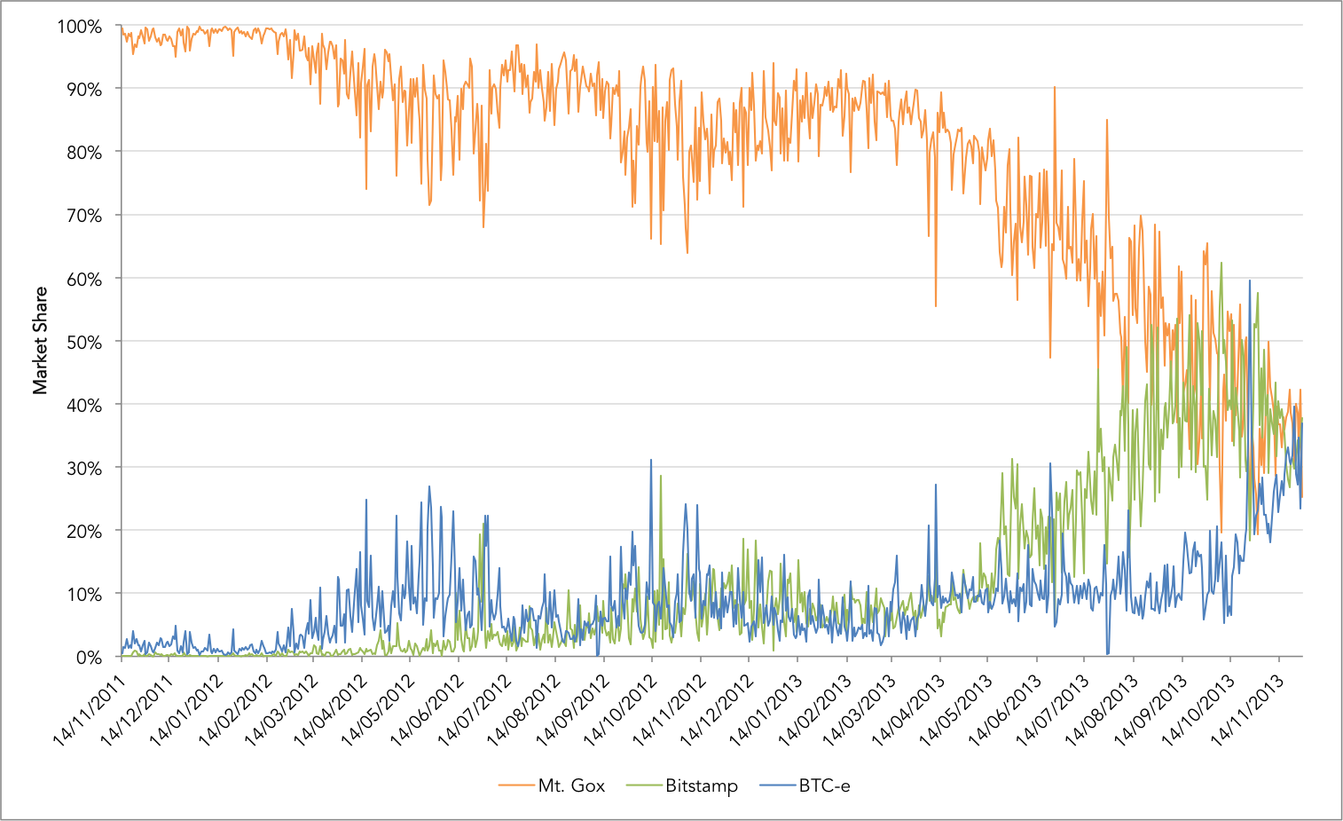
Does price volatility LEAK across bitcoin exchanges ?

Slide 4
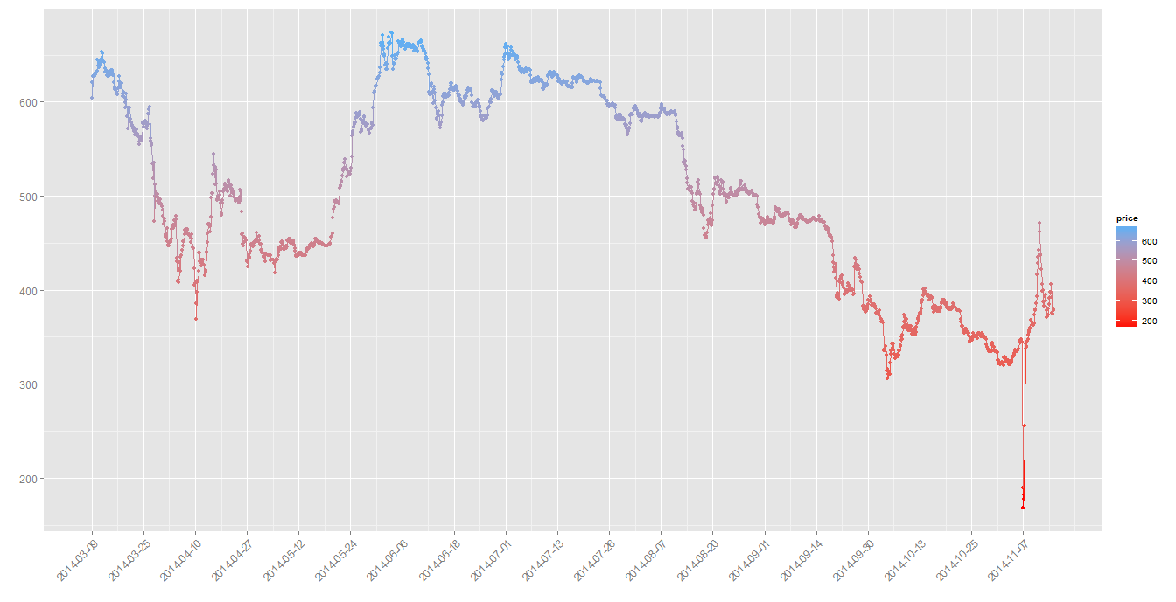
Irregular time series data
Bitcoin price for 1coin exchange (bitcoincharts.com)

Slide 5
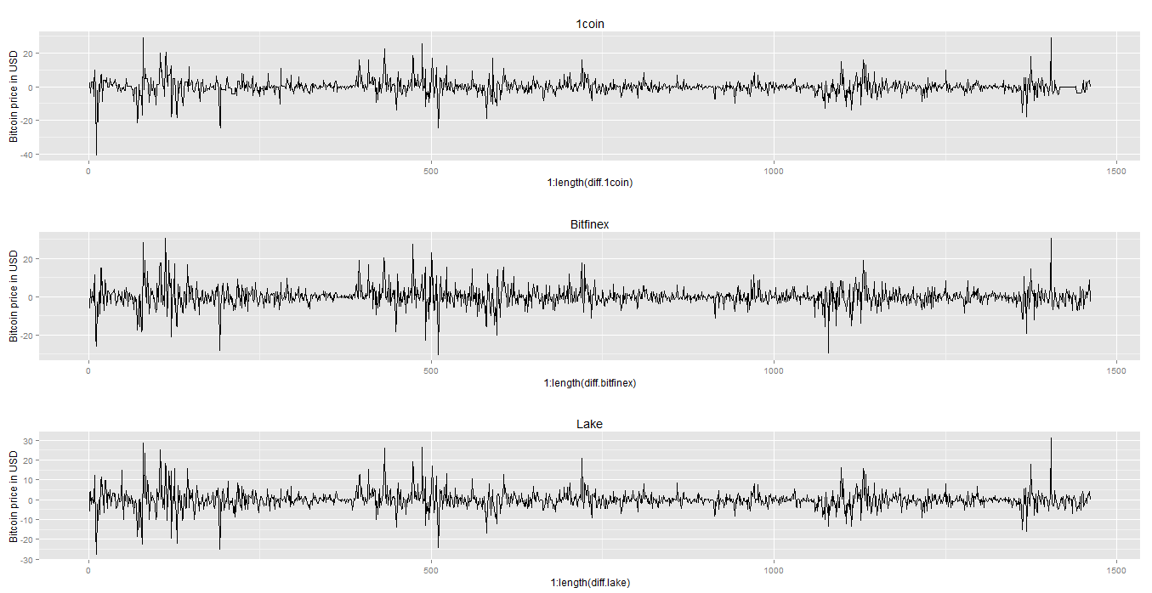
With imputation, exchanges look similar ...

Slide 6
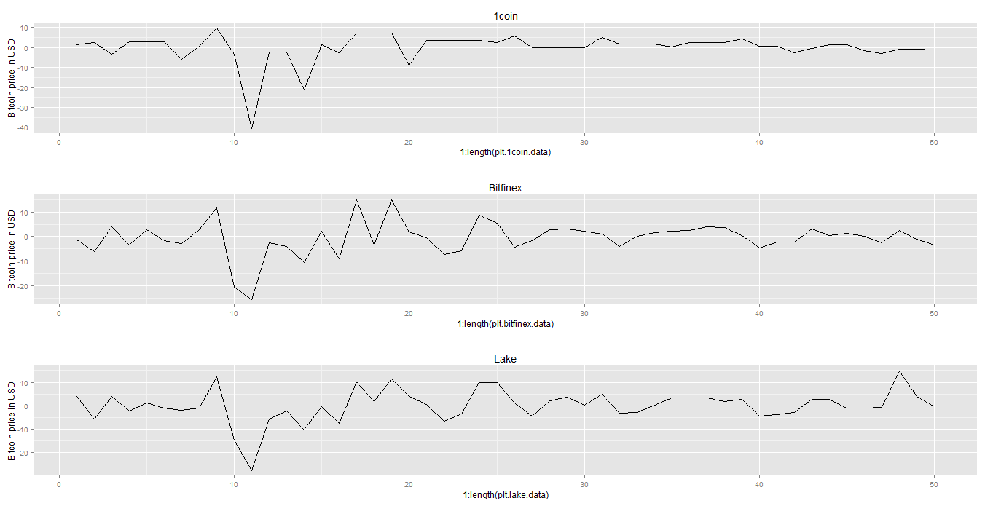
... But zoom in, and differences appear.

Slide 7
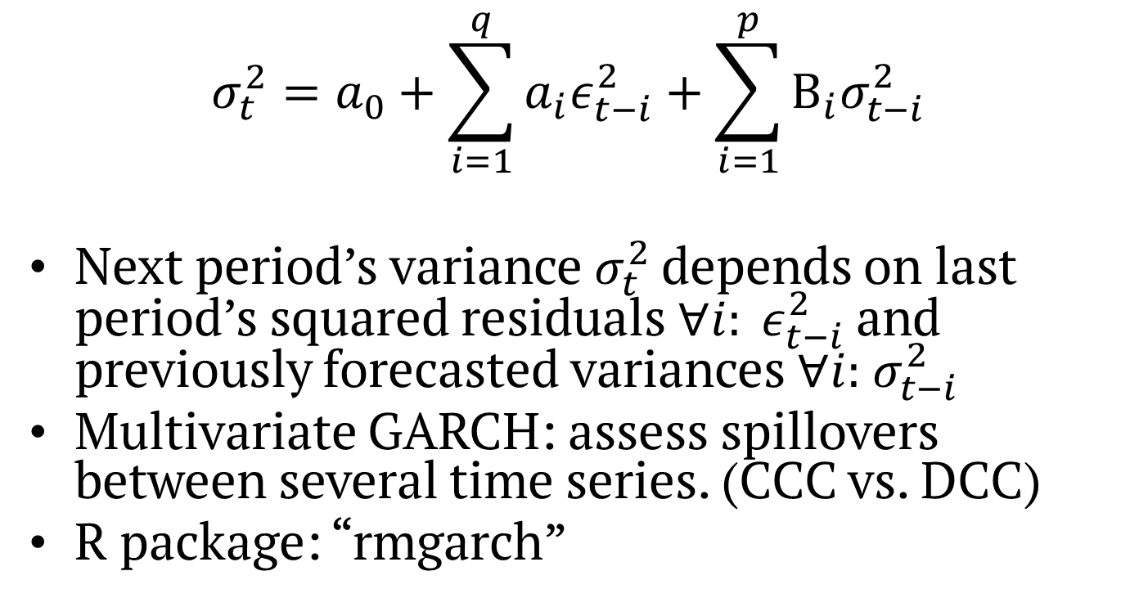
The garch model
$$σ_{t}^{2}=a_{0}+\sum_{i=1}^{q}{a_{i}ε_{t−i}^{2}}+\sum_{i=1}^{p}{Β_{i}σ_{t−i}^{2}}$$
Next period’s variance$σ_{t}^{2}$ depends on last period’s squared residuals$∀i: ε_{t−i}^{2}$ and previously forecasted variances$∀i:{ σ}_{t−i}^{2}$
Multivariate GARCH: assess spillovers between several time series. (CCC vs. DCC)
R package: “rmgarch”

Slide 8

Expected results + direction
Higher spillover from large $→$ small
Less spillover from small $→$ small
Challenge: find ideal extent of intra-daily averaging

Slide 9

Questions?

