Slide 1
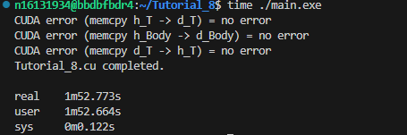
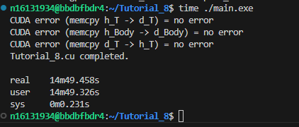
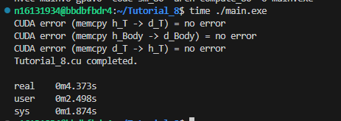
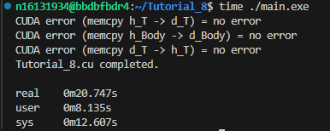
CPU 400000 Step
100*100
Time step:0.02s
CPU 800000 Step
200*200
Time step:0.01s
GPU 400000 Step
100*100
Time step:0.02s
GPU 800000 Step
200*200
Time step:0.01s

Slide 2
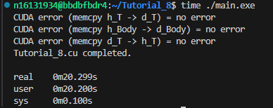
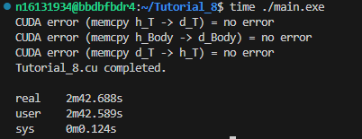
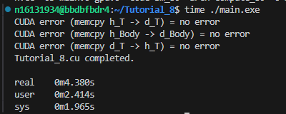
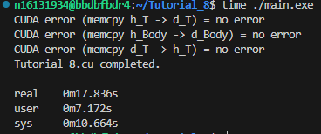
CPU 400000 Step
100*100
Time step:0.02s
CPU 800000 Step
200*200
Time step:0.01s
GPU 400000 Step
100*100
Time step:0.02s
GPU 800000 Step
200*200
Time step:0.01s

