Slide 1
The Doctor in the Machine: Machine Learning and Medical Diagnostics
Evan Colvin, UC Denver
Civilization advances by extending the number of operations we can perform without thinking about them.
—Alfred North Whitehead

Slide 2
Machine learning
Don’t program the machine to make perfect decisions; let the machine figure it out
Built on Linear Regression
Variety of algorithms
  Naïve Bayes
  Neural-Networks (Deep Learning)
  K-Means Clustering
  Support Vector Machines
  Random Forests

Slide 3
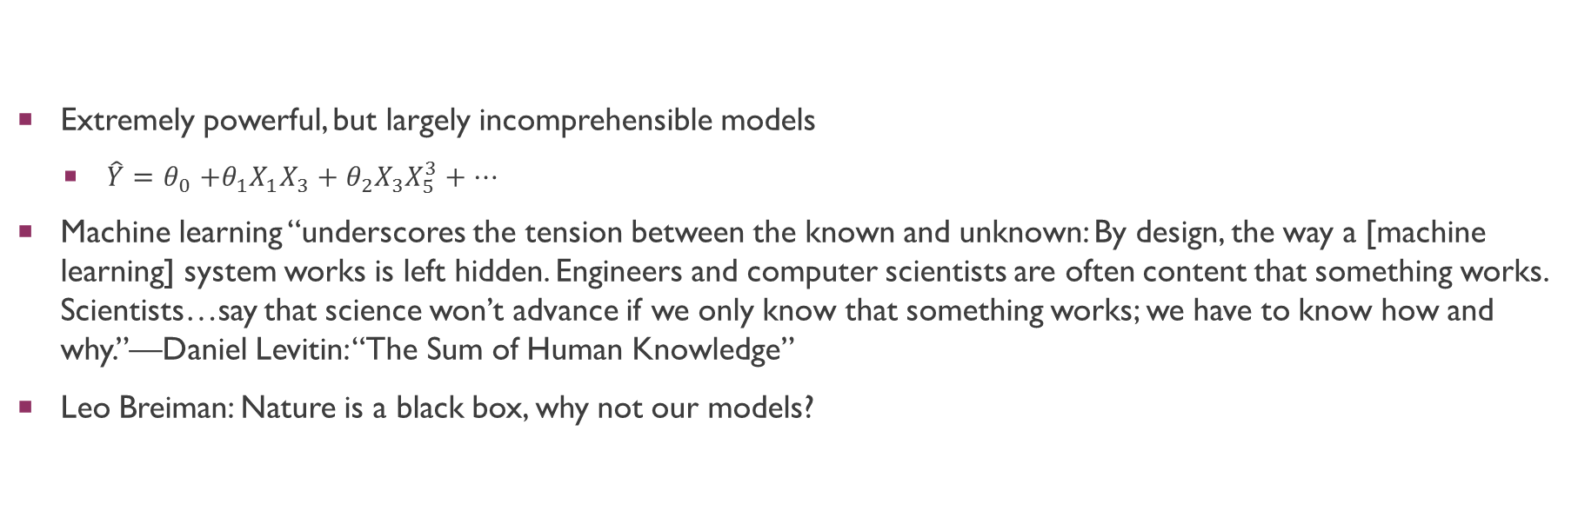
Machine Learning
Extremely powerful, but largely incomprehensible models
  $\hat{Y}{=θ}_{0}+θ_{1}X_{1}X_{3}+θ_{2}X_{3}X_{5}^{3}+…$
Machine learning “underscores the tension between the known and unknown: By design, the way a [machine learning] system works is left hidden. Engineers and computer scientists are often content that something works. Scientists…say that science won’t advance if we only know that something works; we have to know how and why.”—Daniel Levitin: “The Sum of Human Knowledge”
Leo Breiman: Nature is a black box, why not our models?

Slide 4
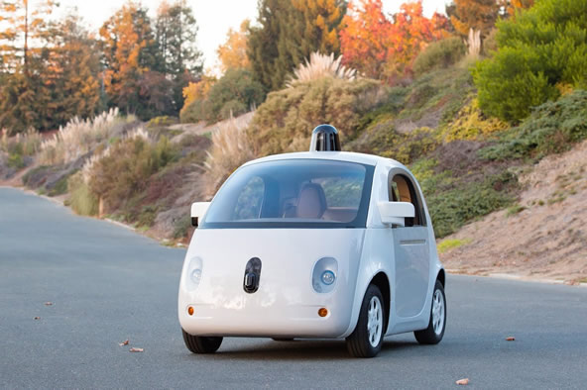
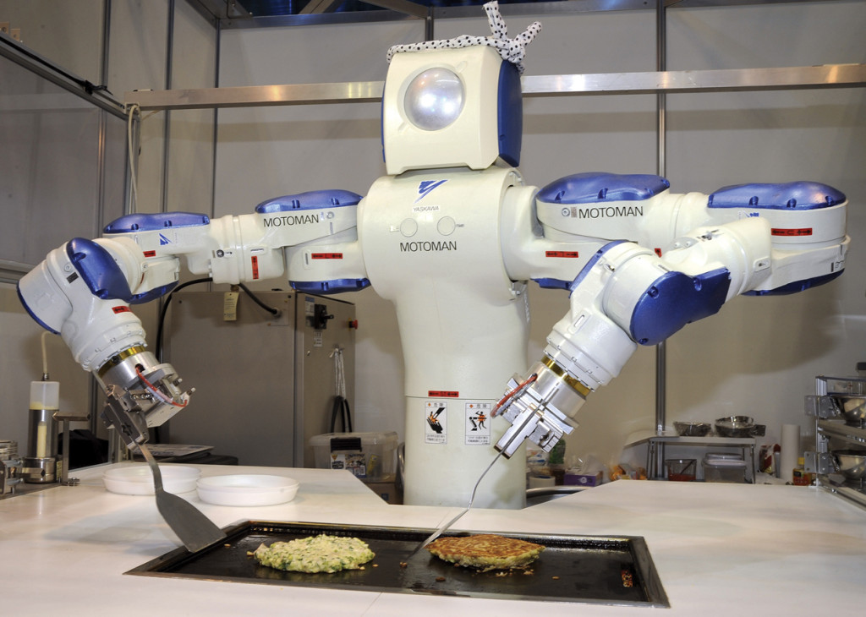
It’s What we can do
Google self-driving car
Image from: Cowen-Tabarrok, Modern Principles of Economics, 3rd ed
marginalrevolution.com

Slide 5
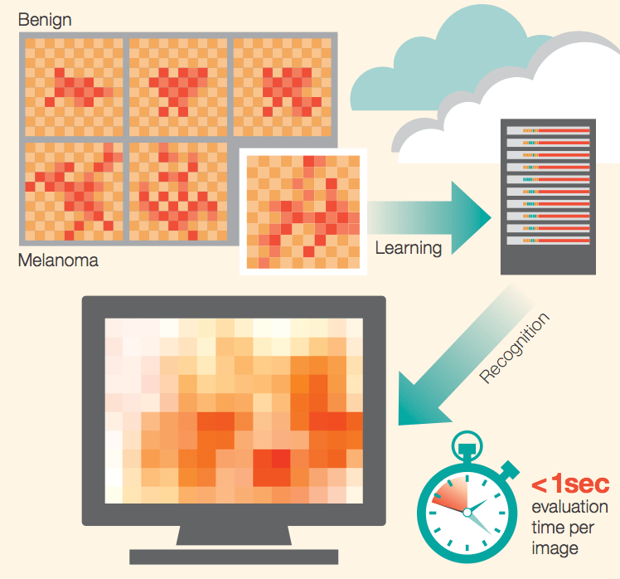
Machine learning and medicine
Integration into the clinical side of medicine before the research side
IBM Watson and the:
  MD Anderson Cancer Center
    Leukemia treatment recommendation
    Natural Language Processing for Journal Articles
  Memorial Sloan Kettering Cancer Center
    97% Melanoma diagnostic accuracy
    Edge Detection algorithms
Image Credit: IBM Research

Slide 6
Naïve Bayes
Outputs probability between 0 and 1
  Similar to logistic regression
Assume features (parameters) are independent of each other
See how strongly the features correlate with the label (outcome)
Rides Bayes Rule
Works well with high-dimensional, discrete data, with few observations

Slide 7
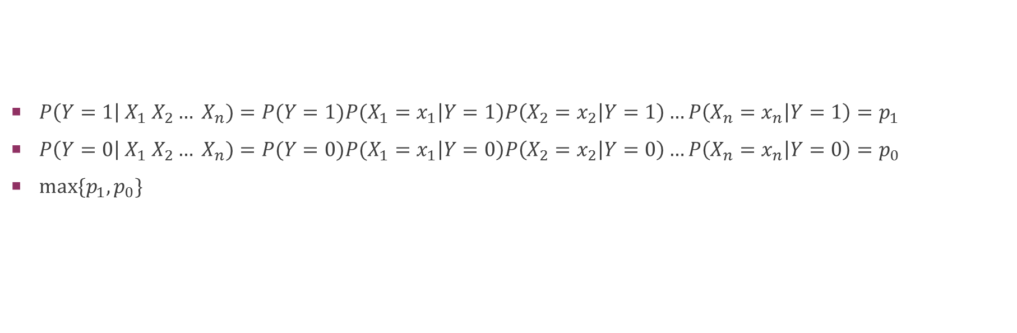
Naïve Bayes
$P\left(Y=1\right| X_{1} X_{2}… X_{n})=P(Y=1)P(X_{1}=x_{1}\left|Y=1\right)P\left(X_{2}=x_{2} | Y=1\right)…P\left(X_{n}=x_{n} | Y=1\right)=p_{1}$
$P\left(Y=0\right| X_{1} X_{2}… X_{n})=P(Y=0)P(X_{1}=x_{1}\left|Y=0\right)P\left(X_{2}=x_{2} | Y=0\right)…P\left(X_{n}=x_{n} | Y=0\right)=p_{0}$
$max⁡\{p_{1},p_{0}\}$

Slide 8
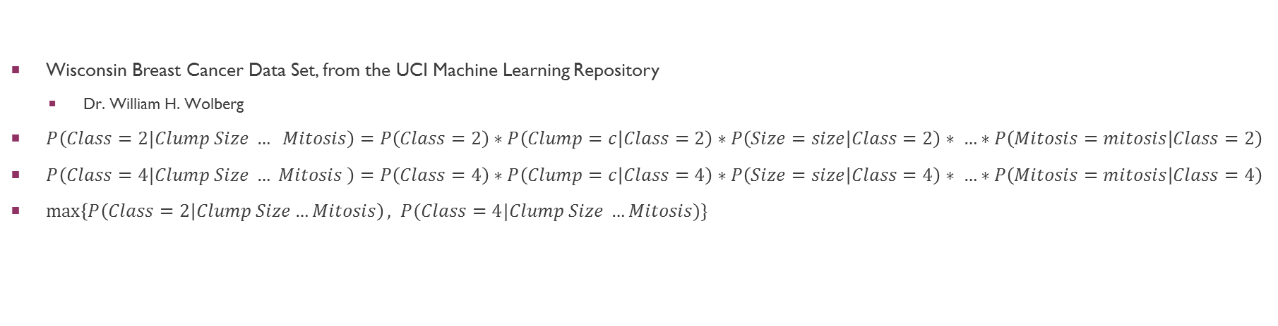
An Example
ID Number | Clump Thickness | Uniformity of Cell Size | Uniformity of Cell Shape | Marginal Adhesion | Single Epithelial Size | Bare Nuclei | Bland Chromatin | Normal Nucleoli | Mitosis | Class: 2=Bengin, 4=Malignant
1000025 | 5 | 1 | 1 | 1 | 2 | 1 | 3 | 1 | 1 | 2
1002945 | 5 | 4 | 4 | 5 | 7 | 10 | 3 | 2 | 1 | 2
1015425 | 3 | 1 | 1 | 1 | 2 | 2 | 3 | 1 | 1 | 2
1016277 | 6 | 8 | 8 | 1 | 3 | 4 | 3 | 7 | 1 | 2
1017023 | 4 | 1 | 1 | 3 | 2 | 1 | 3 | 1 | 1 | 2
1017122 | 8 | 10 | 10 | 8 | 7 | 10 | 9 | 7 | 1 | 4
1018099 | 1 | 1 | 1 | 1 | 2 | 10 | 3 | 1 | 1 | 2
1018561 | 2 | 1 | 2 | 1 | 2 | 1 | 3 | 1 | 1 | 2
1033078 | 2 | 1 | 1 | 1 | 2 | 1 | 1 | 1 | 5 | 2
1033078 | 4 | 2 | 1 | 1 | 2 | 1 | 2 | 1 | 1 | 2
Wisconsin Breast Cancer Data Set, from the UCI Machine Learning Repository
  Dr. William H. Wolberg
$P\left(Class=2|Clump Size … Mitosis\right)=P\left(Class=2\right)∗P\left(Clump=c | Class=2\right)∗P\left(Size=size | Class=2\right)∗ …∗P\left(Mitosis=mitosis | Class=2\right)$
$P\left(Class=4|Clump Size … Mitosis \right)=P\left(Class=4\right)∗P\left(Clump=c | Class=4\right)∗P\left(Size=size | Class=4\right)∗ …∗P\left(Mitosis=mitosis | Class=4\right)$
$\max\left\{P\left(Class=2\right|Clump Size…Mitosis\right), P(Class=4|Clump Size …Mitosis)\}$

Slide 9
Two ways to perform naïve bayes
Bernoulli Naïve Bayes
  Classic Naïve Bayes
  Correctly classifies ~75% of observations in this data set
Gaussian Naïve Bayes
  Adds the assumption that the features are normally distributed

Slide 10
Python Code—Gaussian Naïve Bayes with Scikit-learn
>>> # Training my data
>>> from numpy import genfromtxt
>>> cancer = genfromtxt(‘/Users/evancolvin/Dropbox/cleanCancerFinal.csv’, delimiter = ‘,’)
>>> target = cancer[:,9]
>>> data = cancer[:,0:9]
>>> roger = genfromtxt(‘/Users/evancolvin/Dropbox/cancerRaw.csv’, delimiter = ‘,’)
>>> testTarget = roger[:,9]
>>> testData = roger[:,0:9]
>>> from sklearn import *
>>> from sklearn.naive_bayes import GaussianNB
>>> gnb = GaussianNB()
>>> y_pred = gnb.fit(data, target).predict(data)
>>> print(“Number of mislabeled points out of a total of %d points: %d” % (data.shape[0],target != y_pred).sum()))
>>> new_pred = gnb.fit(data, target).predict(testData)
Number of mislabeled points out of a total of 500 points : 24

Slide 11
Python Code—Gaussian Naïve Bayes with Scikit-learn
>>> # Predicting new observations
>>> new_pred = gnb.fit(data, target).predict(testData)
>>> from __future__ import division
>>> accuracy = sum(testTarget == new_pred)/len(new_pred)
>>> print accuracy
0.980582524272

Slide 12
More on Naïve Bayes
Doesn’t work well for this type of problem
  K-means clustering or Neural-Network
Naïve Bayes is a great spam filter

