Slide 1
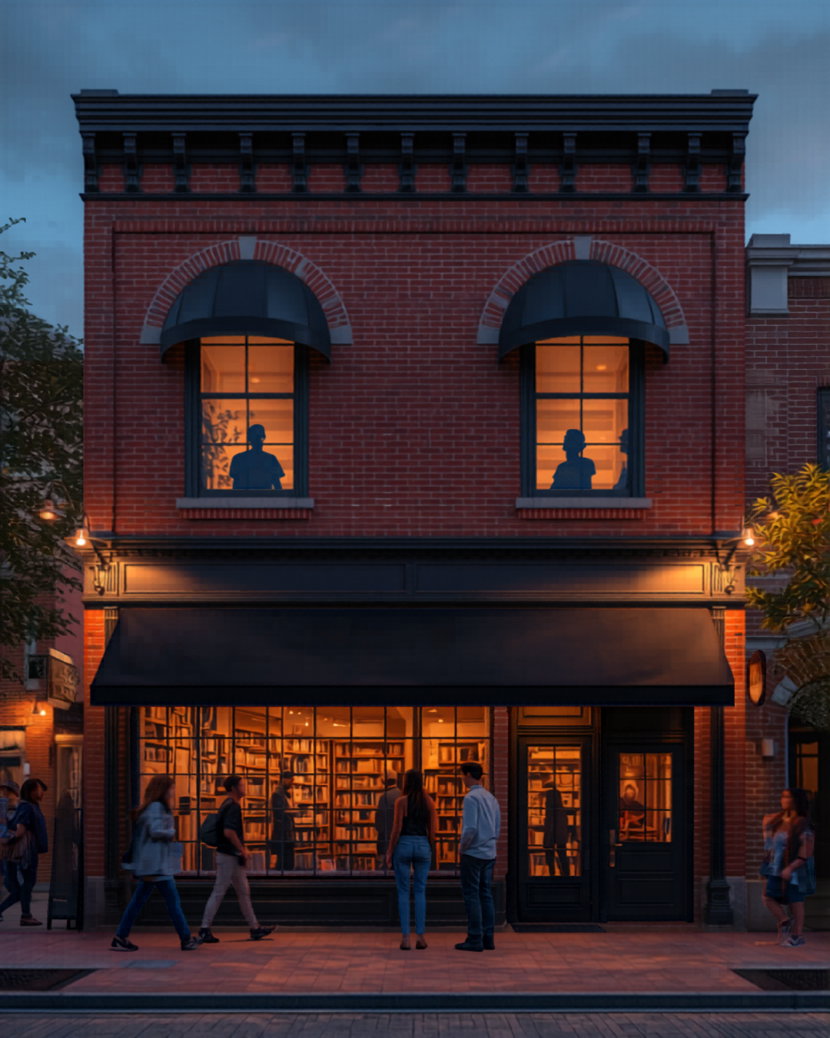
CAFÉ PURG
Purgatory between 18 and 21.
A late-night, zero-proof café and social space in the loft above Once Upon A Time Books — 116 W Central Ave, on the Bentonville square.
Prepared for Craig — June 2026
Every figure verified against primary sources: city code, state rules, county records, supplier pricing. Research files cited throughout.

Slide 2
THE CONCEPT
The idea in three sentences
• Nobody serves 18–21. Too old for curfew, too young for every bar on the square — and after 9pm, nothing else is open.
• Café Purg is a late-night activity venue that happens to be alcohol-free: serious coffee, craft zero-proof cocktails, games, study hours, events — open when everything else closes.
• The Owl's Roost loft removes the #1 café killer (lease risk) — a willing family landlord, on the square, in a building already classed commercial.
Why "no alcohol" is the moat, not the compromise:
Arkansas drinking age is 21 — bars cannot serve this crowd without abandoning their license economics. The zero-proof program is the one thing the five licensed venues on this block can't copy.
All figures sourced — see cafe-purg/research/ in the project repo
2

Slide 3
VERIFIED VENUE-BY-VENUE · JUNE 2026
After 9pm, the square belongs to alcohol
• We checked every venue within ~3 blocks: hours, prices, alcohol, under-21 policy.
• Weeknights after 9pm: every open door on the square serves alcohol as its primary product.
• The ONLY all-ages, non-alcohol venue open past 9 any night: the Spark Café soda fountain (weekends, until 10pm).
• A 17-year-old's options at 9:30pm on a Saturday: one ice cream counter.
• Onyx — the latest-open coffee shop downtown — closes at 8pm daily, at the highest prices in town. The evening daypart supports specialty pricing; nobody stays open for it.
• Even First Friday, the marquee all-ages event, ends at 9pm.
• Watch item: the prime ex-Pressroom corner (100 NW 2nd St) is vacant — someone could fill this gap first.
Source: research/competitive-hours-matrix.md — every venue, hours, and price cited
3

Slide 4
THE MARKET
The customers exist — and they don't drink
US drinking rate (Gallup, Aug 2025)
54% overall — a 90-year low; only 50% of 18–34s drink at all
US non-alcoholic beverage category
$1B+ in 2025, +27%/yr; mocktails sell at $8–14
New 18-year-olds/yr from Bentonville's 2 high schools
~1,400 (819 BHS + 595 BWHS seniors, NCES)
NWACC enrollment
Record 9,017 credit (10,706 total); approved master plan: 30K capacity + ~3,000 housing units
Bentonville growth 2020–24
+14% — fastest-growing city in Arkansas (~62,000)
Crystal Bridges 2025 / Walmart HQ
800K+ visitors; 15,000+ employee campus opened Jan 2025
City event economic impact 2024
$41M — double the prior record; 90,000+ bike tourists/yr
Sources: research/demand-evidence.md, research/bentonville-market-data.md
4

Slide 5
STATED HONESTLY
What the comparable venues teach us
• Standalone "sober bars" fail or pivot routinely — even in LA and NYC. Stay Zero Proof (LA) lasted 8 months; Listen Bar (NYC) never got a permanent home.
• The survivors all became ACTIVITY venues: Sans Bar (Austin) runs one night a week at a $15 cover; Hekate (NYC) is café + bottle shop + events.
• So Café Purg is not an "NA bar." It is games + study hall + events + desserts, with the room itself gently priced (evening cover, study passes).
• Per-head engineering: evening target $15–22 (drink + dessert + cover) vs. the $8–10 coffee-only ticket that sinks long-dwell venues.
• No demand dataset exists for 18–21 memberships anywhere. The only honest test is pre-selling — so nothing gets built until 75–100 founding members have actually committed.
Source: research/demand-evidence.md — comp-by-comp, failures included
5

Slide 6
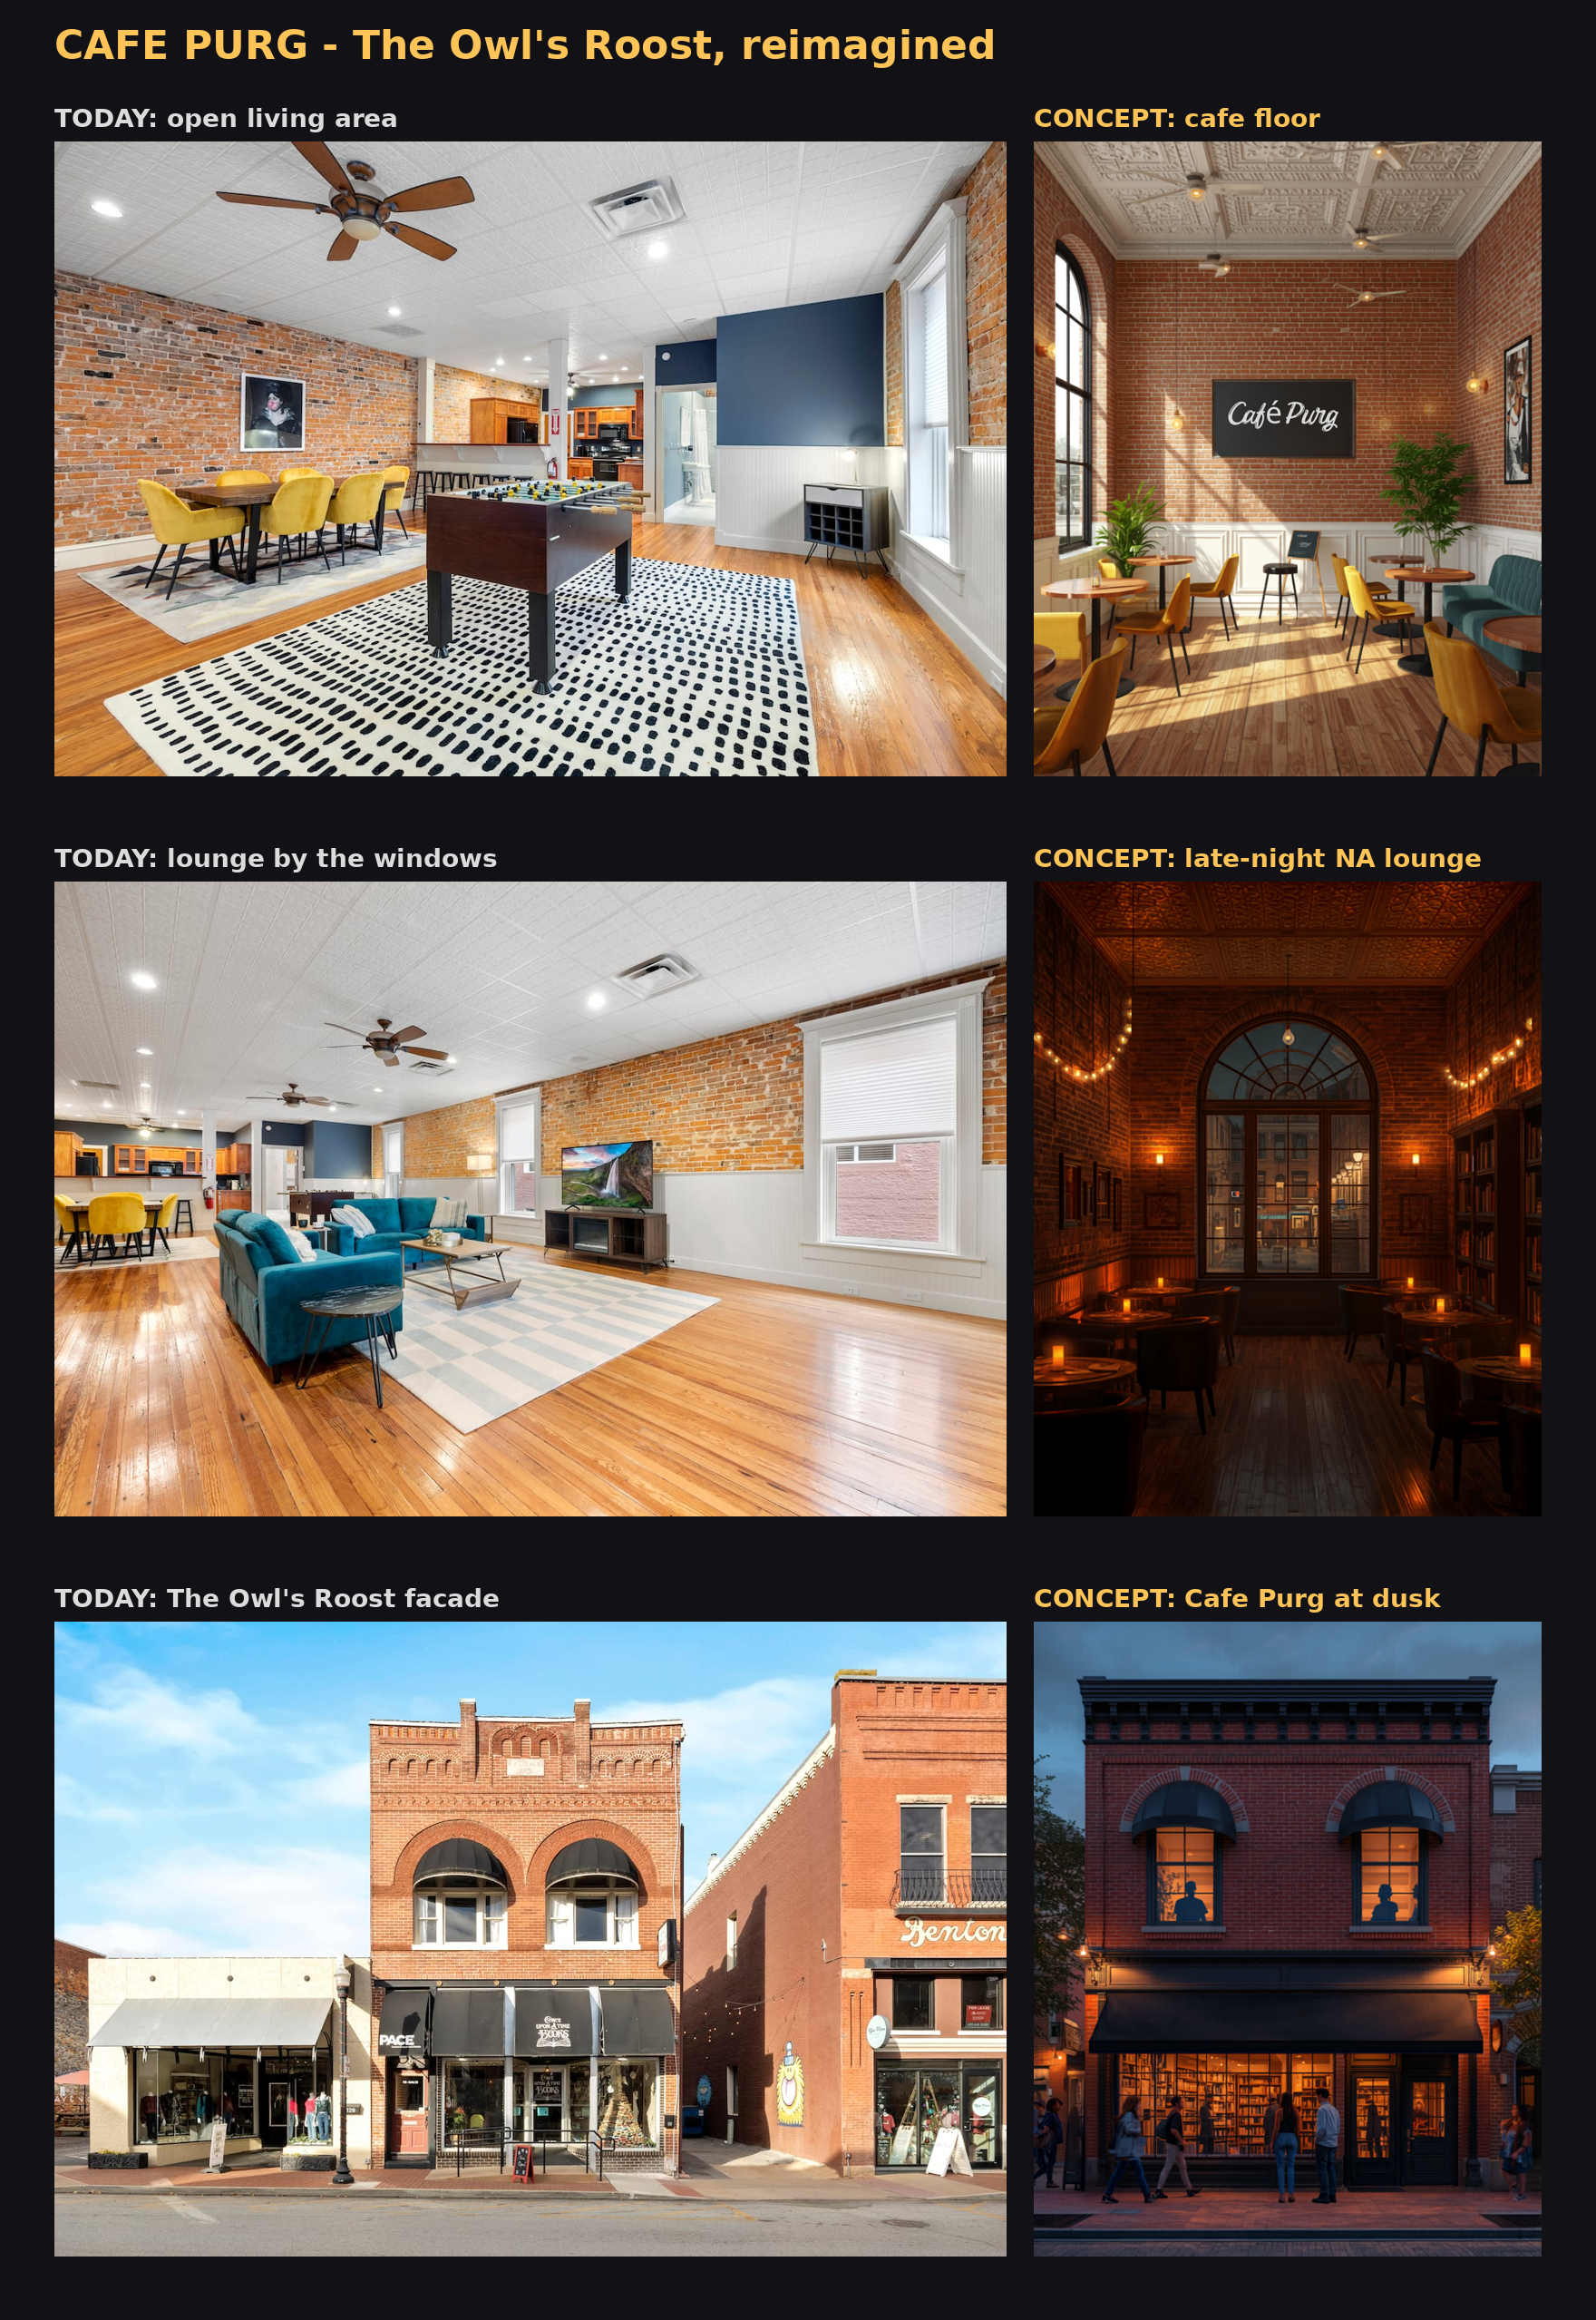
THE PROPERTY — COUNTY RECORD
116 W Central Ave: already commercial, already family-held
• Parcel 01-01059-000 · owner of record: Owls Roast Loft LLC
• County classification: Commercial-Improved, downtown commercial (COM-DT) — no county-level reclassification needed
• Appraised: $959,425 ($217,580 land + $741,845 improvements); assessed $191,885 (AR 20% ratio)
• Property tax ~$11,863/yr at Bentonville's 61.82 mills; +~$1,236/yr per $100K of new improvements
• Footprint ≈ 24 × 82 ft (~1,980 sq ft/floor) — comfortably under the ADA elevator exemption's 3,000 sq ft/story threshold
• Market rent benchmark: ground-floor downtown $25–36/sq ft; second-floor walk-up typically 40–60% less
Sources: research/property-record-116-w-central.md (AR GIS parcel layer, Feb 2026 CAMA), DFA millage report
6

Slide 7
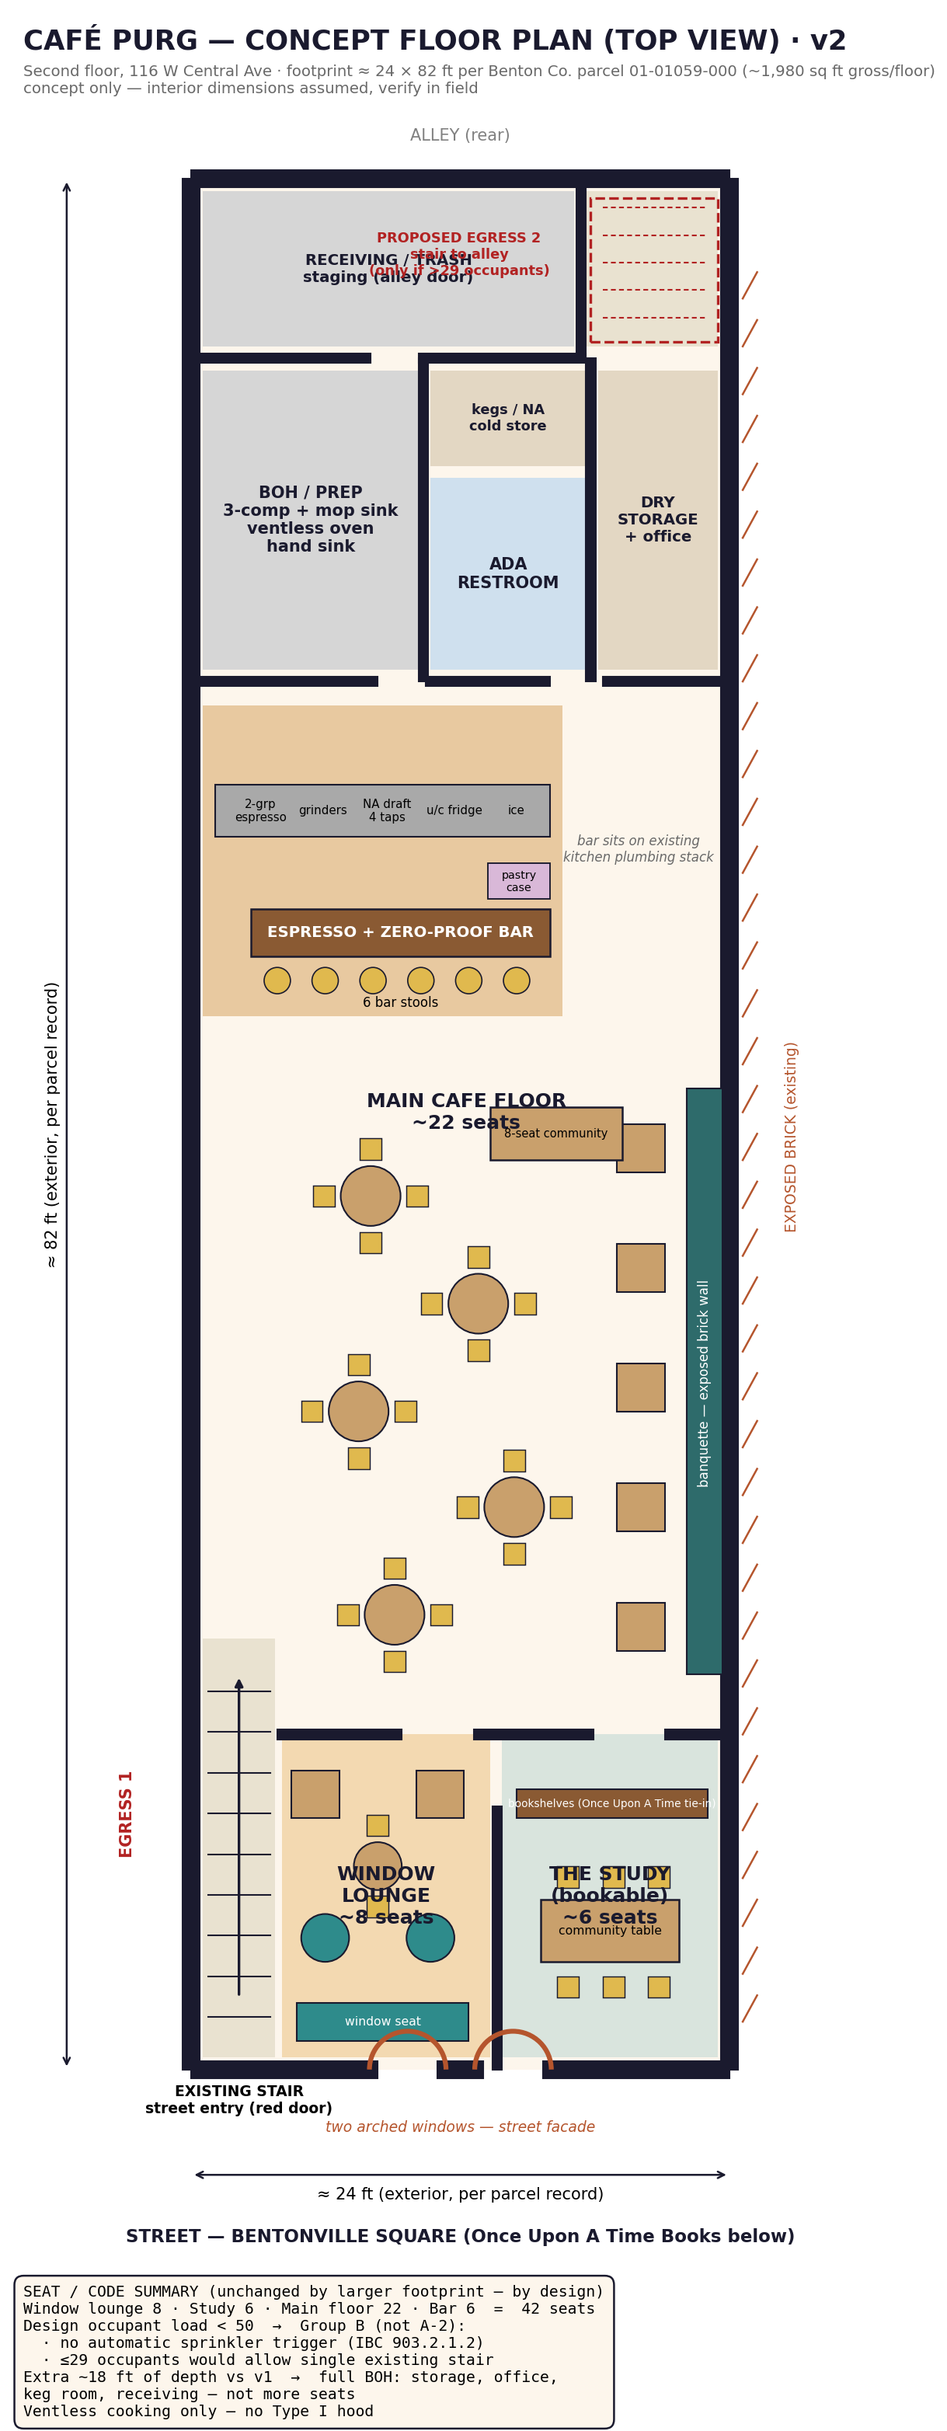
CONCEPT DESIGN
Floor plan — 42 seats by design, not by accident
• Front: two arched-window rooms — Window Lounge (8) + bookable Study (6)
• Middle: main café floor (22) with banquette on the exposed brick
• Bar sits on the existing kitchen plumbing stack — minimal new plumbing
• Rear: full back-of-house — prep, ADA restroom, keg store, dry storage, receiving at the alley
• 42 seats keeps occupant load under 50 → Group B, not Assembly:
• — no automatic sprinkler trigger for a second-floor space
• — at ≤29 occupants, the existing single stair may legally suffice
• — a code-compliant egress stair (~$10–30K) unlocks 30–49 if demand proves out
Footprint per county parcel record; interior assumed — field verify. research/bentonville-permitting-zoning.md
7

Slide 8
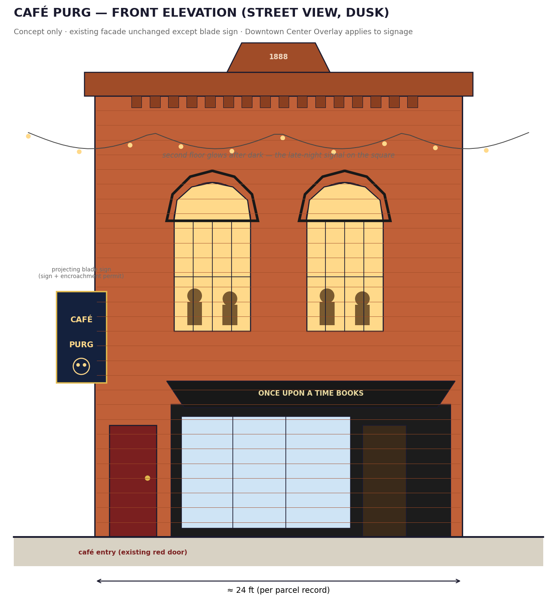
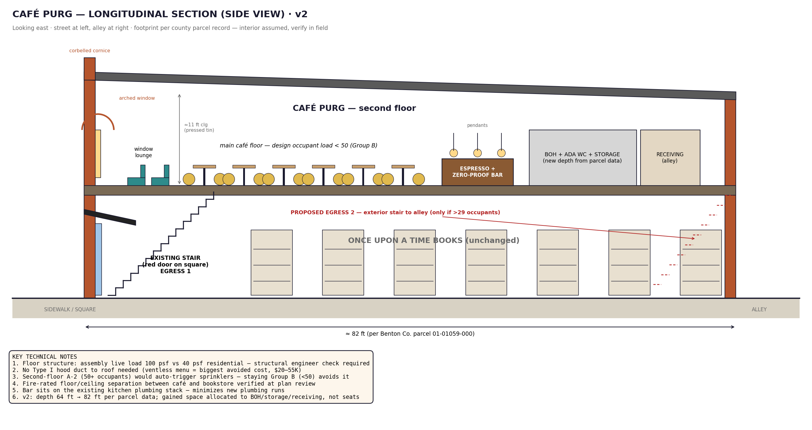
CONCEPT DESIGN
Section and street view
Bookstore unchanged below; facade untouched except the blade sign (sign + encroachment permits)
8

Slide 9
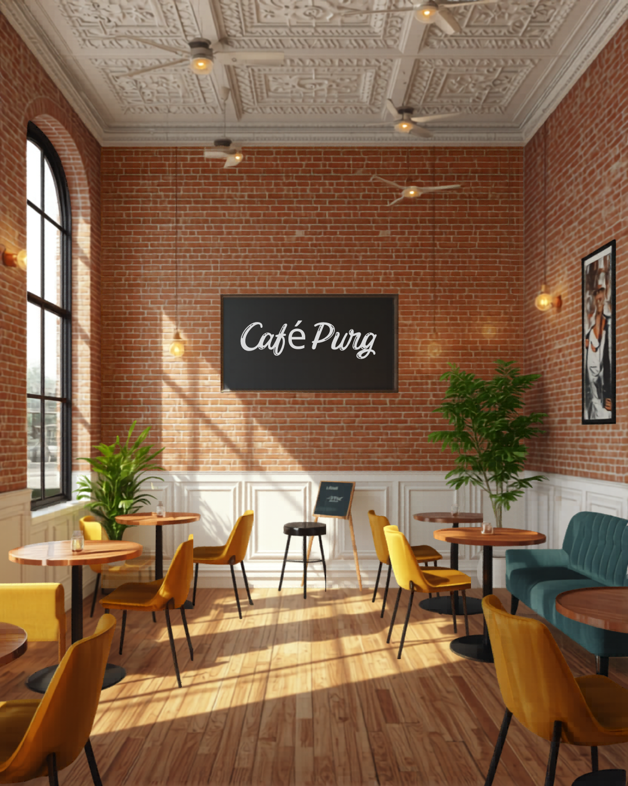
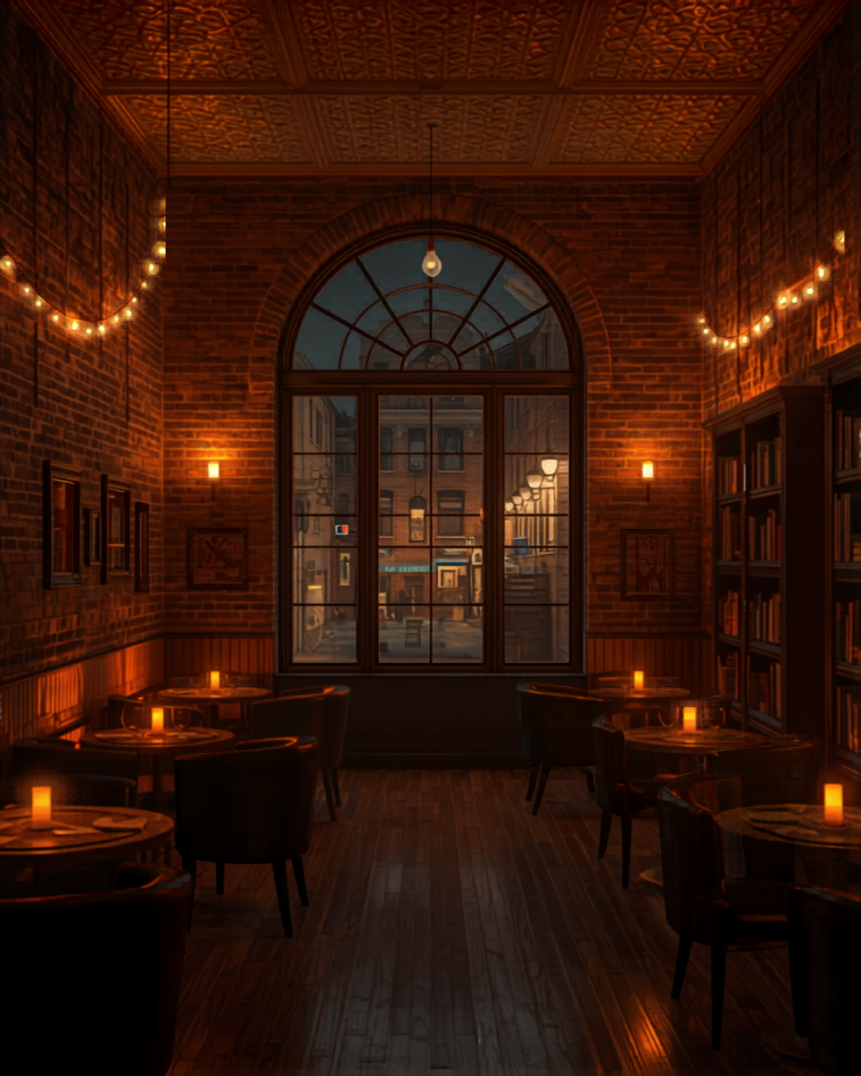
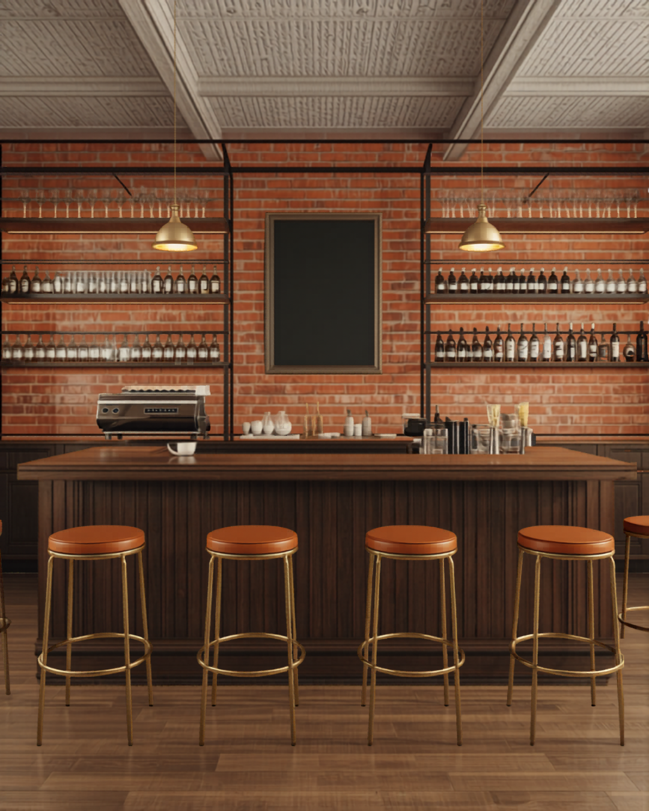

CONCEPT RENDERINGS
What it feels like (AI concepts informed by the real listing photos)
Mood boards, not architectural drawings — the plan/section carry the real dimensions
9

Slide 10
CITY OF BENTONVILLE — VERIFIED JUNE 2026
Zoning is already solved; two questions remain
• Bentonville's NEW development code (effective May 14, 2026): "food and beverage" is a BY-RIGHT use on the square — no rezoning, no conditional use permit, ZERO parking minimums.
• Process: Commercial Alteration Permit via eTrakit; ADH approval required first; free Business Registry. City permit fee for a $150K buildout: ~$730.
• Question 1 — second-floor accessibility: the ADA elevator exemption (<3 stories, <3,000 sq ft/story) plausibly applies — DOJ's "shopping center" carve-out needs 5+ retail tenants; this building has two. Get it IN WRITING before any spend. Fallbacks: ground-floor pickup counter with the bookstore; platform lift $10–25K.
• Question 2 — structure & stairs: assembly floor loading is 100 psf vs 40 residential; the stair count caps occupancy. Both answered by a structural engineer + the free pre-application meeting.
• Health dept: plan review BEFORE construction (1% of cost, max $500), $35/yr permit, one ServSafe manager (~$150). Residential kitchens categorically barred — full conversion is required and budgeted.
• Timeline: 4–7 months from architect engagement to opening.
Sources: research/bentonville-permitting-zoning.md, research/adh-food-permit-requirements.md — code sections cited
10

Slide 11
STARTUP COST
$170K lean — $350K full
Bucket
Lean
Full
The big levers:
Ventless menu — a $12–18K oven instead of a $20–55K Type I hood system
All permits combined: ~$1,300–1,500
Industry range for a seated café: $80–300K (median $150–200K)
Construction/conversion (NWA: $100–150/sq ft)
$90,000
$150,000
Egress stair (only if >29 seats)
$0
$25,000
Coffee equipment
$28,000
$55,000
Mocktail / NA-draft program
$3,500
$8,000
Furniture + counter
$12,000
$35,000
Soft costs (architect, permits, signage, insurance)
$8,000
$20,000
Opening inventory
$3,000
$8,000
Working capital (3–6 months)
$25,000
$50,000
TOTAL
~$170,000
~$350,000
Sources: research/construction-conversion-costs.md, equipment-costs.md, soft-costs-furniture-opex.md
11

Slide 12
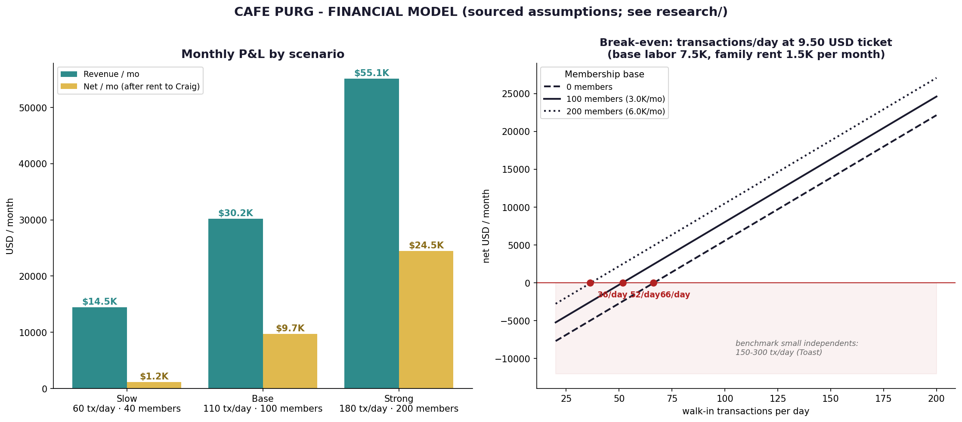
FINANCIAL MODEL
Break-even at 40–70 customers/day; benchmark shops do 150–300
Slow: $14.5K revenue/mo, +$1.2K net · Base: $30.2K/mo, +$9.7K net · Strong: $55.1K/mo, +$24.5K net — all after paying rent. Assumptions: $8.50–10.50 ticket (downtown verified $5–7 lattes, $8–14 mocktails), 30% COGS, NWA wages.
Model: cafe-purg/financials/ — every assumption sourced
12

Slide 13
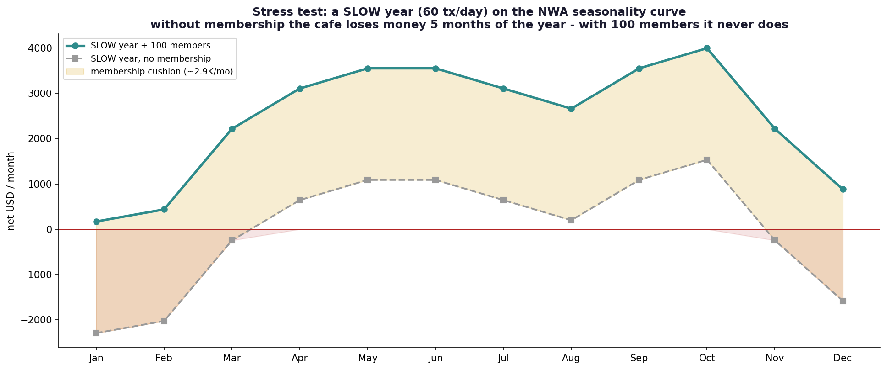
THE MEMBERSHIP CASE
A slow year, stress-tested
At just 60 transactions/day on the NWA tourism curve: without membership the café loses money 5 months of the year. With 100 members at $30/mo, it never does. Membership pricing is proven: Panera $15 — indie clubs $29 — Blank Street $45–90 — coworking $150.
All figures sourced — see cafe-purg/research/ in the project repo
13

Slide 14
RESEARCHED AGAINST THE ABC RULEBOOK DIRECTLY
The alcohol question, answered
• The assumed legal wall does not exist: Arkansas has NO rule excluding under-21 customers from a permitted restaurant. Same room, same tables; staff 19+ may even serve beer/wine (not bartend).
• The upgrade path is cheap and unobstructed: Benton County is wet; the 1,000-ft church/school rule applies only to package stores; this block already holds five permits; Restaurant Beer & Wine = $350/yr; process 1–4 months; beer/wine exempt from mixed-drink taxes.
• What staying dry costs: roughly $25–45K/yr in gross profit at base-case revenue.
• The decision: open zero-proof anyway.
• An 18–21-branded venue pouring alcohol is a permanent compliance target (sale-to-minor cases dominate ABC's enforcement docket), the permit is discretionary and protestable — and the dry program is the only thing the licensed neighbors can't copy.
• For Craig: the tenant is never structurally capped. If evening revenue justifies it, the $350 permit is exercisable in a single season.
Source: research/alcohol-option-abc.md — statute and rule citations throughout
14

Slide 15
VERIFIED PROGRAM-BY-PROGRAM
How it gets funded — a $250K stack
Founder + family equity (gift letters count for SBA)
$60K
SBA 7(a) — Arkansas Capital Corporation
$100K · 10yr · ~10–12%
CDFI microloan — FORGE / Communities Unlimited
$35K · 6yr · 8–13%
Equipment financing (or folded into the 7(a))
$30K
Kiva NWA — 0% interest, credit-blind, Walton-matched
$15K
Pre-sold memberships (deferred revenue — buzz, not equity)
$10K
The most powerful lever isn't a loan: Craig funding $25–75K of fixed buildout as landlord TI, amortized into a market-rate rent at ~7.5% — shrinks the loan before it's sized, earns him a return, and permanently raises his building's value.
SBA's related-party rules don't apply (no SBA money touches the building). Needed: 10+ yr market-rate lease + standard landlord waiver. Free help lenders respect: ASBTDC, Startup Junkie, EforAll NWA.
Source: research/financing-grants.md — incl. what NOT to budget (WFF grants are nonprofit-only)
15

Slide 16
TERM SHEET DRAFTED
A lease that works for Craig, the SBA, and the café
• Base rent $2,500/mo — documented market rate for second-floor walk-up space ($15.15/sq ft vs $25–36 ground floor). Abated during construction; 50% for the first 6 months.
• Plus 4% of sales above $350K/yr — Craig shares the upside (~$1.2K base year, ~$8K strong year).
• Plus TI amortization if Craig capitalizes shell work: $50K at 7.5%/10yr = +$594/mo.
• All-in at base case ≈ $3,194/mo = ~$38K/yr to Craig — about what the Airbnb nets, with a 10-year contract, zero management, and his building improved.
• 10-year term + two 5-year tenant-only options (SBA requirement) · contingencies void the lease if the city requires an elevator or financing fails · year-3 kick-out if sales < $200K · guarantee burns off with performance.
• Use clause written broad enough to add beer/wine later without amendment.
Full draft: cafe-purg/lease-term-sheet.md — AR attorney review budgeted before signing
16

Slide 17
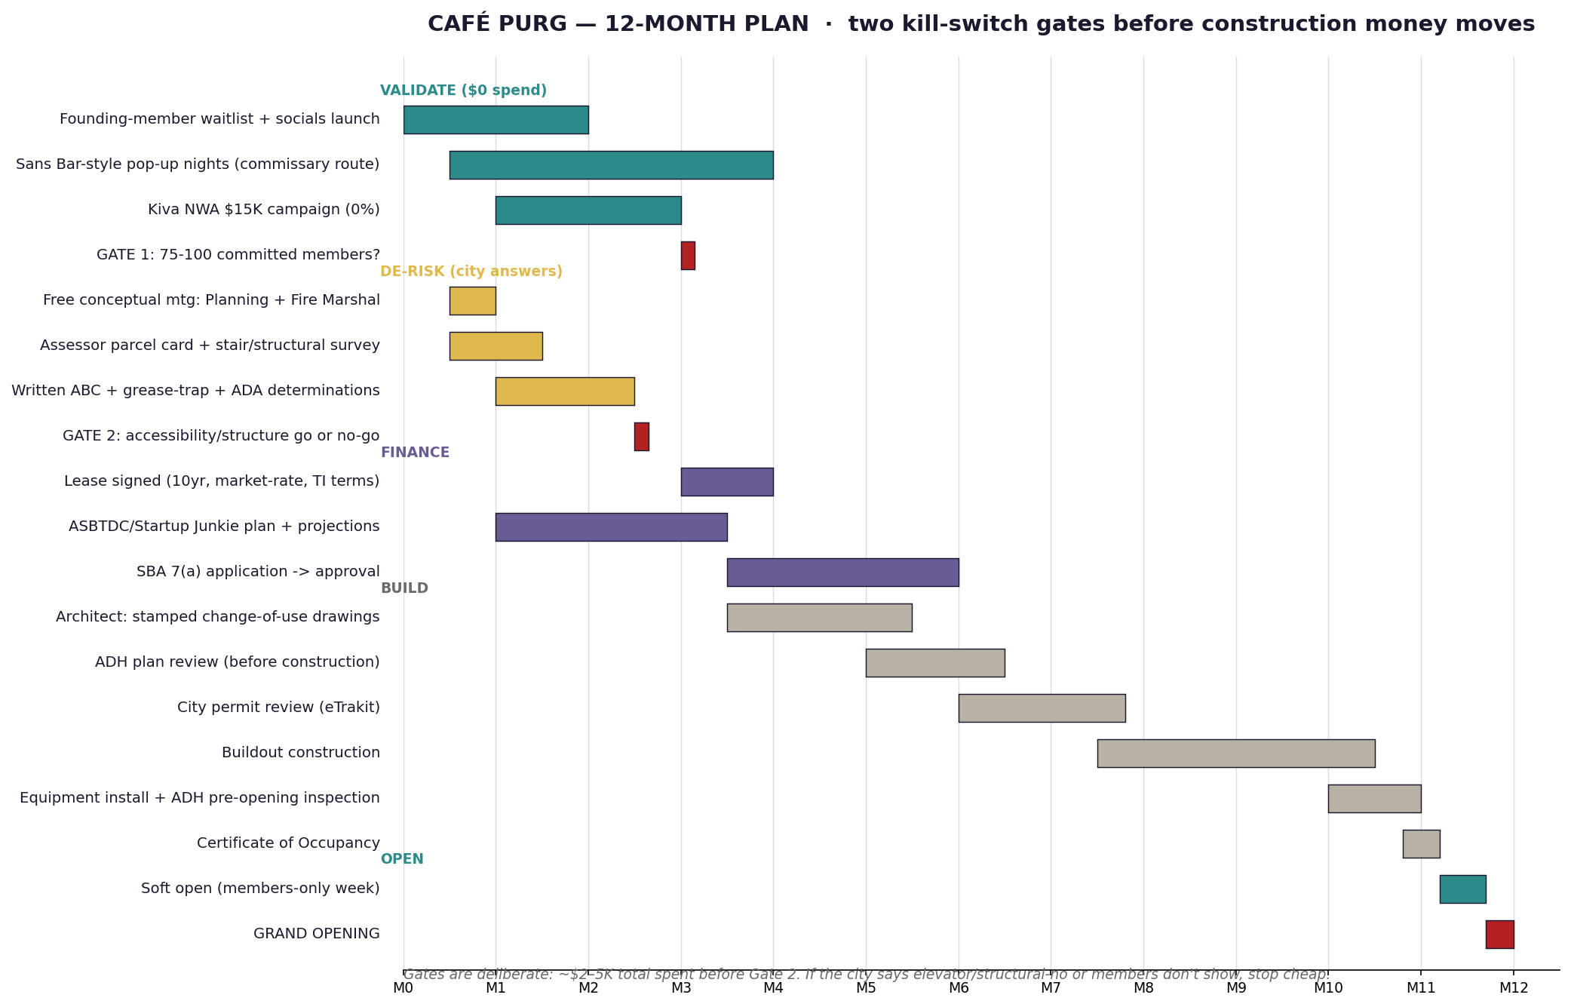
12-MONTH PLAN
Two kill-switch gates before construction money moves
Gate 1: 75–100 paid founding members (pop-ups via licensed commissary — explicitly allowed by ADH). Gate 2: written city determinations on accessibility/egress/structure. Total at risk before Gate 2: ~$2–5K.
All figures sourced — see cafe-purg/research/ in the project repo
17

Slide 18
STATED HONESTLY
Risks and what we do about them
City requires elevator or major structural work
HIGH — the go/no-go gate
Written determination at the free pre-app, before any spend; lift fallback $10–25K
18–21s don't convert to paying members
HIGH — comps say so
Activity-venue positioning, priced room, and Gate 1: no members, no buildout
Single stair caps occupancy at 29
MEDIUM
Design to 29 first; add egress stair (~$10–30K) only when demand proves
Someone fills the night gap first (ex-Pressroom corner)
MEDIUM
Speed: pop-ups build the audience before anyone builds a room
Buildout overruns
MEDIUM
Ventless menu locks out the worst overruns; landlord/tenant TI split
Dec–Feb slump
MEDIUM
Membership floor + finals-week and event programming
About half of independent cafés don't survive five years. The mitigations above are structural, not hopeful — and the pre-sale settles the demand argument for thousands, not hundreds of thousands.
All figures sourced — see cafe-purg/research/ in the project repo
18

Slide 19
THE ASK
1. Agreement in principle — take the loft off Airbnb if both gates clear.
2. Two hours — the free conceptual meeting with Planning (479-271-3122) and the Fire Marshal (479-271-3108), together.
3. A lease conversation after real construction bids exist — term sheet already drafted.
Nothing is spent until the city answers in writing and 75–100 people have already paid.
Full research repo: 13 sourced research files, financial model, drawings, term sheet.

