Slide 1
Automatic Test Data Generation of Character String
Zhao Ruilian

Slide 2
Outline
Introduction
Automatic test data generation
Character string predicate
Automatic test data generation of character string
A example
Conclusion and Future work

Slide 3
Introduction
Software testing is usually difficult, expensive and time consuming.
Accounts for up to 50% of the cost
of whole software development .
If test data could be automatically generated,
the cost of software testing would be significantly reduced.

Slide 4
Introduction
There are many automatic test data generation approaches.
The most used are:
Random test data generation
Symbolic execution-based test data generation
Dynamic test data generation

Slide 5
Introduction
Each approach has its own advantages.
Little attention has been paid to the problem of test data
generation for programs whose inputs are character string.

Slide 6
Introduction
Character string is an important element in programming.
How to automatically generate test data of character string

Slide 7
Automatic test data generation
Random test data generation
Random test data generation develops test data
at random until a useful input is found
Random test data generation is easy to implement.
In fact, random test data generation is generally
ineffective on realistic programs.

Slide 8
Automatic test data generation
Symbolic execution-based test data generation
The basic idea in a symbolic execution system is to allow numeric
variables to take on symbolic values instead of numeric values.
But, symbolic execution is very computational intensive
and a number of technical problems are met in practice.
indefinite loops, subprogram call, array reference and so on

Slide 9
Automatic test data generation
Symbolic execution-based test data generation
If input variable is character string variable
strncpy(tempstr,instr,5);
strupr(tempstr);
if (strcmp(tempstr,”LEFT”)<0);
instr is a input variable of
character string
It is difficult to express the value of variable tempstr in terms of
the symbolic value of the input variable instr in this predicate.

Slide 10
Automatic test data generation
Dynamic test data generation
Dynamic test data generation is a popular approach
for developing test data.
During dynamic test data generation,
if some desired test requirement is not reached,
data generated in each test execution is used to identify
how close the test input is to meeting the requirement.
With the help of feedback, test inputs are
gradually modified until one of them satisfies the requirement.

Slide 11
Automatic test data generation
Dynamic test data generation
Suppose that a program contains the condition statement:
if (y<=38) ….
and the TRUE branch of the predicate should been taken.
Find an input that can make the variable y to hold a value smaller
than or equal constant 38 when the condition statement is reached.

Slide 12
Automatic test data generation
F(x) is a real-value function.
x is a input variable
and rel is one of {<=.<,=}.
Dynamic test data generation
Each predicate can be transformed to an equivalent form:
F(x) rel 0
branch function
If (y<=38)
satisfies :
1) positive (or zero if rel is <) when the predicate is false,
2) negative (or zero if rel is = or <= ) when the predicate is true.

Slide 13
Automatic test data generation
Dynamic test data generation
Let y(x) represent the current value of variable y for input x
when the program is executed up to the condition statement.
Then the branch function F(x) can be expressed as follows:
F(x)= y(x) -38
1) when the predicate is false, F(x) is positive,
2) when the predicate is true, F(x) is negative.
The function is minimal when
the TRUE branch is taken on the condition statement.

Slide 14
Automatic test data generation
Dynamic test data generation
The problem of test data generation can be
reduced to a problem of function minimization.
We need to find an input x
that can minimize the branch function.

Slide 15
Automatic test data generation
Dynamic test data generation
The techniques usually used to perform function minimization
are gradient descent, genetic search, and simulated annealing.
Some systems are developed by using these techniques
to generate test data of integer, real or float types.
They do not generate test data of character string.

Slide 16
Automatic test data generation
Gradient descent
Gradient descent is a standard minimization technique.
which performs function minimization by only evaluating the branch function values.

Slide 17
Automatic test data generation
How to use gradient descent to realize the function minimization
Suppose x₀ is an original input
on which the program is executed up to the condition statement
and the FALSE branch of the predicate is taken.
A branch function can be constructed
whose value is positive for input x₀.
In order to search a good adjustment direction
A new input x₁ is created via a small step increment or decrement
with regard to x₀ in an input variable
that has influenced on the predicate
while keeping all other input variables constant.

Slide 18
Automatic test data generation
How to use gradient descent to realize the function minimization
The program is executed on input x₁
and the branch function is evaluated.
If both increase and decrease on the input variable
do not cause the improvement of the branch function.
Another input variable is taken into account.

Slide 19
Automatic test data generation
How to use gradient descent to realize the function minimization
If the program execution also reaches the predicate
and the branch function is improved.
An appropriate direction is found.
A larger step adjustment is taken in this direction.
The program is executed on this new input,
and the branch function is evaluated again.

Slide 20
Automatic test data generation
How to use gradient descent to realize the function minimization
If the branch function is not further improved
last value of the branch function is retained,
and a new direction is searched on previous input.
If the input no longer reaches the predicate
constraint violation occurrence
An adjustment continues in this direction with a smaller step.

Slide 21
Automatic test data generation
How to use gradient descent to realize the function minimization
The cycle has been repeated
until the branch function becomes negative.
The input x that minimize the branch function is found.
until improvement can not be made for any influencing input variable .
There is not a input that
can make the TRUE branch of the predicate to be taken.

Slide 22
Character string predicate
A character string predicate is the predicate
that consists of at least one character string variable
and one character string comparison function.
A character string predicate can be simple or compound.
A simple character string predicate is of the following form: strcmp(string1,string2) op 0
where op is one of {<=.<,=}.
A compound character string predicate is the predicate including at least one Boolean operator such as ‘NOT’, ‘AND’ or ‘OR’.

Slide 23
Automatic test data generation for character string
Similarly to numerical predicate,
we can construct a branch function with regard to
a given character string predicate,
so that its value is positive for initial input x_{0.}
For example, strcmp(str₁,str₂) > 0
Let F(x)=str₁-str₂ , if str₁ - str₂ is positive for input x₀,
otherwise F(x)=str₂-str₁ .
The current values of str₁ and str₂ in this predicate can be
calculated or collected by using program instrumentation technique
or program slicing technique.

Slide 24
Automatic test data generation for character string
The program input is adjusted gradually
until F(x) becomes negative.
The required inputs have been found.
A problem that we must resolve before adjustment begins
is how to compare two character strings as well as
how to evaluate the branch function.

Slide 25
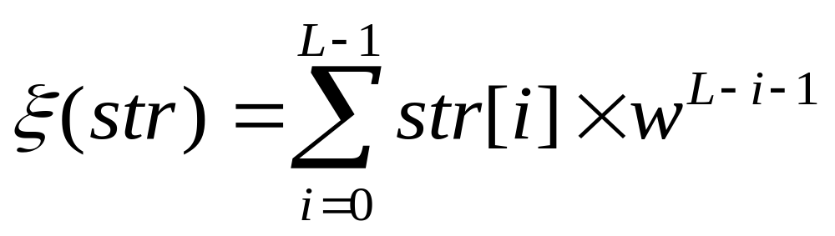
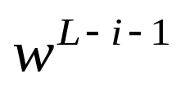
Automatic test data generation for character string
So we first define a function ع
which maps a character string to a nonnegative integer.
where str is a character string, L is its length,
is a positive weighting factor representing
a weighted value imposed upon each character element
of the string, and w is equal to 128.
ﻉ(“ABC”)=A*128*128+B*128+C*1 (L=3)
=65*128*128+66*128+67
=1073475

Slide 26
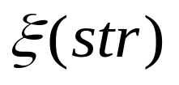
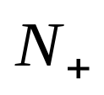
Automatic test data generation for character string
Theorem: Suppose S is a set of character strings,
is a set of nonnegative integers.
Let is defined as above.
Then is a one-to-one function from S to .
By the theorem, a character string can be
transformed into a unique nonnegative integer.

Slide 27
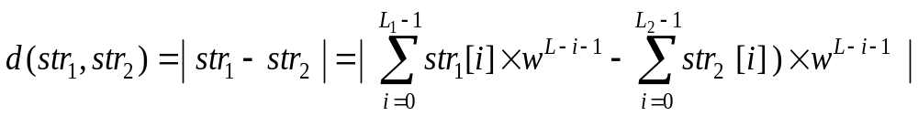
Automatic test data generation for character string
Define the distance between string and string as below:
L₁ and L₂ are the length of string str1, str2,
L=max(L₁,L₂),
Without loss of generality, let L=L₂, str₁[k]=‘\0’.
d (“Ab”-”ABC”)=│(A*128*128+b*128)-(A*128*128+B*128+C) │

Slide 28
Automatic test data generation for character string
Define the distance between string and string as below:
L1 and L2 denote the length of string str1, str2, respectively.
Suppose L=max(L1,L2),
Without loss of generality, let L=L2, str1[k]=‘\0’.
The distance d(str₁,str₂) determines a nonnegative integer,
and then can be used to evaluate the branch function F(x)
with regard to a character string predicate.

Slide 29
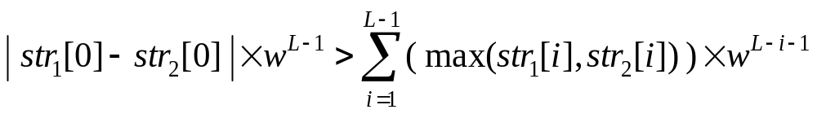
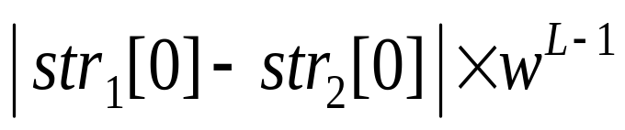
Automatic test data generation for character string
How to search an appropriate direction for
a character string variable to improve the branch function value.
determines the distance
between str₁ and str_{2.}

Slide 30
Automatic test data generation for character string
Search an appropriate direction for
the first character to improve the branch function value.
For equality predicate (=) or non-equality predicate (≠)
For example:
if (!strcmp(str₁,"-ceiling"))
We need to search an appropriate direction for every character
in order to make str₁=“-ceiling”.

Slide 31
A example
Int max(int argc,char ** argv)
{
argc--;
argv++;
if ((argc>0)&&('-'==**argv))
{ if (!strcmp(argv[0],"-ceiling"))
{ strncpy(ceiling,argv[1],BUFSIZE);
argv++; argv++;
argc--; argc--;
}
else
{ fprintf(stderr,"Illegal option %s.\n",argv[0]);
return(2);
}
}
if(argc==0)
{ fprintf(stderr,"Max requires at least one argument.\n");
return(2);
}
for(;argc>0;argc--,argv++)
{ if(strcmp(argv[0],result)>0);
strncpy(result,argv[0],BUFSIZE);
}
if (strcmp(ceiling,result)<=0)
printf("\n max:%s",ceiling);
else
printf("\n max:%s",result);
return(0);
}
The specification:
Which prints the lexicographic maximum
of command-line arguments.
There is one option:
-ceiling
This provides a ceiling:
If the maximum would be larger than this,
this is the maximum.

Slide 32
A example
argc--;
argv++;
instrument_num_branch(argc,0,'>',"&&");
instrument_ch_branch('-',**argv, '=', "");
if((argc>0)&&('-'==**argv))
{ instrument_char_branch(argv[0],"-ceiling", '!', "");
if (!strcmp(argv[0],"-ceiling"))
{ strncpy(ceiling,argv[1],BUFSIZE);
argv++; argv++;
argc--; argc--;
}
else
{ fprintf(stderr,"Illegal option %s.\n",argv[0]);
return(2);
}
}
instrument_num_branch(argc,0,'=',"");
if(argc==0)
{ fprintf(stderr,"Max requires at least one argument.\n");
return(2);
}
instrument_num_branch(argc,0,'>',"");
for(;argc>0;argc--,argv++)
{ instrument_char_branch(argv[0],result, '>', "");
if(strcmp(argv[0],result)>0)
strncpy(result,argv[0],BUFSIZE);
instrument_num_branch(argc,0,'>',"");
}
instrument_char_branch(ceiling,result, '-', "");
if (strcmp(ceiling,result)<=0)
printf("\n max:%s",ceiling);
else
printf("\n max:%s",result);
return(0);
Int max(int argc,char ** argv)
{
argc--;
argv++;
if ((argc>0)&&('-'==**argv))
{ if (!strcmp(argv[0],"-ceiling"))
{ strncpy(ceiling,argv[1],BUFSIZE);
argv++; argv++;
argc--; argc--;
}
else
{ fprintf(stderr,"Illegal option %s.\n",argv[0]);
return(2);
}
}
if(argc==0)
{ fprintf(stderr,"Max requires at least one argument.\n");
return(2);
}
for(;argc>0;argc--,argv++)
{ if(strcmp(argv[0],result)>0);
strncpy(result,argv[0],BUFSIZE);
}
if (strcmp(ceiling,result)<=0)
printf("\n max:%s",ceiling);
else
printf("\n max:%s",result);
return(0);
}

Slide 33
A example
Int max(int argc,char ** argv)
{
1 argc--;
2 argv++;
3 if ((argc>0)&&('-'==**argv))
4 { if (!strcmp(argv[0],"-ceiling"))
5 { strncpy(ceiling,argv[1],BUFSIZE);
6 argv++; argv++;
7 argc--; argc--;
}
else
8 { fprintf(stderr,"Illegal option %s.\n",argv[0]);
9 return(2);
}
}
10 if(argc==0)
11 { fprintf(stderr,"Max requires at least one argument.\n");
12 return(2);
}
13 for(;argc>0;argc--,argv++)
14 { if(strcmp(argv[0],result)>0);
15 strncpy(result,argv[0],BUFSIZE);
}
16 if (strcmp(ceiling,result)<=0)
17 printf("\n max:%s",ceiling);
else
18 printf("\n max:%s",result);
19 return(0);
}
Control flow figure:
1
2
3
4
5
8
6
7
10
11
13
9
14
16
12
15
17
18
19
e

Slide 34
A example
Int max(int argc,char ** argv)
{
1 argc--;
2 argv++;
3 if ((argc>0)&&('-'==**argv))
4 { if (!strcmp(argv[0],"-ceiling"))
5 { strncpy(ceiling,argv[1],BUFSIZE);
6 argv++; argv++;
7 argc--; argc--;
}
else
8 { fprintf(stderr,"Illegal option %s.\n",argv[0]);
9 return(2);
}
}
10 if(argc==0)
11 { fprintf(stderr,"Max requires at least one argument.\n");
12 return(2);
}
13 for(;argc>0;argc--,argv++)
14 { if(strcmp(argv[0],result)>0);
15 strncpy(result,argv[0],BUFSIZE);
}
16 if (strcmp(ceiling,result)<=0)
17 printf("\n max:%s",ceiling);
else
18 printf("\n max:%s",result);
19 return(0);
}
Control flow figure:
1
2
3
4
5
8
6
7
10
11
13
9
14
16
12
15
17
18
Generate test data to execute the path:
1,2,3,4,5,6,7,10,13,14,15,13,14,15,13,14,15,16,17,19,exit.
19
e

Slide 35
A example
Input : Re 65 g
The generated test data are: -ceiling 65 g p x
The number of evaluating branch functions is 126.
These test data execute the program along the selected path.
Input: -ceiling 45 6768 3445 as 34 6788
The generated test data are: -ceiling 45 /768 3445 as
The number of evaluating branch functions is 22.
Input :
The generated test data are: -ceiling ! ! “ $
The number of evaluating branch functions is 89.

Slide 36
A example
1. {1,2,3,4,8,9},
2. {1,2,3,4,5,6,7,10,11,12},
3. {1,2,3,4,5,6,7,10,13,16,17,19},
4. {1,2,3,4,5,6,7,10,13,16,18,19},
5. {1,2,3,4,5,6,7,10,13,14,13,16,17,19},
6. {1,2,3,4,5,6,7,10,13,14,13,16,18,19},
7. {1,2,3,4,5,6,7,10,13,14,15,13,16,17,19},
8. {1,2,3,4,5,6,7,10,13,14,15,13,16,18,19},
9. {1,2,3,4,5,6,7,10,13,14,13,14,13,16,17,19},
10. {1,2,3,4,5,6,7,10,13,14,13,14,13,16,18,19},
11. {1,2,3,4,5,6,7,10,13,14,15,13,14,15,13,16,17,19},
12. {1,2,3,4,5,6,7,10,13,14,15,13,14,15,13,16,18,19},
13. {1,2,3,4,5,6,7,10,13,14,13,14,15,13,16,17,19},
14. {1,2,3,4,5,6,7,10,13,14,13,14,15,13,16,18,19},
15. {1,2,3,4,5,6,7,10,13,14,15,13,14,13,16,17,19},
16. {1,2,3,4,5,6,7,10,13,14,15,13,14,13,16,18,19},
{1,2,3,10,11,12},
{1,2,3,10,13,16,17,19},
19. {1,2,3,10,13,16,18,19},
20. {1,2,3,10,13,14,13,16,17,19},
21. {1,2,3,10,13,14,13,16,18,19},
22. {1,2,3,10,13,14,15,13,16,17,19},
23. {1,2,3,10,13,14,15,13,16,18,19},
24. {1,2,3,10,13,14,13,14,13,16,17,19},
25. {1,2,3,10,13,14,13,14,13,16,18,19},
26. {1,2,3,10,13,14,15,13,14,15,13,16,17,19},
27. {1,2,3,10,13,14,15,13,14,15,13,16,18,19},
28. {1,2,3,10,13,14,13,14,15,13,16,17,19},
29. {1,2,3,10,13,14,13,14,15,13,16,18,19},
30. {1,2,3,10,13,14,15,13,14,13,16,17,19},
31. {1,2,3,10,13,14,15,13,14,13,16,18,19}
Int max(int argc,char ** argv)
{
1 argc--;
2 argv++;
3 if ((argc>0)&&('-'==**argv))
4 { if (!strcmp(argv[0],"-ceiling"))
5 { strncpy(ceiling,argv[1],BUFSIZE);
6 argv++; argv++;
7 argc--; argc--;
}
else
8 { fprintf(stderr,"Illegal option %s.\n",argv[0]);
9 return(2);
}
}
10 if(argc==0)
11 { fprintf(stderr,"Max requires at least one argument.\n");
12 return(2);
}
13 for(;argc>0;argc--,argv++)
14 { if(strcmp(argv[0],result)>0);
15 strncpy(result,argv[0],BUFSIZE);
}
16 if (strcmp(ceiling,result)<=0)
17 printf("\n max:%s",ceiling);
else
18 printf("\n max:%s",result);
19 return(0);
}

Slide 37
A example
1. {1,2,3,4,8,9},
2. {1,2,3,4,5,6,7,10,11,12},
3. {1,2,3,4,5,6,7,10,13,16,17,19},
4. {1,2,3,4,5,6,7,10,13,16,18,19},
5. {1,2,3,4,5,6,7,10,13,14,13,16,17,19},
6. {1,2,3,4,5,6,7,10,13,14,13,16,18,19},
7. {1,2,3,4,5,6,7,10,13,14,15,13,16,17,19},
8. {1,2,3,4,5,6,7,10,13,14,15,13,16,18,19},
9. {1,2,3,4,5,6,7,10,13,14,13,14,13,16,17,19},
10. {1,2,3,4,5,6,7,10,13,14,13,14,13,16,18,19},
11. {1,2,3,4,5,6,7,10,13,14,15,13,14,15,13,16,17,19},
12. {1,2,3,4,5,6,7,10,13,14,15,13,14,15,13,16,18,19},
13. {1,2,3,4,5,6,7,10,13,14,13,14,15,13,16,17,19},
14. {1,2,3,4,5,6,7,10,13,14,13,14,15,13,16,18,19},
15. {1,2,3,4,5,6,7,10,13,14,15,13,14,13,16,17,19},
16. {1,2,3,4,5,6,7,10,13,14,15,13,14,13,16,18,19},
{1,2,3,10,11,12},
{1,2,3,10,13,16,17,19},
19. {1,2,3,10,13,16,18,19},
20. {1,2,3,10,13,14,13,16,17,19},
21. {1,2,3,10,13,14,13,16,18,19},
22. {1,2,3,10,13,14,15,13,16,17,19},
23. {1,2,3,10,13,14,15,13,16,18,19},
24. {1,2,3,10,13,14,13,14,13,16,17,19},
25. {1,2,3,10,13,14,13,14,13,16,18,19},
26. {1,2,3,10,13,14,15,13,14,15,13,16,17,19},
27. {1,2,3,10,13,14,15,13,14,15,13,16,18,19},
28. {1,2,3,10,13,14,13,14,15,13,16,17,19},
29. {1,2,3,10,13,14,13,14,15,13,16,18,19},
30. {1,2,3,10,13,14,15,13,14,13,16,17,19},
31. {1,2,3,10,13,14,15,13,14,13,16,18,19}
Int max(int argc,char ** argv)
{
1 argc--;
2 argv++;
3 if ((argc>0)&&('-'==**argv))
4 { if (!strcmp(argv[0],"-ceiling"))
5 { strncpy(ceiling,argv[1],BUFSIZE);
6 argv++; argv++;
7 argc--; argc--;
}
else
8 { fprintf(stderr,"Illegal option %s.\n",argv[0]);
9 return(2);
}
}
10 if(argc==0)
11 { fprintf(stderr,"Max requires at least one argument.\n");
12 return(2);
}
13 for(;argc>0;argc--,argv++)
14 { if(strcmp(argv[0],result)>0);
15 strncpy(result,argv[0],BUFSIZE);
}
16 if (strcmp(ceiling,result)<=0)
17 printf("\n max:%s",ceiling);
else
18 printf("\n max:%s",result);
19 return(0);
}

Slide 38
A example
Input:
Execution path: {1,2,3,4,8,9}
The generated test data is: -
The number of evaluating branch functions is 10.
Input: -
Execution path:{1,2,3,4,5,6,7,10,11,12}
The generated test data are: -ceiling !
The number of evaluating branch functions is 95.
Input: -ceiling !
Execution path: {1,2,3,4,5,6,7,10,13,16,18,19}
The path is a infeasible path.
The number of evaluating branch functions is 51.

Slide 39
Conclusion and Future work
realize automatic test data generation of character string
for a selected path for programs written in C language.
Compare the effectiveness of gradient descent with random
test data generation of character string with the help atac.

Slide 40
Thank you

