Slide 1
How to give a good presentation
Tony Field
With material from Simon Peyton Jones’s
“Research Skills”
(http://research.microsoft.com/~simonpj/papers/giving-a-talk/giving-a-talk.htm)

Slide 2
The presentation…
40 minutes total, including any demo, and at least 10 minutes for questions
Your chance to show off your achievements
Our chance to find out what you really did
Assessed by a team of academics to ensure accuracy and consistency
Treat the presentation as an opportunity to tell us what you’ve achieved

Slide 3
The presentation…
The presentation carries no explicit marks in its own right
It is compulsory – no presentation means no project mark
Purpose: to ensure you get the right mark, NOT to mock your work or your presentation skills

Slide 4
The audience you would like…
Have read every word of your report
Have previously studied all 5,929,913 lines of code in the Linux kernel
Are all agog to hear about your patch to allow interrupt timings from network devices to contribute to the kernel entropy pool
Will willingly filter out the waffly, irrelevant parts of your talk and extract the “meat” for themselves

Slide 5
In practice, your audience…
(Bar your 1st/2nd markers) Have no idea what your project is about
Know that Linux has a kernel, but have no idea why you’d ever want to “patch” it
May well drift off into fluid queueing theory if you don’t hold their attention
Are trained to be skeptical (they are academics!)

Slide 6
Your mission is to…
GET THEM INTERESTED
KEEP THEM INTERESTED
And make them glad you were in
their team!

Slide 7

Some “do”s

Slide 8
Begin with the problem
The first TWO minutes of every talk is absolutely precious - you MUST engage the audience with your motivation
What is the problem?
Why is it an interesting problem?
What’s the crux of your idea?
So many talks fail at this first hurdle

Slide 9
Examples
When C programs access memory illegally it’s very hard to uncover what happened (give example). Bounds checking can *really* help (give example). I’m going to show you how I built a state of the art bounds checker for gcc...
Game physics engines sometimes glitch when there are large numbers of objects in the game (give example). My idea is to switch to simpler object representations in this case to speed up the physics. I’ve explored the idea by extending the Bullet physics engine...

Slide 10
Finding What C++ Lost:
Tracking Referent Objects with GCC
Alexander Lamaison

Slide 11
> ./myprogram
Segmentation fault

Slide 12
> ./myprogram
>

Slide 13
> ./myprogram
*******
bounds violation caused by earlier pointer arithmetic:
The arithmetic took place at myprogram.cpp:5 (main)
The violation occurred at myprogram.cpp:6 (main)
Before going out-of-bounds the pointer referred to
myprogram.cpp:3 (main) a
time=1181317406.431297 ptr=0xbfaf12cc size=4
pc=0xb7f57124

Slide 14
Make a plan for your talk
You cannot (hopefully!) explain everything you have done
  Try to tell a coherent story from end-to-end
  Ruthlessly prune material that is not on the critical path
  Focus on the interesting detail
Have a “mental picture”
Problem
Solution
Critical path
Other interesting issues
(Omit if time is short)
Side issues/
for questions?
Detail
(Omit these)
Future work

Slide 15

Narrow, deep beats wide, shallow
No
Yes
Avoid shallow overviews
Cut to the chase: the technical “meat”

Slide 16
Use examples and diagrams
Examples and diagrams are key weapons – use them in place of text whenever possible
Some of the very best talks have no linking text at all!
REMARK: I am using linking text here so you can read the slides later on!

Slide 17
Text text text… No No No...!
A temptatation is to write out everything you want to say on the slides or at least have lots of text to jog your memory
This will certainly mean you won’t miss anything
However, the audience will not read a single word
Instead they will listen to you as you read out each bit. For a while…
It will sound very dull and very boring
Then the audience will think… “I could read this talk later by looking at the slides. I know, I’ll do a bit of work on that fluid queue paper I’m writing…”
Meanwhile, you have some problems:
  Do you read the text exactly as it appears?
  Or do try to add a few extra words to make it sound more interesting?
  Or do you skip some of the words, knowing that the audience can fill in the gaps for themselves?
After a while, you begin thinking to yourself “Hmmm - This isn’t going very well”
Then, just as you are getting to the end of the slide (phew!), you realise…

Slide 18
Text text text… No No No...!
That there is another of these ‘monsters’ on the next slide!
And the next slide, and the next slide, and the next slide…
Now you have a dilemma
  Do you talk through the slides much quicker?
  Do you start skipping over some points, saying things like “I think that point is pretty obvious”, “I probably don’t need to say that”…
Meanwhile, that fluid queue paper is now out and the eyes are down; pens in hands
Anyone lucky enough to bring a laptop is now doing their email
The sound of tapping keys and pages turning takes its toll
You start sweating – huge swathes of text fly by as you stab the ‘PgDn’ key...
You run out of excuses as to why you don’t need to stop and read out each slide as it flies by
And then… A revelation…
You remember that somewhere… later… there is... a DIAGRAM…!

Slide 19
Use examples and diagrams
An example:
f e e’ 42 True where f a b c d = …
“Closure”
Immediate fields
42
True
Heap pointers
(closures for e, e’)
4, 2
Other fields
Info Table for f
Entry code
…
(Static)
…
NOW… the audience looks up, the tapping stops…

Slide 20

Some “don’t”s

Slide 21
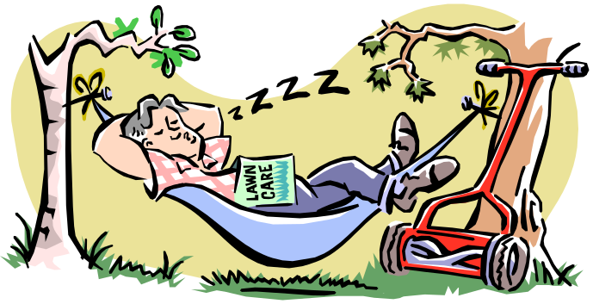
Don’t give an “Outline of my talk”
Background
Why fluid queues?
The Boxma-Dumas model
Limitations of the Boxma-Dumas model
Laplace Transform of the busy period distribution with multiple emptying states
Numerical results
Related work
Conclusions and further work

Slide 22
No outline!
An “Outline of my talk”: conveys near zero information at the start
  But you might highlight key issues that your talk will address, after your introduction…
  …with optional signposts at pause points during the talk

Slide 23
Don’t give a literature survey
Time is precious – the survey is in the report
But DO make it clear that you know your background:
  Respond readily to questions
  Acknowledge supervisor(s) (title slide), and pre-cursors (as you go along)
  Summarise key existing solutions, techniques etc. and their pros/cons
  Do not disparage the opposition

Slide 24
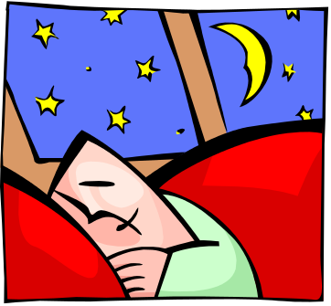
Avoid excessive technical detail
Dense clouds of notation will send your audience to sleep
Present specific aspects only;
refer to the report for missing
details
BUT… have backup slides to use in response to questions

Slide 25
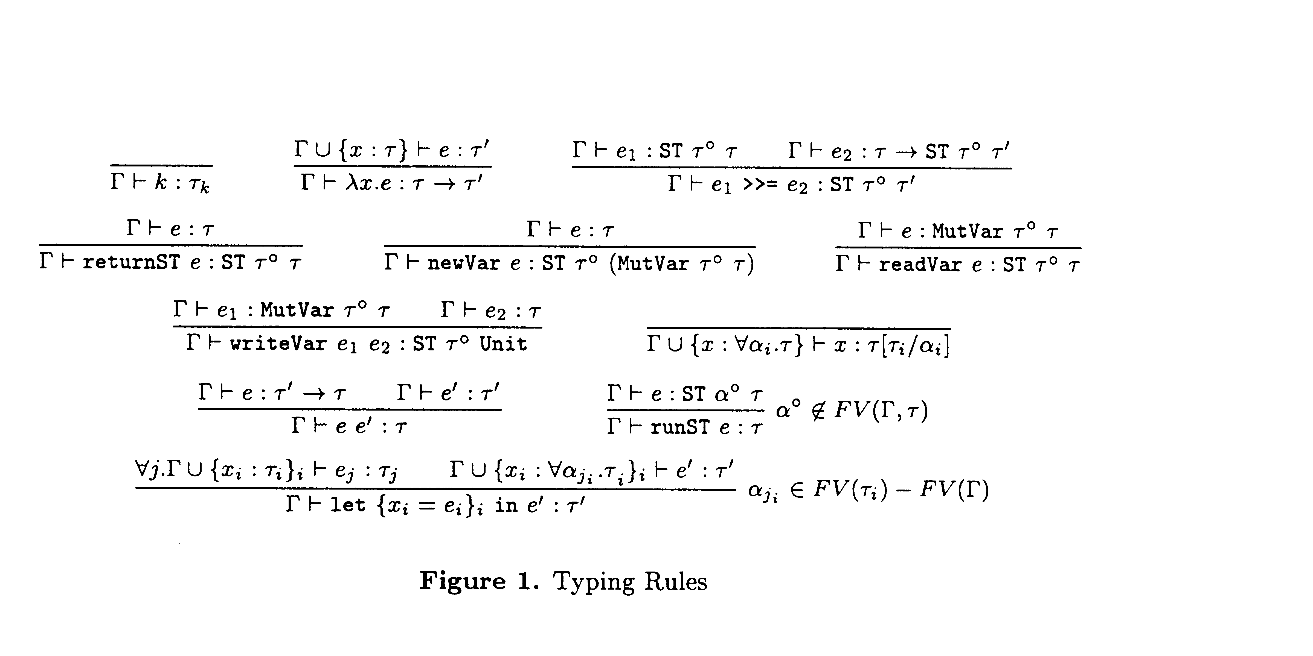
Technical detail
Sometimes it’s useful to `see’ some detail, but don’t try to explain it all

Slide 26

Presenting your talk

Slide 27

How to present your talk
By far the most important thing is to
be enthusiastic

Slide 28
Nerves
You do not need to be nervous. But if you are…
Remember:
  The audience is not examining your presentation skills
  You know something the audience doesn’t!
  The audience is on your side – they want to find out what you’ve done
Script your first few sentences precisely; getting going is often the hardest part
Move around a lot, use large gestures, wave your arms, stand on chairs…

Slide 29
Being seen, being heard…
Avoid monotone ‘stand and deliver’
Move around, change the focus of attention, use the whiteboard
Point at the screen, not at the overhead projector, or in mid air
Don’t use a laser pointer!
NB For a larger audience…
Speak to someone at the back of the room, even if you have a microphone on
Repeat questions so that everyone can hear

Slide 30

Hiding your point
A very annoying technique
is to reveal
your points
one
by one
by one, unless…
there is a punch line

Slide 31
Finishing
Absolutely without fail,
finish on time
Audiences get restive and essentially stop listening when your time is up. Continuing is very counter productive
Simply truncate and conclude
DO NOT try to rescue the situation by speeding up

Slide 32
Beyond this talk…
The general standard of presentation is so low that you don’t have to be outstanding to stand out!
You will attend 50x as many talks as you give. Watch other people’s talks intelligently, and pick up ideas for what to do and what to avoid.

