Slide 1
Participate in a Smart City Contest
DDAA - OPENCLASSROOM - BNPP Data Science Foundations
Evandro Demuth – São Paulo, 22/04/2020

Slide 2
1
INTRODUCTION
2
OVERVIEW OF THE DATASET
Importing the dataset
Showing information regarding the dataframe
Describing the dataframe
Seeing dataframe content
3
METHODS USED TO ANALYZE THE DATA
Grouping
Graphs and Geographical data
Boxplot and Scatterplot
Others
4
SUMMARY OF THE DATA ANALYSIS
What we’ve discovered...
DDAA - OPENCLASSROOM - BNPP Data Science Foundations - Participate in a Smart City Contest
Nome – São Paulo, 22/04/2020

Slide 3
#01 - INTRODUCTION
This presentation was created based on the work and study conducted during the Project #01 : Participate in a Smart City Contest wich is part of the OpenClassroom path BNPP Data Science Foundations from the DDAA Reskilling Program of BNP Paribas Cardif.
Project Brifing:
You have recently established yourself as an independent consultant specializing in Artificial Intelligence. To try your hand at new applications, you make it a point to regularly enter contests.
In your searches, you discover an NGO called “Data for Common Good,” which posts online non-profit and government-sponsored challenges relating to the use of Data Science for the common good.
You decide to participate in a challenge sponsored by the City of Paris. Here are the terms of reference for this challenge:
All are invited to take part in a Data Science challenge sponsored by the City of Paris that will help it become a Smart City!
Challenge participants will be asked to conduct an exploratory analysis of city tree data contained in a dataset developed for Paris’s “Plant the City” program.
Your participation in this challenge will have a real-world impact on Paris’s future!
Data:
Download the dataset for the trees of Paris here. You can also view the dataset in context at opendata.paris.fr.
DDAA - OPENCLASSROOM - BNPP Data Science Foundations - Participate in a Smart City Contest
Nome – São Paulo, 22/04/2020

Slide 4
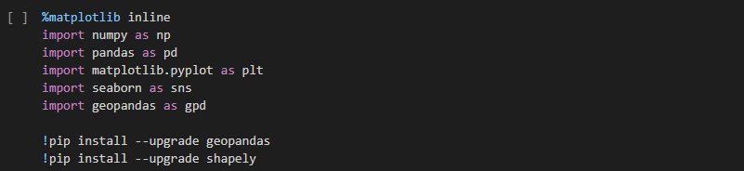
#02 - OVERVIEW OF THE DATASET Importing the dataset
Importing libs and installing packages
We've defined arvores as the name of our DataFrame
By the way arvores means Trees in portuguese :-)
DDAA - OPENCLASSROOM - BNPP Data Science Foundations - Participate in a Smart City Contest
Nome – São Paulo, 22/04/2020

Slide 5
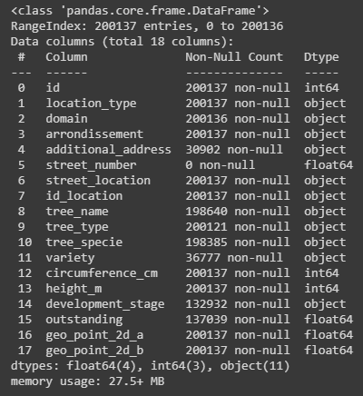
#02 - OVERVIEW OF THE DATASET Showing information regarding the dataframe
Quantity of entries: 200.137
Quantity of columns: 18
Quantity of columns with missing values: 9
DDAA - OPENCLASSROOM - BNPP Data Science Foundations - Participate in a Smart City Contest
Nome – São Paulo, 22/04/2020

Slide 6
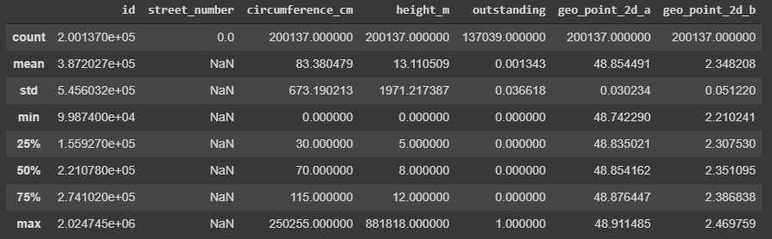
#02 - OVERVIEW OF THE DATASET Describing the dataframe
Here we can see the statistics regarding the data.
For example the minimum, mean and maximum values in each column. It's important and allow us to identify some strange values like height_m max value with 200.881.818 meters, when the mean for this column is 13.11 meters. This value probably were generated by outliers or wrong data filled in the dataset.
DDAA - OPENCLASSROOM - BNPP Data Science Foundations - Participate in a Smart City Contest
Nome – São Paulo, 22/04/2020

Slide 7
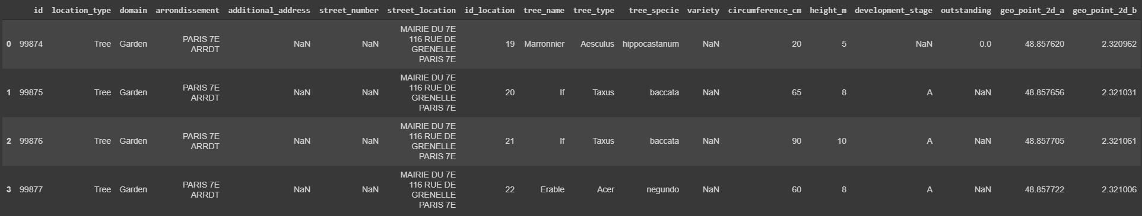
#02 - OVERVIEW OF THE DATASET Seeing dataframe content
First 4 entries
DDAA - OPENCLASSROOM - BNPP Data Science Foundations - Participate in a Smart City Contest
Nome – São Paulo, 22/04/2020

Slide 8
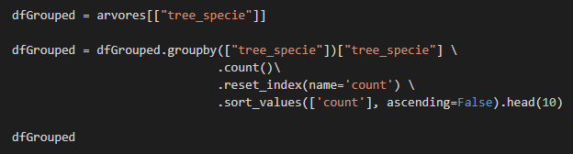
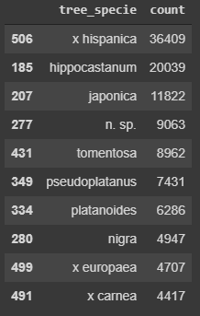
#03 - METHOD USED TO ANALYZE THE DATA Grouping
Here we are using the groupby function to agregate and count by some criteria.
We select a column to groupby (tree_specie). We have created a new dataframe called dfGrouped with this column.
Then we aggregate the data using the groupby function counting each row per tree_specie, sorting by quantity and limiting the 10 first rows of the function result.
After all we have a list of the 10 most popular trees in Paris.
DDAA - OPENCLASSROOM - BNPP Data Science Foundations - Participate in a Smart City Contest
Nome – São Paulo, 22/04/2020

Slide 9
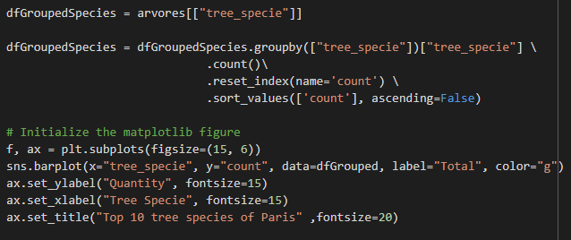
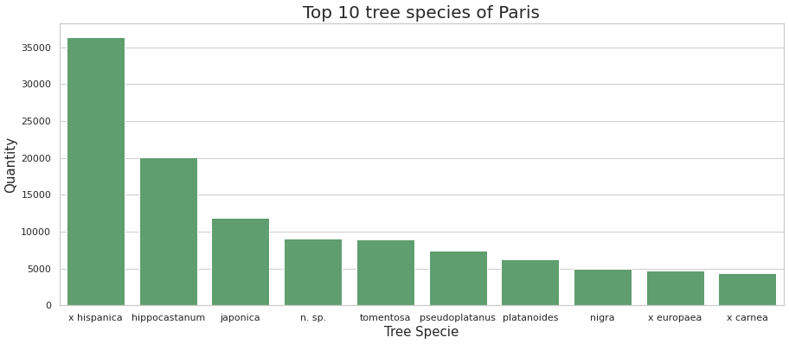
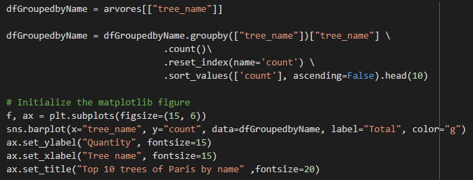
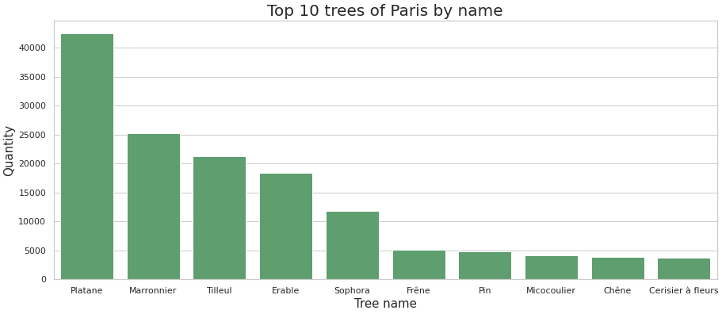
#03 - METHOD USED TO ANALYZE THE DATA Ploting the result with graphs
We've decided to use Seaborn
DDAA - OPENCLASSROOM - BNPP Data Science Foundations - Participate in a Smart City Contest
Nome – São Paulo, 22/04/2020

Slide 10
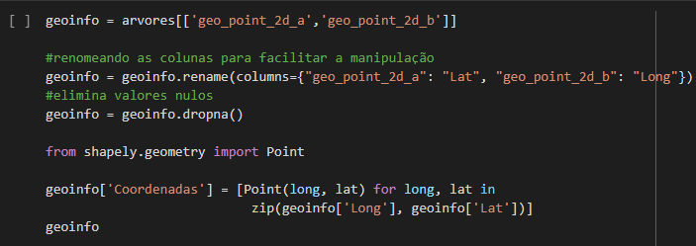
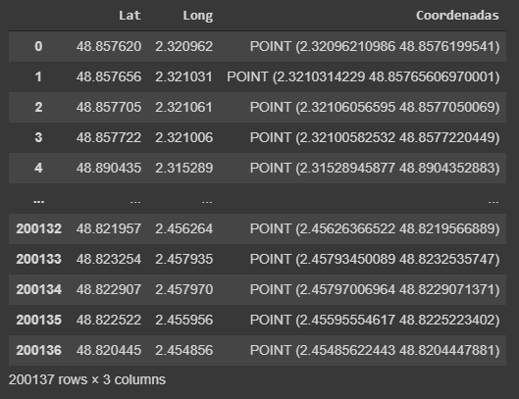
#03 - METHOD USED TO ANALYZE THE DATA Using Geopandas & Shapely
To use Geopandas we had to create a new column with the coordenates (longitude and latitude) in a way that geopandas dataframe accept.
We used Shapely geometric library to fill this new column with the coordinates.
DDAA - OPENCLASSROOM - BNPP Data Science Foundations - Participate in a Smart City Contest
Nome – São Paulo, 22/04/2020

Slide 11
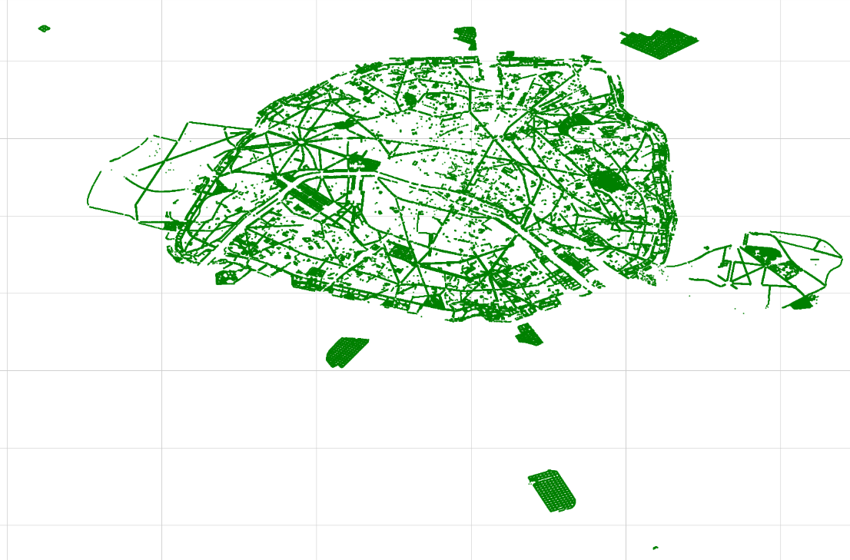
#03 - METHOD USED TO ANALYZE THE DATA Ploting Geopoints with Geopandas
Once we have the coordinates we can create the GeoDataFrame.
After create the GeoDataframe is easy to plot the data
DDAA - OPENCLASSROOM - BNPP Data Science Foundations - Participate in a Smart City Contest
Nome – São Paulo, 22/04/2020

Slide 12
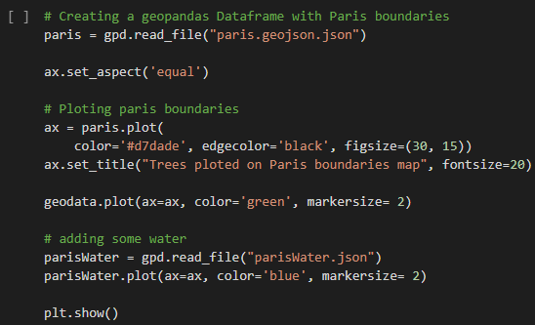
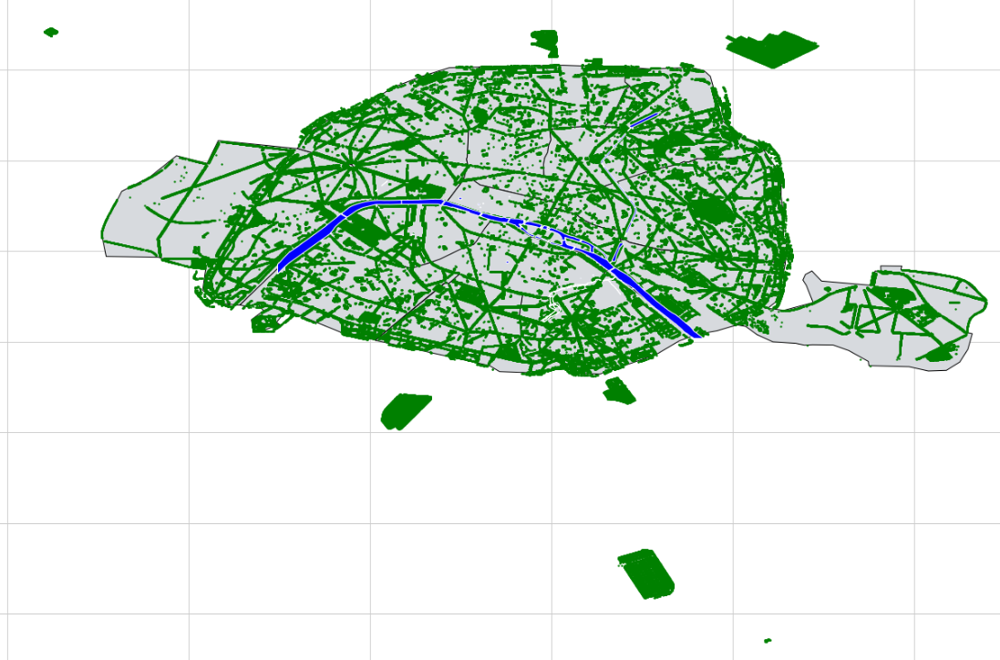
#03 - METHOD USED TO ANALYZE THE DATA Enhancing the graph
To make the graph more understandible and rich, we added the boundaries of Paris (gray color) and the hydrography map (blue color)
DDAA - OPENCLASSROOM - BNPP Data Science Foundations - Participate in a Smart City Contest
Nome – São Paulo, 22/04/2020

Slide 13
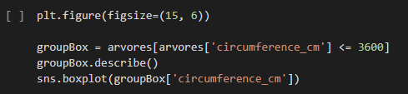
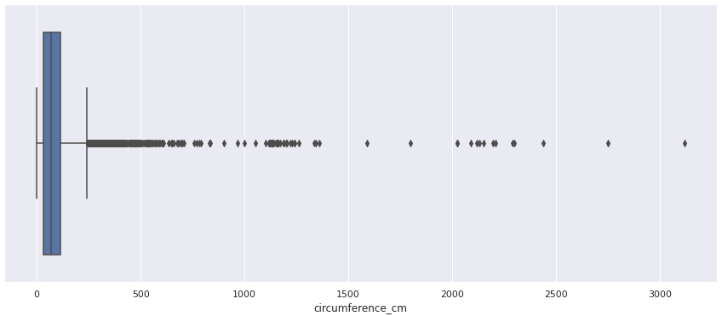
#03 - METHOD USED TO ANALYZE THE DATA Boxplot and Removing outliers
We have removed the entries where the circumference_cm values are more than 3600.
We have searched that the biggest tree in the world has 36 meters of circumference.
DDAA - OPENCLASSROOM - BNPP Data Science Foundations - Participate in a Smart City Contest
Nome – São Paulo, 22/04/2020

Slide 14
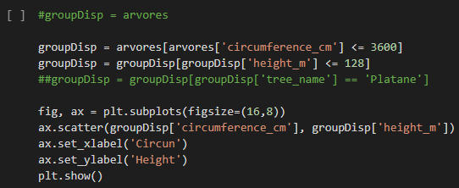
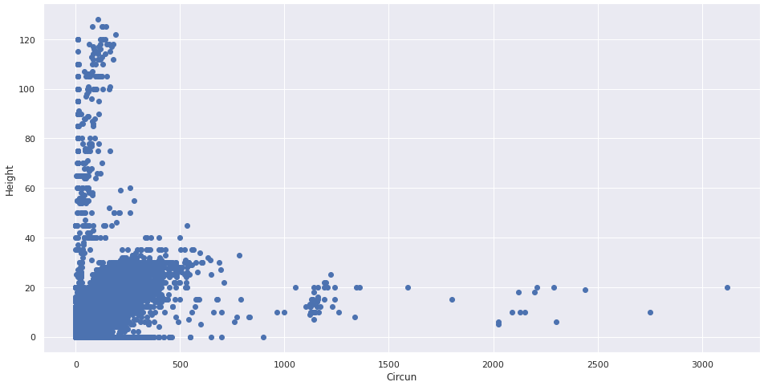
#03 - METHOD USED TO ANALYZE THE DATA Scatterplot and Removing outliers
Here is hard to identify the groups, but we can see the itensity of points around the circunferences (0-500cm) and height (0-30mt)
Let's put some color here!
DDAA - OPENCLASSROOM - BNPP Data Science Foundations - Participate in a Smart City Contest
Nome – São Paulo, 22/04/2020

Slide 15
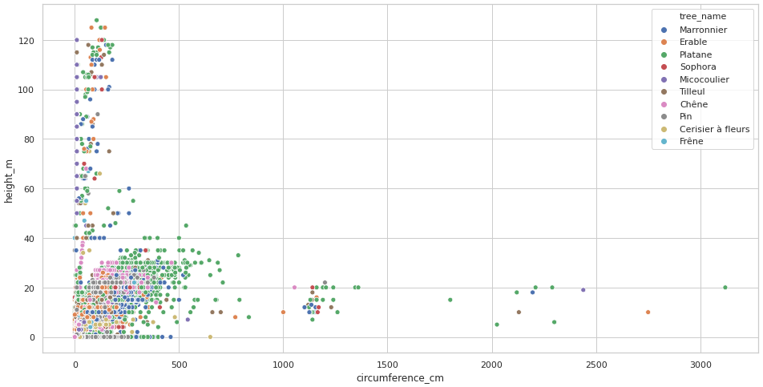
#03 - METHOD USED TO ANALYZE THE DATA Scatterplot and Removing outliers
Here is hard to identify the groups, but we can see the itensity of points around the circunferences (0-500cm) and height (0-30mt)
Let's put some color here!
DDAA - OPENCLASSROOM - BNPP Data Science Foundations - Participate in a Smart City Contest
Nome – São Paulo, 22/04/2020

Slide 16
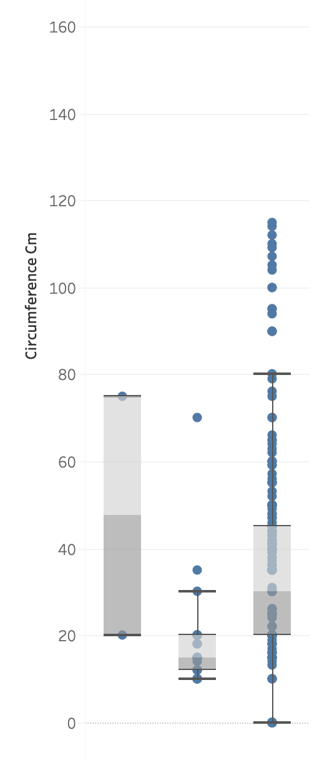
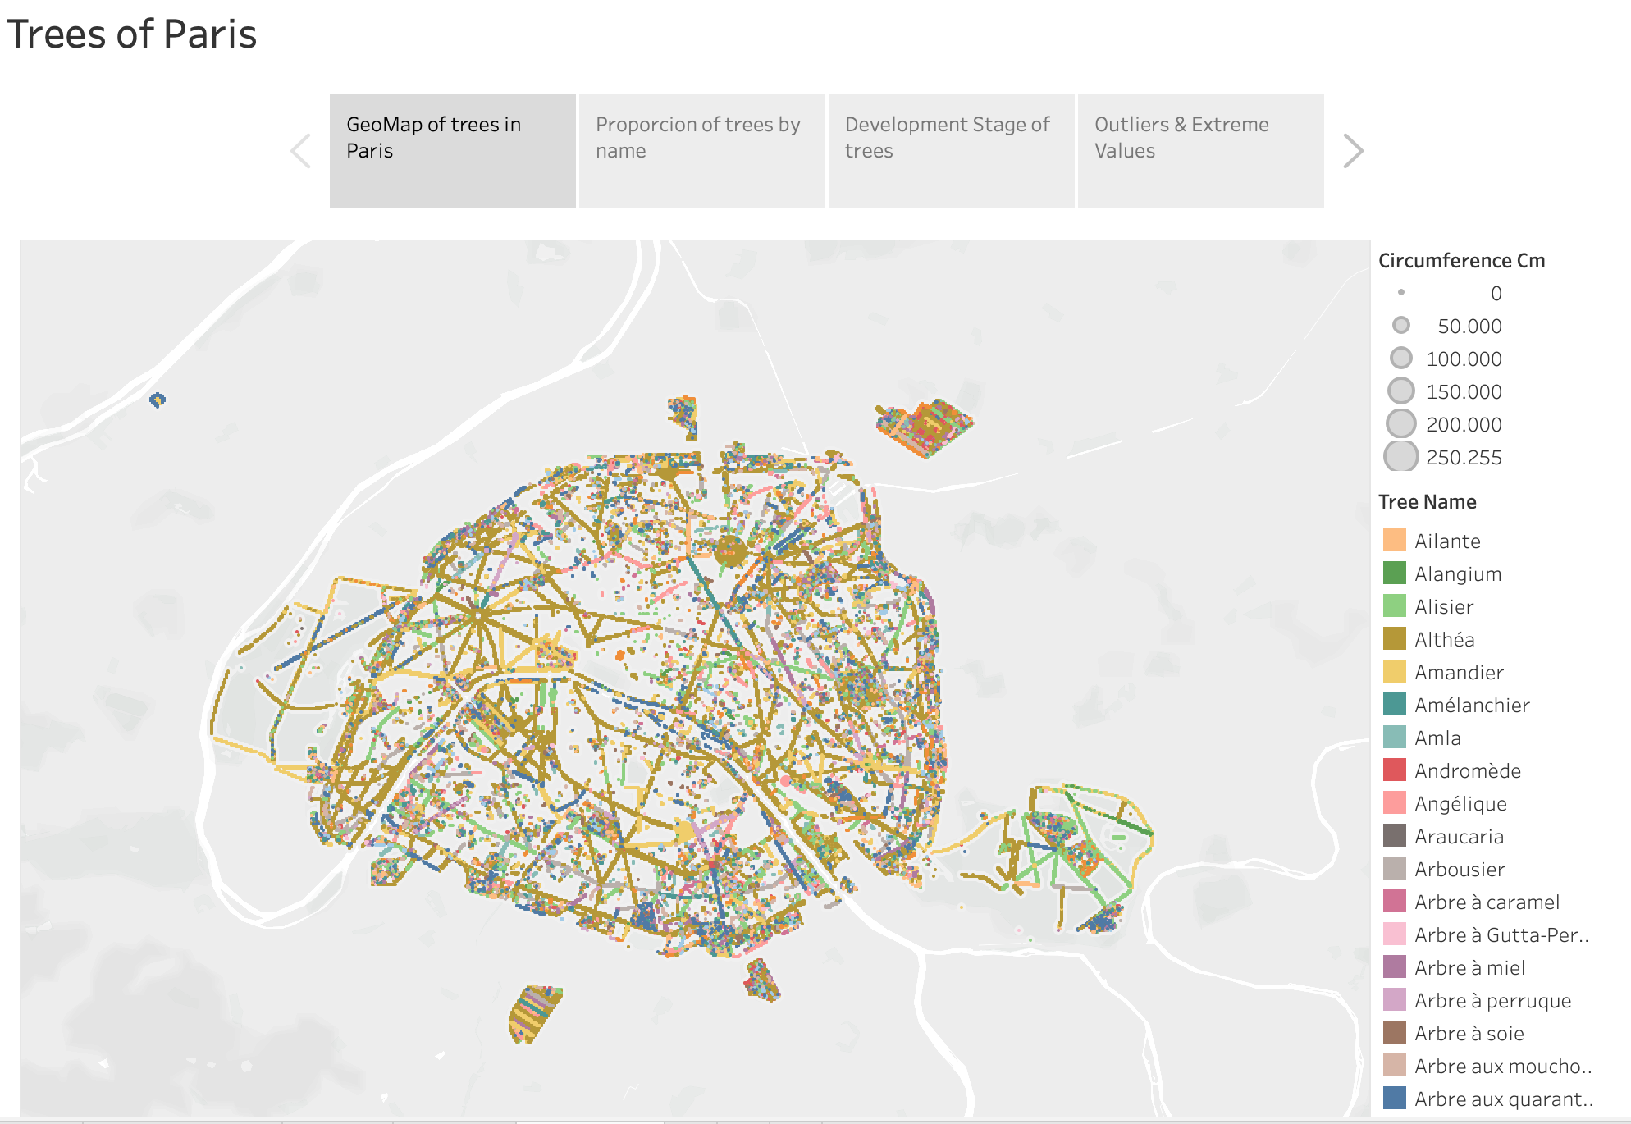
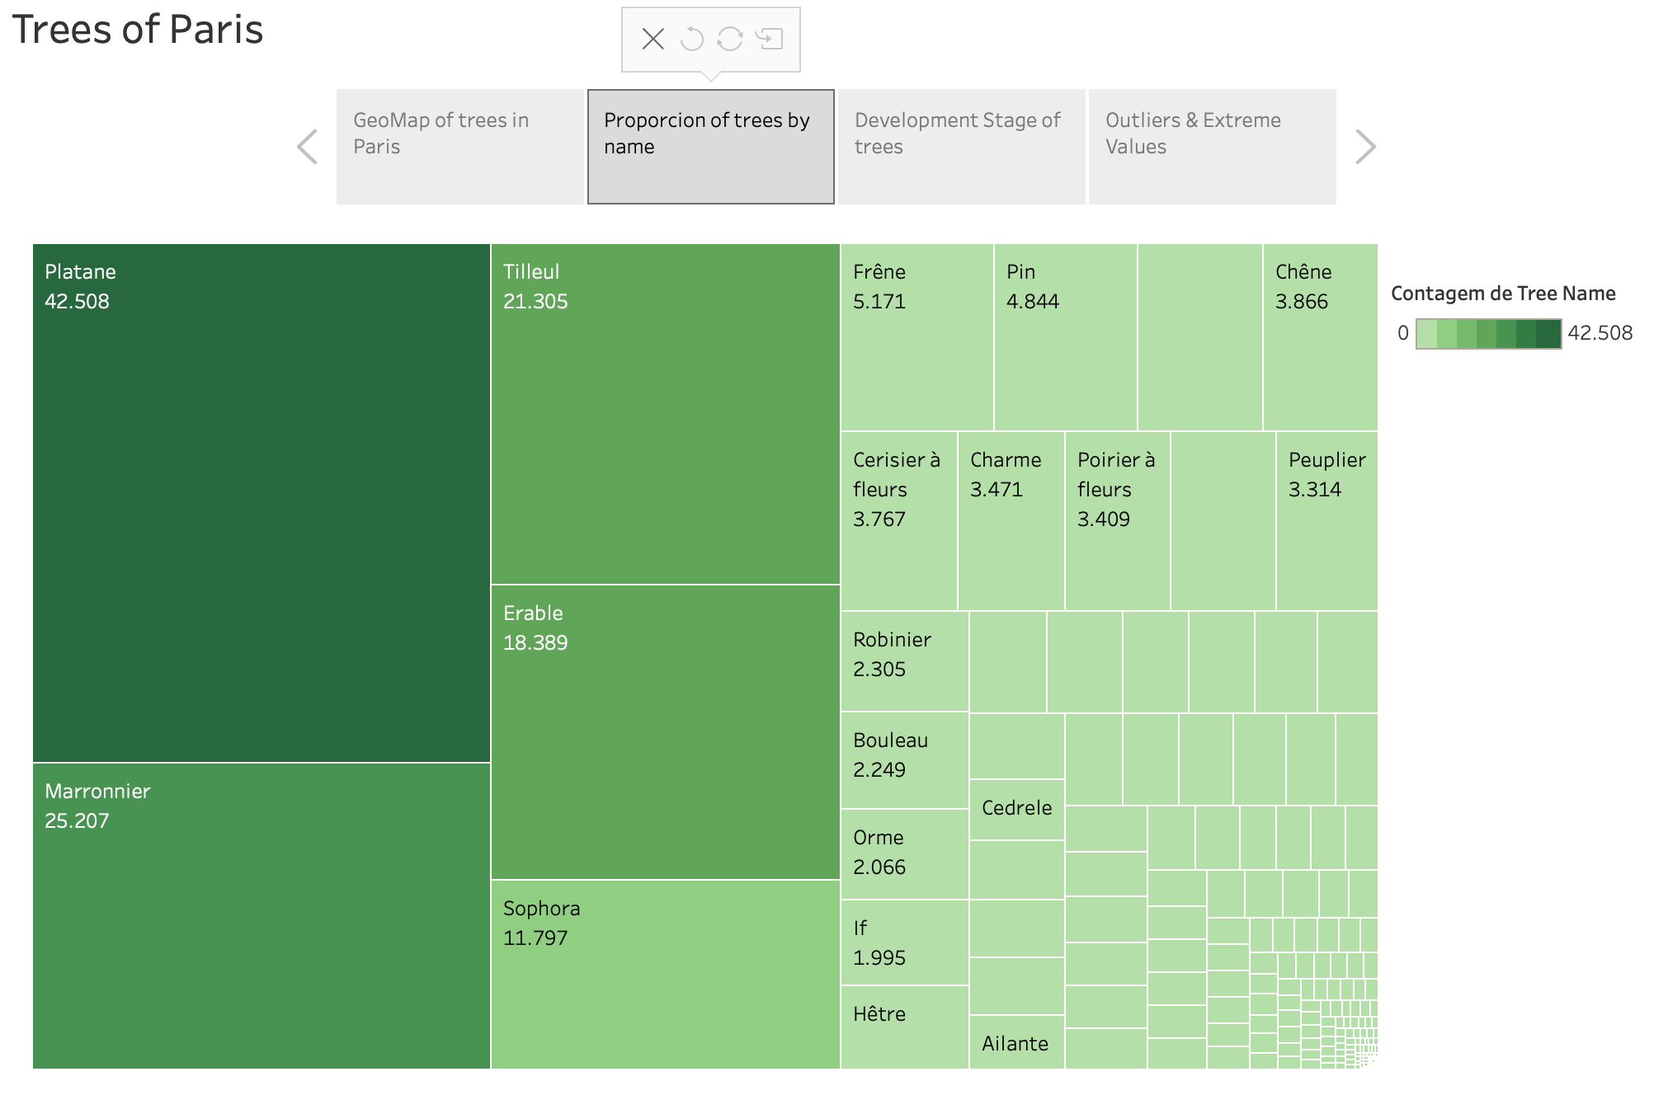
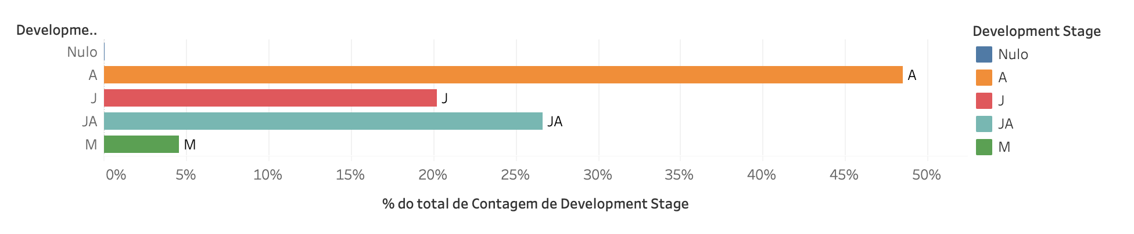
#04 – Data Visualization with Tableau Some great graphs I did using Tableau Software
With Tableau we can easily generate beautiful graphs
DDAA - OPENCLASSROOM - BNPP Data Science Foundations - Participate in a Smart City Contest
Nome – São Paulo, 22/04/2020

Slide 17
#04 - SUMMARY OF THE DATA ANALYSIS
What we’ve discovered…
Platane is the most popular tree in Paris (+40k).
There are a lot of tree species in this city, 539 to be precise,
The concentration of height and Circumferences:
For height between 1m and 40m
For circumference between 1cm and 500cm
The Dataset has wrong values like a tree with 250.255cm of circumference and another with 881.818 meter of height.
With the geographic map we can assume that Paris is a Wooded City, there are a lot of areas covered by trees, even though the city of Paris exists more than 3 thousand years.
DDAA - OPENCLASSROOM - BNPP Data Science Foundations - Participate in a Smart City Contest
Nome – São Paulo, 22/04/2020

Slide 18
Thanks!
😉
ANY QUESTION?
DDAA - OPENCLASSROOM - BNPP Data Science Foundations - Participate in a Smart City Contest
Evandro Demuth – São Paulo, 22/04/2020

