Slide 1
NSU FIT | Computing Platforms
Co-design Group Project
“The Game of Noughts and Crosses”
Lylova Sofia, Smolyakov Pavel, Badin Ivan
2022

Slide 2
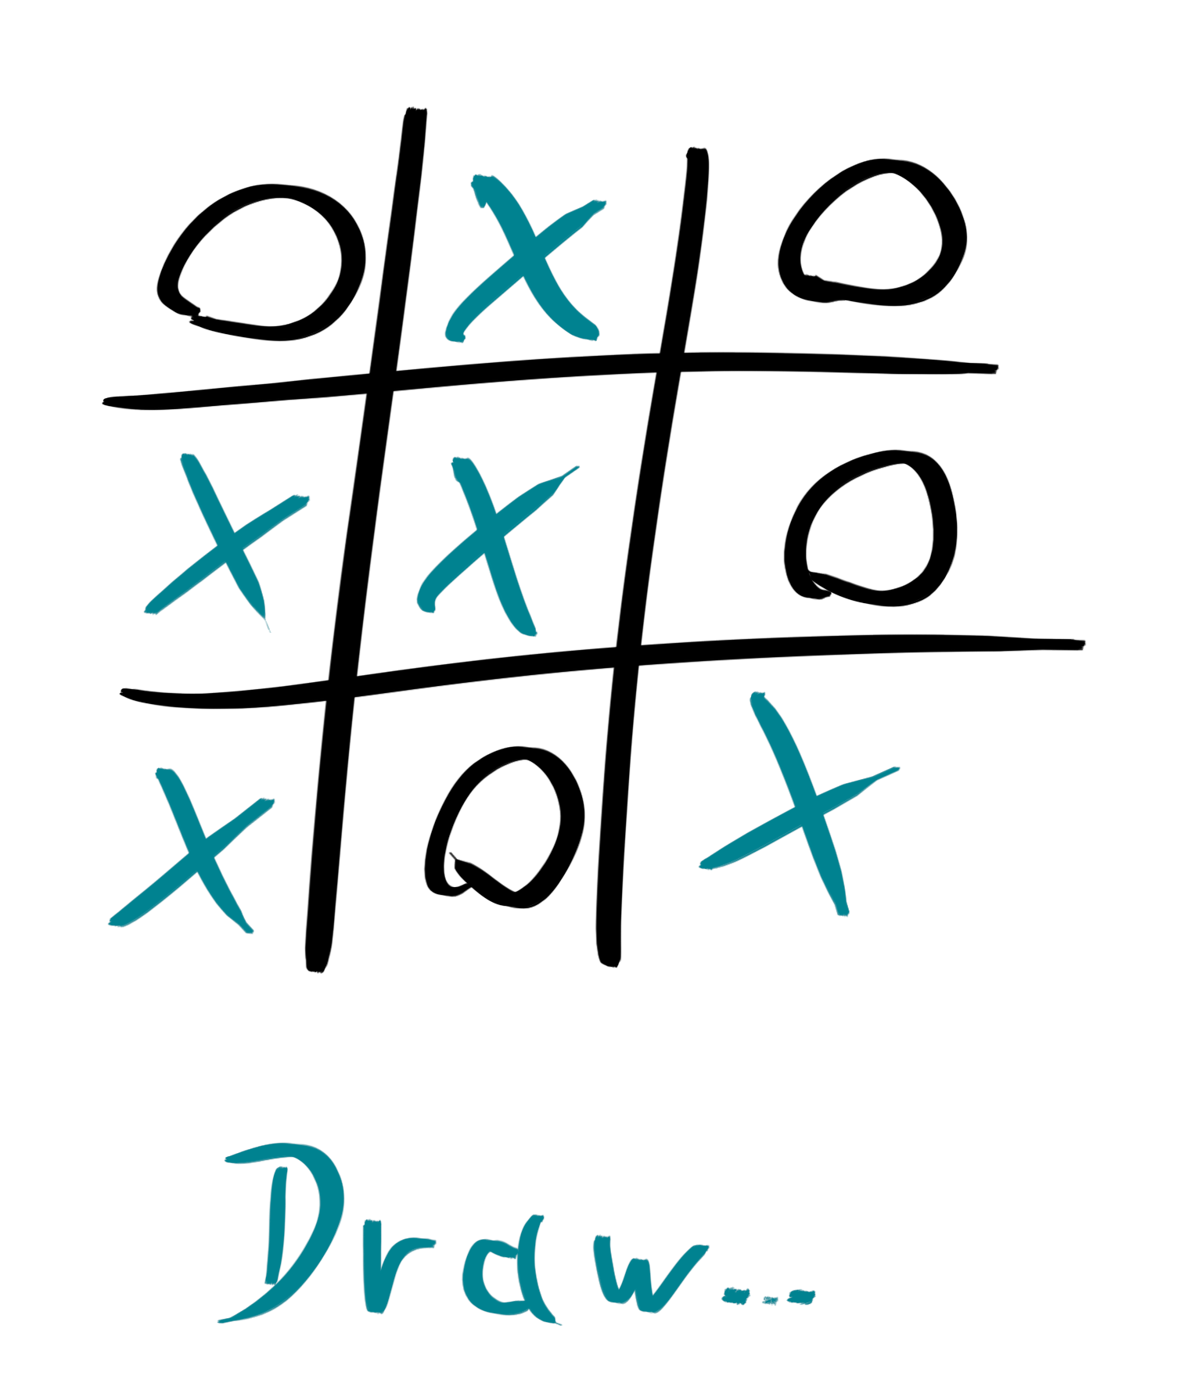
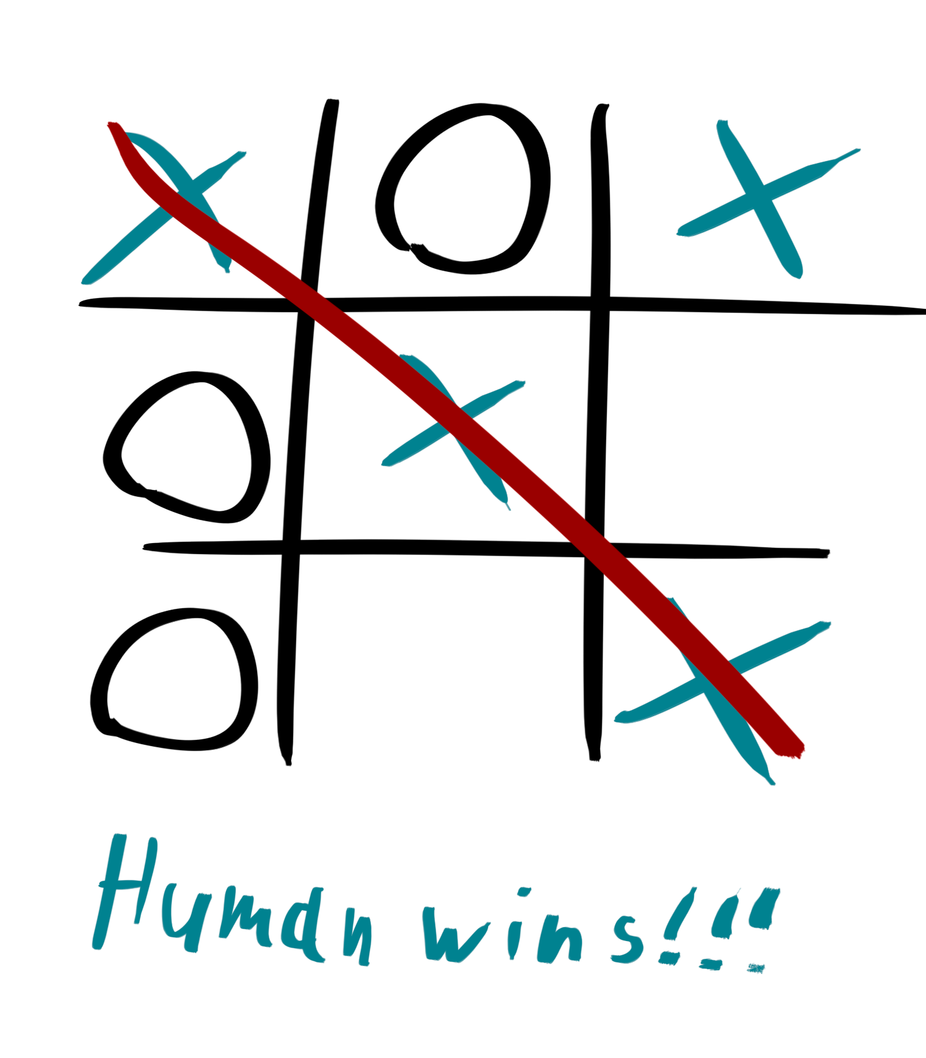
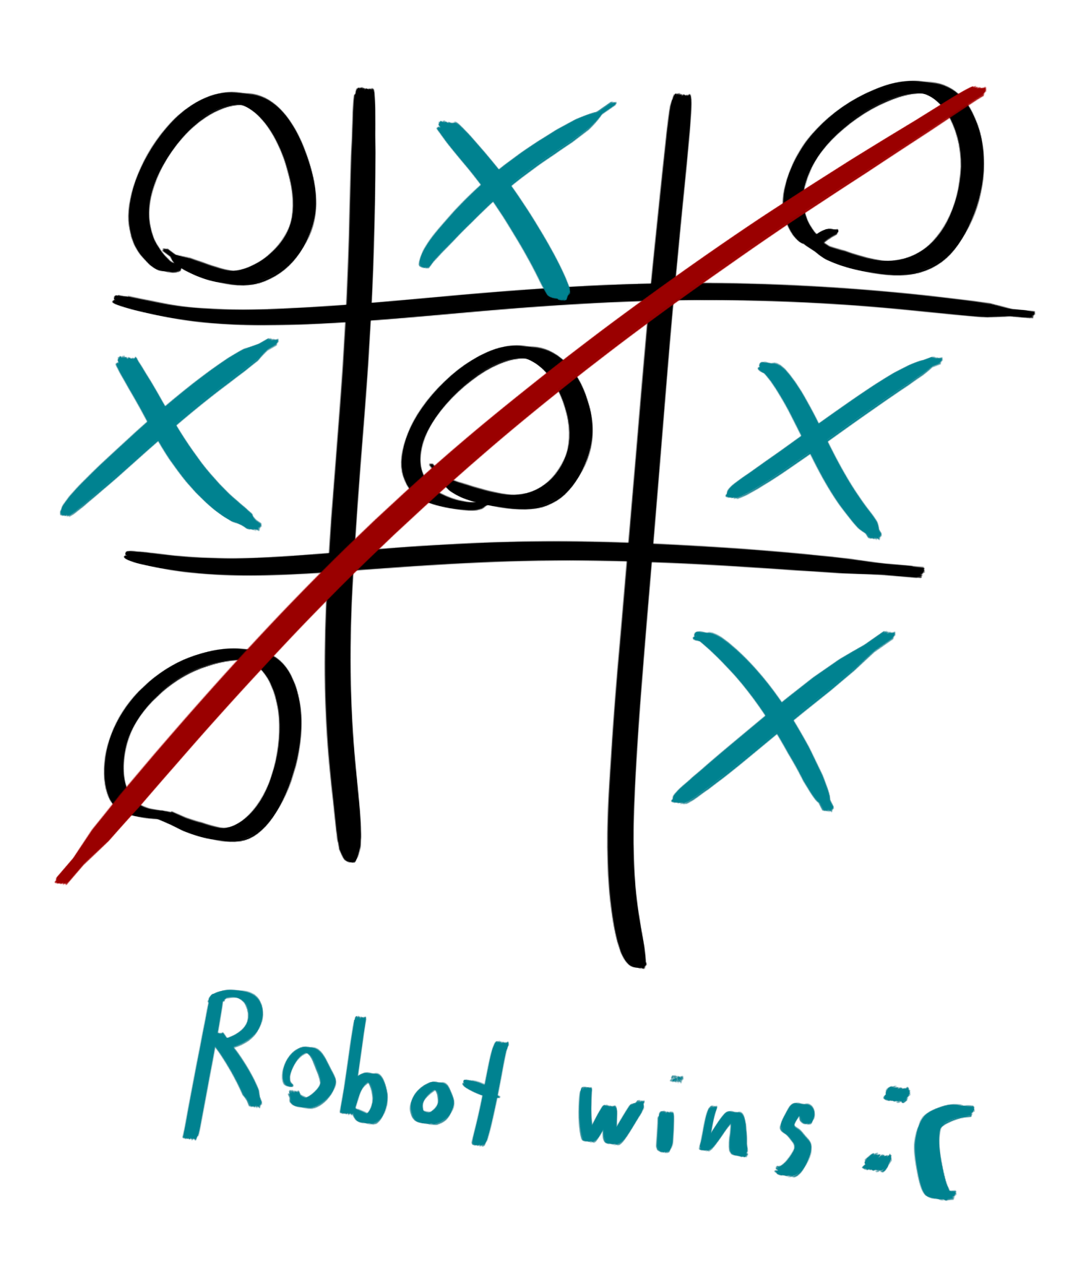
The Rules of the Game

Slide 3
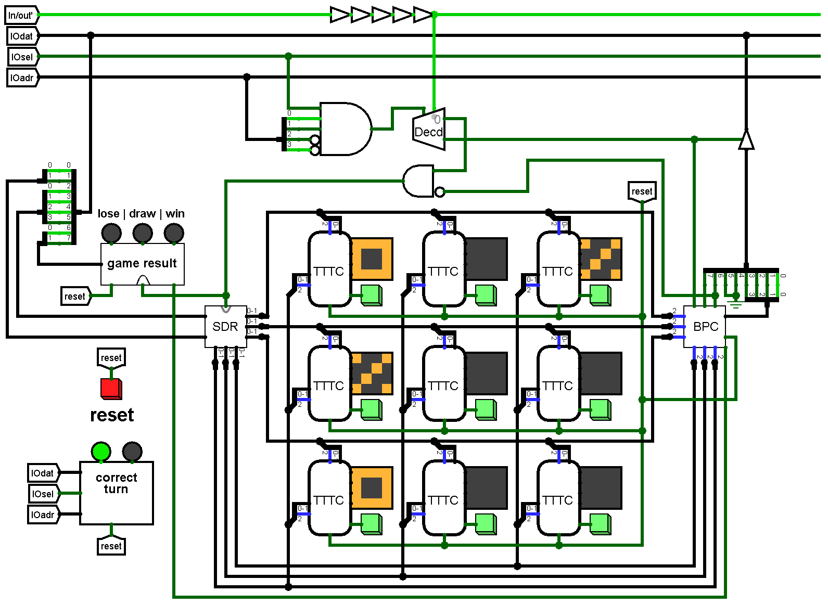
Hardware
Notes:
In the picture we can see our implementation of the game pad.

Slide 4
Hardware
Notes:
Each cell of the playing field is represented by an LED matrix and a green button. The button is used to select this cell.

Slide 5
Hardware
Notes:
We also have a red button labelled reset. When you click on it, the game restarts.

Slide 6
Hardware
Notes:
Above the “reset” button we have a game result chip connected to three diodes. Each diode corresponds to one result of the game, which is signed above the diode.

Slide 7
Hardware
Notes:
Under the restart button we have a “correct turn” chip that is connected to two diodes. One diode is red and other is green. If the green diode lights up, then turn is correct. If red lights up, then turn is incorrect.

Slide 8
Software
input handler
output handlers
game state checker
AI player
main loop, which connects everything together
Notes:
Generally, software part of tic-tac-toe implementation consists of input handler, two output handlers, game state checker, AI player and a main loop, which connects everything together.

Slide 9
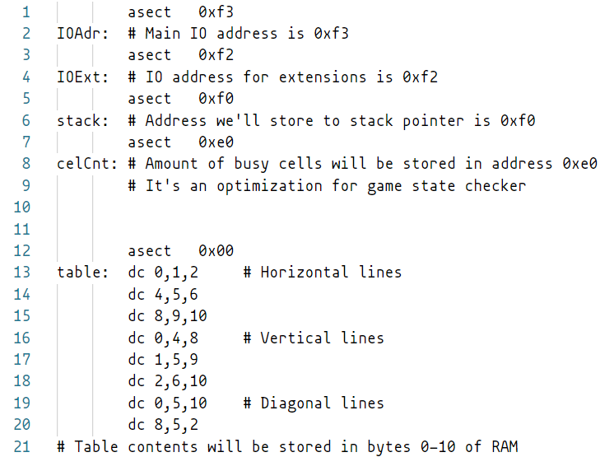
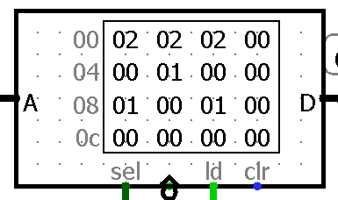
Memory planning
Notes:
Table is located in first 10 bytes of RAM (pic).
We use two IO addresses (one is enough for main functionality, but not our extension).
Also, we store amount of busy cells in a dedicated address.

Slide 10
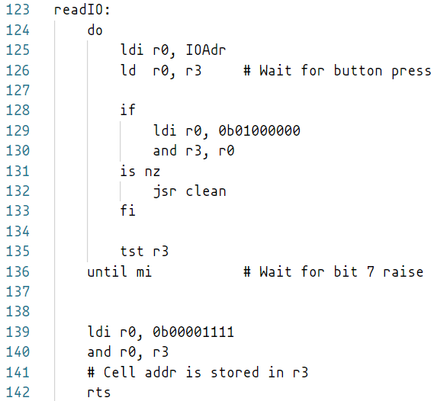

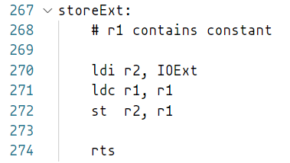
Input/output
Notes:
Main input handler waits until button is pressed (specifically it waits until bit 7 is set to 1).
Our extension clears game field up if bit 6 is set to 1 (specifically reset button is pushed).
Main output handler just stores 8-bit string, from zero to seven it’s 2-bit symbol ID, 4-bit X and Y coordinates, 2-bit game state.

Slide 11
Game state checker
it exists.
Notes:
We optimized the code a bit, so if we have less than 5 cells used (it means that we have less than 3 both crosses and noughts) we keep playing.
Otherwise it goes through the table and tries to find a line of three noughts or crosses.

Slide 12
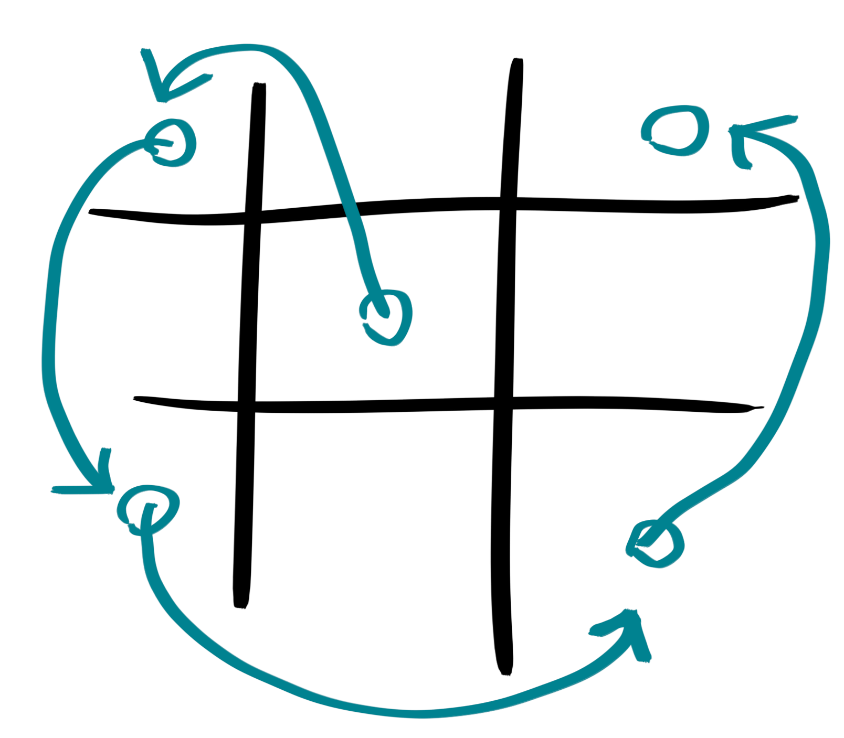

AI player
Notes:
Our genius AI player is not smart enough to participate, so he follows prepared route, which minimizes amount of strategies human player can use: first he tries to take center, then - corners. You can see this route on this slide.

Slide 13
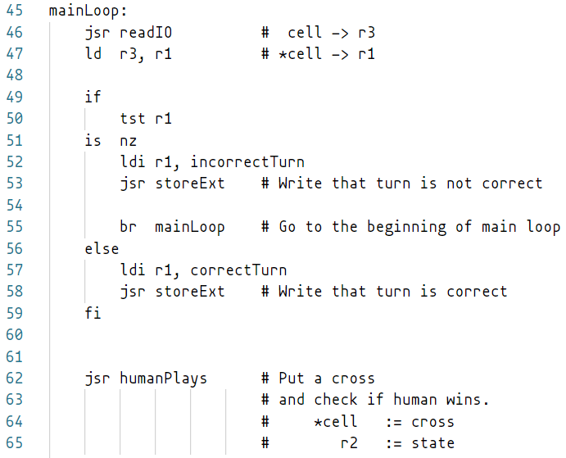
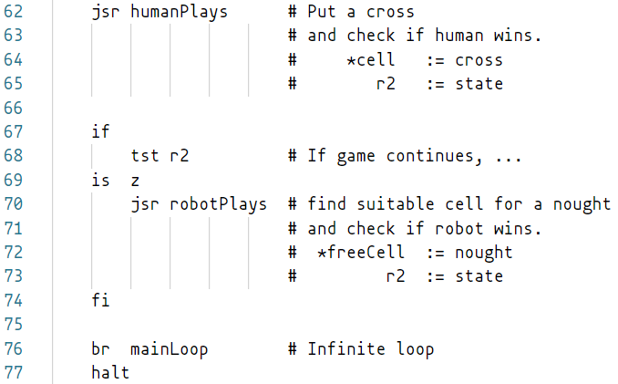
Main loop
Notes:
And here is the main loop - it just connects all previously described parts.

Slide 14

All resources can be found in our GitHub repository:
https://github.com/evangelionexpert/cdm8-tictactoe

Slide 15
Thanks for your
attention!

