Slide 1
Sample Web Application Gallery

Slide 2
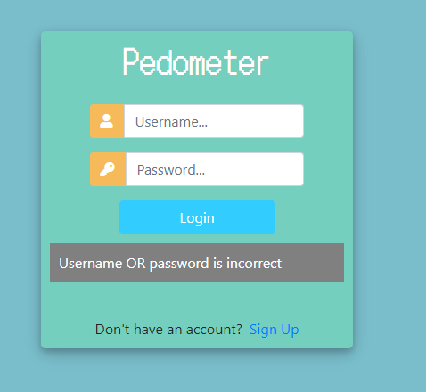
Log in page
On this page the user logs in if they already have an account, or registers if they do not.
At this point validation runs to check the submitted username and password against the user list in the database.

Slide 3
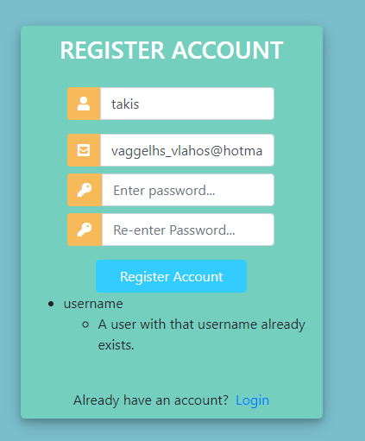
Register Page
On the register page the user enters their personal information. If the form is valid and the chosen username and password are accepted, the user is redirected to the login page.

Slide 4
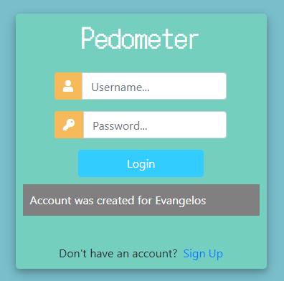
Log in page
A message confirms that the account has been created, and then we wait for the user to enter their credentials.

Slide 5
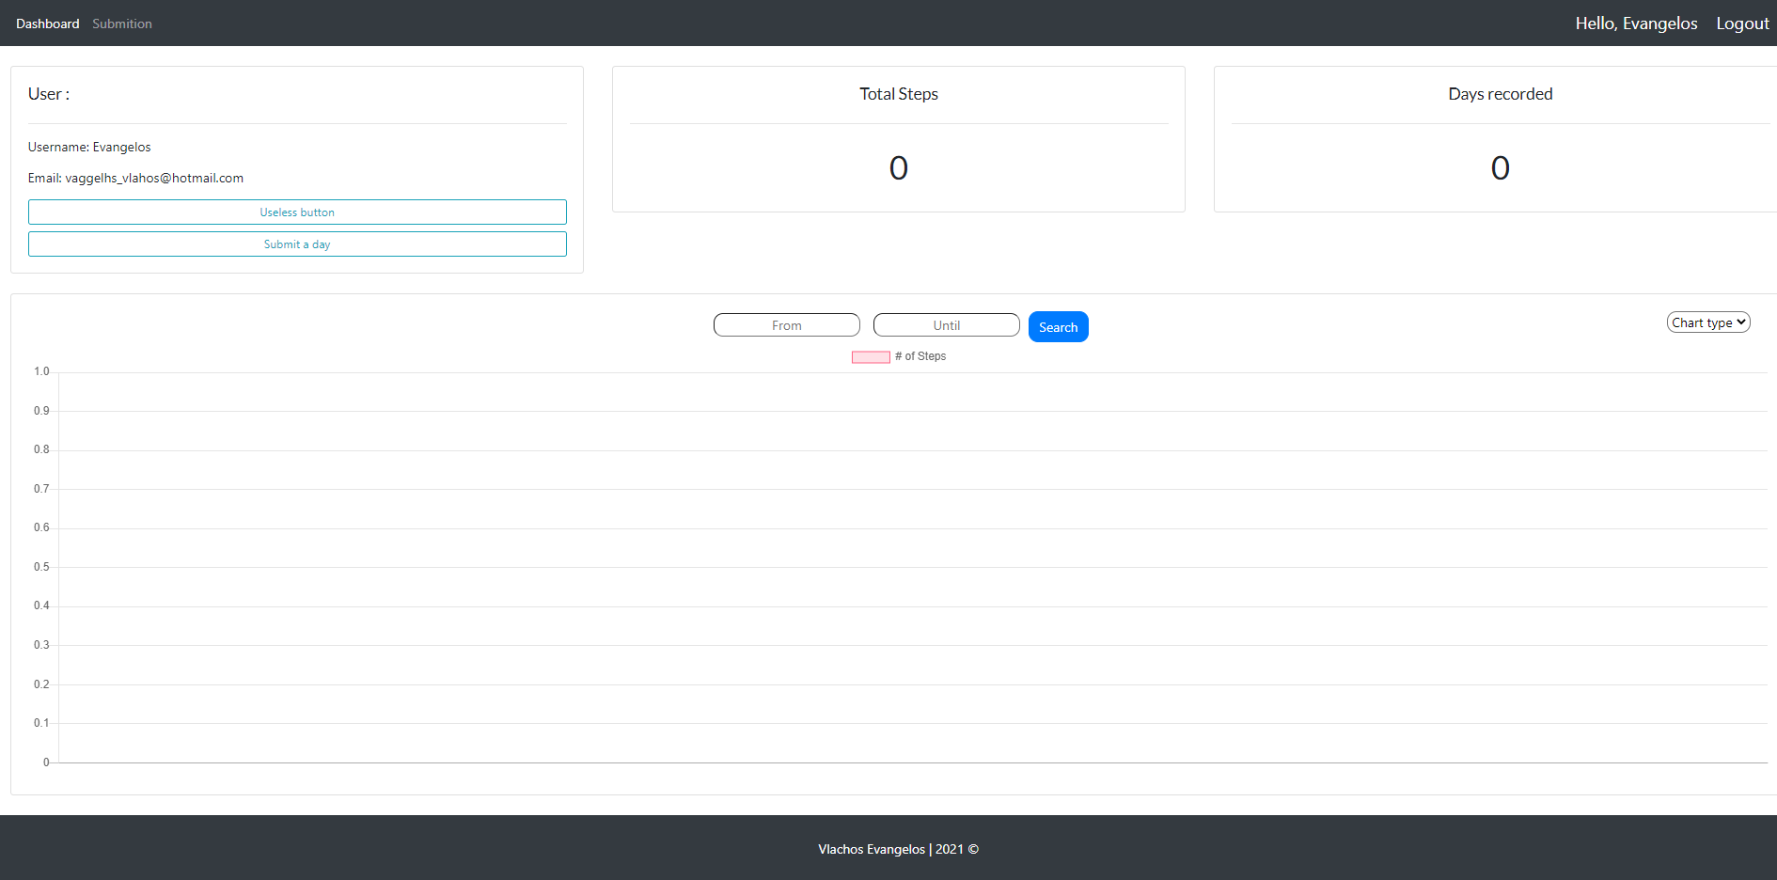
Dashboard
This is the main dashboard the user lands on after logging in. A navbar lets them switch between the dashboard and the create-record page, and the top section shows information about the user.
In the middle the main content
And on the bottom a simple footer.

Slide 6
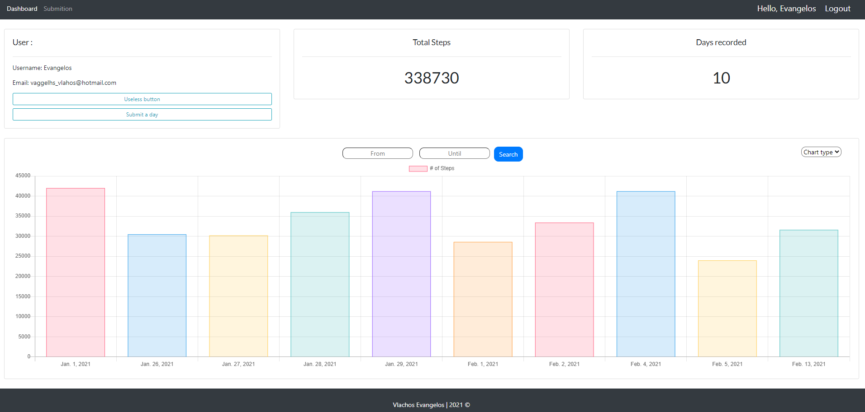
Dashboard
After a few manual insertions, the chart already shows the steps recorded over the past days.
The user’s information updates dynamically from the database, and so does the chart data.

Slide 7
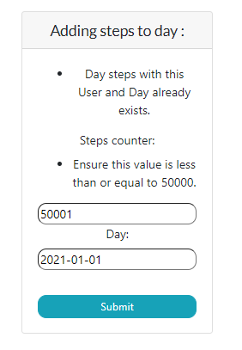
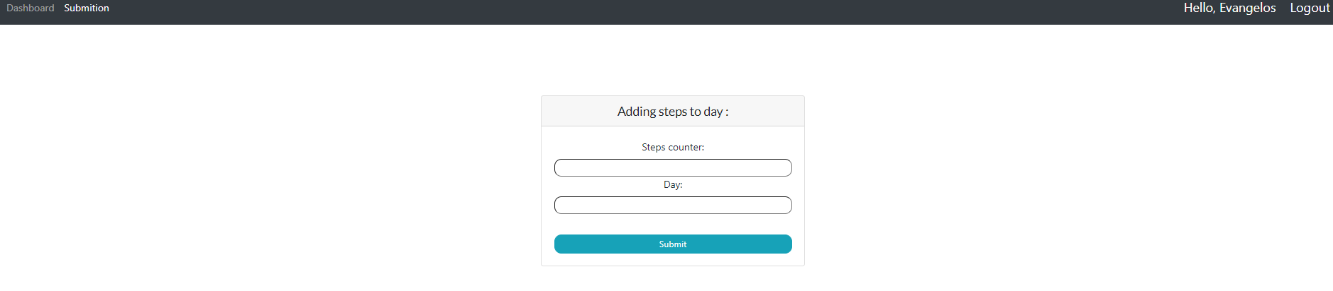
Submitting Day’s Steps
At the end of a day the user can add their step count.
The user cannot add steps twice for the same day, and the step count must be between 0 and 50,000.

Slide 8
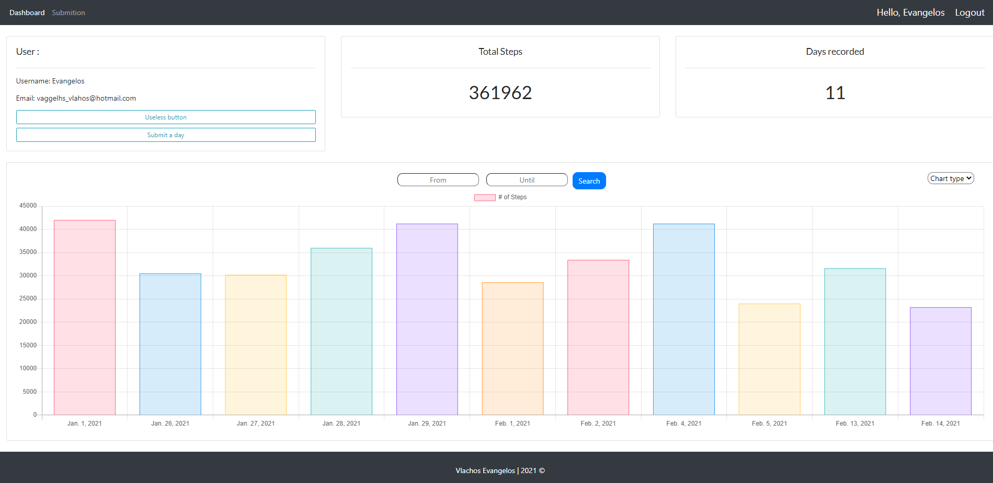
After Submission
The user has successfully added another day of steps.
They can now use the chart-type selector to change how the data is displayed.

Slide 9
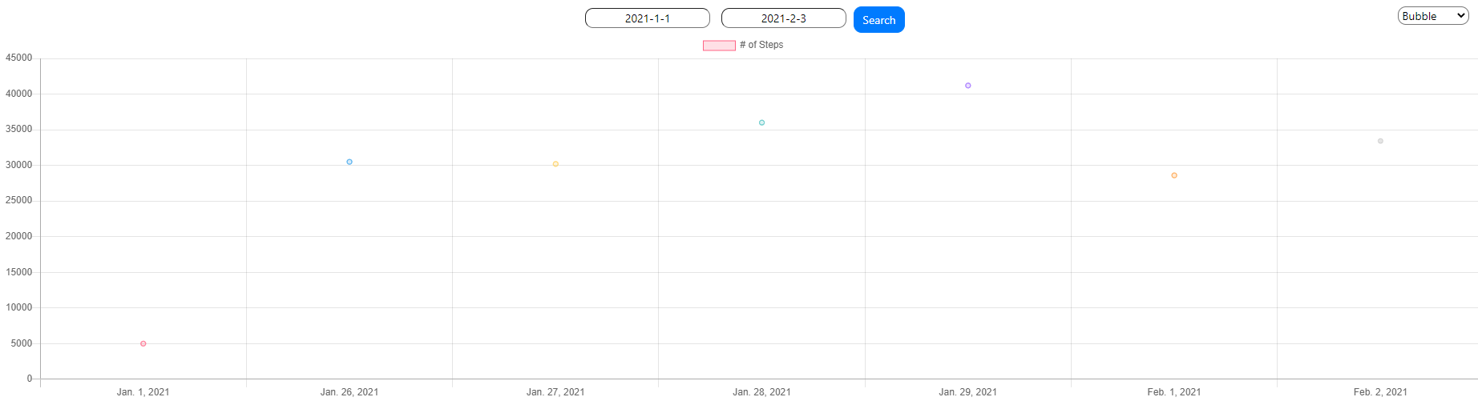
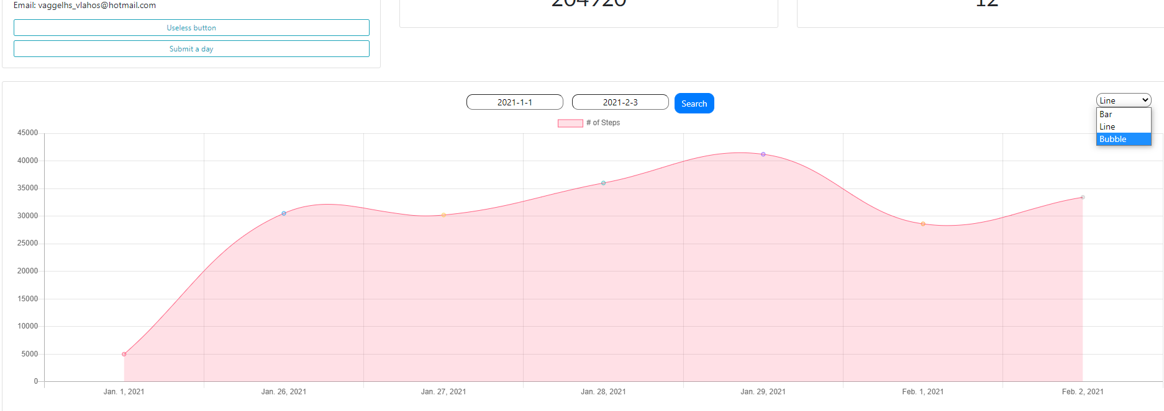
Bubble chart:
Line chart:

Slide 10

Filters
Finally, the user can filter by a specific time period to view the statistics for that range. The charts refresh automatically, just like when the chart type is changed.
Code on github Repository: https://github.com/evangelosvlachos96-dotcom/step-tracker

