Slide 1
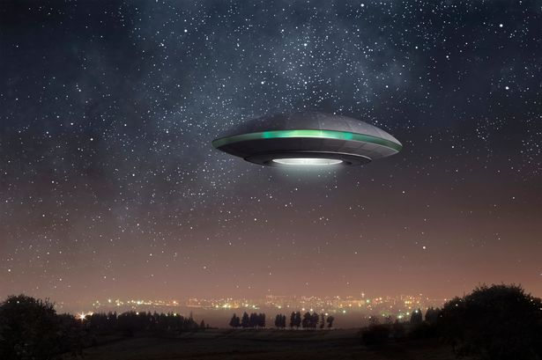
AROUND THE WORLD IN 80 PROBES
AN ANALYSIS OF UFO SIGHTINGS AROUND THE WORLD IN THE LAST CENTURY
DISCLAIMER: NO PERSON OR PERSONS WERE PROBED IN THE MAKING OF THIS PRESENTATION

Slide 2
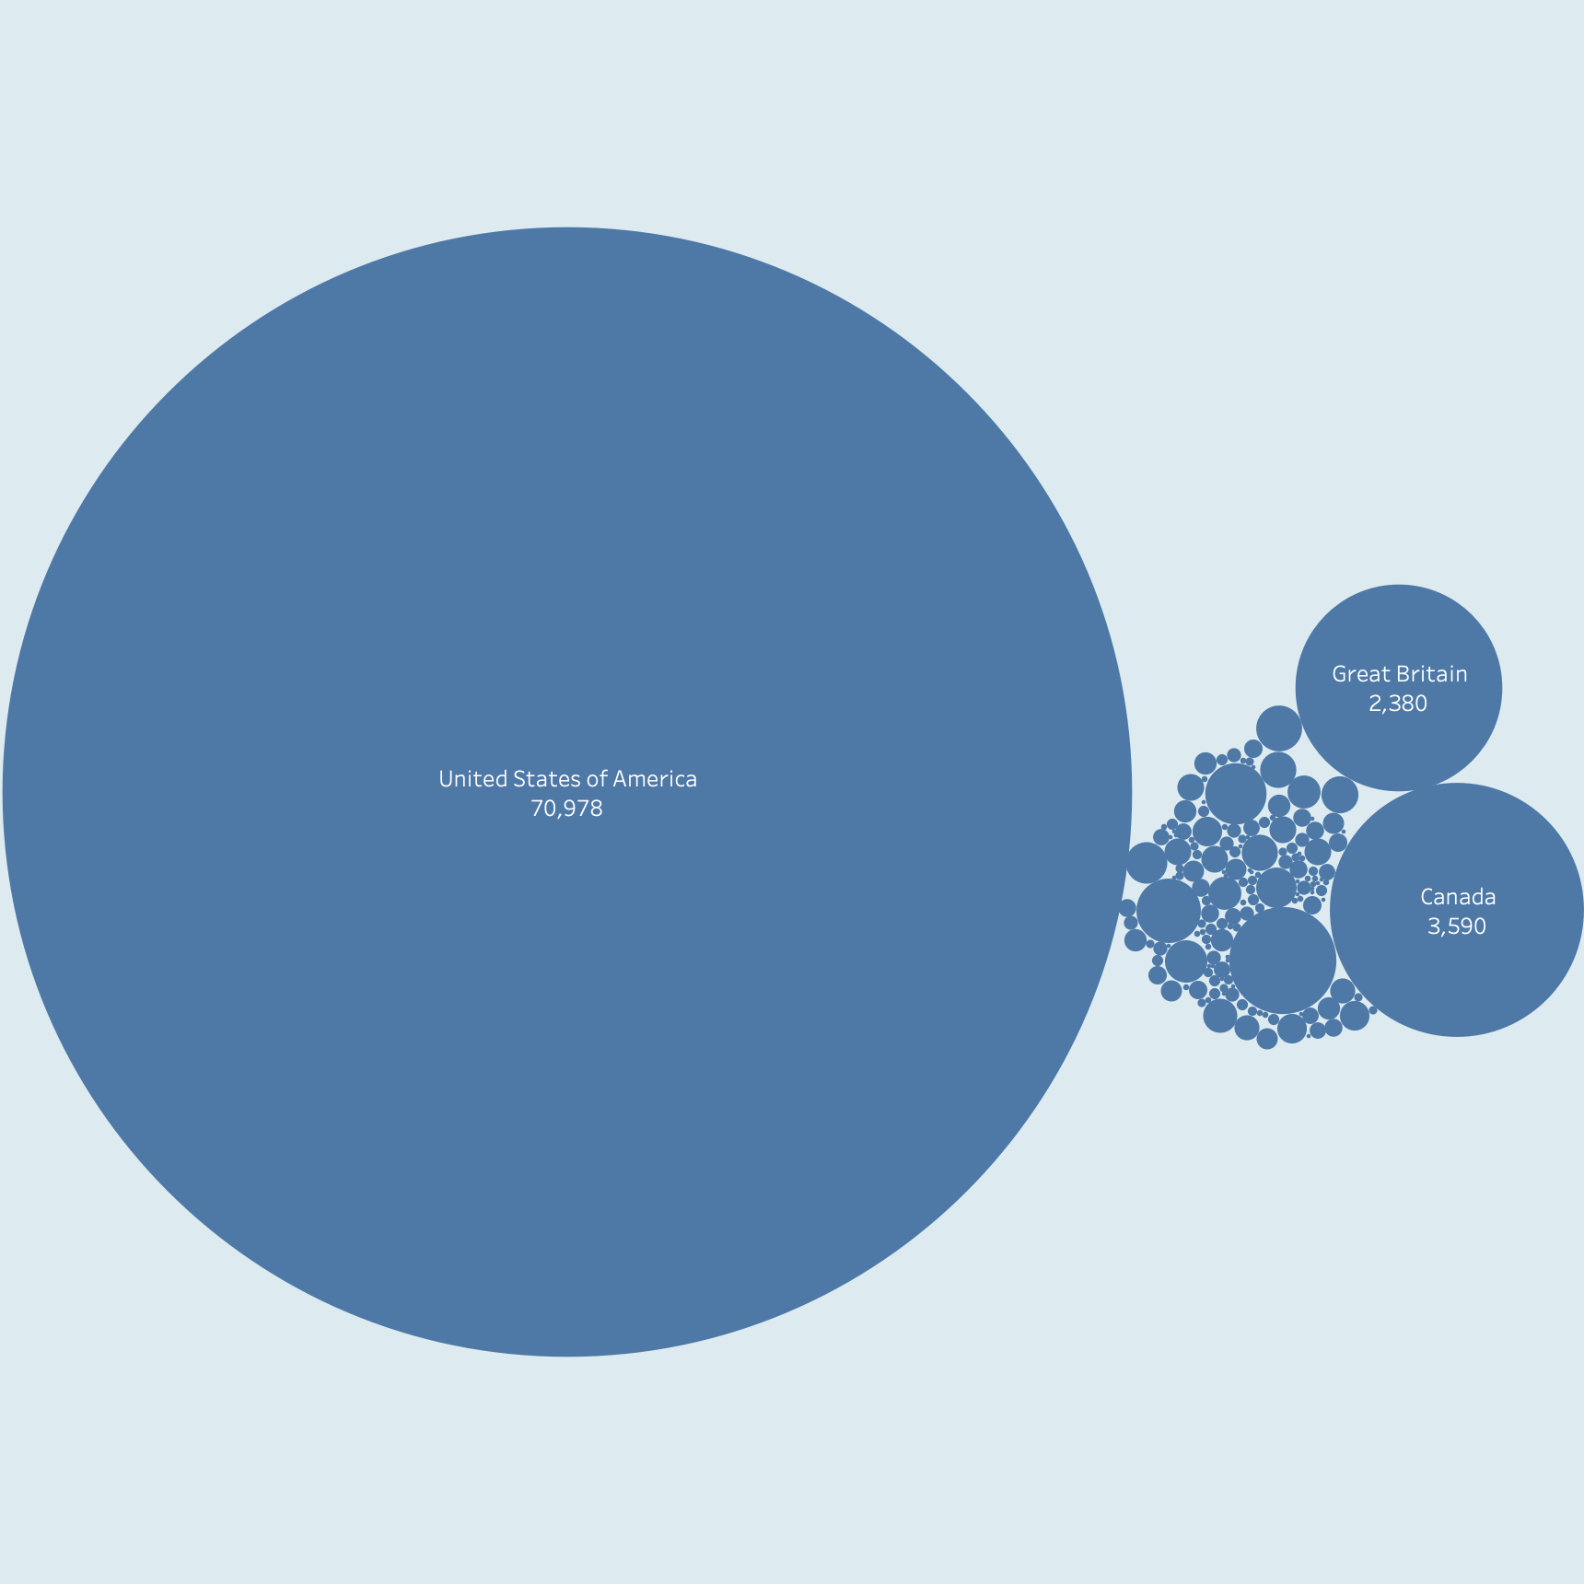
- What factors contribute to UFO sightings? - What do people see? - And seriously… Why America?

Slide 3
First an overview

Slide 4
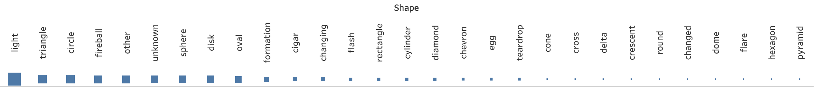
First an overview
What are they seeing?

Slide 5
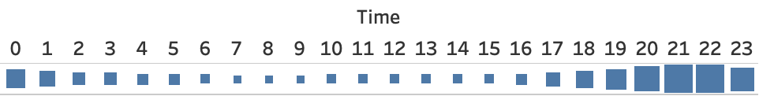
First an overview
What are they seeing?
When are they seeing it?

Slide 6
This raises some final questions
If most sightings are at night, will the seasons affect sightings?
Will the sightings be higher in winter when it is darker longer?
And if the main sighting is light, will that also mean a higher count in the winter due to the high reflectivity of snow?

Slide 7
What are the challenges facing this analysis?
Not all sightings get reported
No knowledge of the information gathering process
A study like this is not guaranteed to have any patterns at all
It is difficult to predict overall global patterns when there is one dominating country skewing the rest of the data

Slide 8
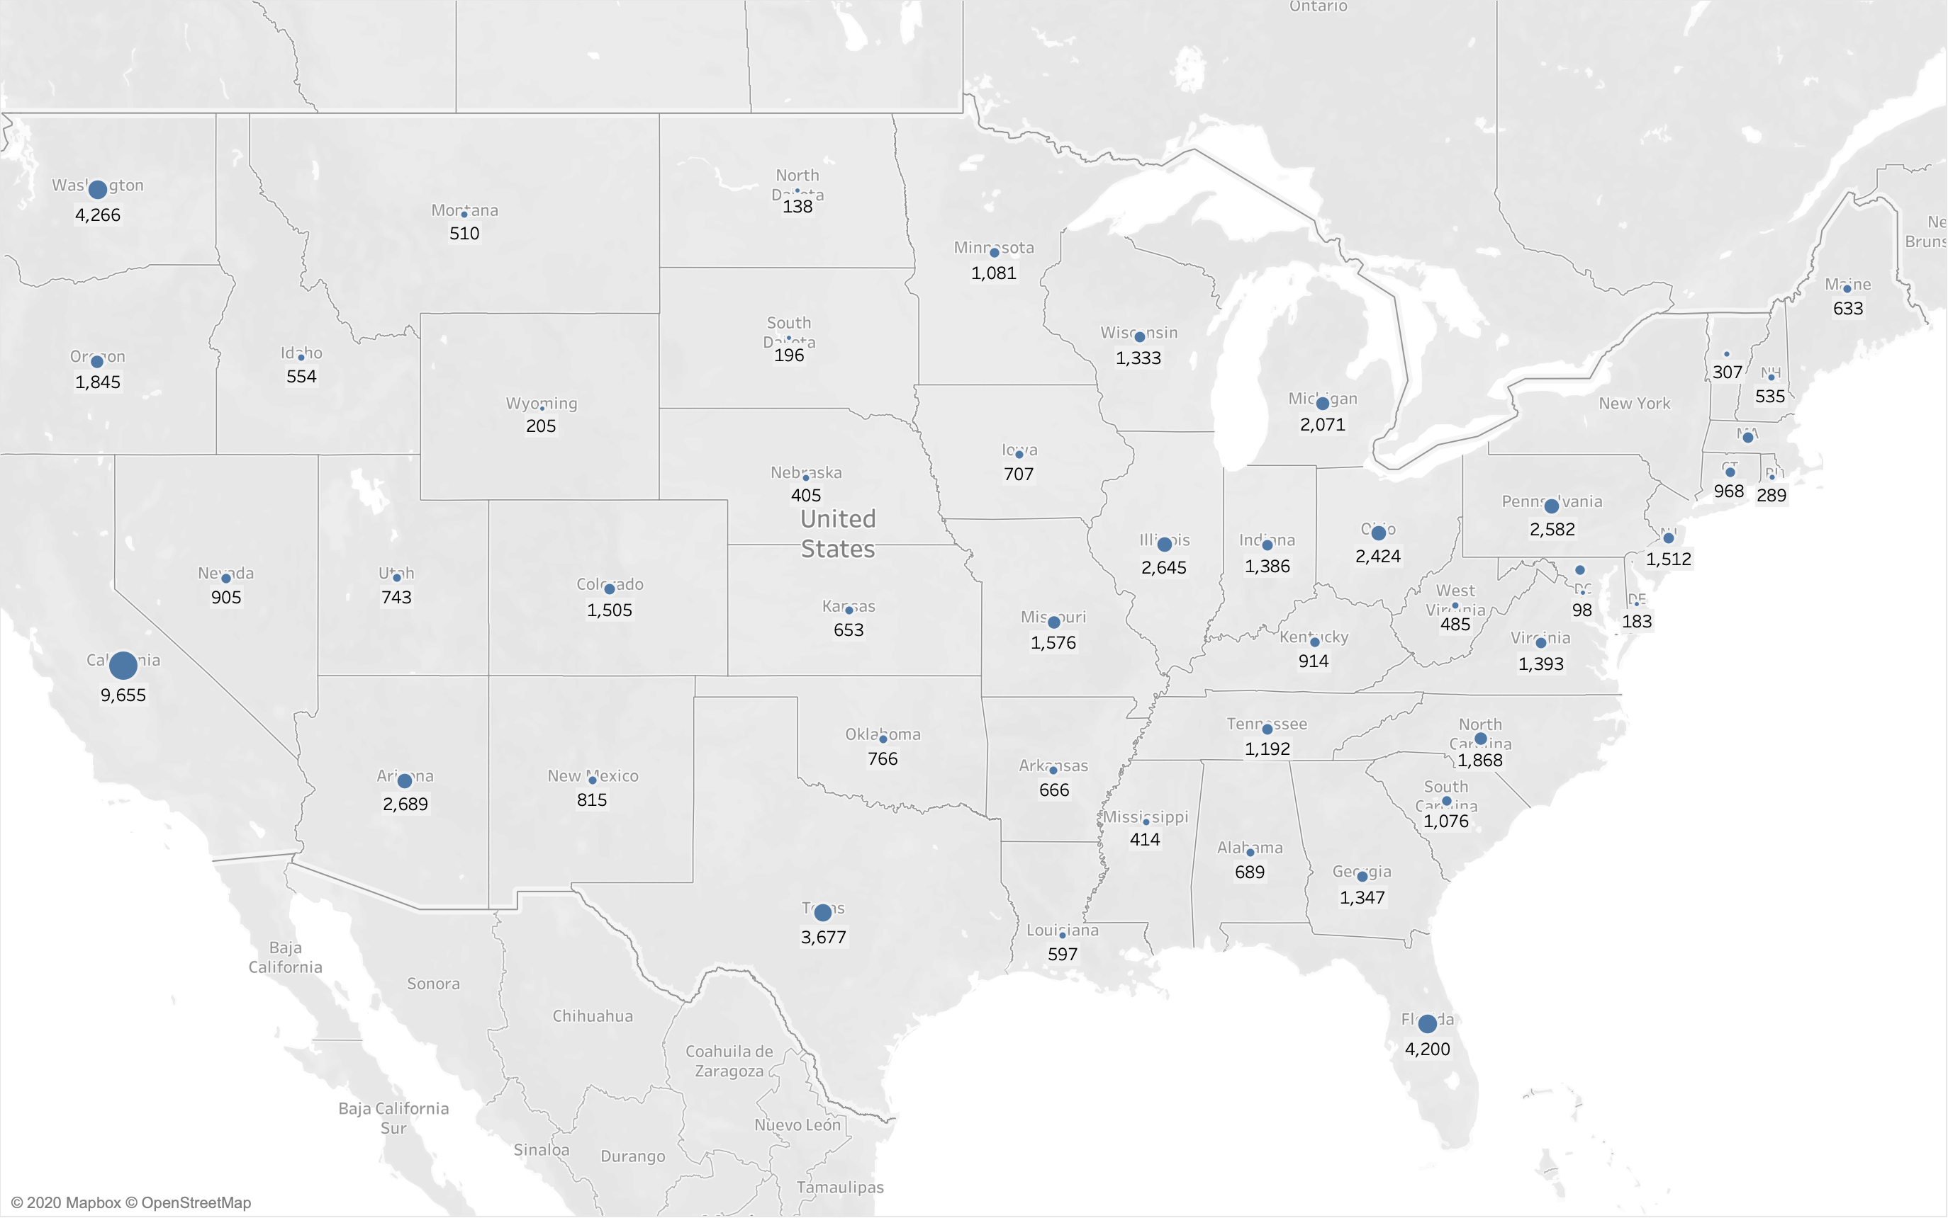
So let us focus our attention on the country with over 88% of the sightings

Slide 9
A cursory glance shows sightings higher near large bodies of water
Let’s take a closer look at the western coast

Slide 10
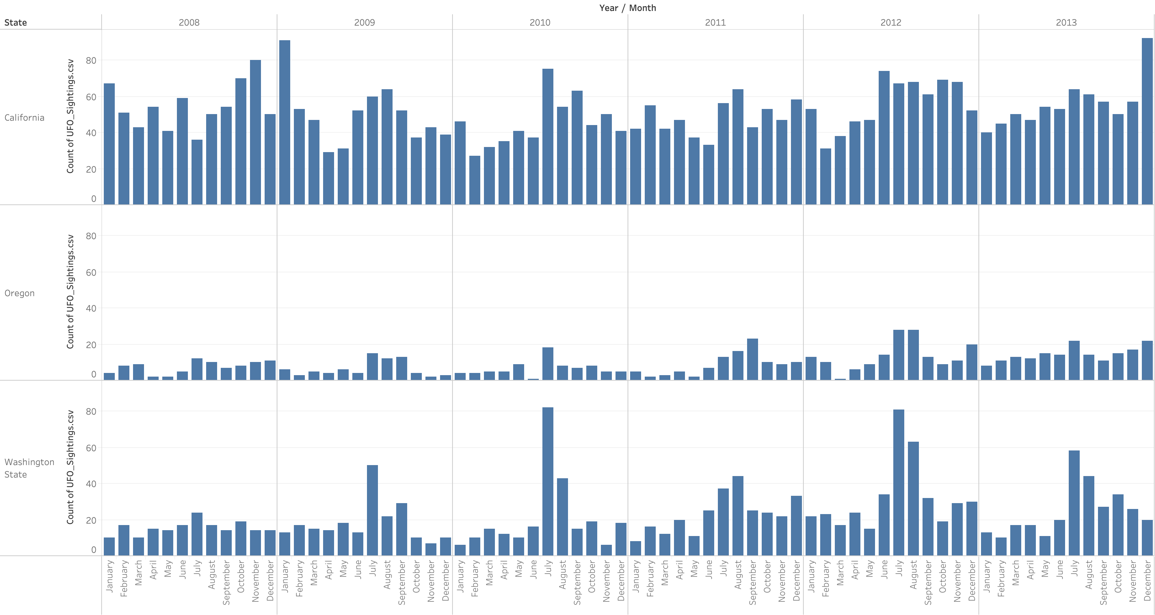


Slide 11
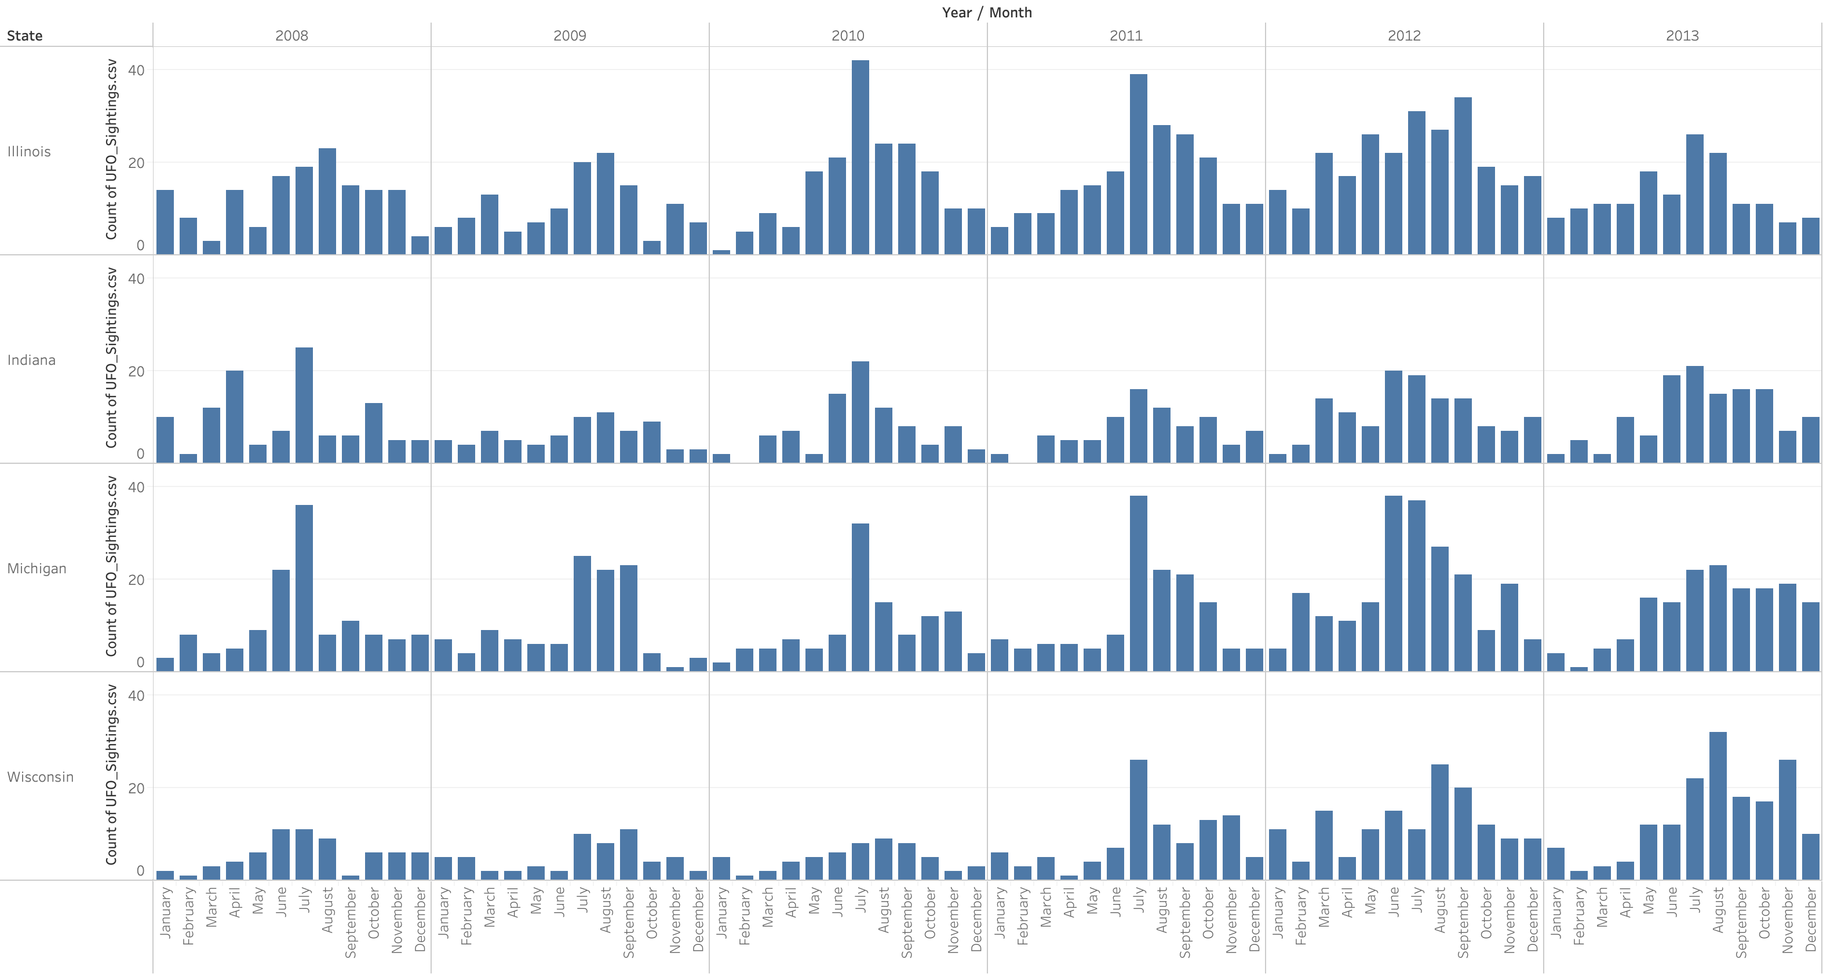


Slide 12
Is this trend reflective of the entire country?
My previous postulate was that because most sightings happened at night, we should be seeing a spike in wintertime when it is darker for longer periods of time

Slide 13
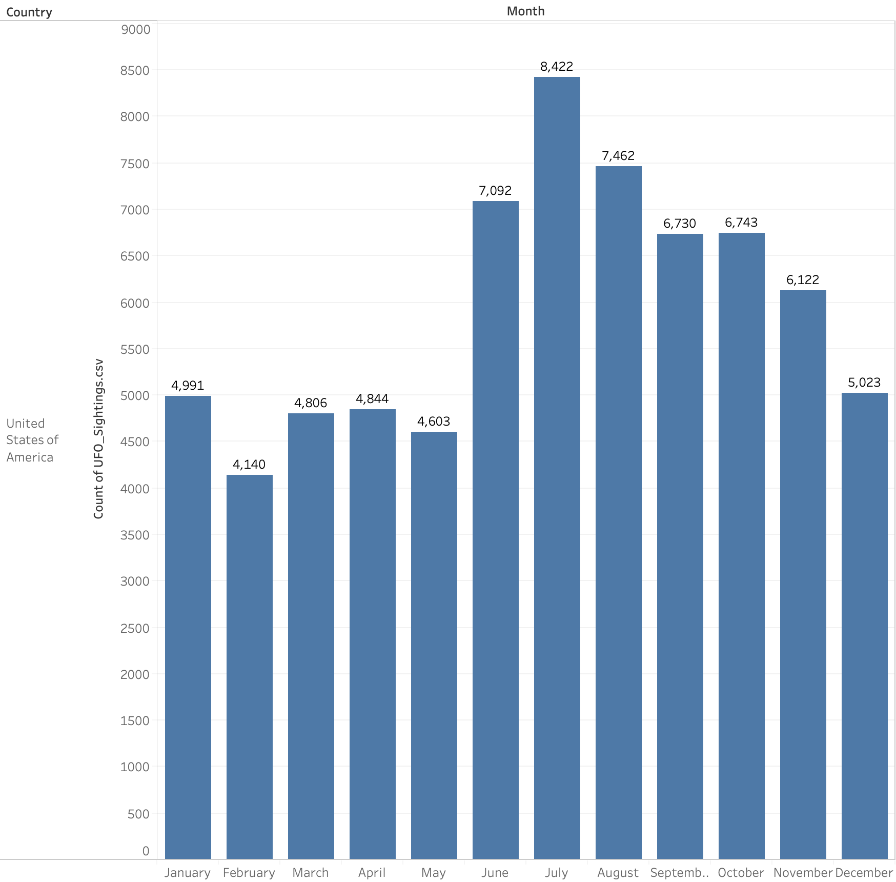
Is this trend reflective of the entire country?
My previous postulate was that because most sightings happened at night, we should be seeing a spike in wintertime when it is darker for longer periods of time

Slide 14
Since this trend is country wide it is unlikely that local weather, altitude or terrain will tell us why more sightings happen in the summer
Instead let’s look into why the most popular sighting is light
Since many of the states with higher counts were on the ocean, do lighthouses contribute to UFO sightings?

Slide 15
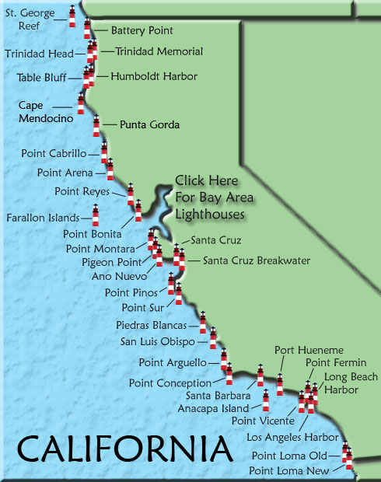
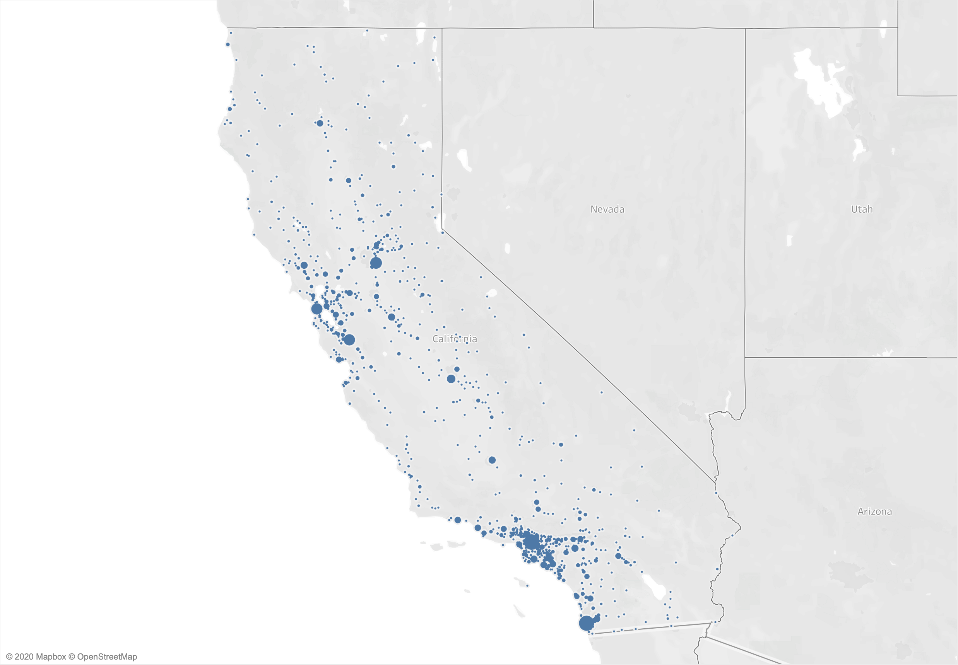







Slide 16
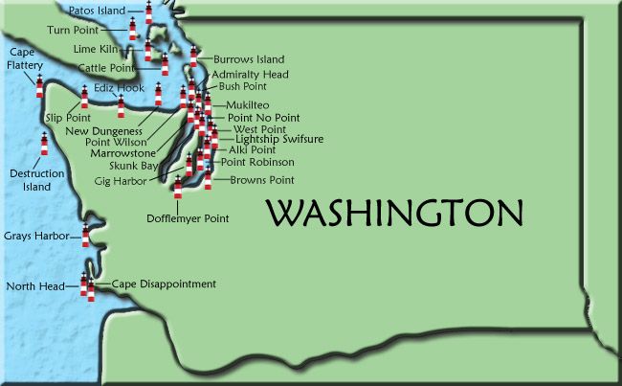
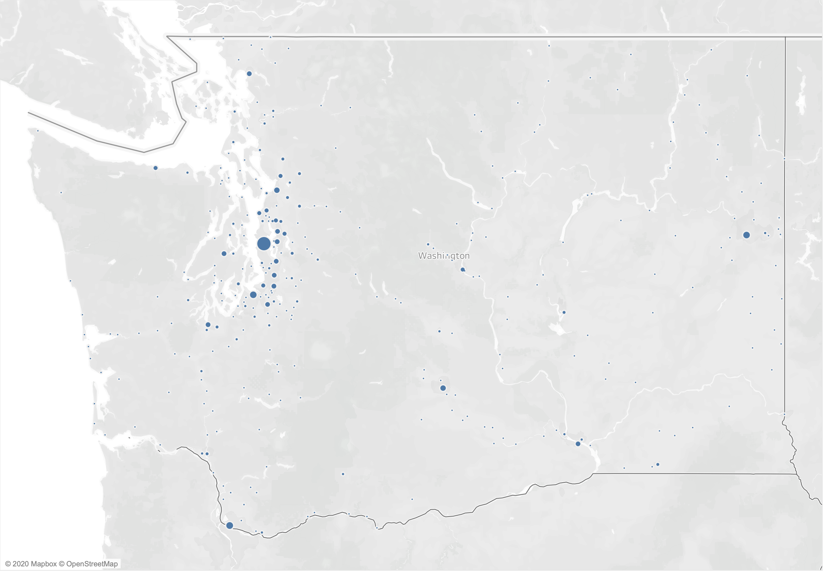




Slide 17
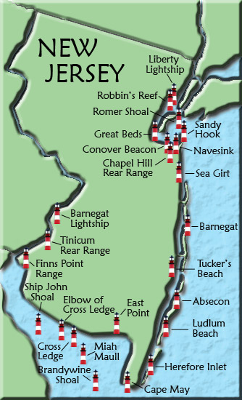
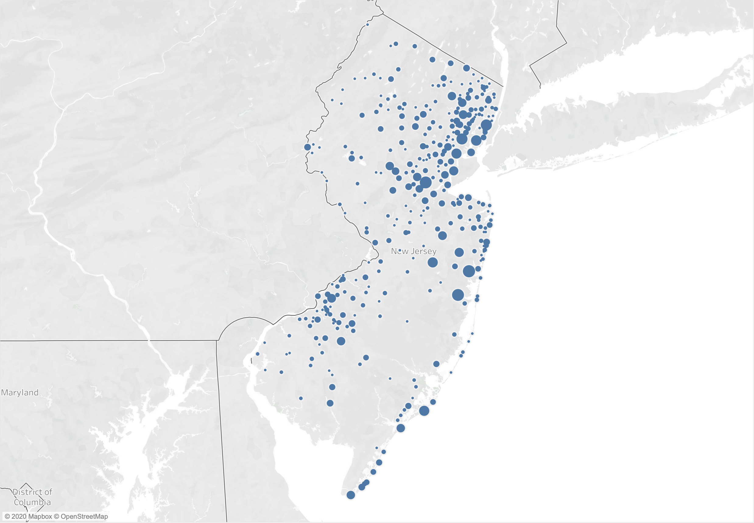




Slide 18
Conclusions
Lighthouses seem to play a large role in UFO sightings, which could be due to common coastal weather like fog obstructing visibility
Optical illusions from the horizon could also play a part in the higher summer sightings

Slide 19
Appendix
Lighthouse maps courtesy of https://www.lighthousefriends.com/index.html

