Slide 1
Database contains the minimum number of tables to offer the features we have implemented in our day 1 launch version of the product
test_sample | Datatype
TID | int(Primary)
UID | int(Foreign)
serial_number | int(20)
test_date | date
result | int(1)
is_signed | boolean
user_profile | Datatype
UID | int(Primary)
username | varchar(25)
password | varchar(64)
fname | varchar(25)
lname | varchar(25)
dob | date
ssn | int(10)
permission | int(1)
login_logs | Datatype
LLID | int(Primary)
UID | int(Foreign)
login_date | date
is_successful | int (1)

Slide 2
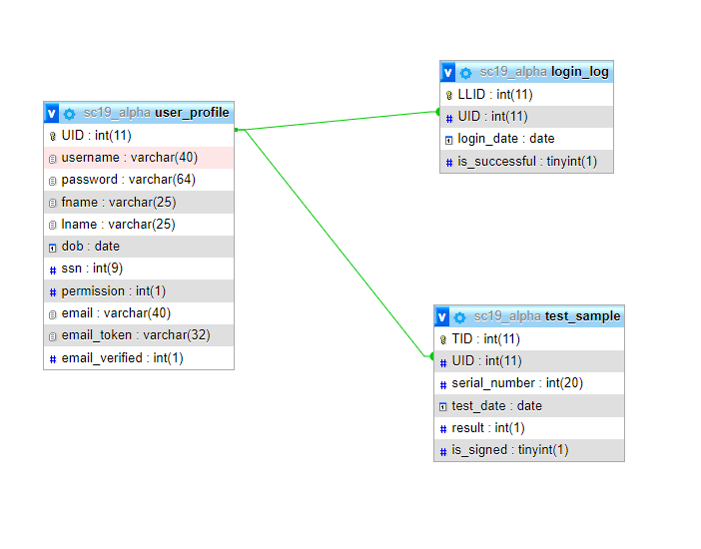
Database contains the minimum number of tables to offer the features we have implemented in our day 1 launch version of the product
user_profile | Datatype
UID | int(Primary)
username | varchar(25)
password | varchar(64)
fname | varchar(25)
lname | varchar(25)
dob | date
ssn | int(10)
permission | int(1)
login_logs | Datatype
LLID | int(Primary)
UID | int(Foreign)
login_date | date
is_successful | int (1)
test_sample | Datatype
TID | int(Primary)
UID | int(Foreign)
serial_number | int(20)
test_date | date
result | int(1)
is_signed | boolean

Slide 4
Reasoning for use of tables and minimizing database…
Creating additional tables to store more user profile data was not the most efficient use of the database:
We considered separating the user permissions into another table but realized that user permissions can be a simple flag on the account.
We can track the user session by tracking the user’s permission flag in a session variable, thus forming the permission “profile” that follows them through the software product
We considered separating user_login (username/pw) and user_profile (fname, lname, etc) into 2 separate tables but, again, we realized that unnecessarily splitting data across multiple tables is not efficient database design when the user_profile can store all data associated with the user

Slide 5
Future iterations of the product will use additional tables for planned features if they are required
A planned feature is email verification for password reset
This can utilize the already existing email_token field in the user_profile table and therefore does not require another table be created
A planned feature is maintaining inventory of test vials
Test vials, to be purchased from vendor company, will come from vendor with pre-set serial numbers which should be maintained in the system prior to the employee ever giving a sample out to a patient
After implementation of this feature, the employee’s “test sample submit” form will ensure that the serial number is that of a valid vial before allowing the test sample to be submitted
This can likely require another table for test_sample inventory where the serial number is the primary key, thus requiring the existing test_sample table to have the serial number as a Foreign key (index) from that other table

