Slide 1
Cupboardly
Weekly Report for 4/3/2026

Slide 2
Image Saving
We confirmed the images were being saved
They aren’t being saved to the phone’s camera roll, but in a different folder in the phone’s files
/storage/emulated/0/Android/data/com.seniorproject.cupboardly/files/Pictures/

Slide 3
Image Processing
We have text detection working using MLKit
BitMap vs Full Image – we chose full image for higher resolution, but that means we need to temporarily save the image
We still need to delete the image after processing is complete

Slide 4
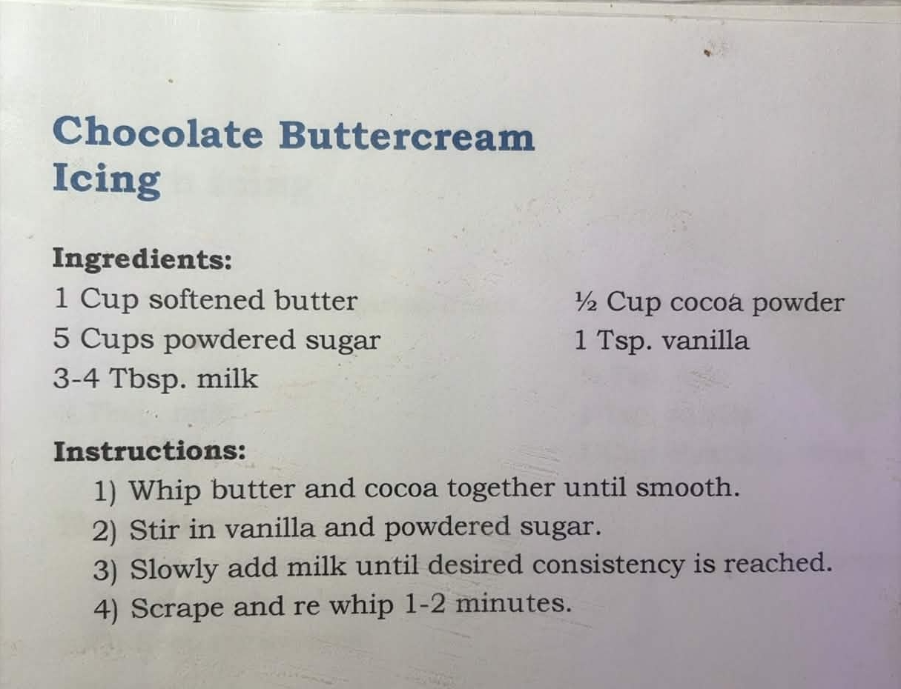
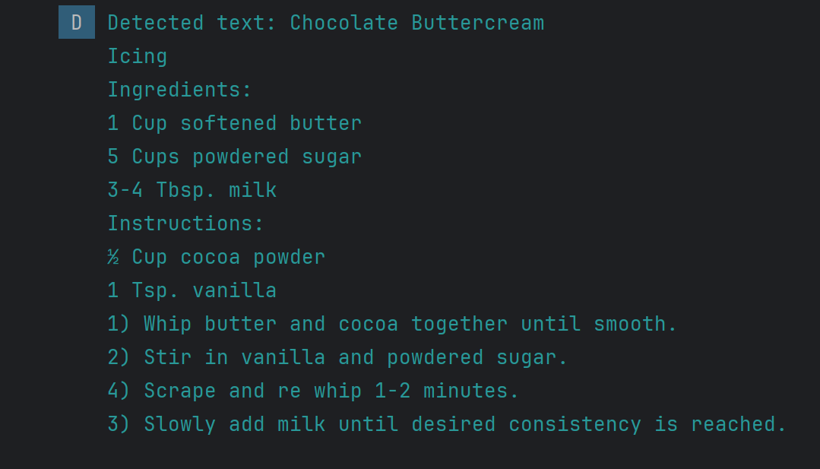
Image Processing – Text Detection With MLKit

Slide 5
Expiration Date Handling
We added a new database table to store ingredients in “batches”
Example:
Batch 1 = 2 gallons milk, $8.00, expires 4/05/2026
Batch 2 = 4 gallons milk, $14.00, expires 4/07/2026
Batch-id | Ingredient-id | Quantity | Price | Expiration-date | Date-added
0001 | 0005 | 2 | 8 | 4/05/2026 | 4/02/2026
0003 | 0005 | 4 | 14 | 4/07/2026 | 4/03/2026

Slide 6
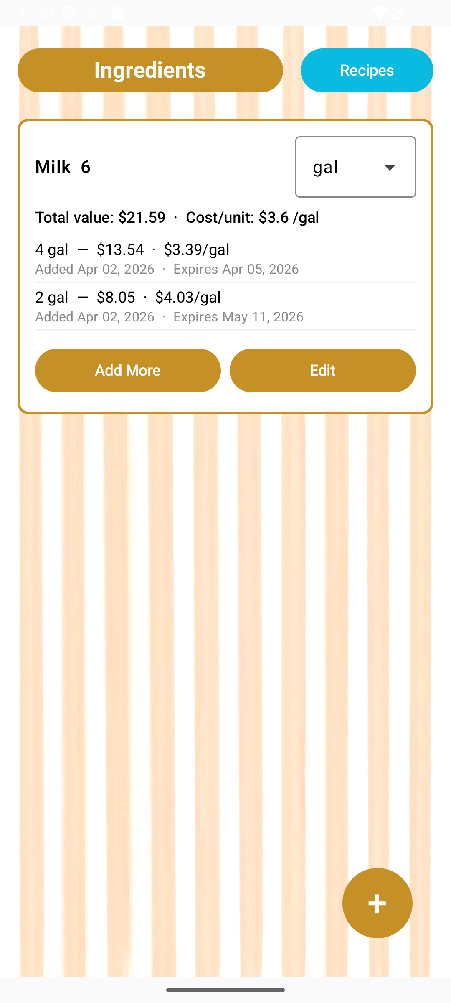
Expiration Date Handling
We are properly storing and displaying batch data including expiration dates
Will add an alert when an ingredient is expiring

Slide 7
Expiration Date Challenge
This new batch system was added on a new Git branch, and changed a lot of the system’s functionality
The ingredient and recipe functions need to be able to use many batch entries instead of a single ingredient entry
Merging this branch into main safely will be a challenge

Slide 8
Deleting Ingredients Issue
If an ingredient is being used by a recipe, and then is deleted, it removes it from the recipe
This should not happen
Idea:
Reduce ingredient values to 0, but don’t delete it entirely, unless it isn’t being used by a recipe
But this change had to be set aside until the new batch system is merged

Slide 9
For next time
Merge new ingredient storage system into main branch
Send the extracted text to Gemini for processing
Fix deleting ingredient issues
Add alert for expiring ingredients

