Slide 1
Cupboardly
Weekly Report for 4/10/2026

Slide 2
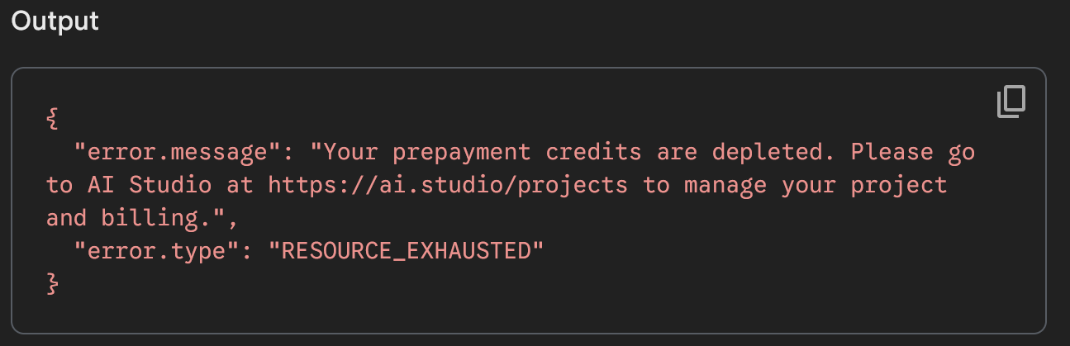
Problems
AI Tokens Limit
We had outdated information – it turns out we had less free tokens than we thought
We had to pay for $10 worth of Gemini tokens to continue
Which is ~40 million tokens (~30 million words) worth of the Gemini-2.5-flash-lite model we are using
Adding ingredients and recipes from camera don’t work properly without AI access

Slide 3
Problems
Git syncing issues again
When updating the project, not all files would sync
We had to run these commands to fix it:
git fetch origin
git reset --hard origin/master
git clean –fd
File → Invalidate Caches / Restart

Slide 4
Gemini Recipe Prompt
We are now sending the scanned text to Gemini to process
It returns it in a JSON type format
Recipe name
Ingredients
Instructions
We can then extract the formatted text and use it

Slide 5
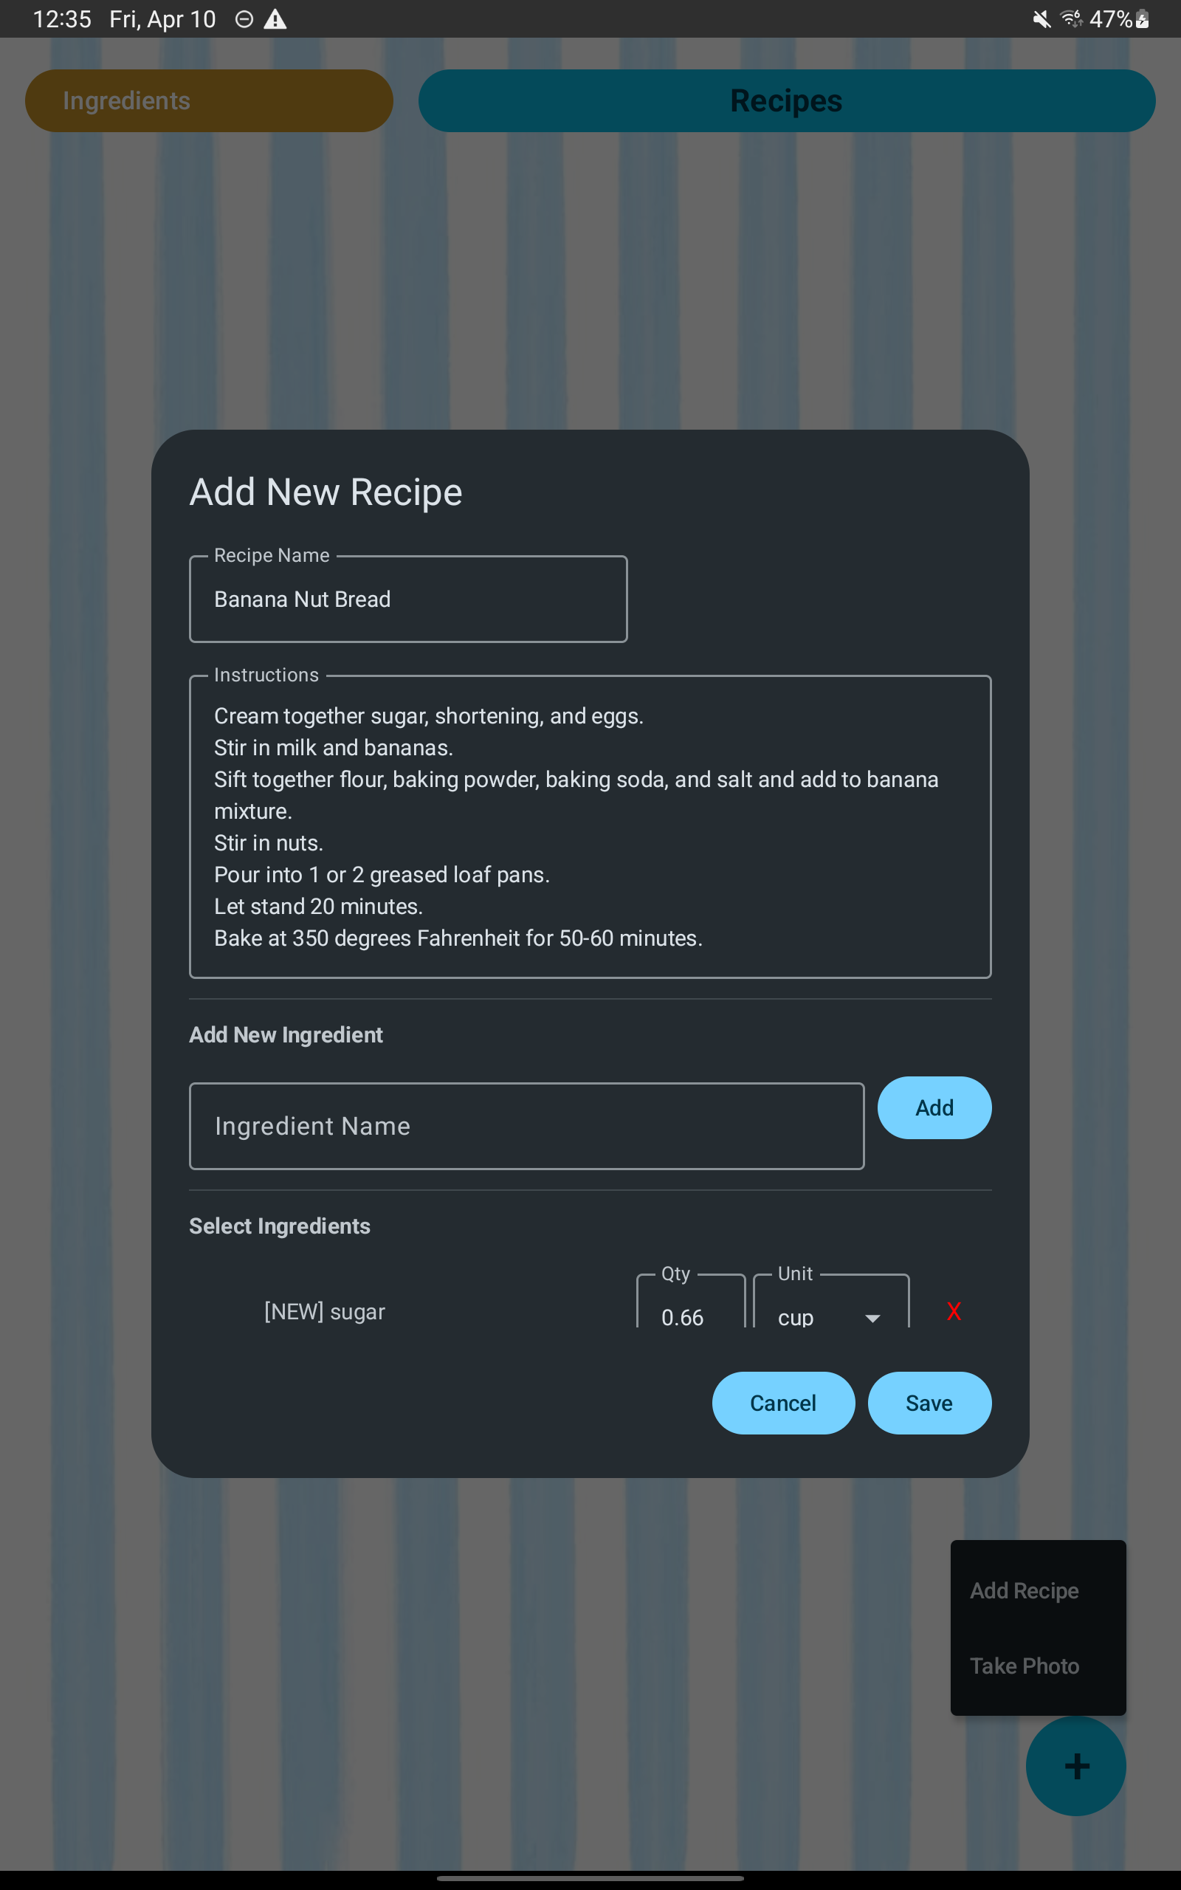
Recipe Auto-Fill
When adding a recipe from a picture, it automatically fills in the add recipe screen with data
The user can edit/change this data before confirming

Slide 6
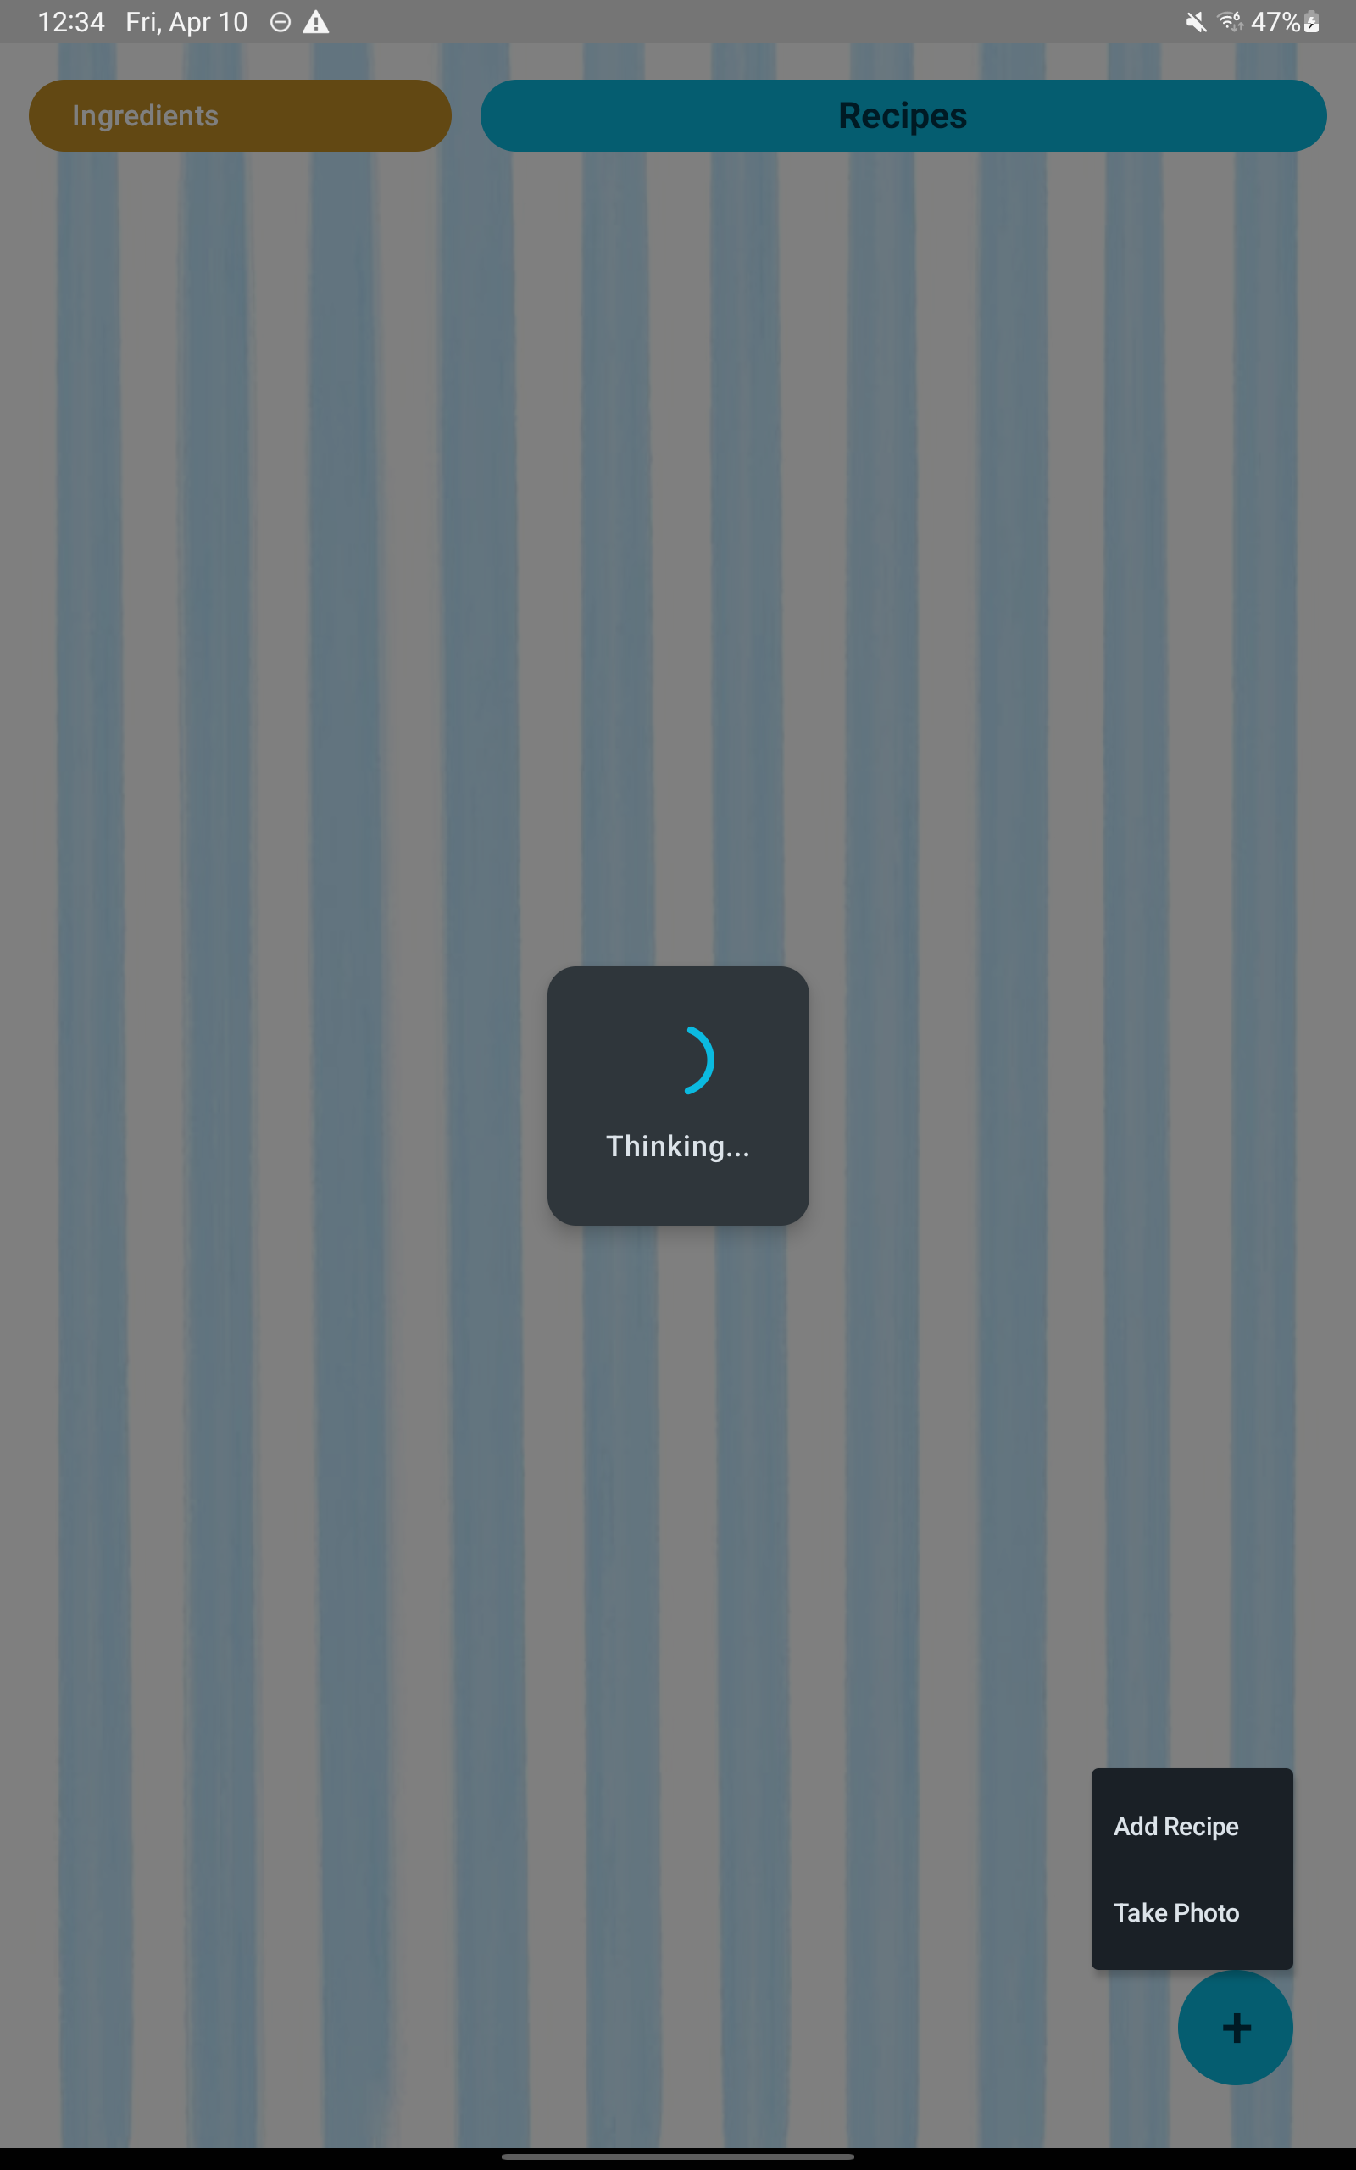
“Loading” popup
When the app is waiting for AI processing to complete, a popup appears which prevents the user from pressing anything until it is done
Previously it was possible to break things by tapping other options while the AI was still processing the first task

Slide 7
In Progress (close but not yet ready)
Expiration date coloring
White -> Yellow -> Red based on time until expiring
Edit button on recipes
Delete / Zeroing ingredients logic
Doesn’t delete if an ingredient is being used by a recipe, instead set to 0

Slide 8
For next time
Move camera button into add recipe menu
Various UI tweaks to make it look cleaner
Get export / import of data working

