Slide 1
Cupboardly
Weekly Report for 4/17/2026

Slide 2
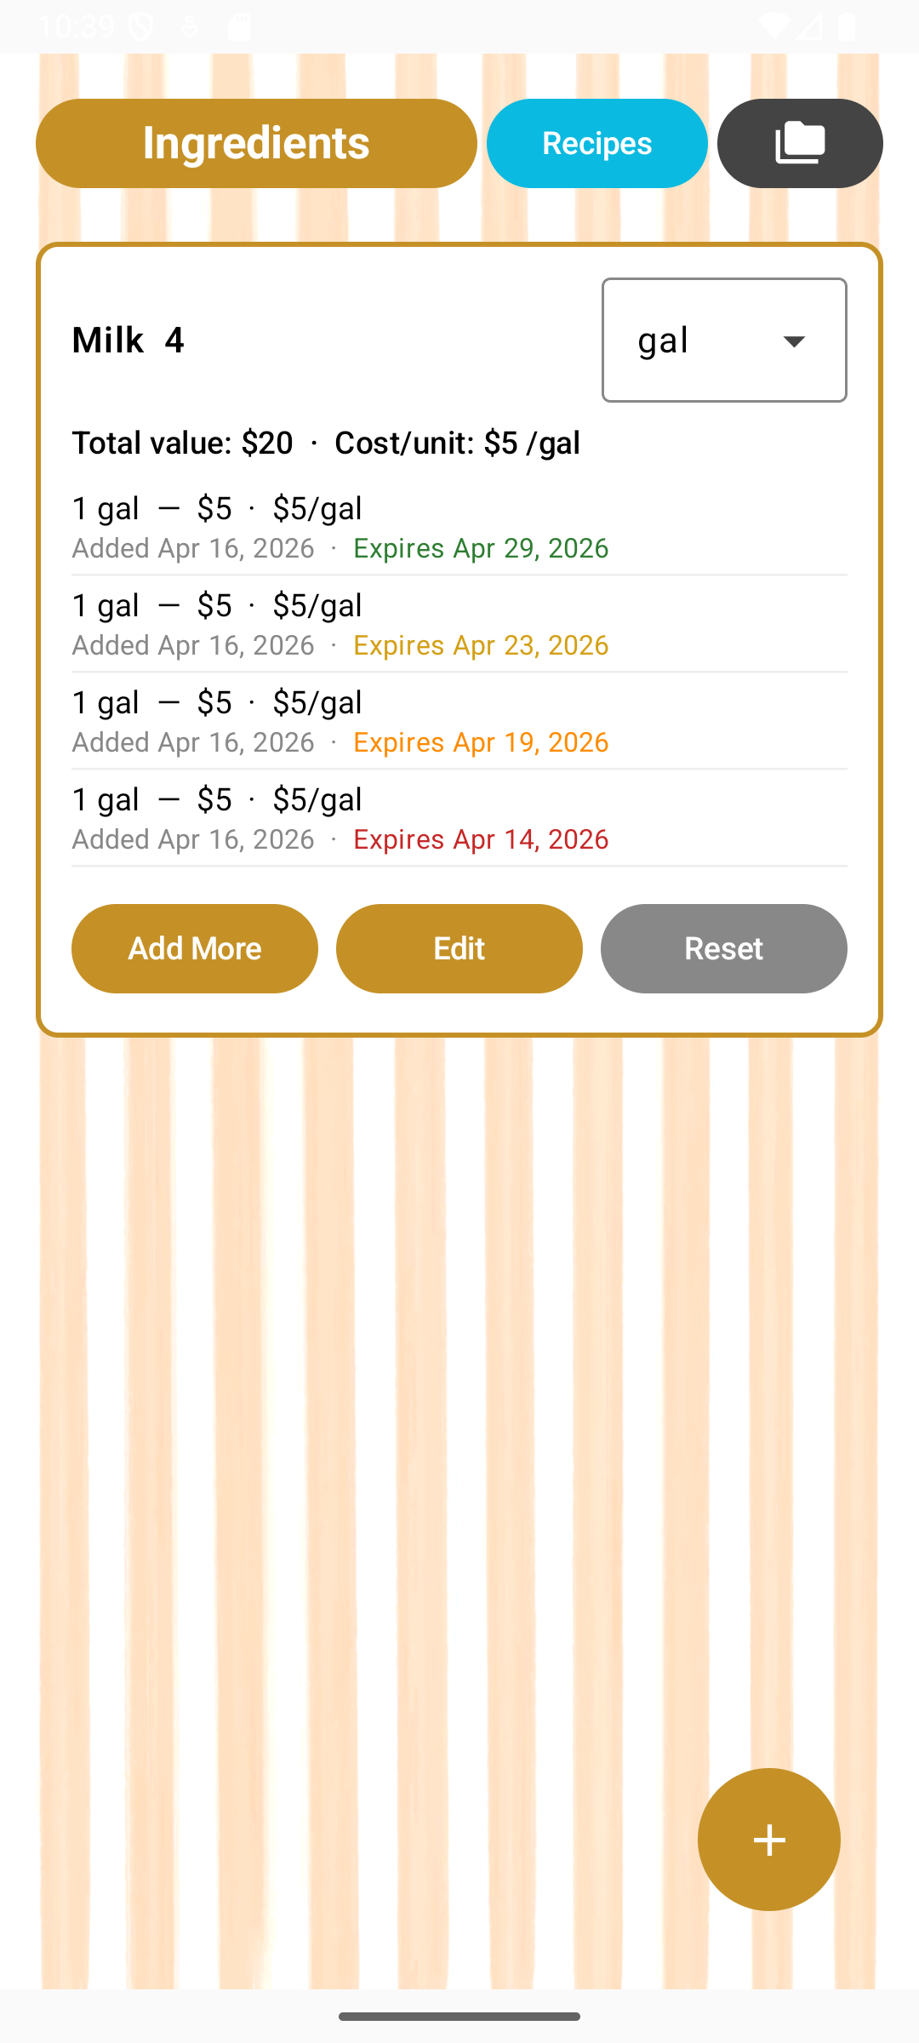
Expiration Date Coloring
Green, Yellow, Orange, or Red
Based on expiration date

Slide 3
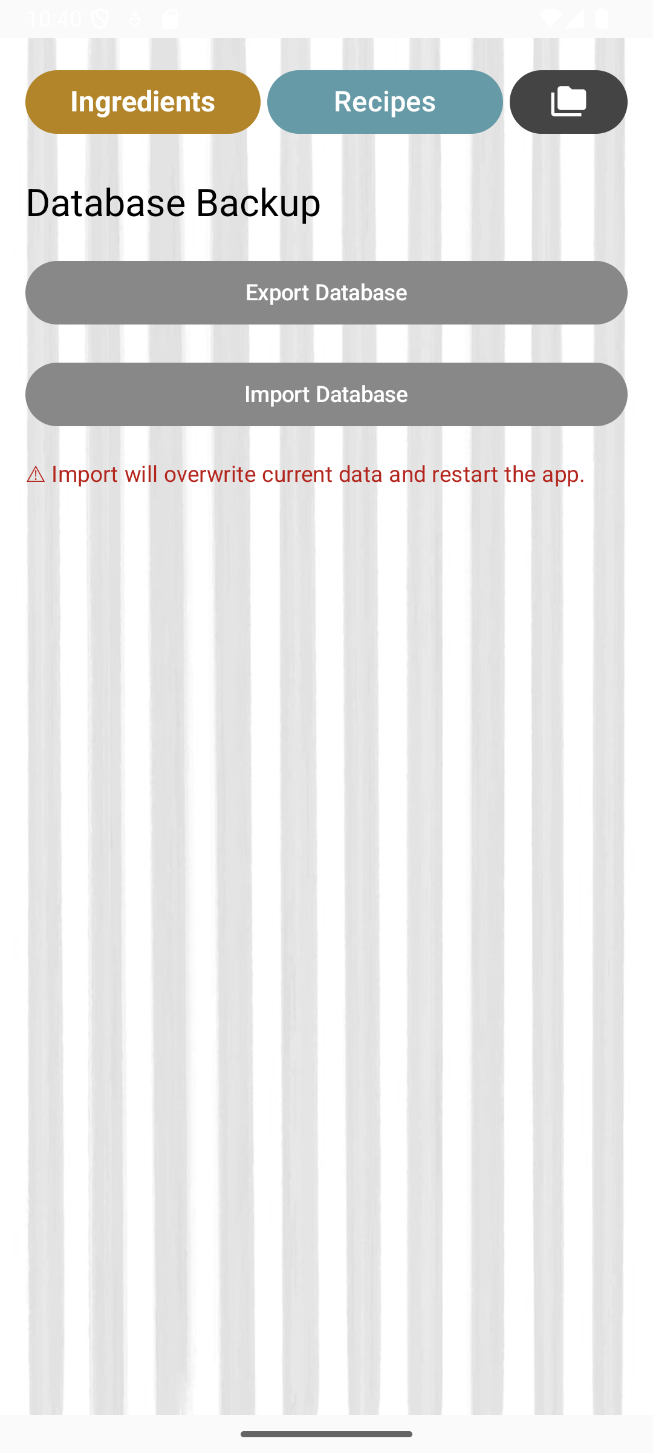
Exporting / Importing Databases
New screen for import / export
Users can export and import a database

Slide 4
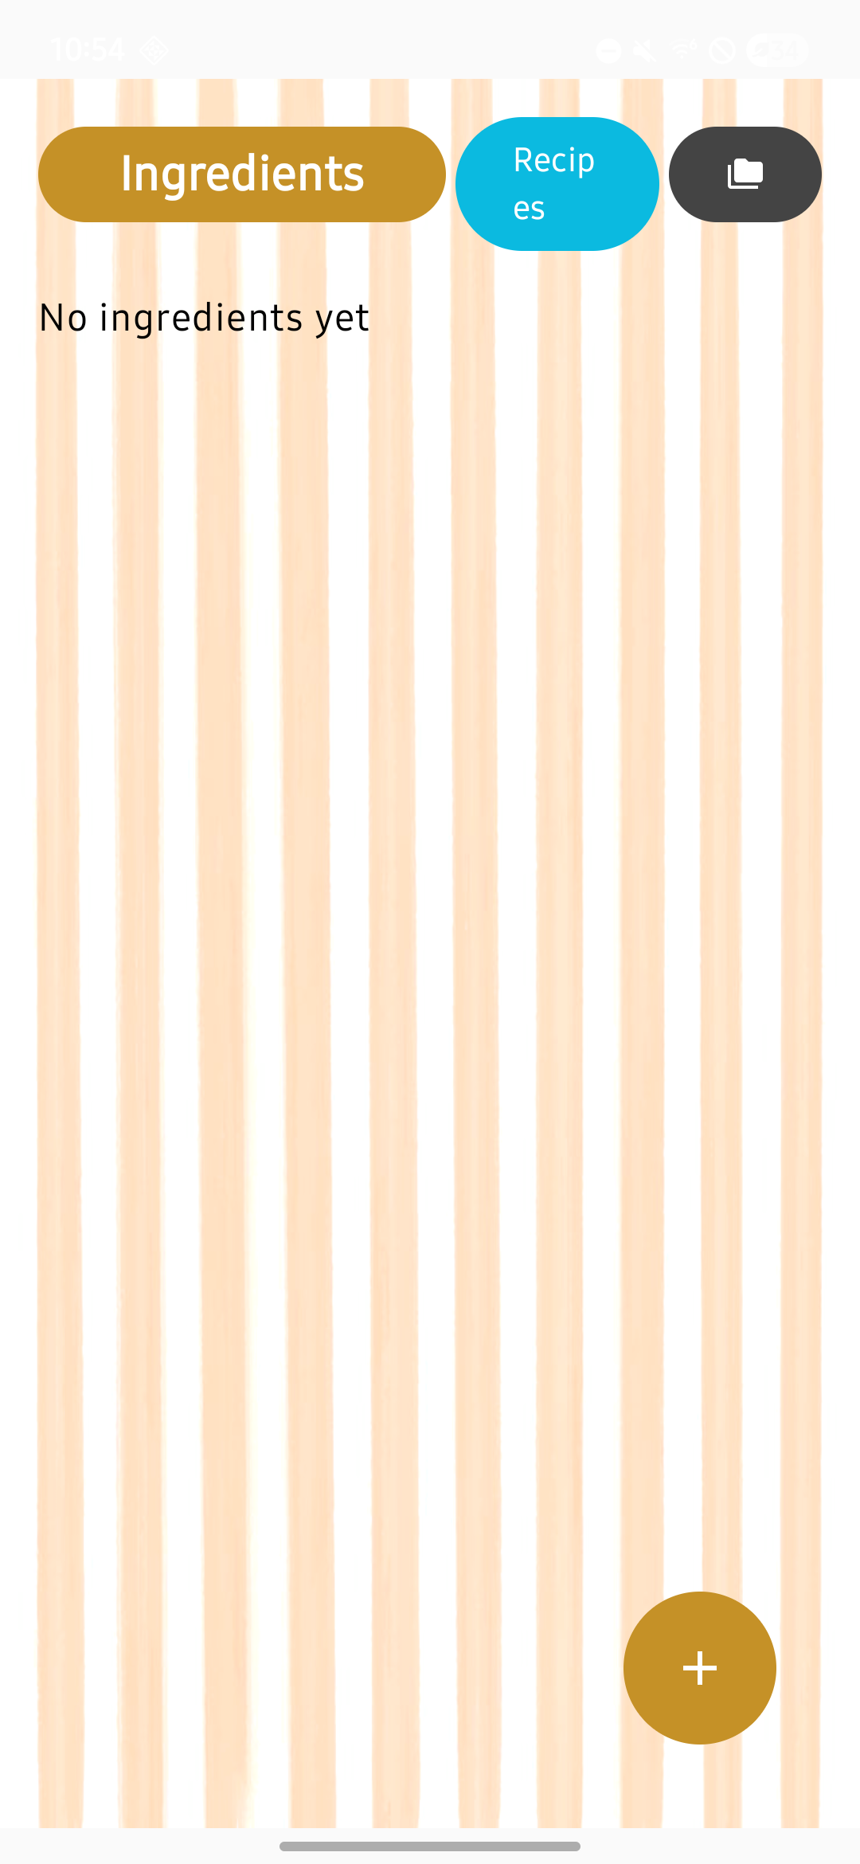
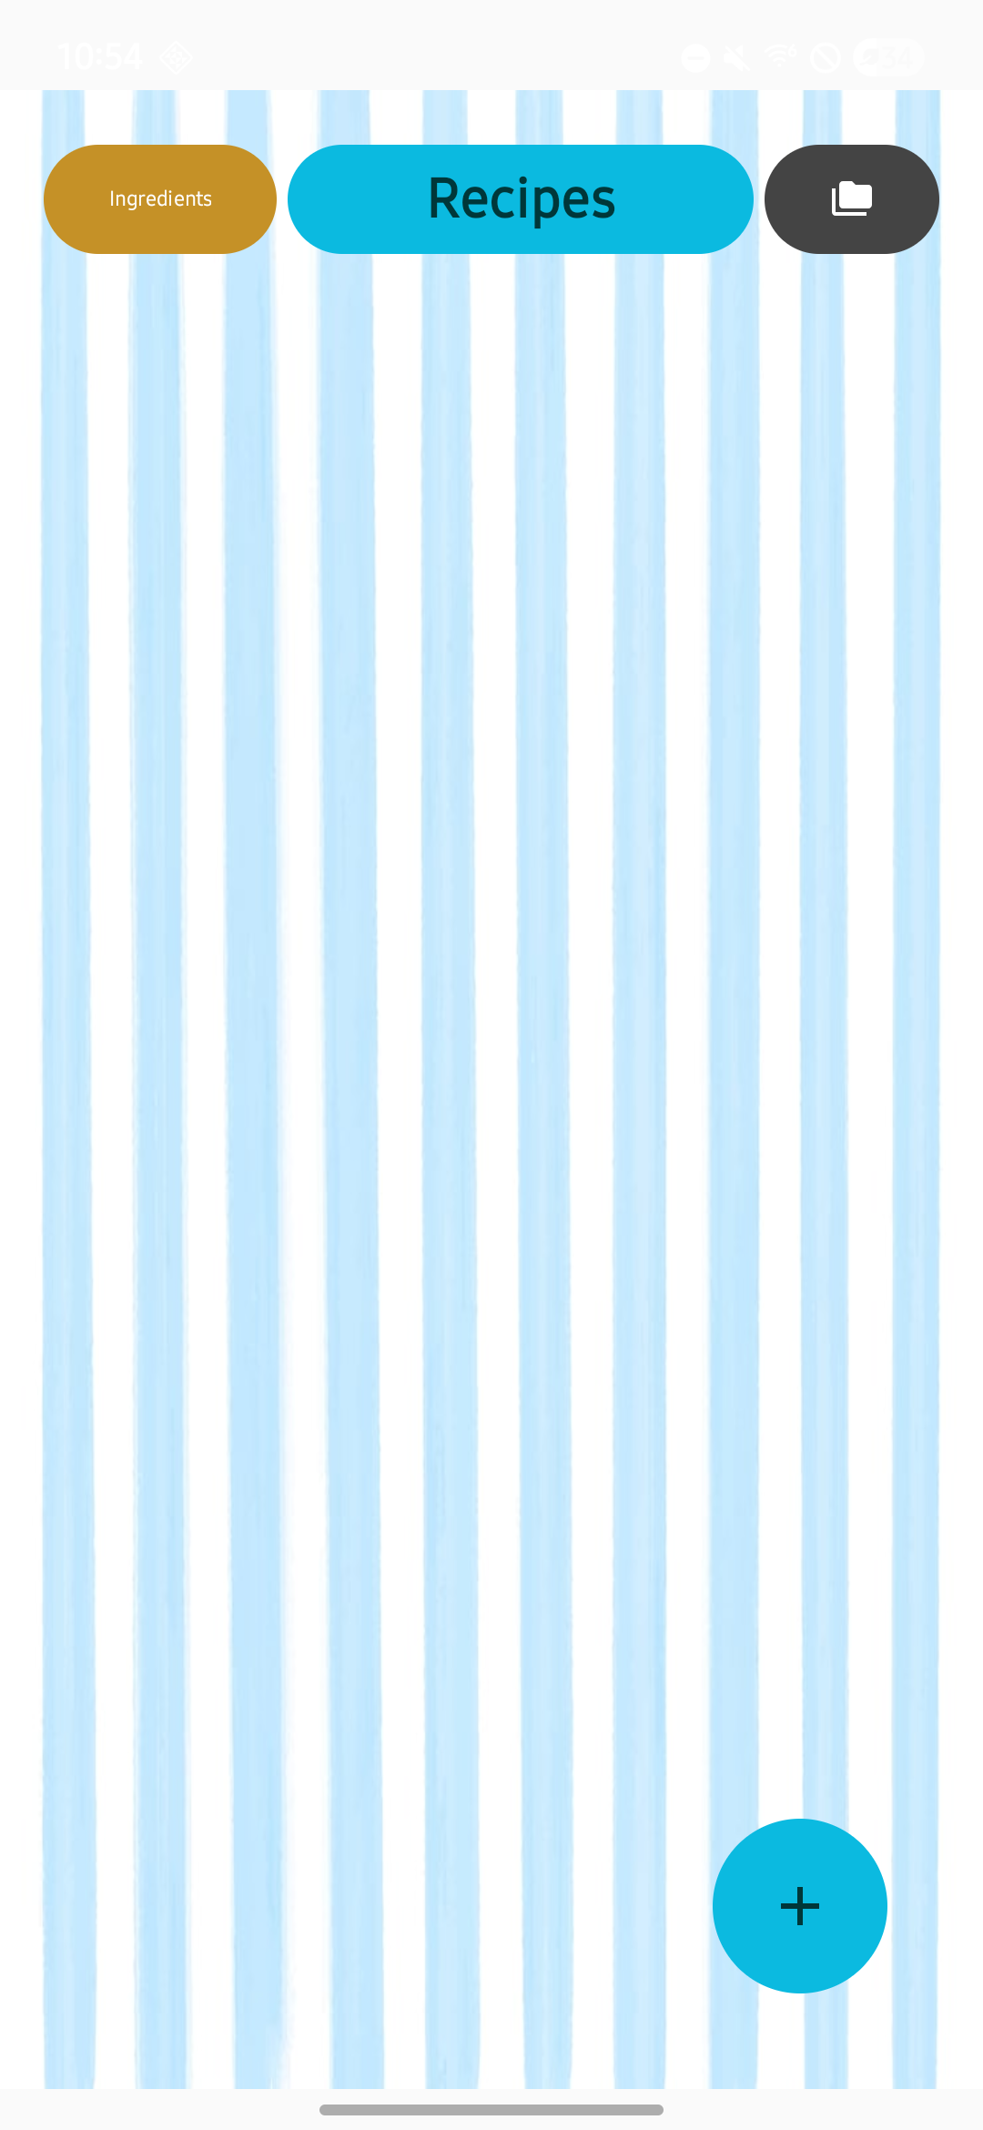
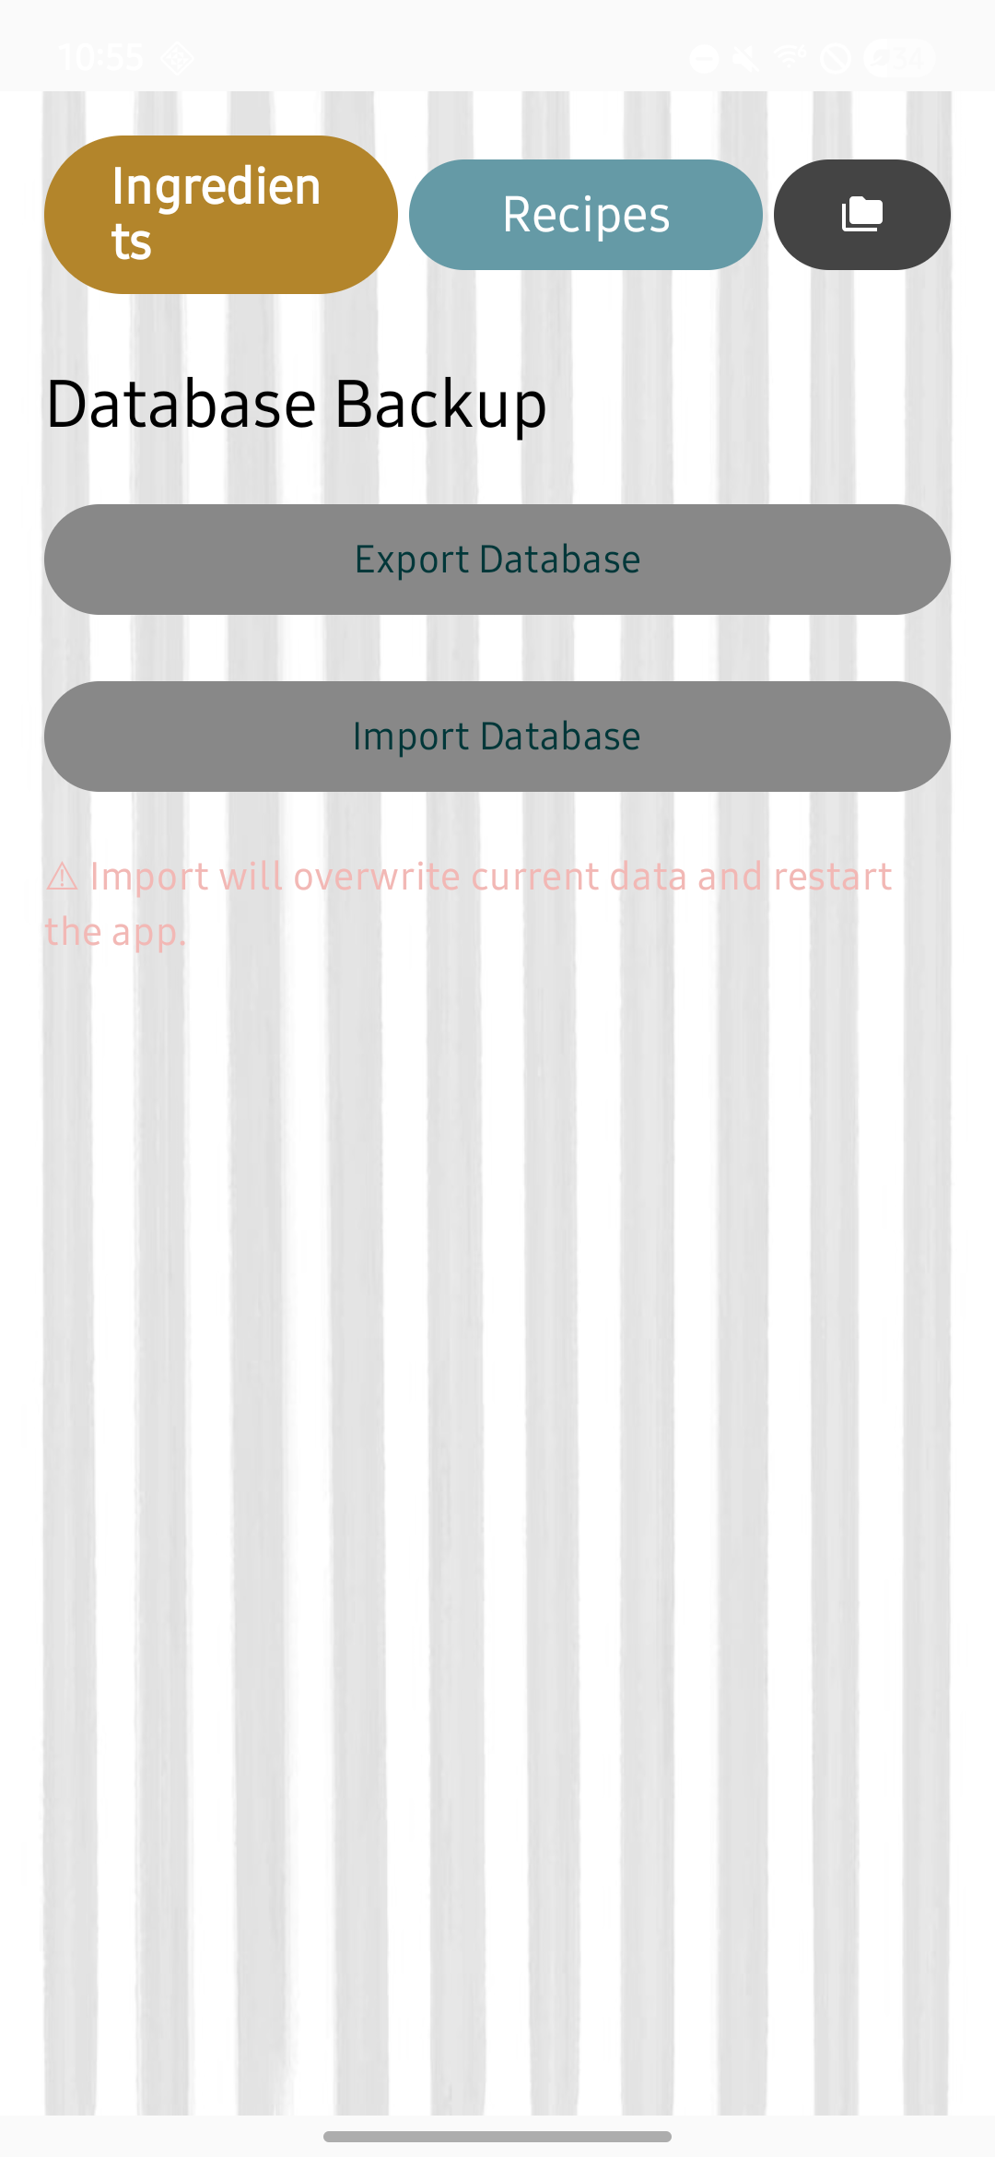
UI Bug

Slide 5
Other Improvements
Added confirmation to many buttons
Delete buttons, reset buttons
Requires the user to confirm – “Are you sure?”
Moved camera button into add recipe screen
Matched coloring for popup menus

Slide 6
For next time
Documentation
Minor UI tweaks and fixes
Maybe a recipe expiration popup

