Slide 1
Cupboardly
Weekly Report for 1/30/26

Slide 2
About the Project
Android app
Tracks recipes and ingredients
Dynamically changes ingredients based on recipe followed
User can input ingredients and information
User can input recipes and information
User can take a photo of a recipe to add it to their recipes list

Slide 3
Issues
In our documentation, we said we would use Python
After testing, we realized Android and Python are not optimized for each other
Getting it to work how we wanted would cause too many issues
We decided to abandon Python
Kotlin is default in Android Studio
We now must learn how to use a new IDE and a new language

Slide 4
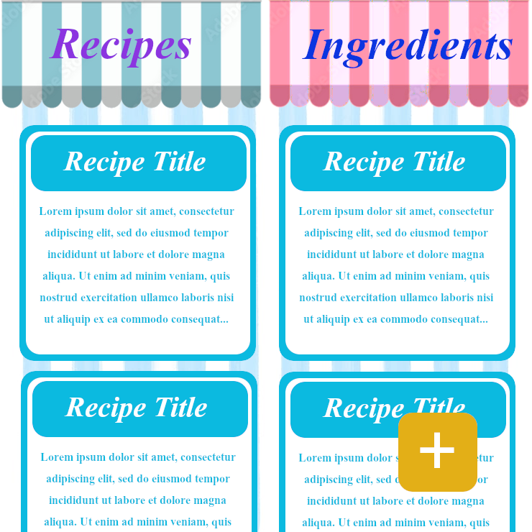
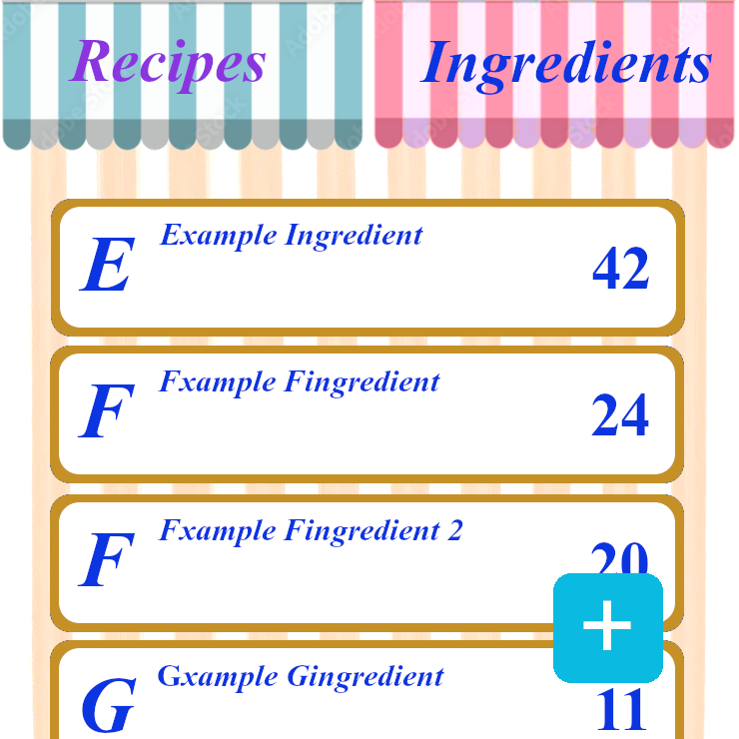
Progress
Completed last week:
Experimented with Python and Android Studio
Made Gantt Chart
Made website cupboardly.wordpress.com
Made first concept UI design for the app
Created Android Studio project
Setup GitHub for version control

