Slide 1
Cupboardly
Weekly Report for 2/6/2026

Slide 2
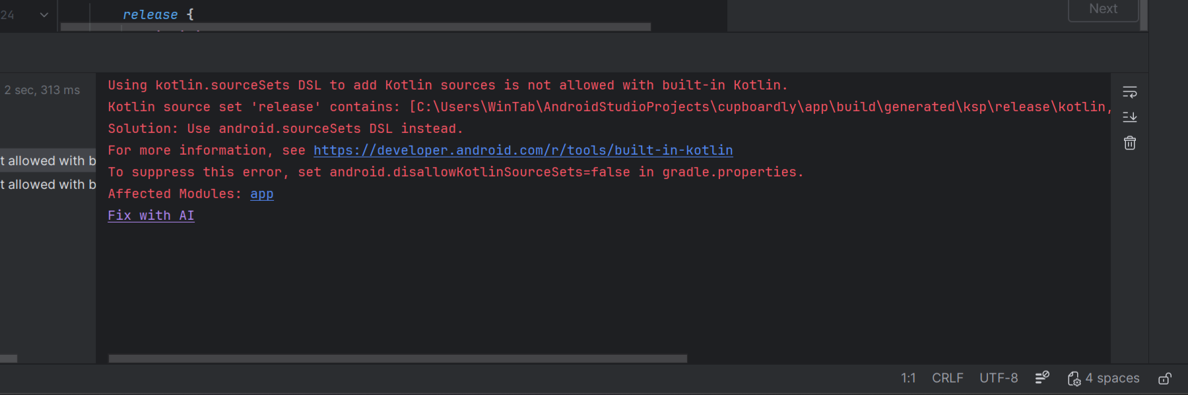
Issues
We were getting errors preventing compilation
We tried reinstalling latest Java version

Slide 3
Solution
We are using certain plugins in Android Studio for our project
room and KSP
After ensuring these were updated to the latest version the errors went away

Slide 4
Issues
We were getting sync errors using GitHub
Not all files were being updated properly when trying to use the latest version of the project

Slide 5
Solution
Forcing Android Studio to use the latest project version from GitHub through a terminal command
Deleting cached data
Restarting Android Studio

Slide 6
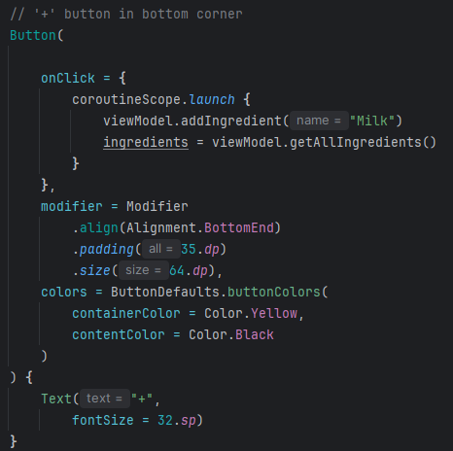
Issues
We thought XML via “views” was the standard for UI development
Latest Android Studio versions default to a more modern system called “Compose”
We did not realize this until we were going to start making a first draft UI
Compose uses a Java-like structure

Slide 7
Progress
Our Databases:
We used “room” to access SQL in Android
It requires 3 files for 1 database to work:
A DAO file
An Entity file
A Database file
We created two separate databases – an ingredient and a recipe database

Slide 8
About room files
Entity Files
Describe the data table
Define fields in the table
example: ingredient name, ingredient quantity, and so on
DAO (Data Access Object) Files
Defines access to the table
example: insert, delete, search functions
Database Files
Puts it all together and creates the actual database itself

Slide 9
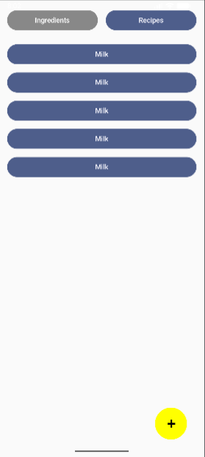
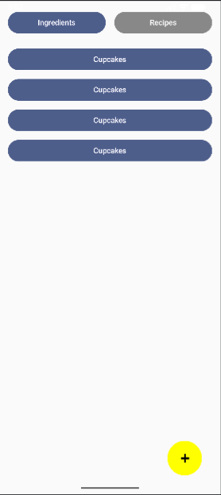
Progress
Ingredients Screen
Recipes Screen
Working UI demo

Slide 10
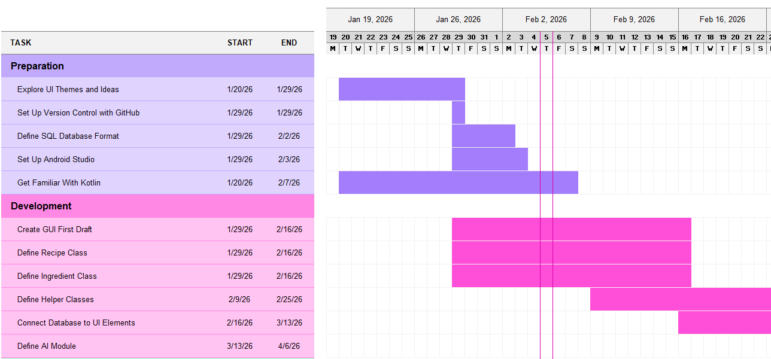
Gantt Chart Accuracy
It took longer to define the databases
But we already have them connected to UI elements
We need more time to get familiar with the IDE and Kotlin
We are on track for most other tasks
We did not realize how closely UI is integrated with the rest of the development
We are constantly needing to be aware of the UI systems

Slide 11
For Next Week
We plan to:
Add more parameters to the databases (quantity, price, and so on)
Currently, we only have “name”
Have the user be able to enter those details about a recipe or ingredient
Currently, we are only using default values

