Slide 1
Cupboardly
Weekly Report for 2/13/2026

Slide 2
Progress
Combined databases into one database
Added more parameters to the Ingredients:
name, quantity, unit, price, pricePerUnit, dateEntered, dateLastUpdated
Added more parameters to the Recipes:
name, instructions, dateCreated, numTimesFollowed

Slide 3
Linking the Databases
The Recipe database could not directly contain entries from the Ingredient database
To fix this, we combined the databases into 1 database, but with 3 tables
An ingredient table
A recipe table
A linked table

Slide 4
Linking the Databases
The linked table is for storing which ingredients correlate to which recipes
It contains recipeID, ingredientID, and quantityUsed
Stores the recipe ID, connects it to ingredient IDs and a quantity for each ingredient

Slide 5
Example Tables Inside the Database
ID | name | quantity | unit | price | pricePerUnit | dateEntered | dateLastUpdated
1 | Flour | 5.0 | lbs | 10.00 | 2.00 | 20260202 | 20260213
2 | Eggs | 12 | units | 5.00 | 0.42 | 20260212 | 20260214
ID | name | instructions | dateCreated | numTimesFollowed
1 | Pancakes | Mix ingredients... | 20260130 | 4
2 | Scrambled Eggs | Whisk eggs, cook on low... | 20260210 | 2
ID | recipeID | ingredientID | QuantityUsed
1 | 1 | 1 | 0.5
2 | 1 | 2 | 2
3 | 2 | 2 | 2

Slide 6






Example Tables Inside the Database
ID | name | quantity | unit | price | pricePerUnit | dateEntered | dateLastUpdated
1 | Flour | 5.0 | lbs | 10.00 | 2.00 | 20260202 | 20260213
2 | Eggs | 12 | units | 5.00 | 0.42 | 20260212 | 20260214
ID | name | instructions | dateCreated | numTimesFollowed
1 | Pancakes | Mix ingredients... | 20260130 | 4
2 | Scrambled Eggs | Whisk eggs, cook on low... | 20260210 | 2
ID | recipeID | ingredientID | QuantityUsed
1 | 1 | 1 | 0.5
2 | 1 | 2 | 2
3 | 2 | 2 | 2

Slide 7
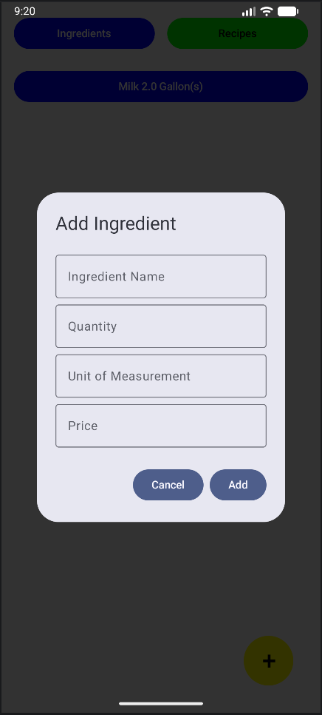
Progress
The user can now enter specific details about an ingredient
TO DO:
Data validation – right now any data can be input, so errors or crashes can occur

Slide 8


UI Theme
Currently the UI uses default android themes
With the goal of making Cupboardly look unique, we have started work on background textures, but have not applied them yet
We will be experimenting with button theming, but have concerns about functionality

Slide 9
Issues
Database communication (fixed)
More GitHub syncing issues
git fetch origin
git reset –hard origin/master
git clean –fd
In android studio – Invalidate Caches, then restart the IDE
UI "Buffering"

Slide 10
UI "Buffering"
When a user pressed any button, it would not take effect (at least visually in the UI), until the next button press
For example:
A user presses the button to delete an ingredient, nothing happens
The user presses the button to add an ingredient, the original ingredient is then deleted, but the new one is not added
The new ingredient is added after the *next* button press, and so on
What the UI displayed was always 1 step behind

Slide 11
UI "Buffering" Fix
Instead of using a List<> to list the ingredients or recipes, use StateFlow<List<>>
val ingredients: StateFlow<List<IngredientEntity>> = _ingredients
Instead of refreshing the UI manually after every button press, use the collectAsState() function
viewModel.ingredients.collectAsState(initial = emptyList())
This combination dynamically updates the UI as changes are made to the list of ingredients (or recipes)

Slide 12
For Next Week
We plan to:
Create a popup UI similar to the ingredients screen, but for adding recipes
Validate data to ensure only good data is entered
Allow users to select an ingredient or recipe and directly edit it

