Slide 1
Cupboardly
Weekly Report for 2/20/2026

Slide 2
Progress
Applied color scheme / theme to both screens
Added autofill for some data when entering an ingredient
Added data validation when entering an ingredient
Ingredients / Recipes can now be expanded to show more information

Slide 3
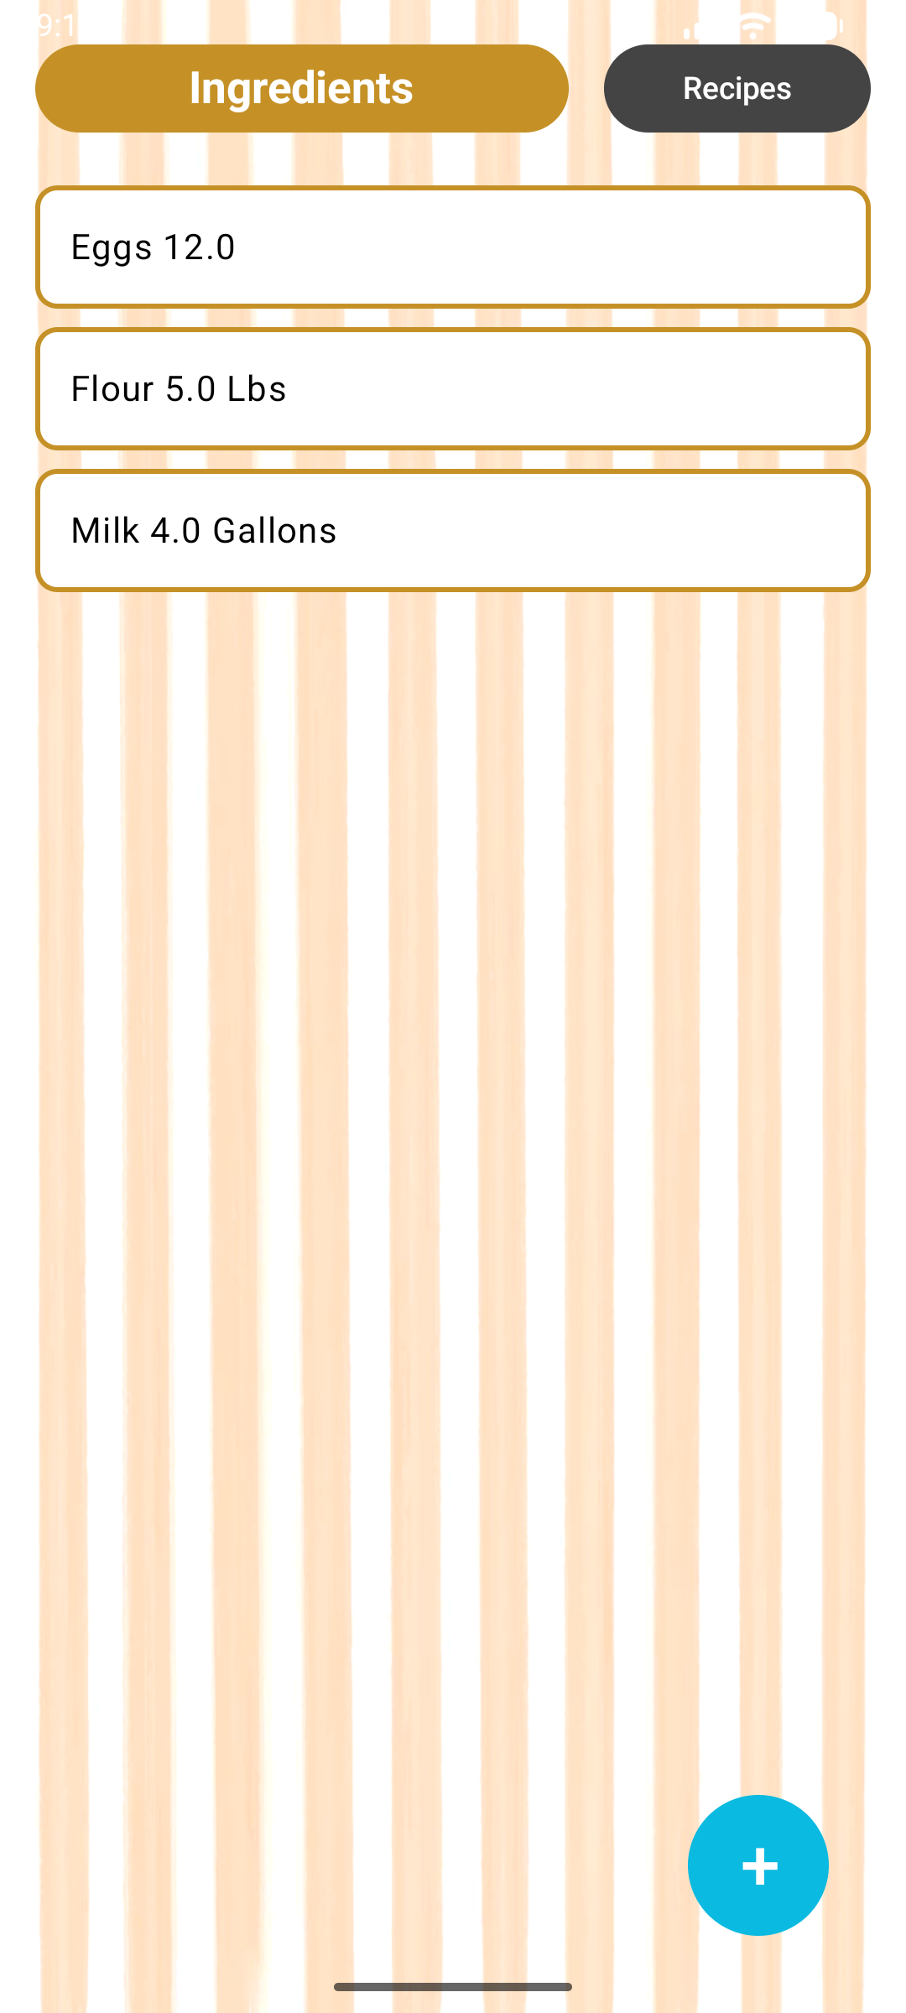
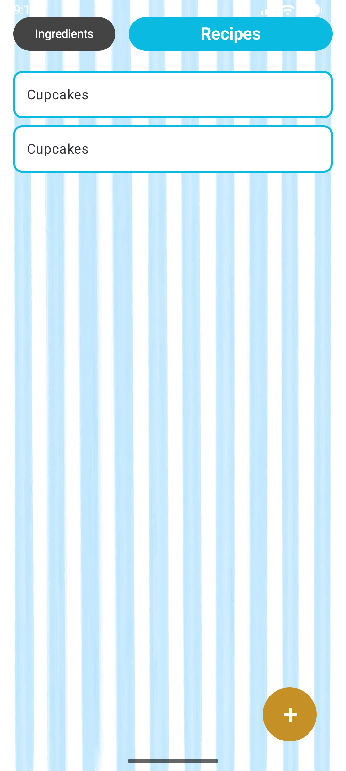
Theme / Colors

Slide 4
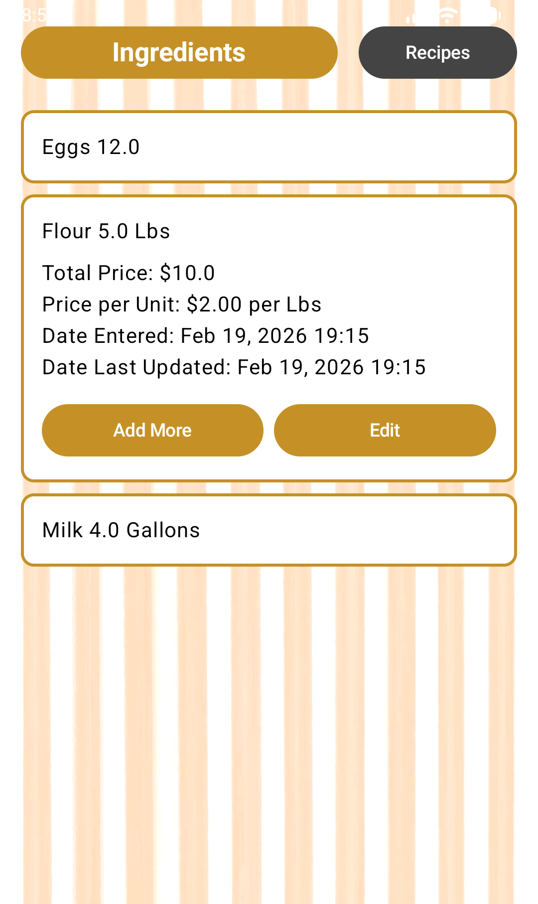
Ingredient Expansion
Detailed ingredient data
To be implemented:
“Add More” button
“Edit” button

Slide 5
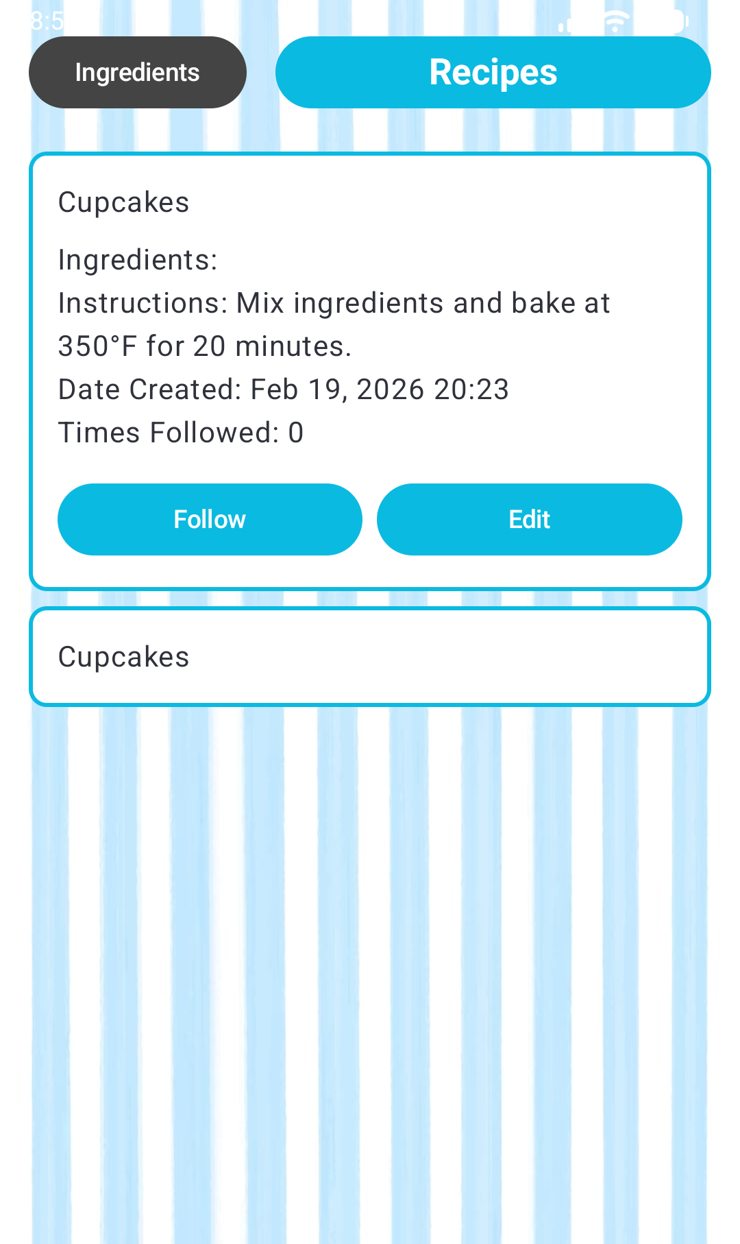
Recipe Expansion
Detailed recipe data
To be implemented:
“Follow” button
“Edit” button
Populate ingredient list

Slide 6
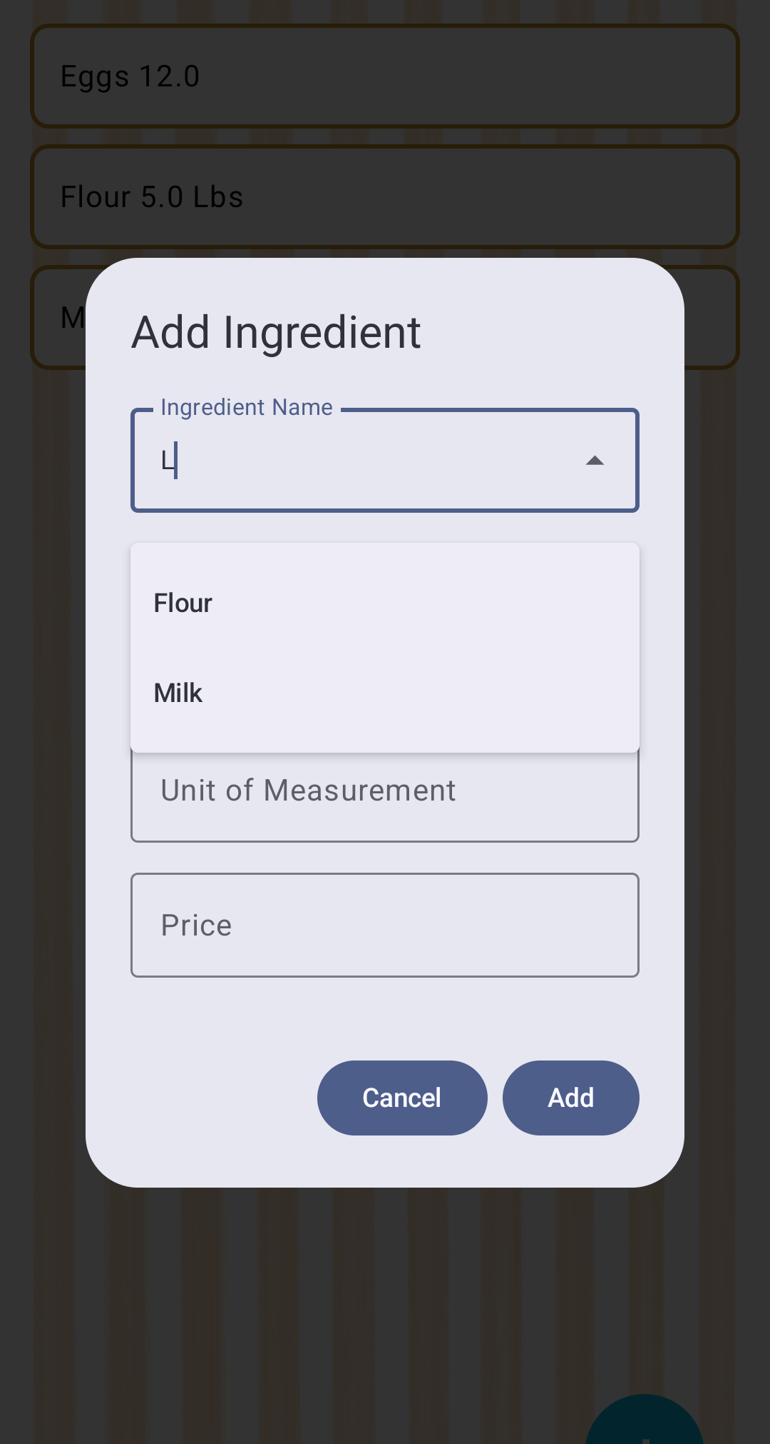

Autocompletion
Example:
“L” is entered, a dropdown menu appears showing all ingredients containing that letter
If an existing ingredient is pressed, it autocompletes the units

Slide 7
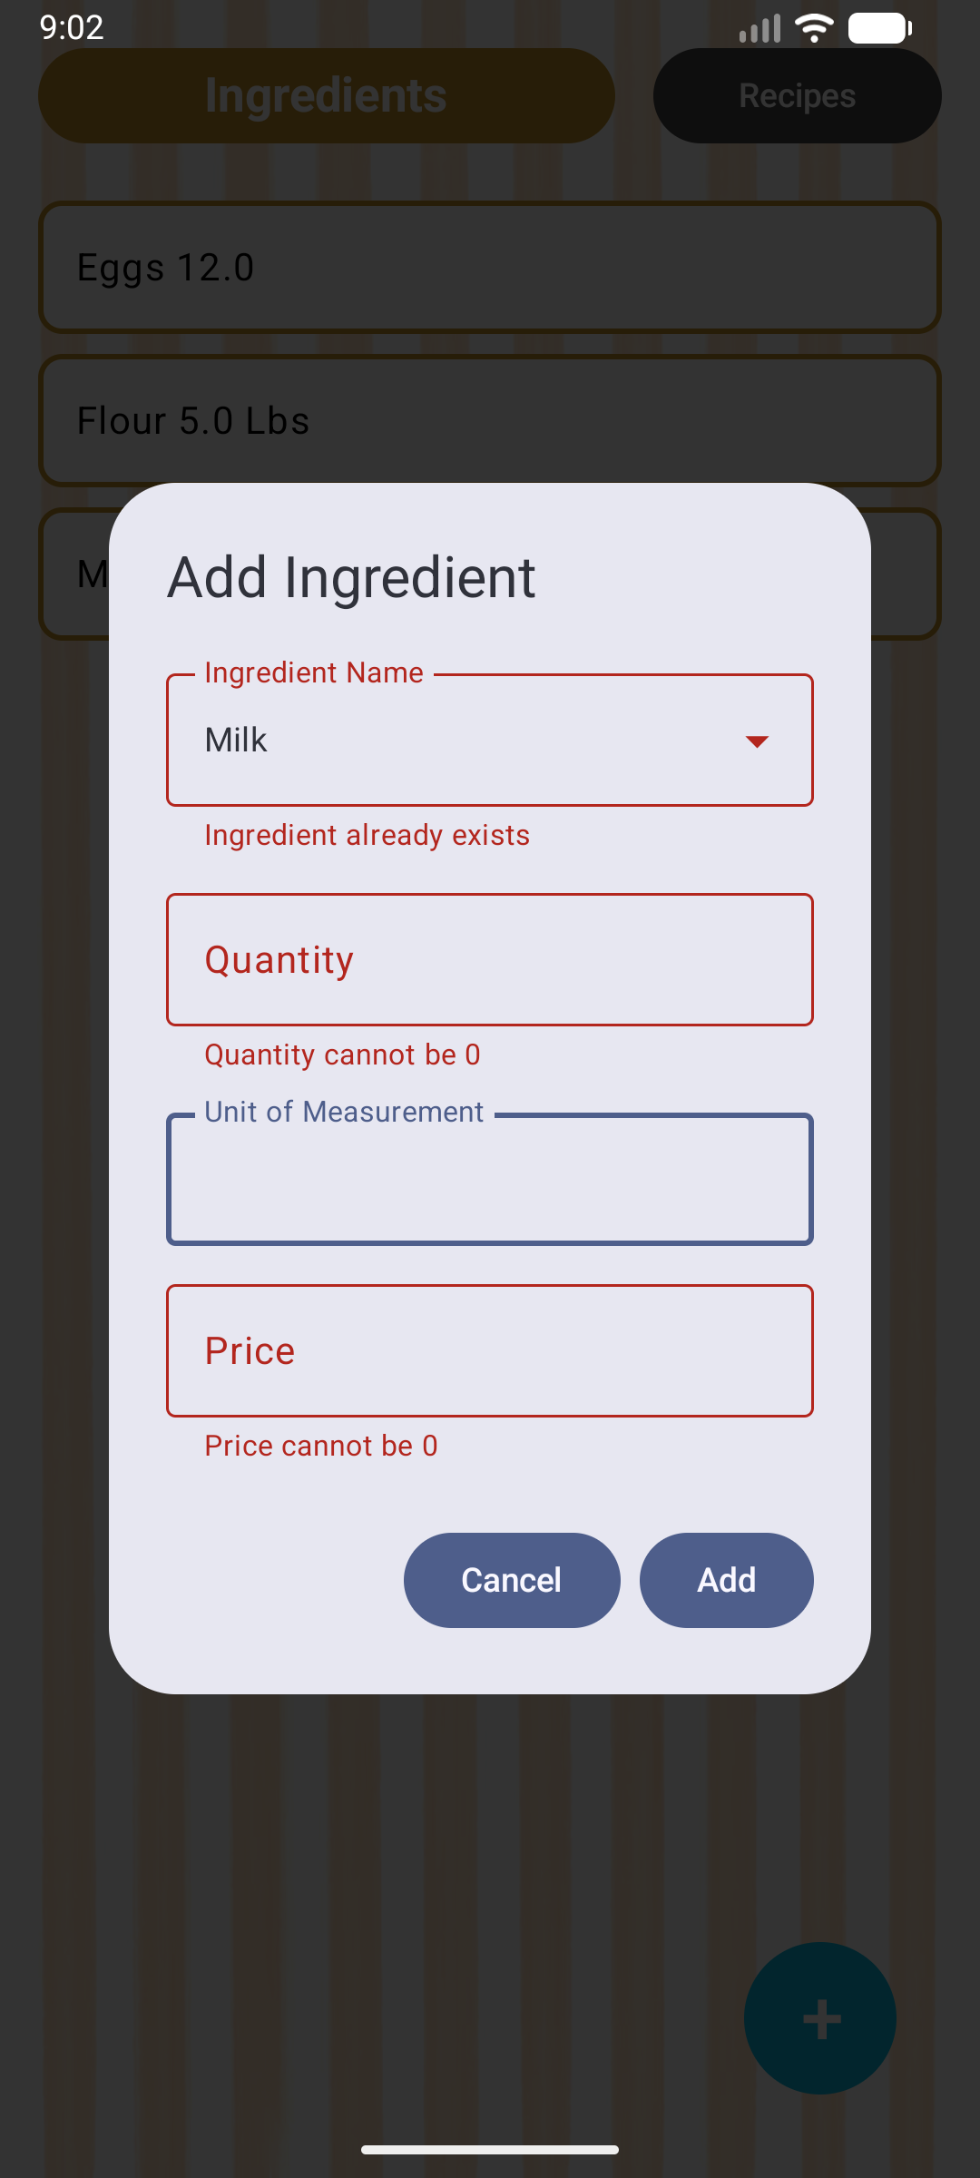
Data Validation
Will notify if invalid data is entered and won’t add ingredient to database
Needs fix:
Currently will not add to an existing ingredient

Slide 8
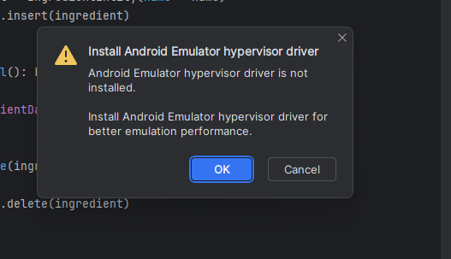
Issues
Android emulator stopped working
But fixed itself and we don’t know why

Slide 9
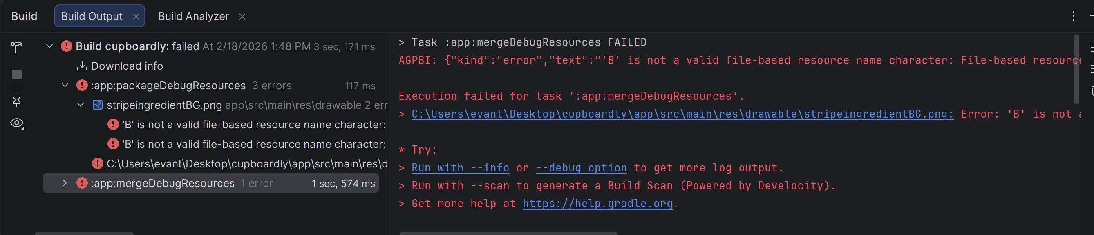
Issues
Background images under “drawable” folder in Android Studio have specific naming conventions

Slide 10
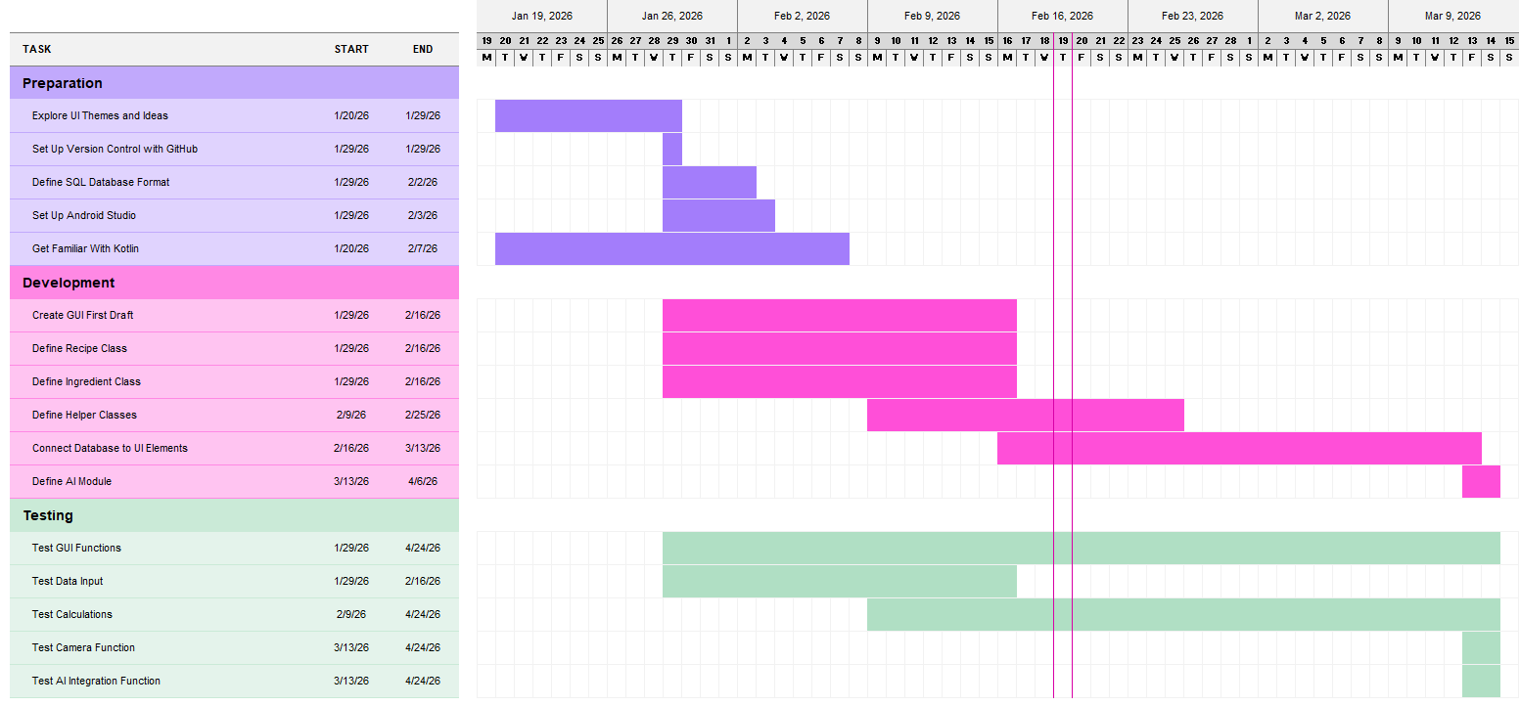
Gantt chart

Slide 11
For next week
Add menu to add recipes like ingredients
Add data validation for recipes
Display ingredient list inside the expanded recipe

