Slide 1
Cupboardly
Weekly Report for 2/27/2026

Slide 2
Progress
“Add More” button
“Edit” button
Add Recipe button*
Fixed validation being too strict when adding ingredients
Added all time values for quantity and cost to ingredients (might not use them for calculations)

Slide 3
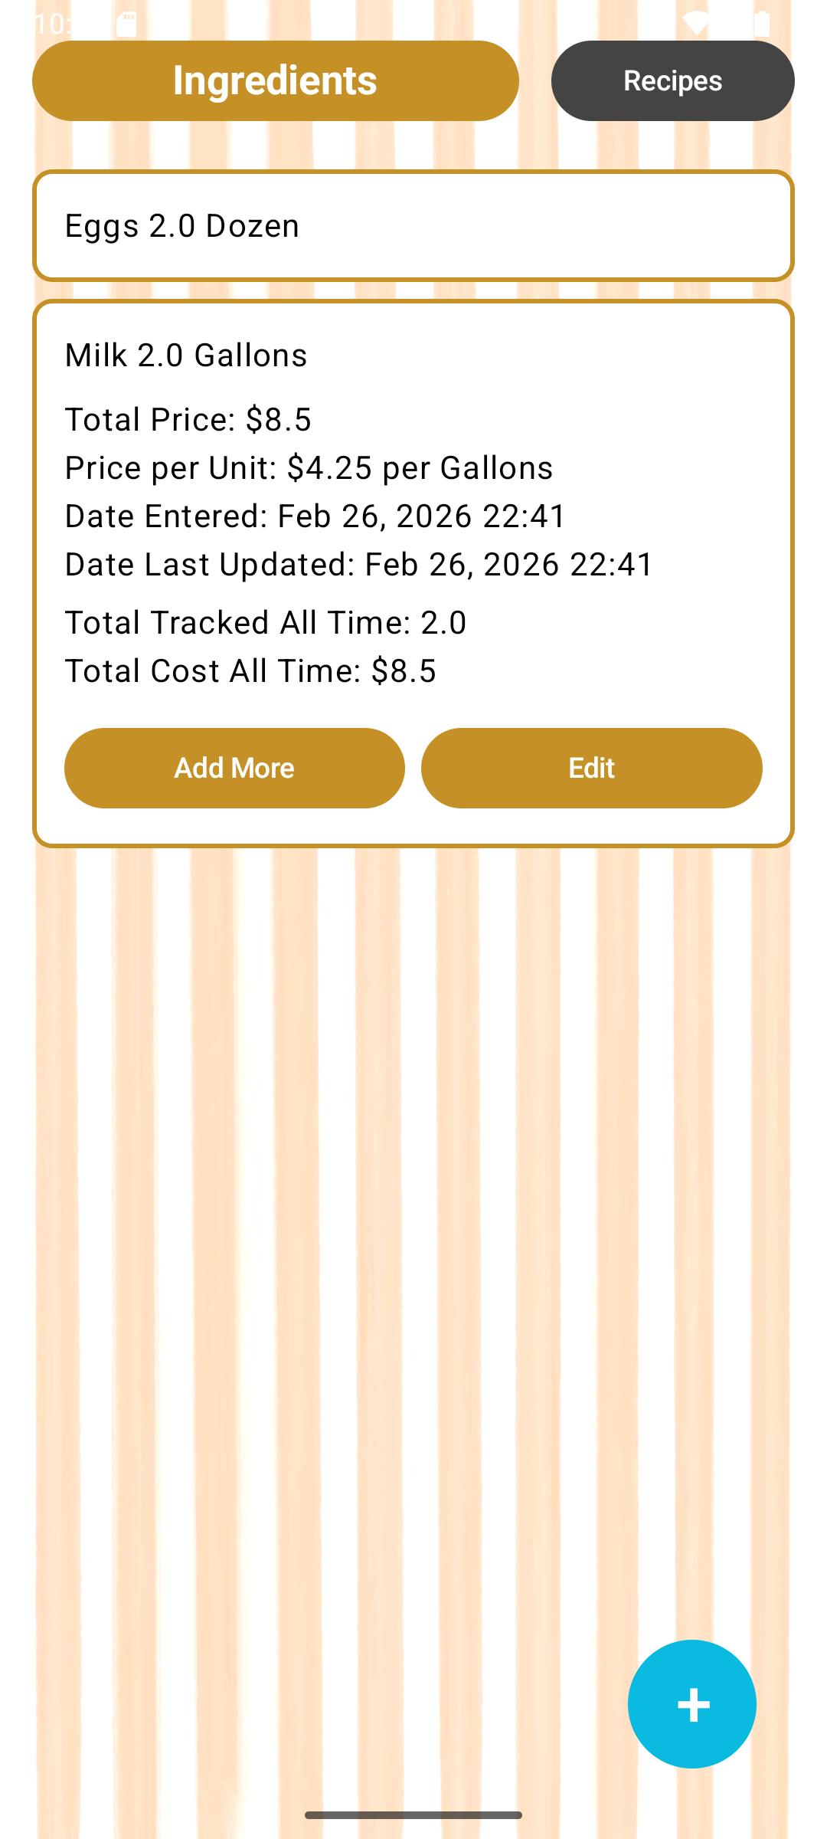
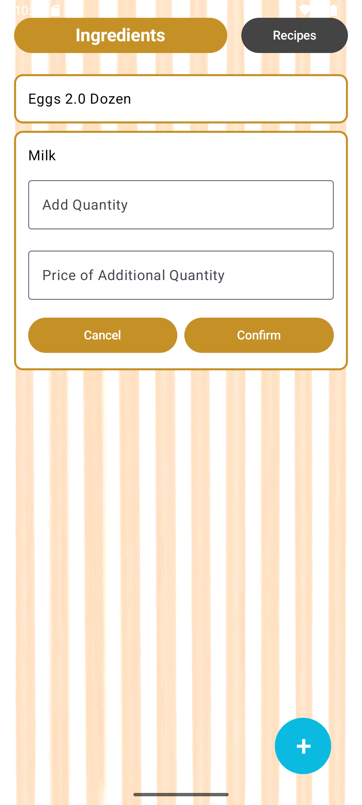
“Add More” Button
Adds onto existing totals for an ingredient

Slide 4
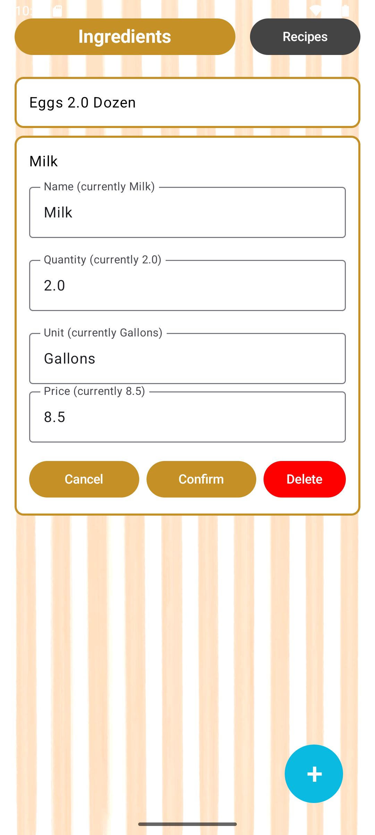
“Edit” Button
For editing specific details of an ingredient

Slide 5
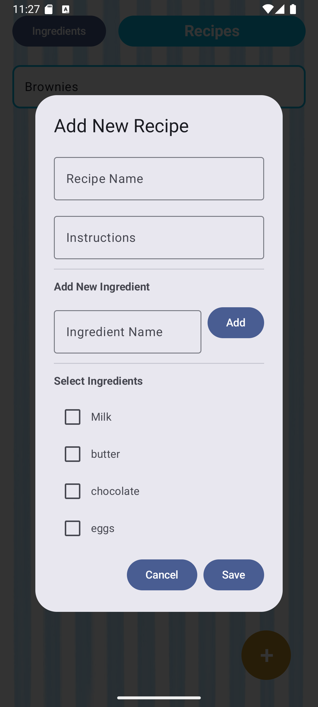
Add Recipe Button
Almost ready
Will behave similarly to the add ingredients button
The user can enter recipe information

Slide 6
Validation Fix
When adding a new ingredient, if the name already exists, it will add onto that existing ingredient
2 ways to add onto an existing ingredient:
When pressing “+,” if it already exists, it adds to it
When using the dedicated “Add More” button on an ingredient

Slide 7
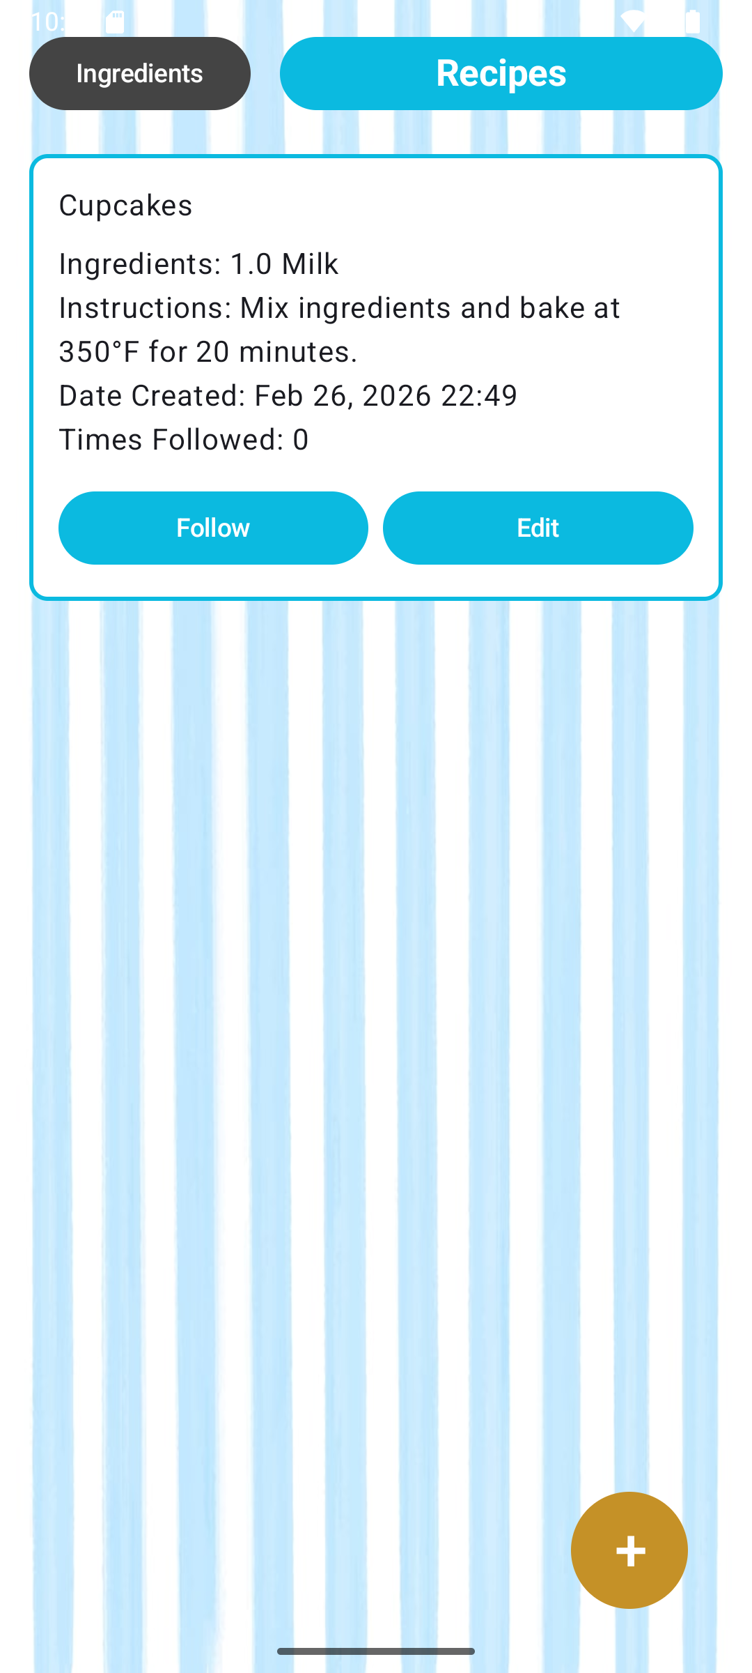
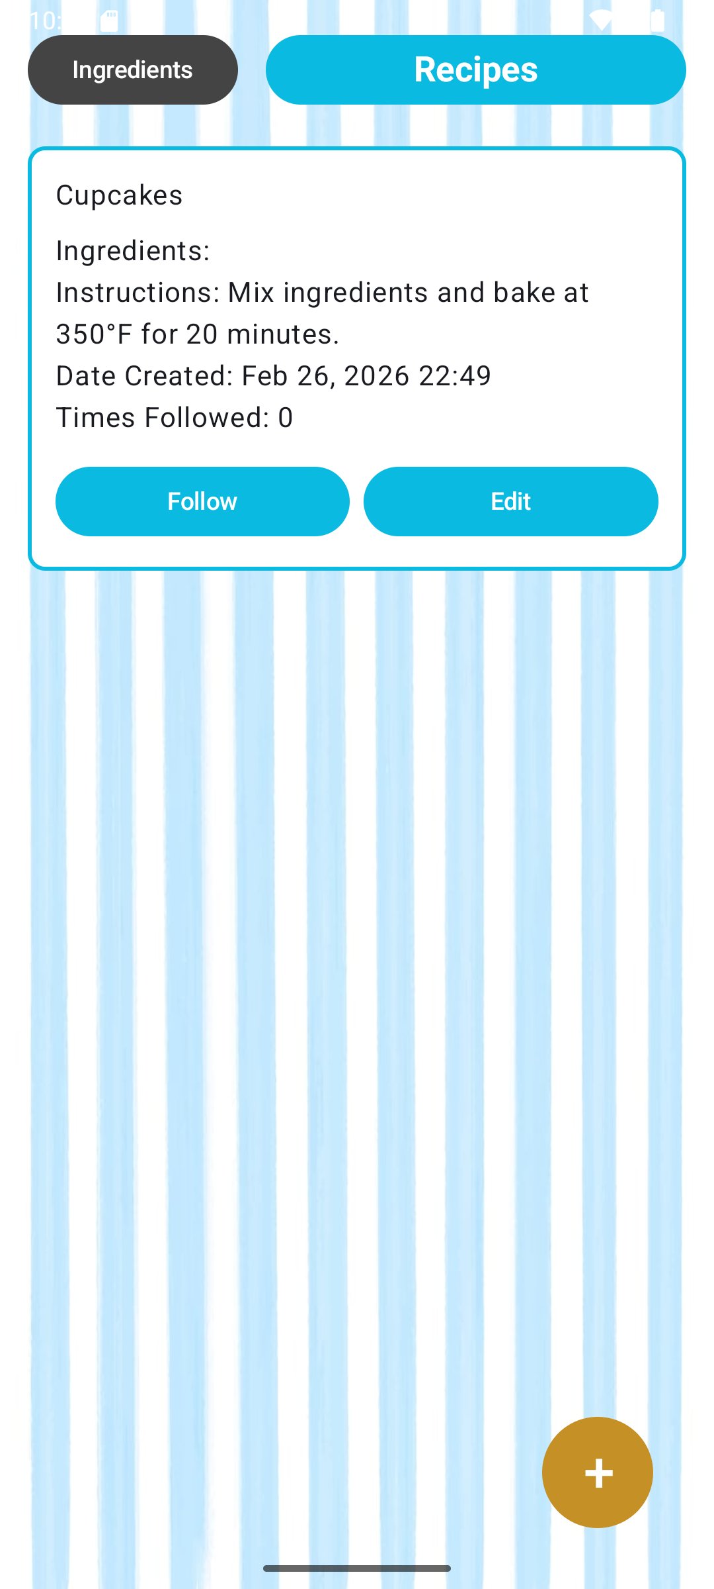
Recipe Screen Bug
Ingredients are sometimes not being listed under an expanded recipe

Slide 8
Unit Conversions Question
Categories of units:
Volume
Weight
Converting within categories is easy:
Volume: cups -> tablespoons
Weight: pounds -> grams
However, a recipe might call for “1 cup of flour,” while the user is storing their flour in “pounds” in the database

Slide 9
Unit Conversions Question
The conversion from volume to weight is different for every ingredient
pounds -> cups of sugar =/= pounds -> cups of flour
Potential Fix:
Forcing user to input volume and weight for future conversions is technically possible, but not desirable
Instead, keep a record of most unit conversions for most popular ingredients a user might add (milk, eggs, flour, sugar, salt, etc.)
But storing all conversions for all possible ingredients is not possible
If an ingredient isn’t found, send to AI to generate conversion values
Some other solution?

Slide 10
Average Cost Question
How to determine average cost over time?
Options:
Use (total cost all time)/(amount stored all time), regardless of current amount
Since prices change over time, it would not reflect current prices of ingredients
Update average price using only current values
We would have to subtract proportionally when quantity is reduced
If current quantity = 10 and current cost = $100, current cost/unit = $10
If user subtracts 2 from quantity, current quantity is 8
We would need to subtract: $100 - (cost/unit * 2) to preserve the cost per unit, and it would make current cost = $80
Divide by 0 error when quantity, and therefore price, go to 0
Some other option?

Slide 11
For next week
Work on unit conversions
Notify if not enough ingredients to complete a recipe
“Follow Recipe” functionality to deduct from ingredient database

