Slide 1
Cupboardly
Weekly Report for 3/6/2026

Slide 2
AI Integration
Google Gemini
If Gemini API key is used directly in the app - security vulnerabilities
So we are using Google's Firebase service
API key is accessed through Firebase, not stored on the app

Slide 3
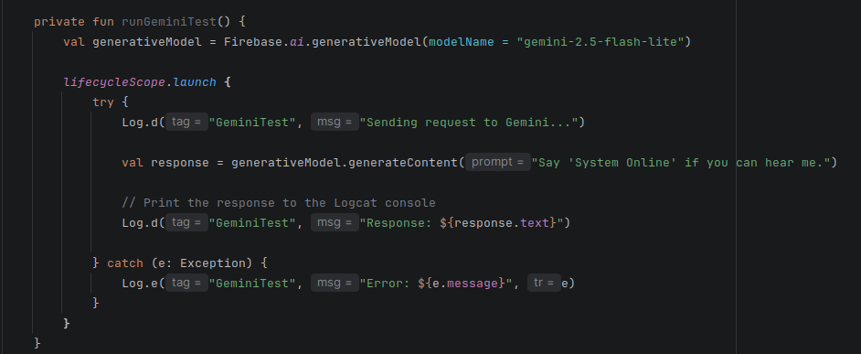

Slide 4
Add Recipe Screen
The add recipe screen now functions as intended
Scrolling menu functions properly
Adding an ingredient to a recipe works now
Duplication check is working

Slide 5
Finalizing Ideas
If these issues were not solved sooner than later, it would cause a lot of difficulty later in development
Much of last week was spent coming up with solutions, though not yet implementing them
Unit conversions
Unit selection

Slide 6
Unit Conversions
We will store a single density value with each ingredient
grams per cup
This will let us convert between mass and volume
Formula for converting mass to volume:
Example:
If 5 pounds flour in storage, and recipe needs 2 cups:
Amount used = 2 cups * 120 g / 1 cup * 1 pound / 453.592 g = ~0.53 pounds of flour
Now 5 – 0.53 = 4.47 pounds of flour in storage

Slide 7
Unit Conversions
We can have a list of popular ingredient densities, such as milk, flour, sugar, salt, and so on
When the user adds an ingredient, we check if we already know the density
If we do, we populate the ingredient's density field in the database
If we do not, we ask the AI for the average density of that ingredient, then populate the ingredient's density field in the database
Only prompt the AI if we do not know the density

Slide 8
Unit Selection
When adding an ingredient, the user will select from predefined options such as grams, cups, pounds, units, and so on
Instead of typing in any unit
Since we know how to handle unit conversions, we can display the current quantity in any unit
The user can select any unit to view an ingredient in at any moment
The display will automatically update to reflect the proper unit values

Slide 9
Text Recognition
ML Kit
API that can be used in Android Studio
Simply import the proper dependencies and libraries
It can recognize text from images or videos
In our case images of recipes

Slide 10
For next time
Add new unit selection system when adding an ingredient
Add conversion formulas between mass and volume
Fix variable names to be clearer (cost vs price)

