Slide 1
Cupboardly
Weekly Report for 3/20/2026

Slide 2
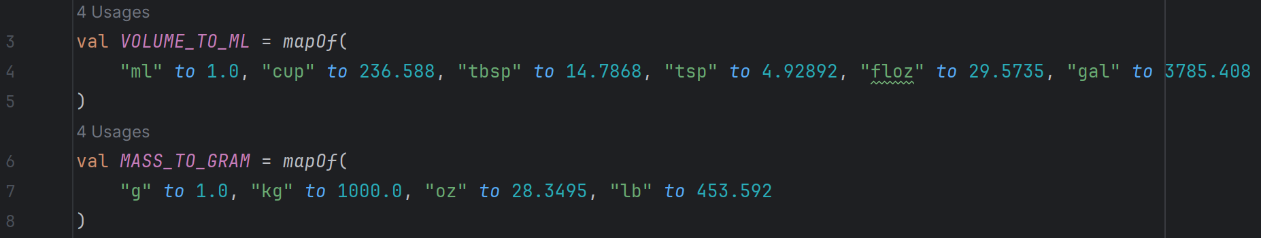
Unit Conversions
We are storing quantities in grams in the database – this never changes regardless of units
We are storing density in grams per milliliter
We have dictionaries (maps) for the conversions:
grams to other masses
milliliters to other volumes

Slide 3
Unit Conversions
The unit conversion functions use the density and those dictionaries to convert between units
We have a working system to dynamically change quantities based on unit selection
The quantity in the database is never changed, only the displayed version of that data

Slide 4
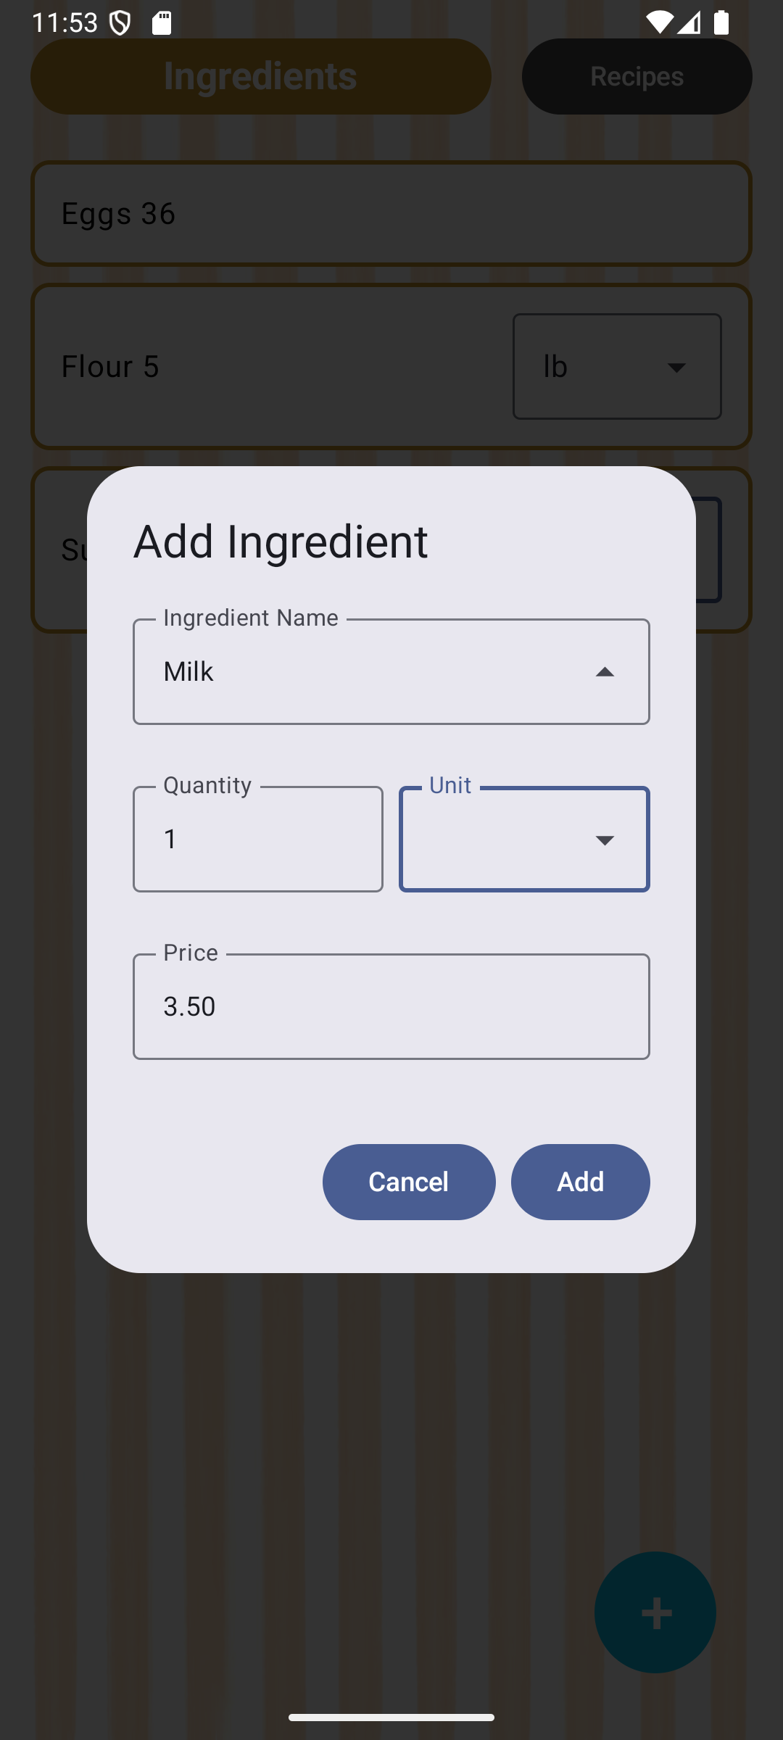
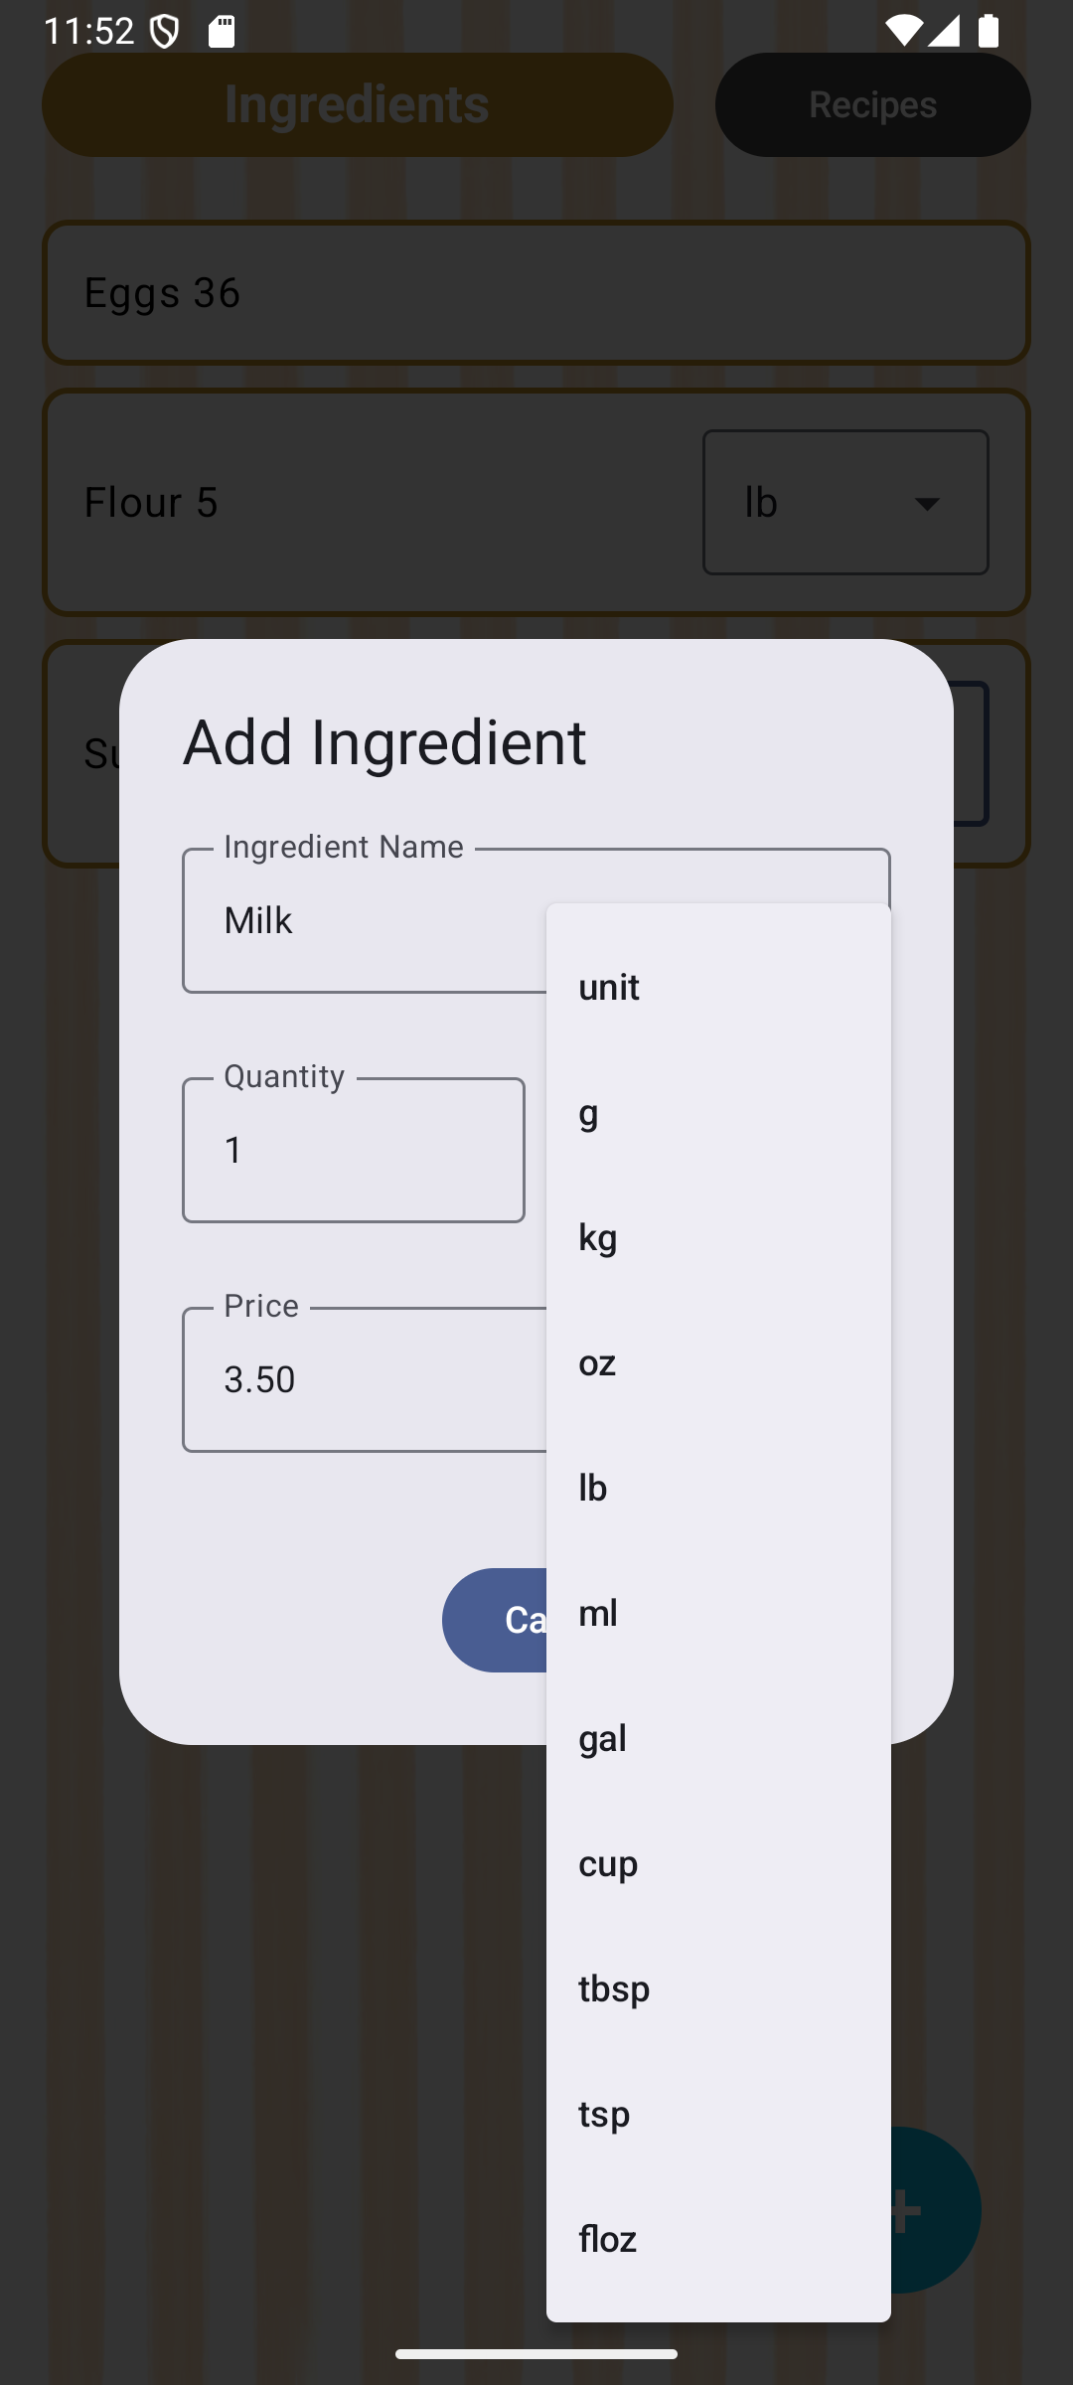
Unit Selection
We now force the user into a predefined selection of units
Instead of letting them enter any unit they want to

Slide 5
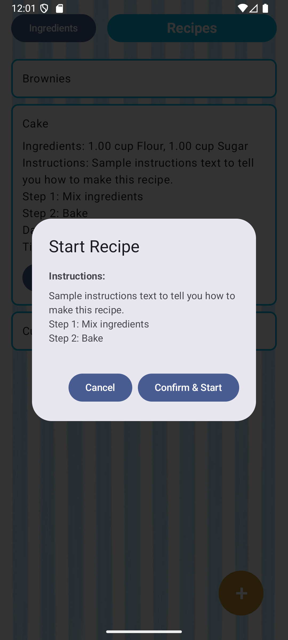
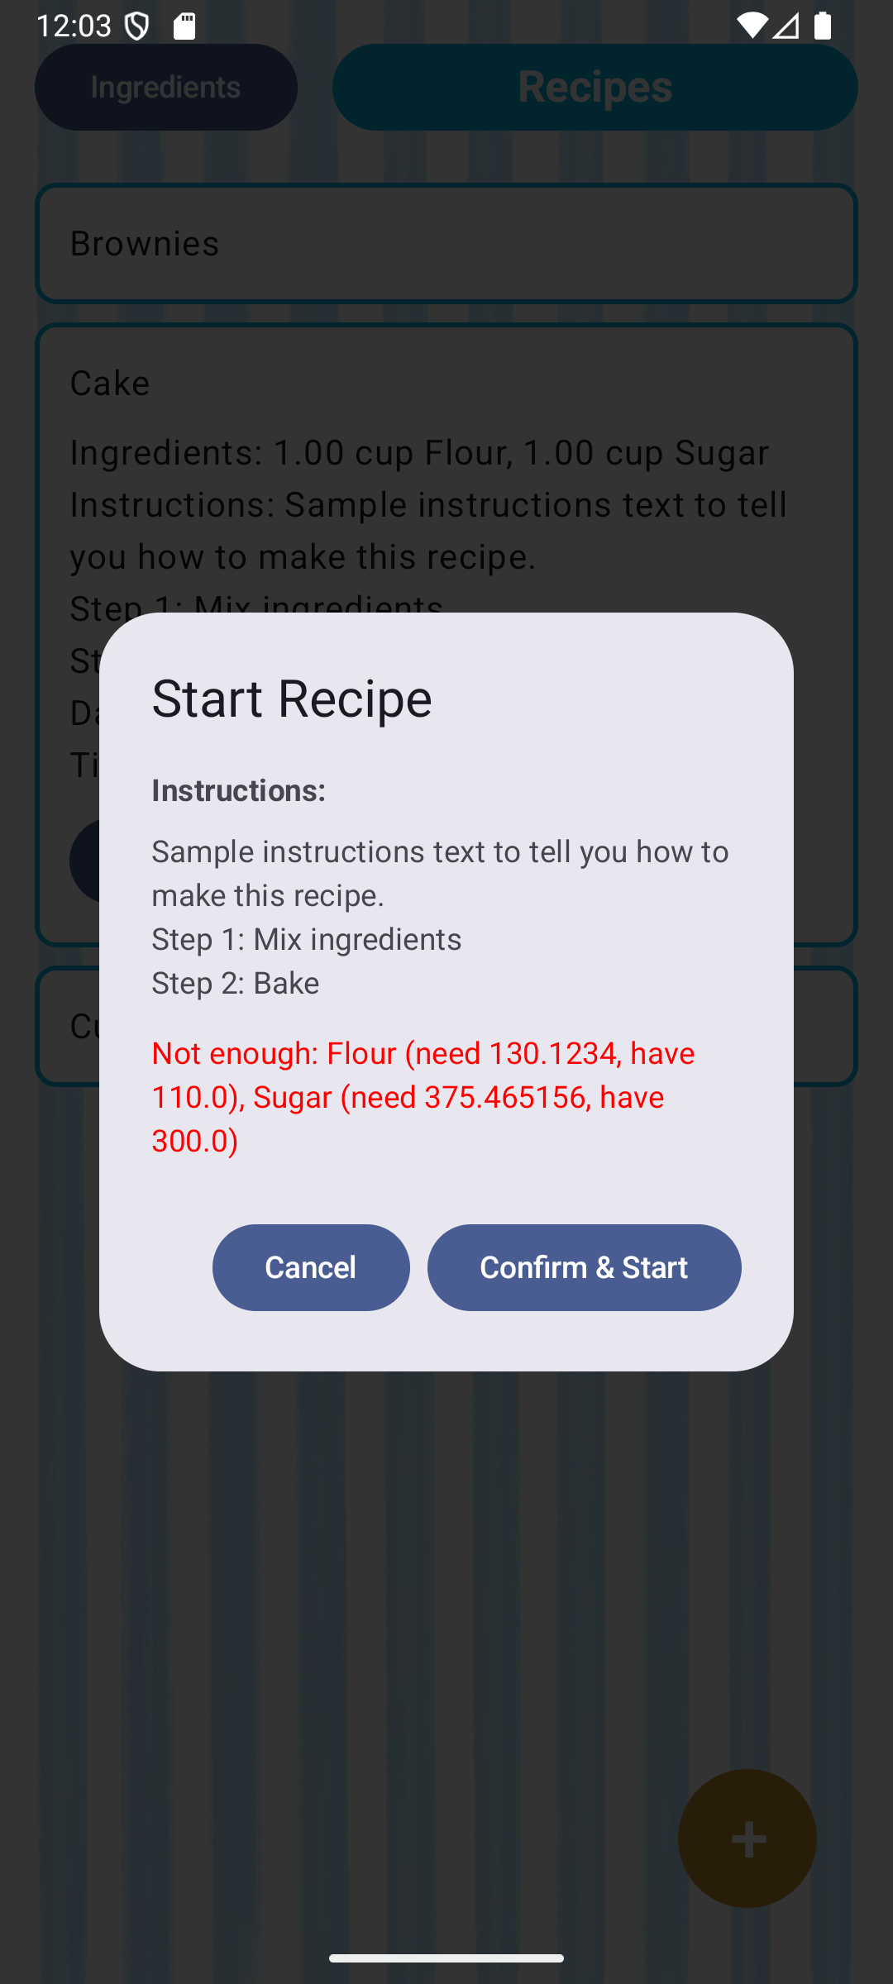
Following a Recipe
The button to follow (start) a recipe
It tells the user if they don’t have enough ingredients
(Not using unit conversions properly yet)

Slide 6
Camera
We will need to add a new screen (similar to how we currently have an ingredients screen and a recipe screen)
Questions:
Permissions
Image storage location

Slide 7
Physical Phones
We have real Android Phones connected to Android Studio
We can install and run the app on real devices instead of on emulators

Slide 8
Issues
Sometimes a phone refuses to connect to Android Studio
Solution:
Restarting phone
But constantly restarting phones can be annoying when trying to test new features as they are added

Slide 9
Issues
There is no validation to ensure a unit is selected when entering an ingredient
The drop down field can be left blank
This breaks that ingredient entry and it doesn’t behave properly

Slide 10
Issues
In the app on some real phones, the content overlaps with the top status bar
Button sizing is wrong on real phones, causing text wrapping in the buttons

Slide 11
Issues
Gemini prompts were not being sent out after switching to a new git branch
Invalidating caches and rebuilding the app in Android Studio fixed this

Slide 12
For next time
Ensure unit conversions are being used across the app anywhere they are needed
Add edit and delete buttons to recipes
Start to get camera screen working

