Slide 1
Cupboardly
Weekly Report for 3/27/2026

Slide 2
Camera Problem
Camera permissions require explicit declaration in the AndroidManifest.xml and are case sensitive (the path is case sensitive)
Camera permissions also need to be asked for when the app gets to a segment that can call a camera (i.e. recipescreen)
Camera needs directory permissions explicitly declared in the same manner, even if not saving to the device
.xml file needs to be made to set up the path for the camera to access

Slide 3
Camera
Permissions can be granted by the user and the camera app can be successfully launched
We have a directory created to save the image into
The image is not being used yet, though

Slide 4
Recipe Screen
Delete button has been added
Recipe screen shows how much of an ingredient you will have left if you were to follow a recipe
Warns user if they don’t have enough ingredients to follow a recipe, but the user can override this and follow the recipe anyway

Slide 5
UI Scaling Fixed
The UI no longer overlaps with the status bar on the top of devices
.safeDrawingPadding() automatically handles this
Buttons no longer text wrap, text is scaled down to fit

Slide 6
Other Fixes
When adding an ingredient, the unit cannot be left blank (default value)
Added formatting to numbers to avoid many decimal places
Edit ingredient screen has a drop down menu for unit selection

Slide 7
Other Fixes
Made UI labels clearer:
“Value of Ingredient” instead of saying price or cost
No longer shows all time values for quantity or price
Ingredient Value decreases properly when an ingredient is used, to preserve price per unit calculations

Slide 8
Recipe Screen Problem
We were getting errors saying there was an unresolved reference to one of our functions used in the recipe screen
We spent hours debugging, changing variable and function names, trying different code, but nothing worked
It turns out there was a duplicate file (RecipeViewModel.kt), somehow
Android Studio didn’t know which one to look at so it errored
Deleting the duplicate file fixed the error

Slide 9
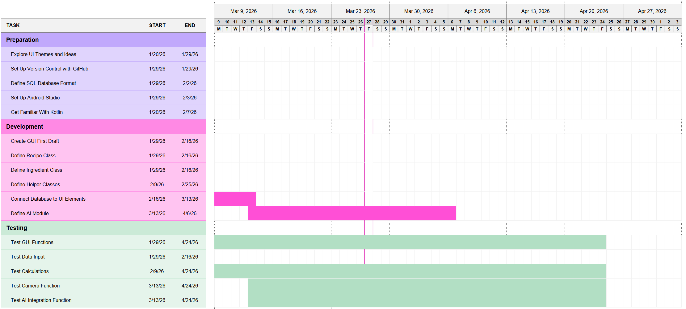
Gantt Chart
Our Gantt Chart was made under the impression that each component would be made then left alone.
However, we’ve found that practically every component is being constantly modified and worked on, so our chart is not entirely accurate.

Slide 10
What Each Team Member Did
Eli added the recipe functionalities
Evan added the UI scaling and various other fixes
Nik added the camera functionality

Slide 11
For next time
Set up text extraction from image
Add edit button to recipes
Add expiration date handling for ingredients

