Slide 1
Sprint 2 Presentation
Team 5
Evan Kennedy
Brian Magnusen
Punleuk Oum

Slide 2
WebGL with three.js
three.js
Cross-browser graphics JavaScript API using WebGL
WebGL
No plug-ins required
GPU-accelerated

Slide 3
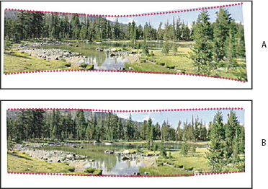
Cylindrical Panoramas
Horizontal field of view up to 360 degrees
Vertical field of view practical limit of 120 degrees
Reduces “bow-tie” distortion

Slide 4
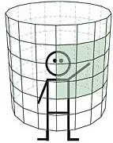
Rendering cylindrical panoramas
Create segmented cylinder
Texture the cylinder with the panorama
Render viewpoint from inside the cylinder

Slide 5
Demonstration
User Stories
Drag and drop images into any order
Cancel in-progress stitching requests
Add support for cylindrical panoramas
Import images from URL
Add user accounts
Support multiple panoramas

Slide 6
Sprint 3 Plans
Add online help documentation
Support saving panoramas to local filesystem in PNG format
Support spherical panorama stitching and viewing
Support zooming and panning around planar panoramas

Slide 7
Questions from the audience?

