Slide 1
Sprint 1 Presentation
Team 5
Evan Kennedy
Brian Magnusen
Punleuk Oum

Slide 2
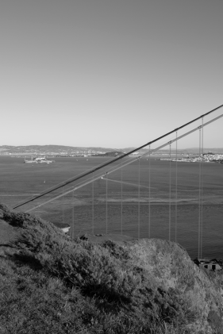
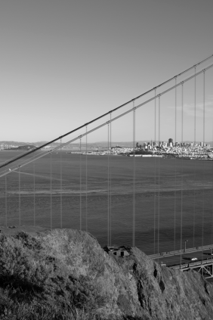
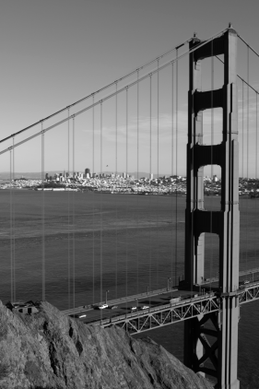

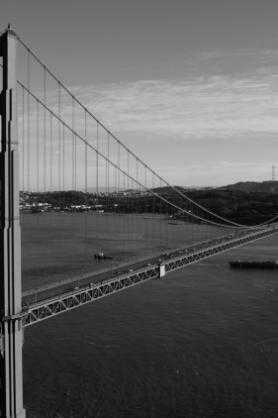
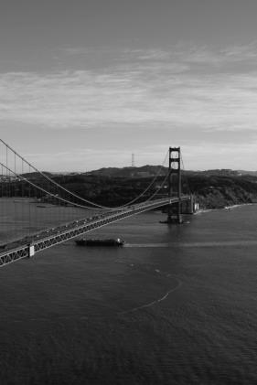
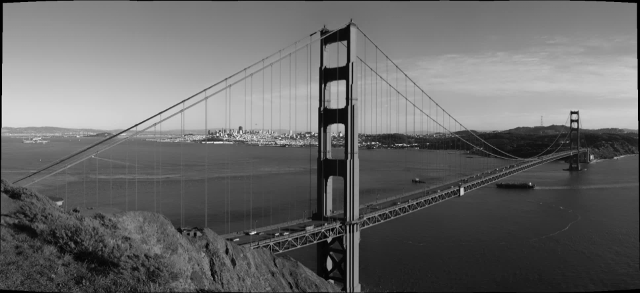
Project Overview
Panoramic Image Stitcher

Slide 3
Motivation
Panoramic Image Stitching is limited to smartphone and high-end digital camera owners
Many proprietary desktop solutions only work on the client-side
A cloud-deployed image stitching service allows all users access to panoramic images, even those with slower computers

Slide 4
Technology Stack
Server-Side
Amazon EC2
Amazon S3 – Image Storage and Static Site Hosting
Amazon Lambda – Scalable Computing
OpenCV
Node.js
Client-Side
HTML5
AngularJS
Less (CSS)
Dropzone.js

Slide 5
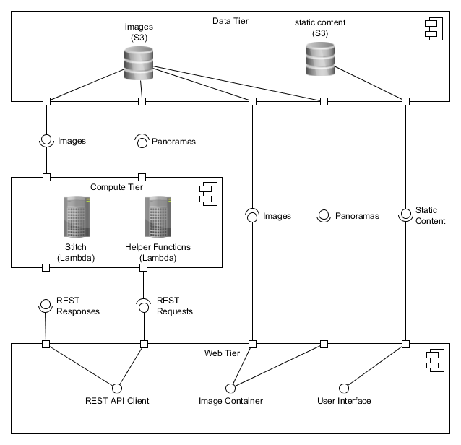
Component Diagram

Slide 6
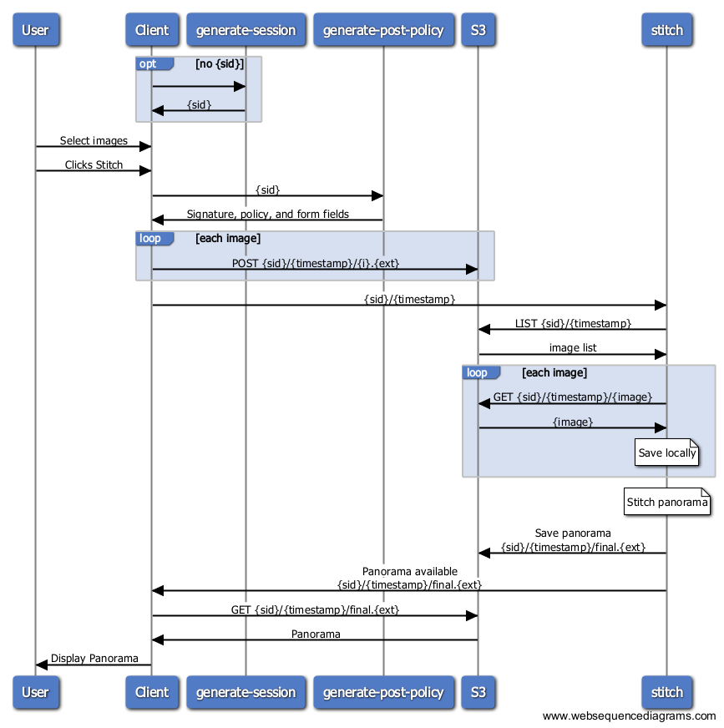
Application Sequence Diagram

Slide 7
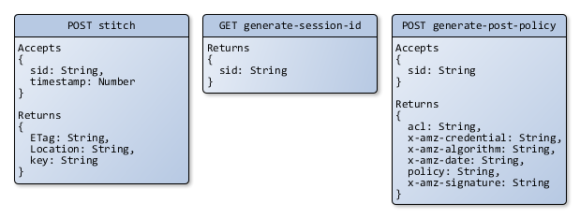
REST API Object Model

Slide 8
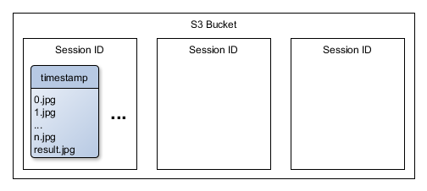
Data Layer Object Model

Slide 9
Demonstration
User Stories
As a user I would like to add images from my local filesystem
As a user I would like to delete images from the source list
As a user I would like to stitch images to create a planar panorama
As a user I would like to view a panorama

Slide 10
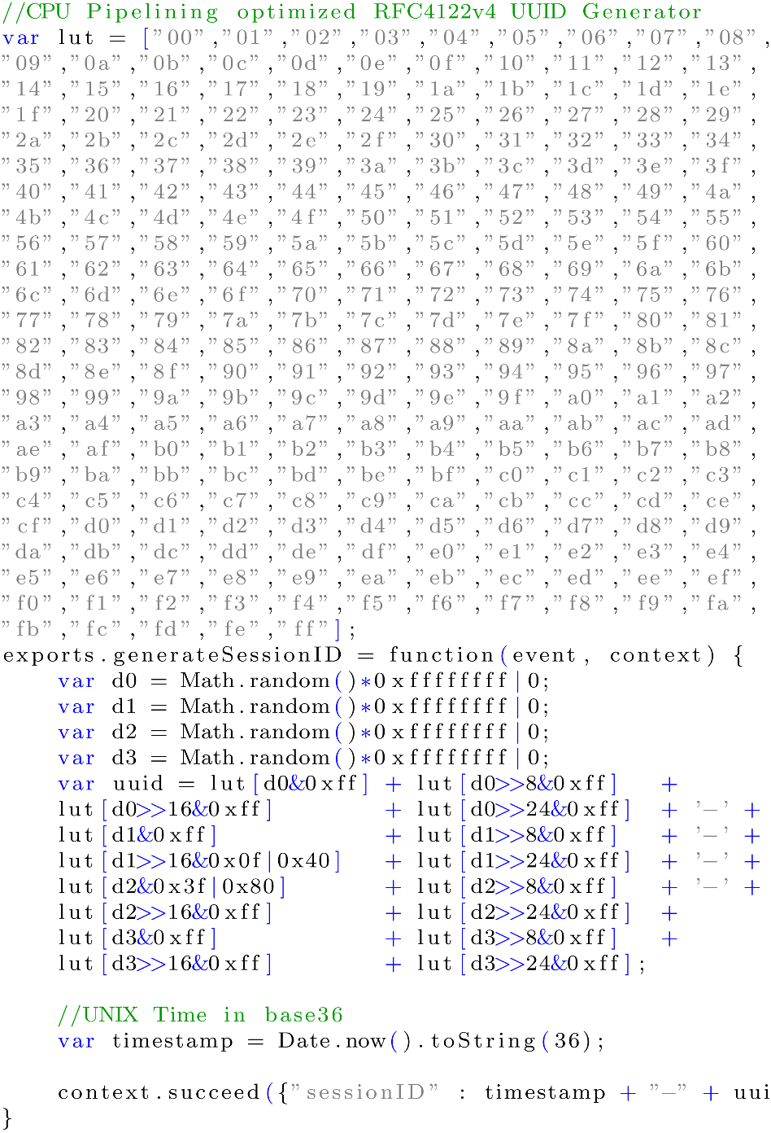
Code Examples

Slide 11
Sprint 2 Plans
Import images from URL
Add support for cylindrical panoramas
Support multiple panoramas
Drag and drop images into any order
Cancel in-progress stitching requests
Add user accounts

Slide 12
Questions from the audience?

