Slide 1
Final Presentation
Team 5
Evan Kennedy
Brian Magnusen
Punleuk Oum

Slide 2
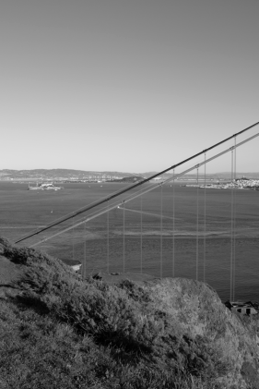
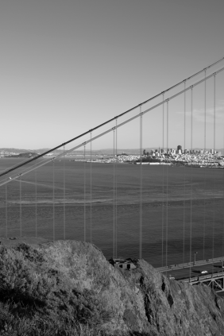
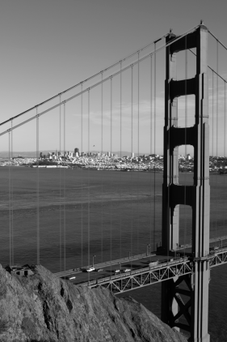

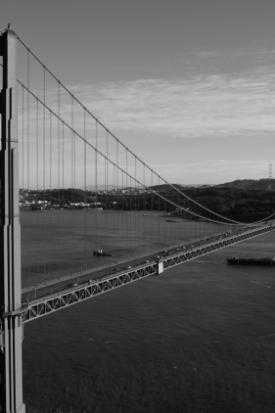
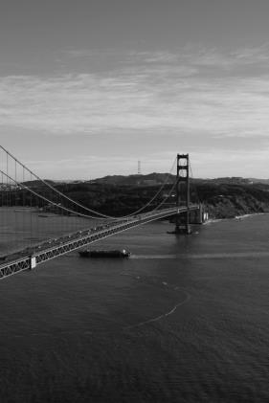
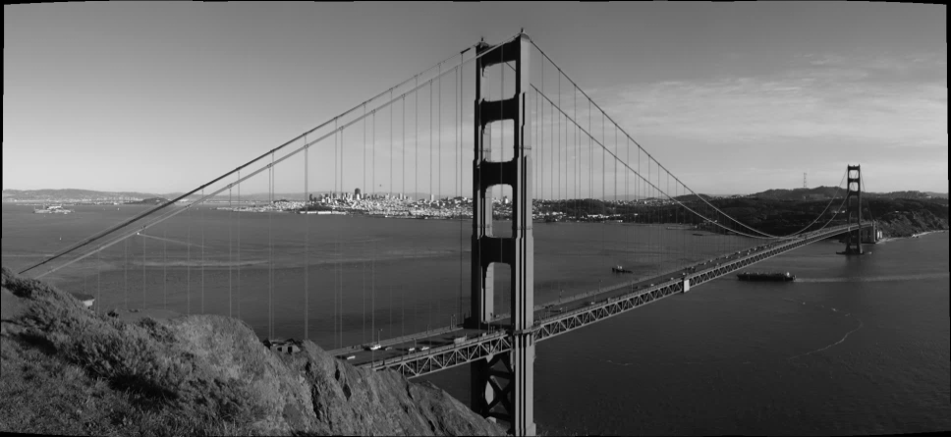
Project Overview
Panoramic Image Stitcher

Slide 3
Motivation
Panoramic Image Stitching is limited to smartphone and high-end digital camera owners
Many proprietary desktop solutions only work on the client-side
A cloud-deployed image stitching service allows all users access to panoramic images, even those with slower computers

Slide 4
Technology Stack
Server-Side
Amazon S3
Amazon Lambda
Amazon DynamoDB
OpenCV
Node.js
Testing
Selenium IDE
Postman
Client-Side
HTML5
Javascript
Bootstrap
JQuery
Three.js
WebGL
Dropzone.js
Cropper.js

Slide 5
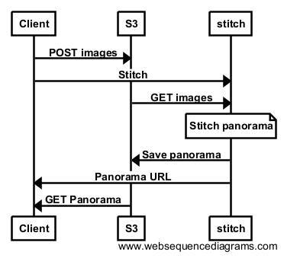
Sequence Diagram

Slide 6
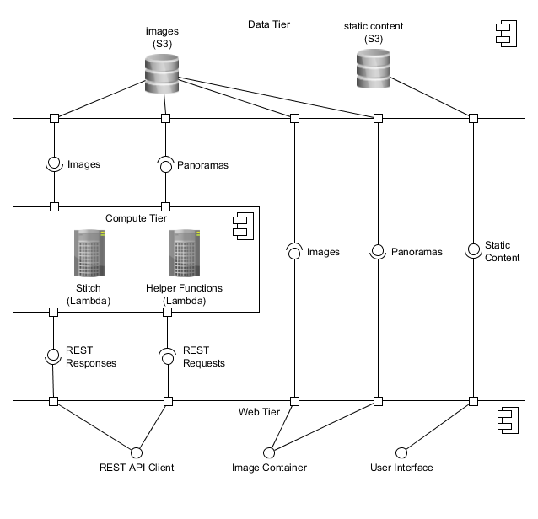
Component Diagram

Slide 7
Walkthrough
Support for stitching three types of panoramas
Planar
Cylindrical
Spherical
Image import from filesystem or URL
Pan & zoom support

Slide 8
Walkthrough
User accounts
Online panorama storage
Panorama downloading with cropping support
JPEG
PNG

Slide 9
Walkthrough
Online help content
Tooltips for user interface elements
Panorama sharing via Facebook

Slide 10
Questions?

