Slide 1
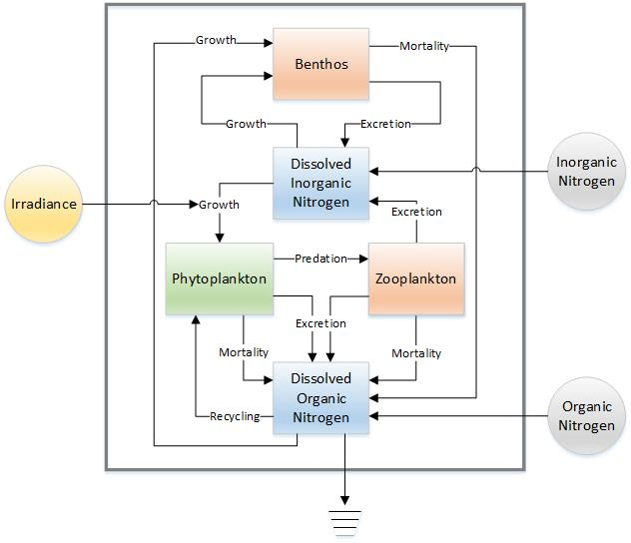
Phytoplankton
P_dot = (i * Pg * P) + (Pr * DON * P) - (h * P * Z) - (Pm * P * P) - (Pe * P)
P = initial[0] # phytoplankton
Z = initial[1] # zooplankton
B = initial[2] # benthos
DIN = initial[3] # dissolved inorganic
DON = initial[4] # dissolved organic
ddin = dtinput.Val("ddin")
ddon = dtinput.Val("ddon")
i = constants.Val("i") #irradiance
Pg = constants.Val("Pg") # max P growth
Bg = constants.Val("Bg") # max B growth
e = constants.Val("e") # Z ingestion
Zm = constants.Val("Zm") # Z mortality
Pm = constants.Val("Pm") # P mortality
Bm = constants.Val("Bm") # B mortality
Pe = constants.Val("Pe") # P excretion
Be = constants.Val("Be") # B excretion
Pr = constants.Val("Pr") # P recycle
h = constants.Val("h") # Z grazing
s = constants.Val("s") # sedimentation
(i*Pg*P)
+
(h*P*Z)
-
-
(Pe*P)
+
-
(Pm*P*P)
(Pr*DON*P)

Slide 2
Zooplankton
Z_dot = ((2 * e - 1)*h * P * Z) - (Zm * Z * Z)
P = initial[0] # phytoplankton
Z = initial[1] # zooplankton
B = initial[2] # benthos
DIN = initial[3] # dissolved inorganic
DON = initial[4] # dissolved organic
ddin = dtinput.Val("ddin")
ddon = dtinput.Val("ddon")
i = constants.Val("i") #irradiance
Pg = constants.Val("Pg") # max P growth
Bg = constants.Val("Bg") # max B growth
e = constants.Val("e") # Z ingestion
Zm = constants.Val("Zm") # Z mortality
Pm = constants.Val("Pm") # P mortality
Bm = constants.Val("Bm") # B mortality
Pe = constants.Val("Pe") # P excretion
Be = constants.Val("Be") # B excretion
Pr = constants.Val("Pr") # P recycle
h = constants.Val("h") # Z grazing
s = constants.Val("s") # sedimentation
(0.8* (1 - e) * h * P * Z)
[(2*e-1)*(h*P*Z)]
-
+
(0.2 * (1 - e) * H * P * Z)
-
-
(Zm*Z*Z)

Slide 3
Benthos
(BM * B * B)
B_dot = (Bg * B)/ (1 + Bg * B) * (DON + DIN) - (BM * B * B) - (Be * B)
+
-
(Bg * B)/ (1 + Bg * B) * (DON + DIN)
P = initial[0] # phytoplankton
Z = initial[1] # zooplankton
B = initial[2] # benthos
DIN = initial[3] # dissolved inorganic
DON = initial[4] # dissolved organic
ddin = dtinput.Val("ddin")
ddon = dtinput.Val("ddon")
i = constants.Val("i") #irradiance
Pg = constants.Val("Pg") # max P growth
Bg = constants.Val("Bg") # max B growth
e = constants.Val("e") # Z ingestion
Zm = constants.Val("Zm") # Z mortality
Pm = constants.Val("Pm") # P mortality
Bm = constants.Val("Bm") # B mortality
Pe = constants.Val("Pe") # P excretion
Be = constants.Val("Be") # B excretion
Pr = constants.Val("Pr") # P recycle
h = constants.Val("h") # Z grazing
s = constants.Val("s") # sedimentation
+
-
(Be * B)

Slide 4
Dissolved Inorganic Nitrogen
DIN_dot = ddin + (0.8* (1 - e) * h * P * Z) + (Be * B) - (i * Pg * P) - (Bg * B)/ (1 + Bg * B) * DIN
P = initial[0] # phytoplankton
Z = initial[1] # zooplankton
B = initial[2] # benthos
DIN = initial[3] # dissolved inorganic
DON = initial[4] # dissolved organic
ddin = dtinput.Val("ddin")
ddon = dtinput.Val("ddon")
i = constants.Val("i") #irradiance
Pg = constants.Val("Pg") # max P growth
Bg = constants.Val("Bg") # max B growth
e = constants.Val("e") # Z ingestion
Zm = constants.Val("Zm") # Z mortality
Pm = constants.Val("Pm") # P mortality
Bm = constants.Val("Bm") # B mortality
Pe = constants.Val("Pe") # P excretion
Be = constants.Val("Be") # B excretion
Pr = constants.Val("Pr") # P recycle
h = constants.Val("h") # Z grazing
s = constants.Val("s") # sedimentation
(Bg * B)/ (1 + Bg * B) * DIN
(Be * B)
-
+
(i * Pg * P)
+
ddin
-
(0.8* (1 - e) * h * P * Z)
+

Slide 5
Dissolved Organic Nitrogen
DON_dot = ddon + (Bm * B * B) + (Pm * P * P) + (Zm * Z * Z) + (Pe * P) + (0.2 * (1 - e) * H * P * Z) - (Pr * DON * P) - ((Bg * B)/ (1 + Bg * B) * DON) - (s * DON)
P = initial[0] # phytoplankton
Z = initial[1] # zooplankton
B = initial[2] # benthos
DIN = initial[3] # dissolved inorganic
DON = initial[4] # dissolved organic
ddin = dtinput.Val("ddin")
ddon = dtinput.Val("ddon")
i = constants.Val("i") #irradiance
Pg = constants.Val("Pg") # max P growth
Bg = constants.Val("Bg") # max B growth
e = constants.Val("e") # Z ingestion
Zm = constants.Val("Zm") # Z mortality
Pm = constants.Val("Pm") # P mortality
Bm = constants.Val("Bm") # B mortality
Pe = constants.Val("Pe") # P excretion
Be = constants.Val("Be") # B excretion
Pr = constants.Val("Pr") # P recycle
h = constants.Val("h") # Z grazing
s = constants.Val("s") # sedimentation
(Pe * P)
(0.2 * (1 - e) * H * P * Z)
(Pm * P * P)
(Zm * Z * Z)
+
+
+
+
(Bm * B * B)
(Pr * DON * P)
+
ddon
-
+
-
-
((Bg * B)/ (1 + Bg * B) * DON)
(s * DON)

