Slide 1
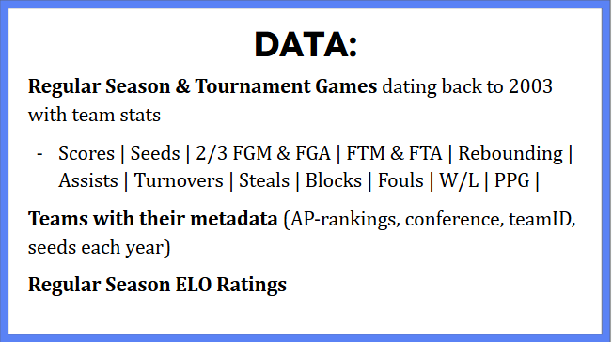
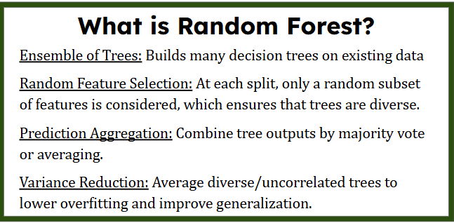
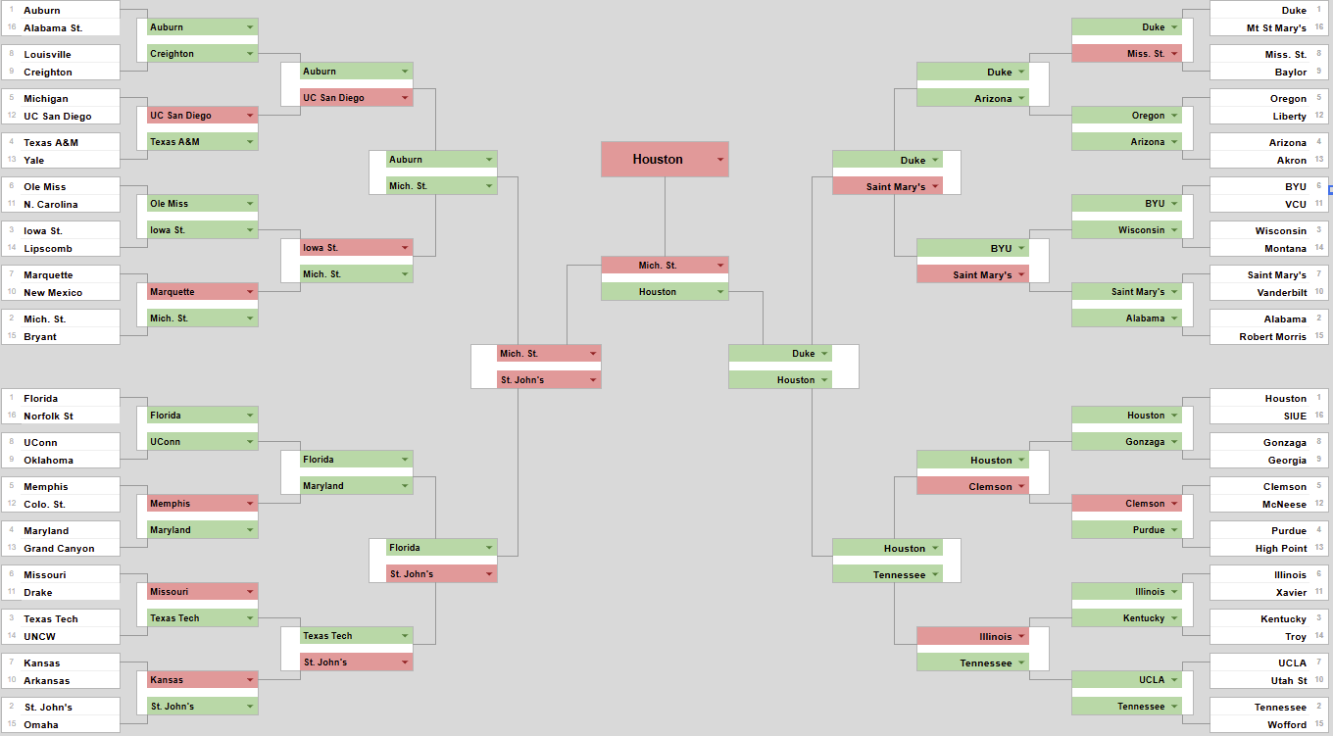
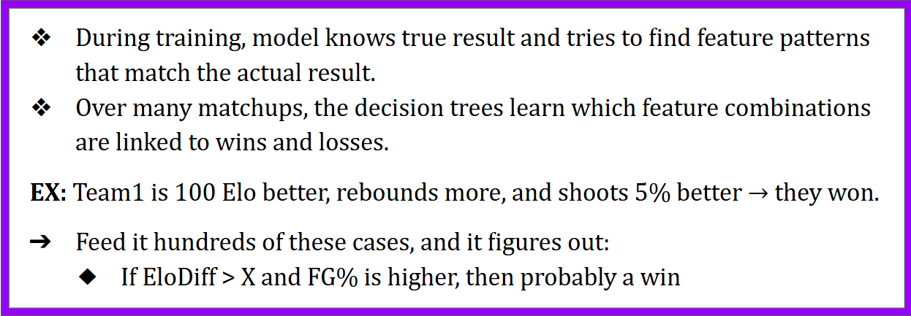
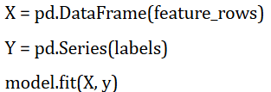
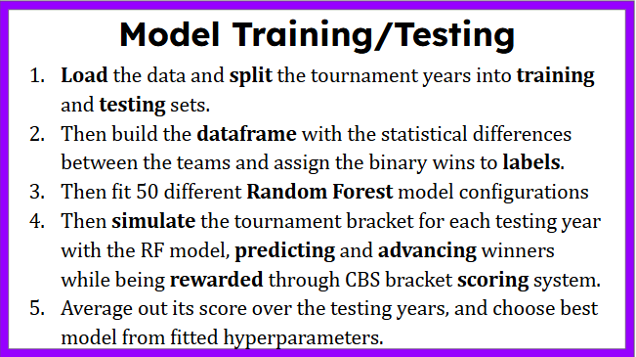
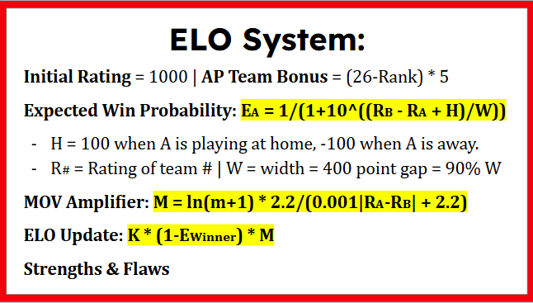
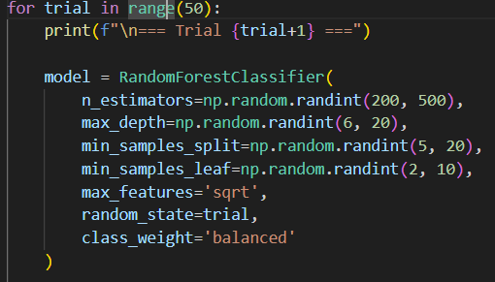

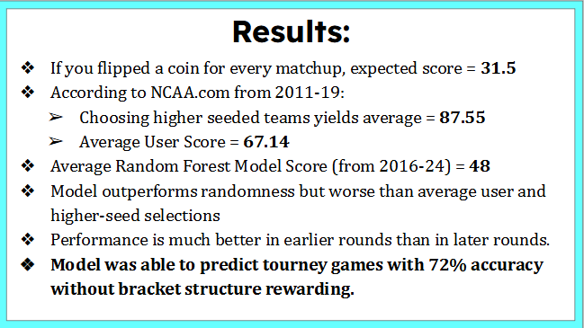

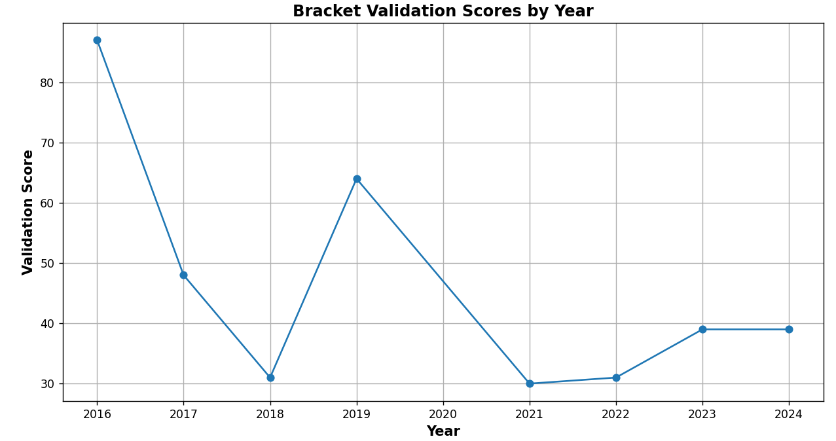
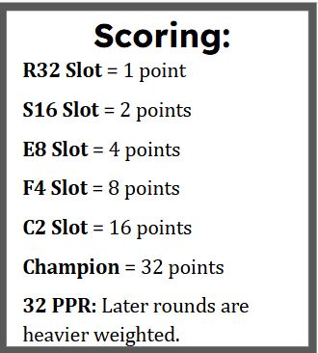


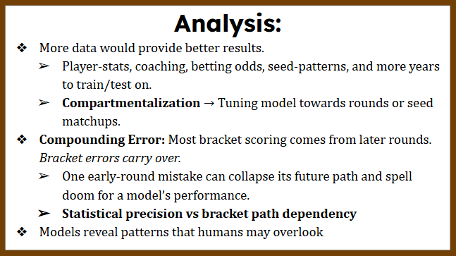

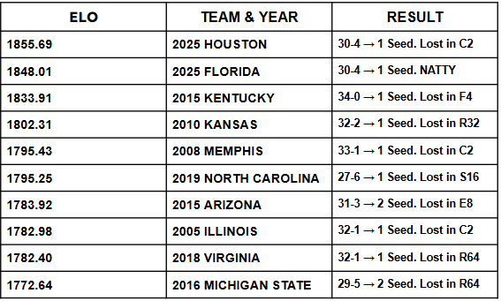
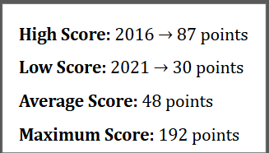

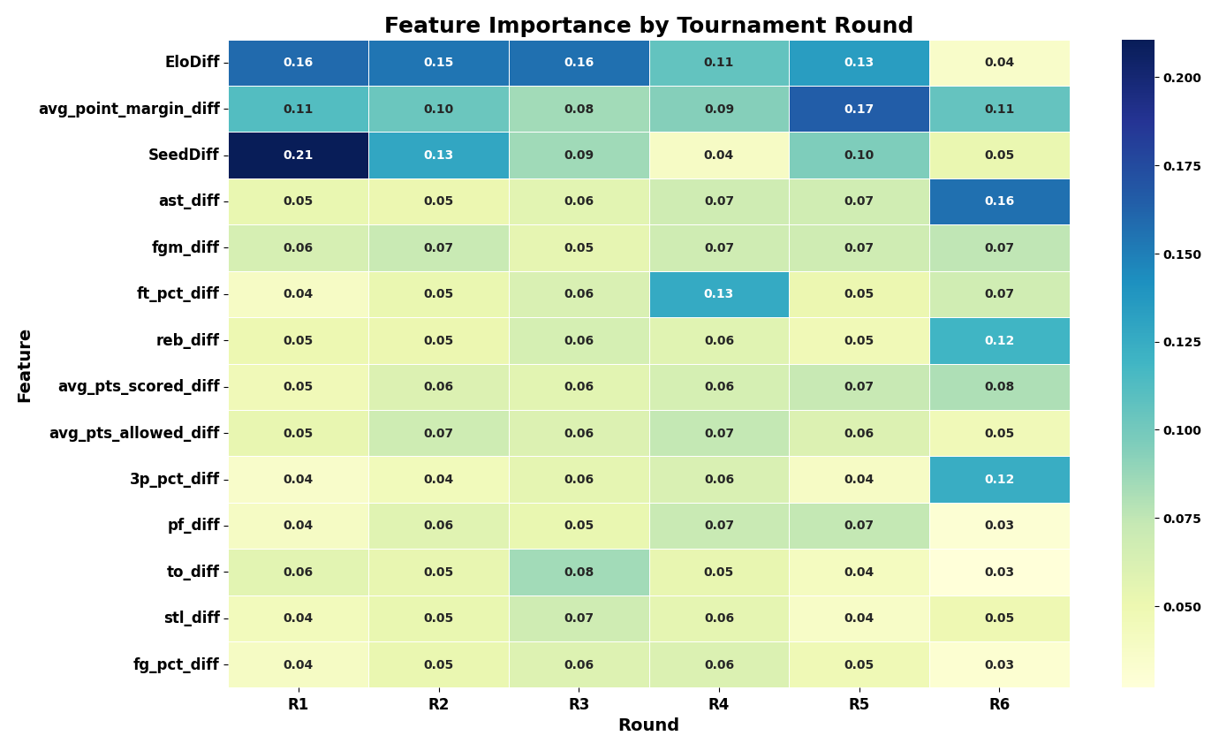
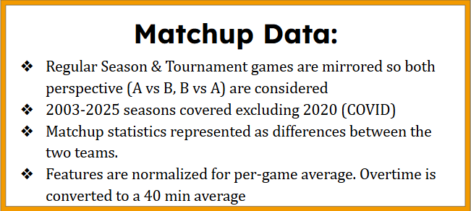
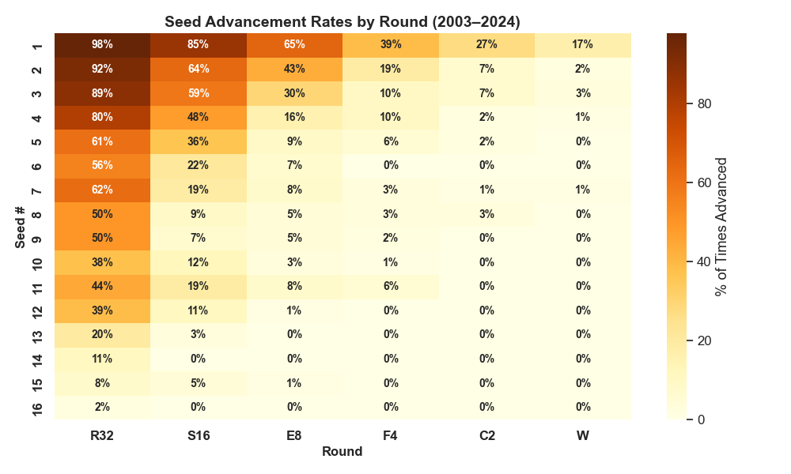

STAT 4610X – Sports Analytics
Final Poster Presentation
2025-05-14
Evan Litzer: Random Forest Bracket Model
Lots of little decision trees all voting together to pick the best answer!
2025 Score: 101 Points
Training: 2003-15
Testing: 2016-2024
2025 Cinderella Pick
Most of my models advanced UC San Diego to the S16.
They lost valiantly to Michigan 68-65 in the R64.
The Bottom Line: Brackets were built to be unpredictable → that’s why it’s called March Madness!
There are 23% less grains of sand on Earth than bracket combinations. 9.2 Quintillion!
11 Seeds historically have significantly more success than 5-10 seeds.
College basketball is an everchanging league. Higher three-point shooting rates and the transfer portal growth only scrape the surface of the sport’s transformation.
In 2018, 1 seeds were 139-0 against 16 seeds. Then UMBC shocked the world!
Acknowledgments: NCAA.com, Getty Images

