Slide 1


UN Global Compact and Korea

Slide 2
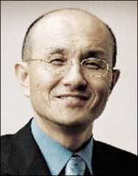
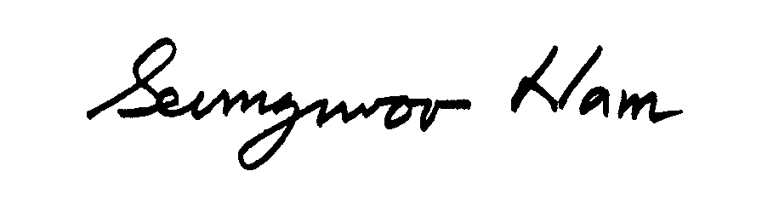
Welcome Address
Message from Nam Seung-Woo, CEO of Pulmuone and President of UN Global Compact Korea Network
I am pleased to present to you the Global Compact Korea Network (GCKN); an initiative launched in September 2007, which works in partnership with Korean business in guidance with the 10 principles of the Global Compact.
The Republic of Korea of today is much changed from Korea of the early 20th Century. It has advanced and developed at an unprecedented rate and has established its footing as a strong global economy, giving rise to the development of major, recognised brands.
There is also a fascinating maturity emerging in terms of culture and democracy. Changing too in a linear fashion are significant social transformations; social perceptions and philosophies characterize and represent these very changes. Indeed, Korea is a society which will continue to embrace and nurture this outlook for ambitious global prospects.
With this in sight, GCKN has ventured into partnership with multiple stakeholders to ensure that issues facing our global business climate are considered by Korean practice; namely those of human rights, labour, environment and anti-corruption. Through this, businesses have been able to interact with one another, consider operating in a more sustainable and efficient way and build confidence in working to be good corporate citizens.
The establishment of the GCKN is one of the most significant stepping stones for corporate citizenship amongst Korean business. Already working with 118 member institutions, GCKN has made a promising start to their launch, organizing various symposia and interactive workshops. However, it is your continued support and partnership which will strengthen our network and create a more unified atmosphere in which we can fulfill our objectives and plans for business in Korea.
I thank you for your support thus far and look to the future with anticipation of what fruits our partnership will bear.
Nam Seung –Woo
Notes:
Just need photos.

Slide 3
Who Are We?
Inaugural Ceremony
UNGC Korea Network held its official inaugural ceremony on 17 September 2007. More than 180 participants, including about 70 CEOs representing Korean business, government, labour and civil society gathered to congratulate the official launch of the UNGC Korea Network.
118 Participating Members
There are currently 118 participating members in the Global Compact initiative from Korea, which include business, academic and municipal institutions. 38 of them have signed up as establishing members for the Korea Network on 2 July 2007 at the Kick-off Ceremony and most participants have shown a commitment to join the UNGC Korea Network.
II. Article of Corporation
Unlike the general structure of a Korean article of corporation, the article of Corporation of the UNGC Korea Network includes a Preamble, which emphasizes the unique characteristics of the Korea Network, which is that it is a domestic organization with key links to the United Nations.
UN Global Compact Korea Network Article of Corporation Preamble:
“The UN Global Compact is the largest voluntary corporate citizenship initiative in the world and offers a unique platform to engage companies in responsible business behavior in the world, through the Ten Principles in the areas of human rights, labour standards, the environment and anti-corruption. It provides access to the United Nation’s broad knowledge base in development issues as well as in mobilizing governments, business, civil society and labour organisations as well as academic institutions to take collective actions…”

Slide 4
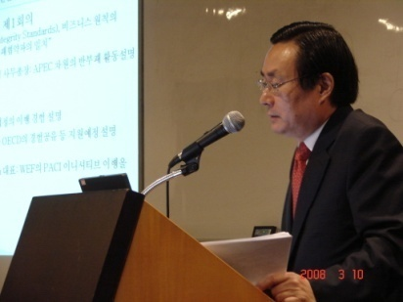
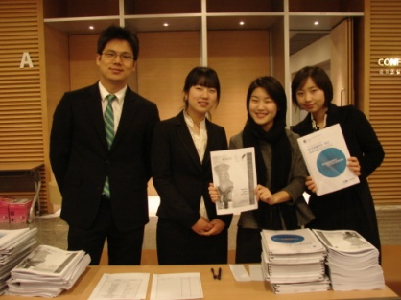
Our Structure
General Assembly: All GC Korea Network Participants. The assembly is the highest legislative organ composed of full members and generals members; also, the President is the Chairperson of the assembly.
Board of Directors: 1 President, 3 Vice-Presidents, 13 Board of Directors, 2 Auditors ; meets every quarter.
Steering Committee: 1 Chairman, 2 Vice-Chairman, 15-20 Committee Members
Purpose: To execute the resolution made by the general assembly and the Board of Directors and also to implement activities stated in the Article of Corporation; meets every quarter.
Secretariat: 1 Secretary- General, 1 Team Manager, 1 Analyst, 6 interns, 1 events co-ordinator.
Purpose: To promote the work of the
UNGC effectively, make or keep in file
documents, and assist the work of the
Board of Directors and the Steering
Committee.
.
[Chul-ki Ju: Secretary General]
Advisory Committee: 1 Chairperson, 5-15 Committee members (including representatives from the government and civil society.)
Purpose: To advise operation of the network.
[ A few of our GCKN Staff]

Slide 5
Our Timeline of Events
2007. 9. 17 | Inauguration Ceremony of the UNGC Korea Network is successfully held.
2007.9.18 | GC Korea Network organises first COP Workshop.
2007.10.17-18 | GC Korea Network participates in the 5th Round Network Forum in Mexico.
2007.11.27 | GC Korea Network and the Korean Chamber of Trade and Commerce jointly host “The Climate Change and Korean Businesses Counterplan” symposium
2008.02. | GC Korea Network actively participates in the Jeju Conference on Business Schools; our Secretary-General delivers a lecture on PRME.
2008.03.10 | GC Korea Network organises an Anti-Corruption Symposium at the Korean Chamber of Trade and Commerce.
2008.03.26 | GC Korea Network participates “UN Global Compact and the Asian Networks Conference” in Bangkok, organized by UNESCAP.
2008.04.11 | GC Korea Network organises second COP Workshop.
2008.04.22-23 | The “B4E Business for the Environment Global Summit” held in Singapore, attended by our Secretary-General.
2008.5.29 | GC Korea Network attend the 2008 JCI Asia-Pacific Conference, organised by the Junior Chamber International. Our Secretary General delivers a lecture on UNGC.
2008.6.16 | Global Compact Korea Network host Asia Network Meeting
2008.6.17-18 | Changing Landscapes: Towards a Sustainable Economy in Asia is jointly hosted by UN Global Compact, UNEP-FI and PRI

Slide 6
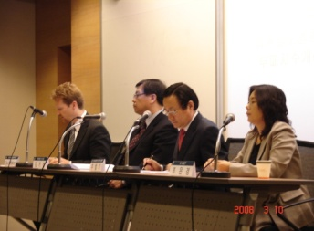
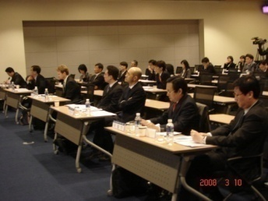
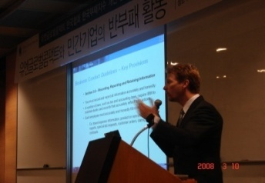
What Are Our Plans?
Work Plan for 2008 includes:
‘Changing Landscapes: Towards a Sustainable Economy in Asia (16-18 June)
UN Global Compact and MDG (I)(10/11 September)
COP Training Workshop (September)
Human Rights Conference to commemorate the 60th anniversary of the Universal Declaration of Human Rights. (October)
Global Compact and Sustainable Environment (October)
General Conference for the Korean Network (November)
Global Compact and Labour (November)
Global Compact and MDG (II) (December)
Mid and Long Term Activities include:
Increase general knowledge of Global Compact, the Korea Network and strengthening the infrastructure of the Korea Network.
Increase participation of Global Compact and the Korea Network.
Setting up of functional working groups, including four main areas of the GC initiative.
Emphasis on COP improvement and special training session on various initiatives including COPs, PRI etc. (at least one COP session per quarter)
Strengthen PR for academia, CSO and media, especially in promoting the work of PRME.
Cooperation and networking with GCO, Local Networks, Regional networks and International Organisations.
Constant studies and propositions regarding the future role of Korean corporations for contributing to the Global Compact initiative.

Slide 7



Changing Landscapes
Changing Landscapes: Towards a Sustainable Economy in Asia. (June 17-18, 2008)
This conference will be the first event jointly hosted by the United Nations’ three leading sustainability driven organisations: Principles for Responsible Investment, UN Environment Programme Finance Initiative and UN Global Compact. The event, which will be held at the Grand Hyatt Seoul, will feature a common issue that investors, financial institutions and businesses can gather together.
Considering the fact that Korea is one of the countries where sustainable finance is rapidly emerging, Seoul seems to be the appropriate place to overview and discuss on sustainable economy in Asia. The conference will provide a unique opportunity to share views on particular issues that can be accepted differently due to regional or cultural differences between developed and emerging markets.
This conference provides the platform for representatives from financial institution, institutional investors, CEOs and senior executives from leading global companies to be joined by leaders from politics, academia, civil society and other organisations to discuss current issues in the field of sustainable finance, responsible investment and corporate citizenship that cut across all sectors.
www.changinglandscapes.org

Slide 8
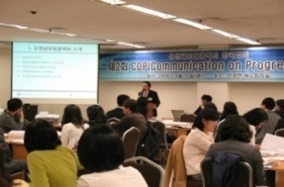
Our Activity on COP
Communication on Progress
Purpose
The purpose of the COP requirement is to ensure and deepen the commitment of Global Compact participants, safeguard the integrity of the initiative and to create a rich repository of corporate practices that serves as a basis for continual performance improvement.
.
Policy for Communication on Progress
Companies must submit a COP report annually. Failure to do so within the first two years of registration will result in a company being listed as inactive.
Global Compact Integrity Measures
The Global Compact Integrity Measures are important in promoting continuous quality improvement, and in preserving the credibility and integrity of the initiative and the United Nations more generally. In the case of the Communication on Progress, they are designed to make more transparent participants’ progress in implementing the Global Compact’s principles.
Use of the Global Compact Logo in COPs
Participants in the Global Compact and other Stakeholders are encouraged to advocate widely and express their support for the Global Compact and its principles. For such activities, the Global Compact Office may authorize Participants and other Stakeholders to use the modified “We Support the Global Compact” logo.
Benefits
The main internal benefit is that a COP motivates a company to define and live up to a sustainability vision and strategy.
It also motivates a company to integrate corporate citizenship activities into their core business operations and increase positive social impacts of their value chain.
[GC KN’s 2nd COP Workshop]

Slide 9
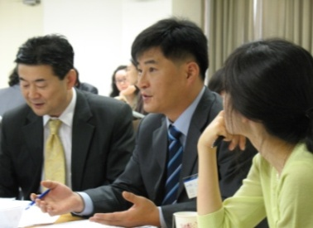
How to Write a COP
Step One: Creating COP
A statement of continued support for the Global Compact in the opening letter
A statement or message from the company’s top executive;
a description of practical actions that participants have taken to implement the Global Compact principles since their last COP (or since they joined the Global Compact)
3. A measurement of outcomes or expected outcomes using, as much as possible, indicators or metrics such as, for example, the Global Reporting Initiative Guidelines.
[GC KN’s 2nd COP Workshop]
Step Two: Sharing a COP with the Company’s Stakeholders
It is important to note that the COP is not a communication with the United Nations Global Compact Office. Rather it is intended to provide a means for participants to communicate their progress on implementing the ten Global Compact principles directly with their stakeholders. Therefore, ideally, COPs should be integrated into a companies existing communication with stakeholders, such as an annual financial or sustainability report. A stand alone COP should not be created, unless the company has no other vehicle to report on corpo­rate citizenship issues.
Step Three: Posting a COP to the Global Compact Website
To Upload: From the home page click on “participant login” and enter your username and password to access your account. Once logged in you will be able to edit contact information. Click on “submissions,” enter all of the required data and click on Save.
The uploaded file may not exceed 12MB.

Slide 10

How to Join Us
As a voluntary initiative, the Global Compact seeks wide participation from a diverse group of businesses and other organizations. To participate in the Global Compact, a company:
Sends a letter from the Chief Executive Officer (and endorsed by the board) to the Secretary-General of the United Nations expressing support for the Global Compact and its principles;
Sets in motion changes to business operations so that the Global Compact and its principles become part of strategy, culture and day-to-day operations;
Is expected to publicly advocate the Global Compact and its principles via communications vehicles such as press releases, speeches, etc; and
Is expected to publish in its annual report or similar corporate report (e.g. sustainability report) a description of the ways in which it is supporting the Global Compact and its ten principles

Slide 11
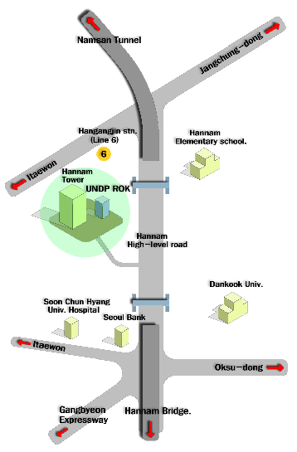
Contact Us
Address:
UN Global Compact Network
Seoul, Yongsan-gu
Hannam-dong,
Hannam Tower #103
140-212
Tel: +82-2-749-2149/50
Fax: +82-2-749-2148
Email: ungckorea@gmail.com
Website: www.unglobalcompact.kr
New York Headquarters:
UN Global Compact Office
United Nations
New York, 10017
USA
UNGCKN

Slide 12
Copyright 2008 © by www.unglobalcompact.kr
The Ten Principles
Human Rights
Principle 1: Businesses should support and respect the protection of internationally proclaimed human rights; and
Principle 2: make sure that they are not complicit in human rights abuses.
Labour Standards
Principle 3: Business should uphold the freedom of association and the effective recognition of the right to collective bargaining.
Principle 4: the elimination of all forms of forced and compulsory labour;
Principle 5: the effective abolition of child labour; and
Principle 6: the elimination of discrimination in respect of employment and occupation.
Environment
Principle 7: Businesses should support a precautionary approach to environmental challenges;
Principle 8: undertake initiatives to promote greater environmental responsibility; and
Principle 9: encourage the development and diffusion of environmentally friendly technologies.
Anti-Corruption
Principle 10: Businesses should work against corruption in all its forms, including extortion and bribery.
Ten Principles on Back Cover

