Slide 1


Data Book
May 2012
Click here to download as PowerPoint

Slide 2

Introduction
There’s an old saying that the plural of anecdote is not data.
At H Engage, we believe that being equipped with the right data is the best way to influence change.
Our January 2012 data deck was met with a great deal of enthusiasm and was accessed over 800 times on slideshare.net. The May 2012 Data Book builds upon this prior report. Slides that have been updated are marked with “updated” in the upper right hand corner.
As we did last time, we’ve purposely left this document as a PowerPoint instead of a PDF. Take the slides. Drop them into presentations. And feel free to drop us a note to ask additional questions and share what you’re hearing from your leaders and clients.
All the best,
Vlad Gyster
Co-founder, CEO
vlad@hengage.com
617-360-8305

Slide 3
The headlines
Adults are active cell phone users | Online behavior has changed dramatically
Cell phones have the highest penetration of any device – 88% of adults own one Smartphone owners now outnumber feature phone owners – 46% of American adults now have a smartphone 75% of adults text – 64% text almost every day, 86% text at least once a week Mobile access is increasing rapidly, especially in older age segments – Adults age 55+ who use social media on their phone grew 109% from 2010 to 2011 | 80% of adults use the Internet The average social gamer is a 43 year old woman working full-time Email accounts for only 13% of time spent online Social networks/blogs and games account for over 50% Twitter may get plenty of attention, but 96% of time spent on social networks/blogs is spent on Facebook 20-30% of Facebook “power users” drive the majority of activity; the rest receive more than they give

Slide 4
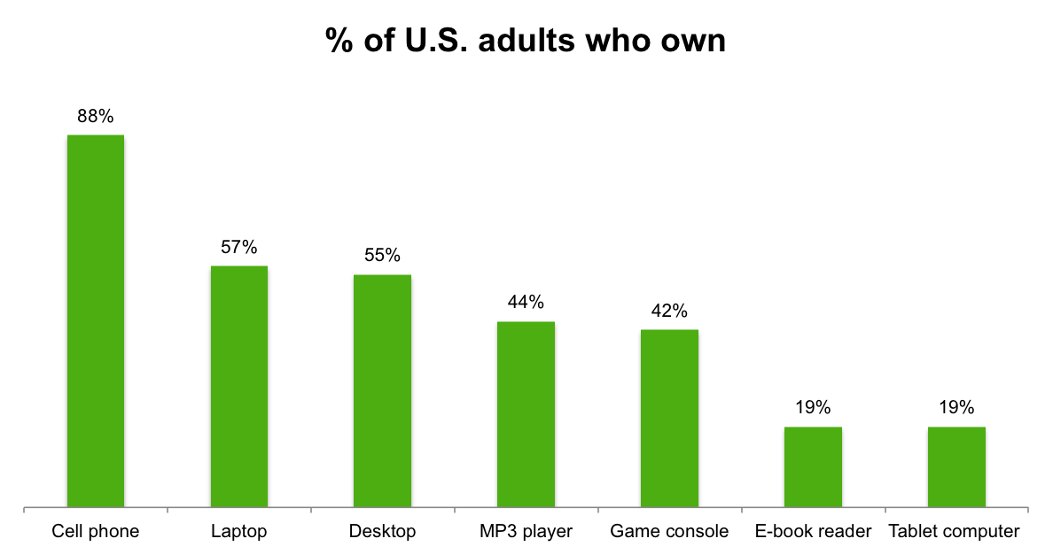
88% of adults own a cell phone
UPDATED
Relative to other technologies, cell phones are unmatched in their adoption rates
Pew Research Center via H Engage
April 2012

Slide 5
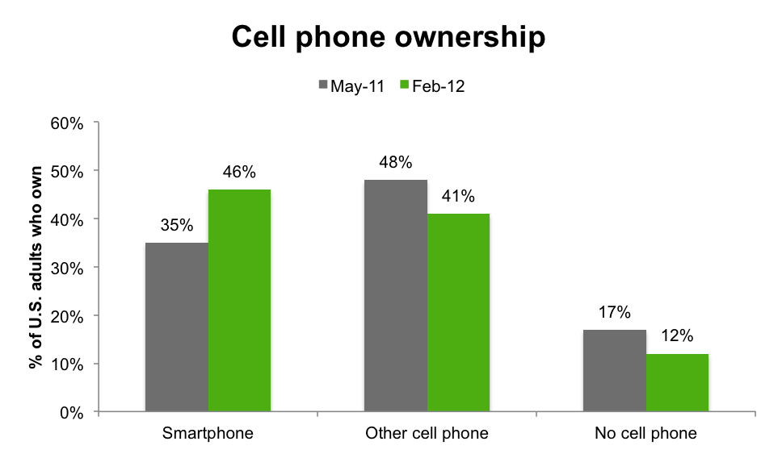
Smartphone users outnumber those with feature phones
UPDATED
Smartphones dominate new phone purchases – accounting for 66% of new phones purchased
Pew Research Center via H Engage
February 2012

Slide 6
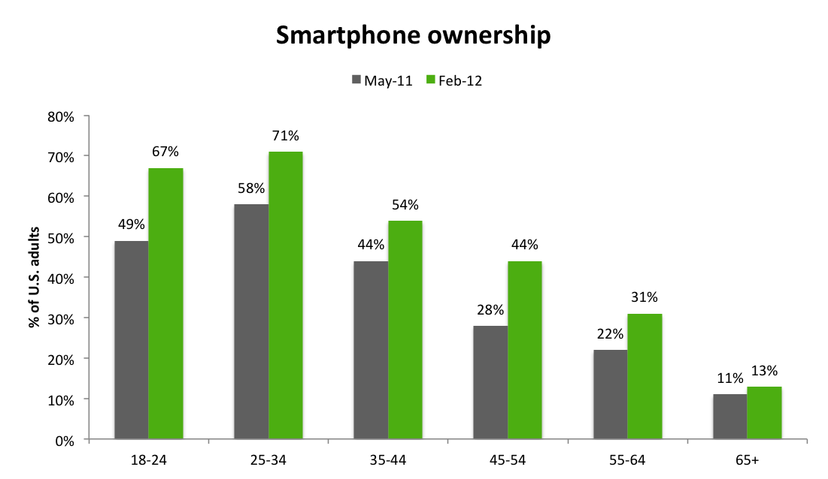
Over 50% of adults age 18 to 44 own a smartphone
UPDATED
Older adults are catching up – 2 in 5 adults age 45-54 now own a smartphone
U.S. avg. = 46%
Pew Research Center via H Engage
February 2012

Slide 7
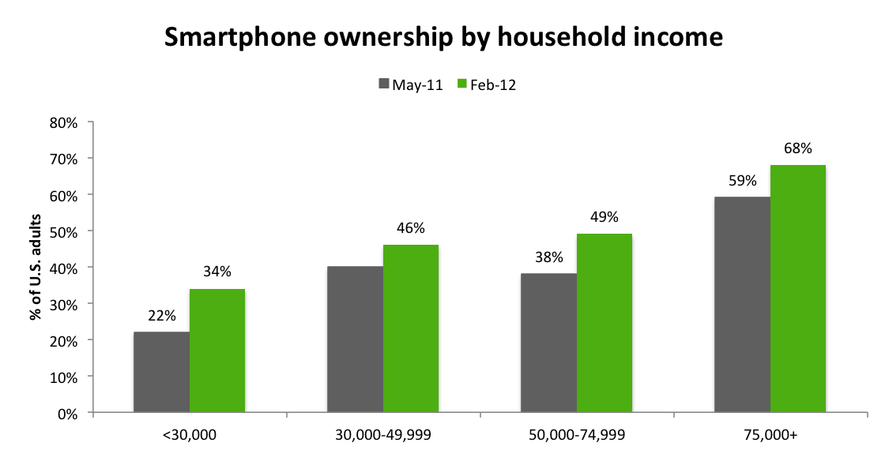
Lower income brackets lag in smartphone adoption
UPDATED
However, those earning <$30k saw the fastest growth in ownership, a sign that smartphones are becoming more widely accessible
40%
U.S. avg. = 46%
Pew Research Center via H Engage
February 2012

Slide 8
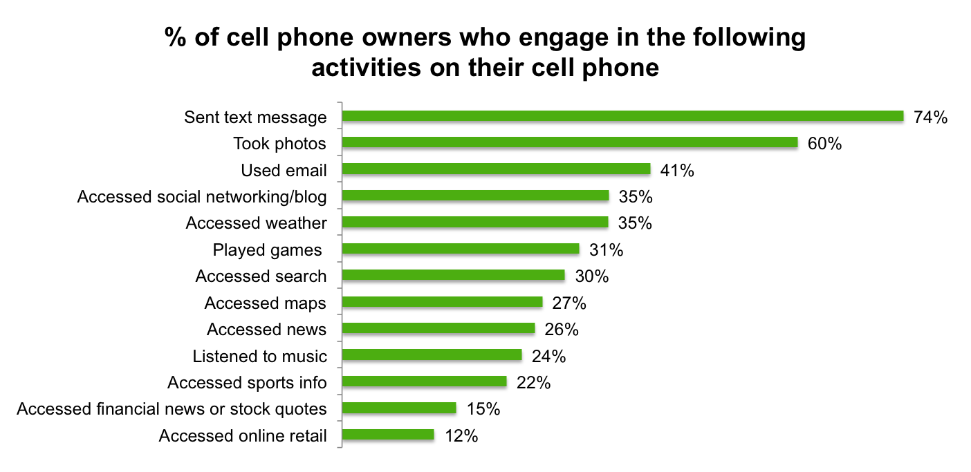
3 out of 4 adults text
UPDATED
Of adults who text, 64% send a text almost every day, and 86% send a text at least once a week
ComScore via H Engage
December 2011

Slide 9
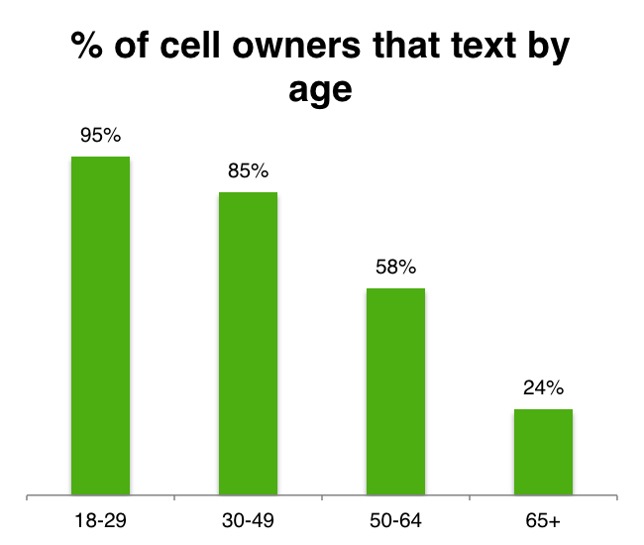
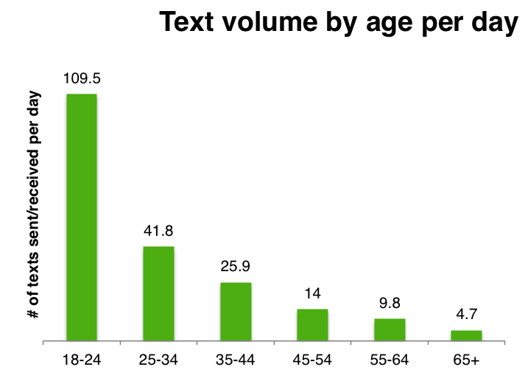
Text message behaviors vary by age segments
All age segments send and receive a significant amount of texts per day, but 18-24 years olds are particularly active, likely due to relatively lower utilization of other communication mediums, like email and voice calls.
Pew Research Center via H Engage
May 2011

Slide 10
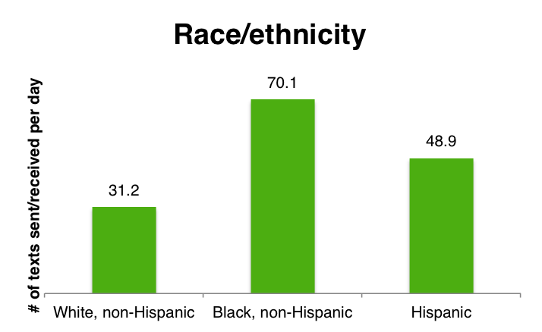
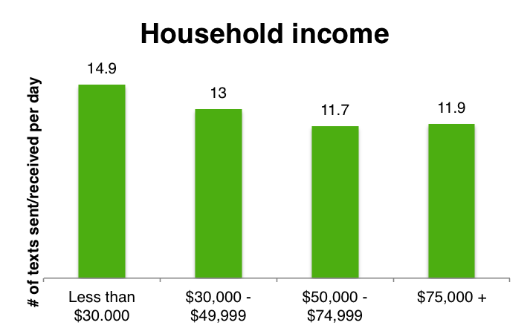
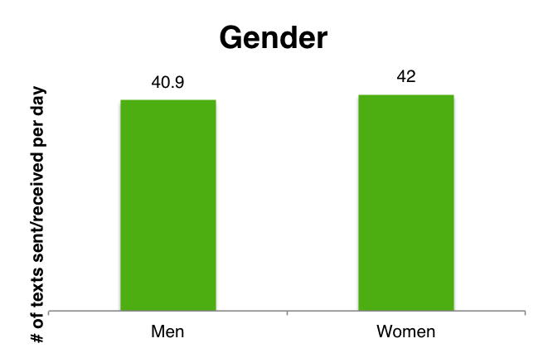
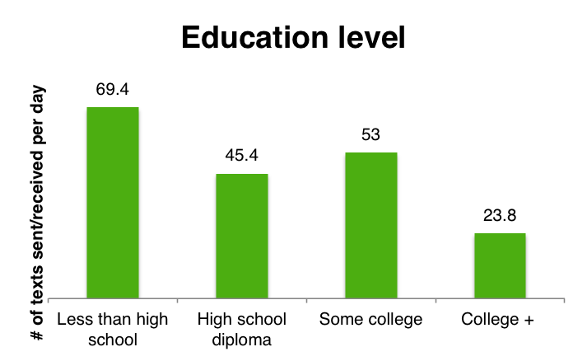
Minority and low income Americans text more
Pew Research Center via H Engage
May 2011

Slide 11
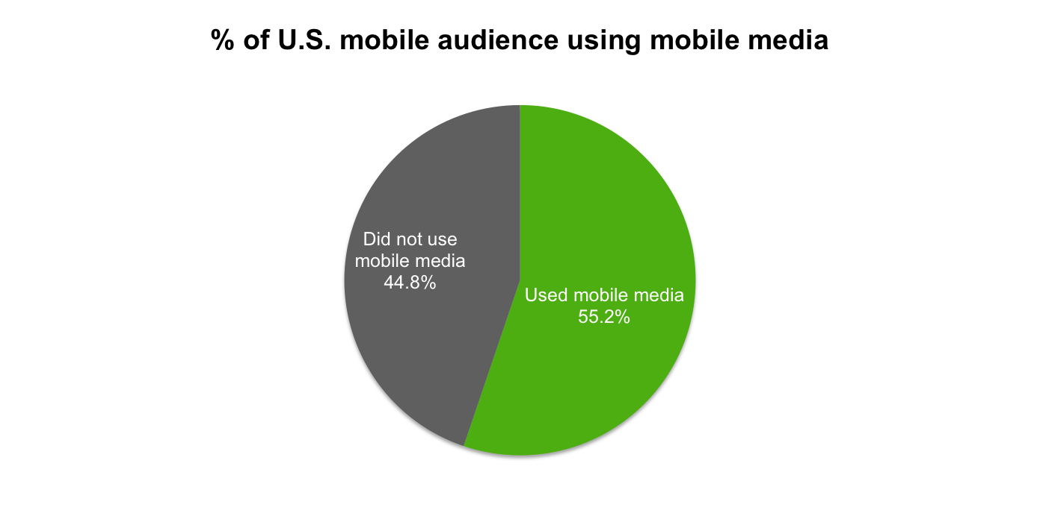
Mobile beyond calling and texting
UPDATED
More than 55% of U.S. cell phone users browse the web, download content and access applications on their phone –
a 24% increase from 2010 to 2011
ComScore via H Engage
Q4 2011

Slide 12
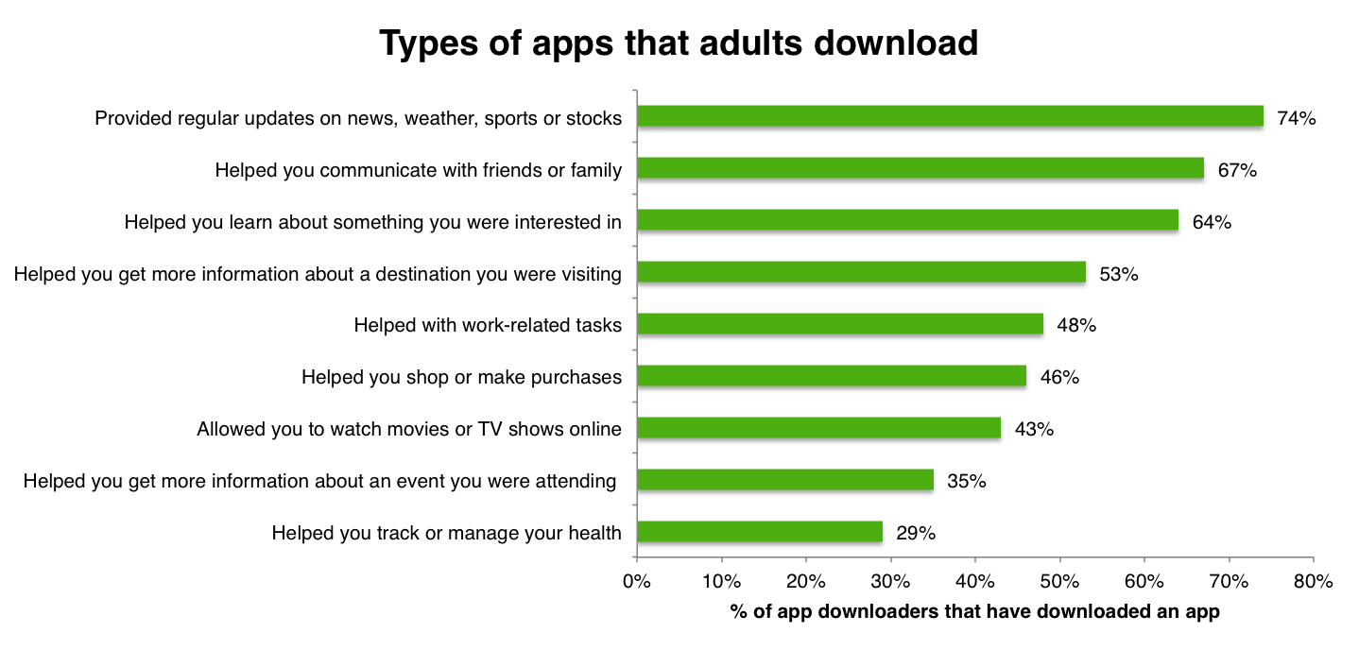
People love social apps, not health apps
Social apps are the most downloaded, while apps that “helped you track or manage your health” are the least popular.
Pew Research Center via H Engage
August 2011

Slide 13
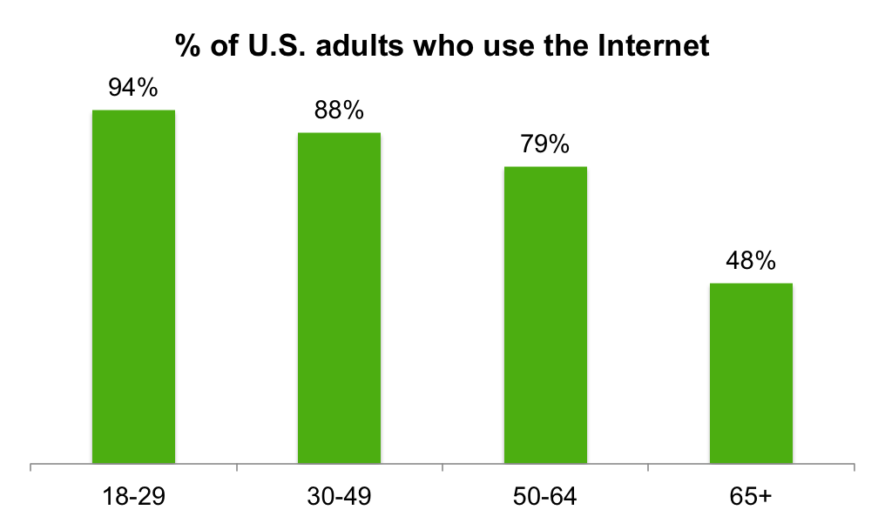
80% of adults use the Internet
UPDATED
Internet use is almost ubiquitous among adults in the U.S. – especially among working age adults (18-64)
U.S. avg. = 80%
Pew Research Center via H Engage
February 2012

Slide 14
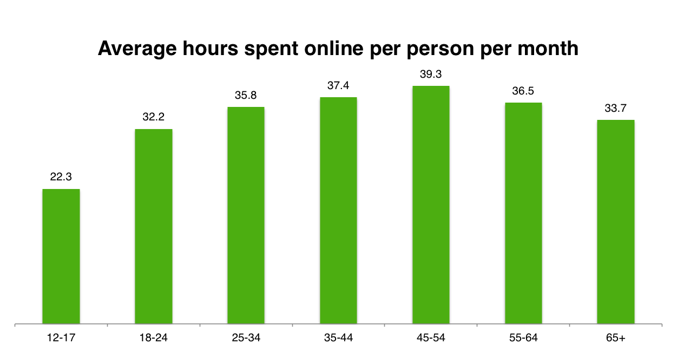
Adults average 32 hours per month online
Those between the ages of 45-54 spent the most time, averaging almost 40 hours per month
ComScore via H Engage
Q1 2011

Slide 15
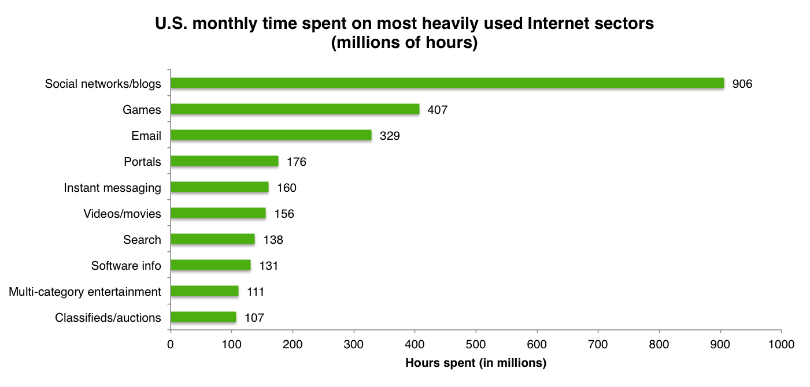
50% of time online is spent on social and gaming
Email continues to fall to third place, accounting for only 13% of time spent online
Nielsen via H Engage
June 2010

Slide 16
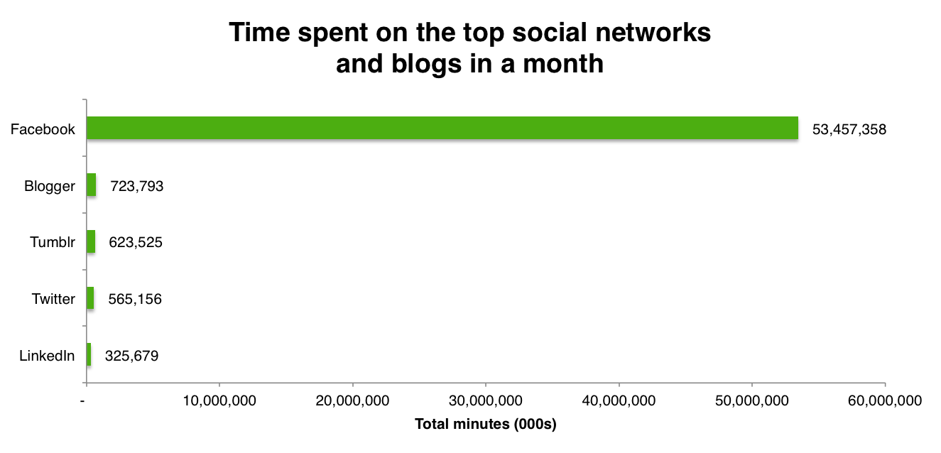
Facebook is the most popular social network/blog
Facebook accounts for 96% of time spent on the top five social networks and blogs
Nielsen via H Engage
May 2011

Slide 17
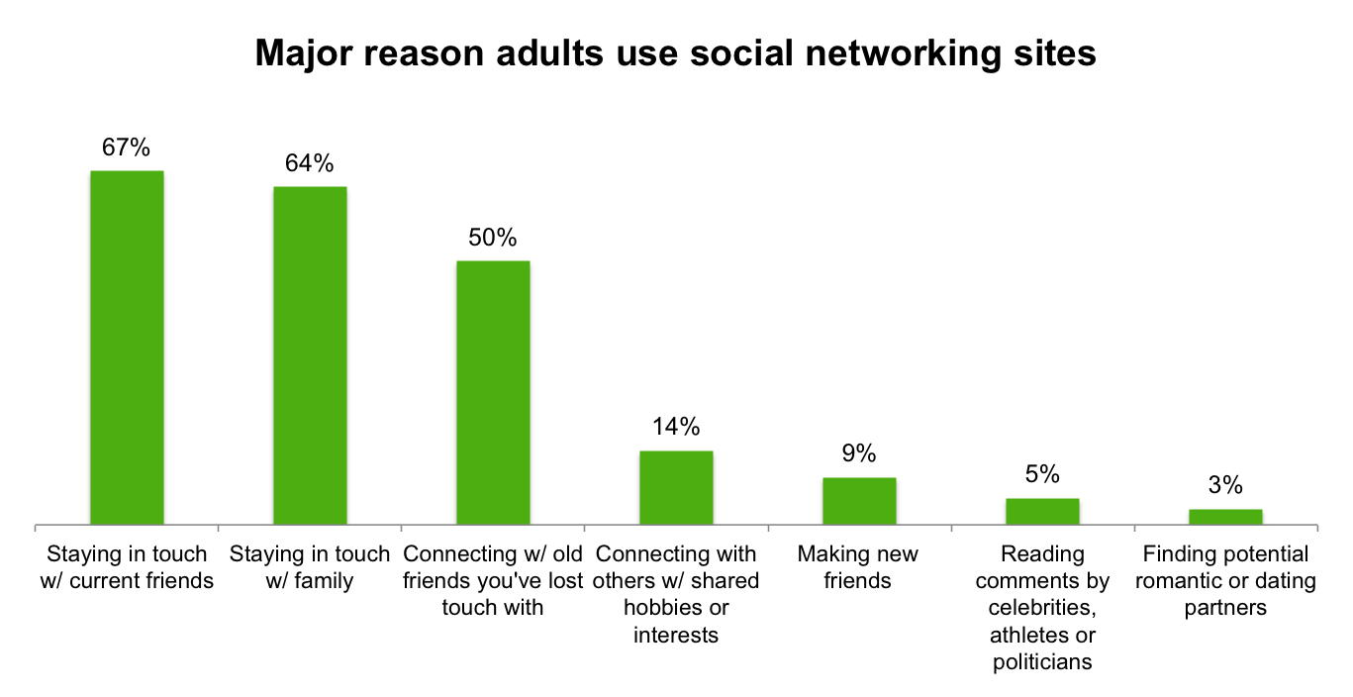
66% of adults use an online social media platform
UPDATED
Most use social media platforms to stay in touch with family members and friends (both new and old)
Pew Research Center via H Engage
November 2011

Slide 18
20-30% of Facebook users drive the majority of activity
UPDATED
The rest of users receive more information and feedback from their connections than they contribute
Contribute
Receive
Photos
  12% of users tagged a friend in a photo
  35% were tagged in a photo
Friend Requests
  40% of users made a friend request
  63% received a friend request
“Likes”
  “Liked” a friend’s content 14 times
  Had their own content “liked” 20 times
Messages
  Sent 9 messages
  Received 12 messages
Pew Research Center via H Engage
February 2012

Slide 19
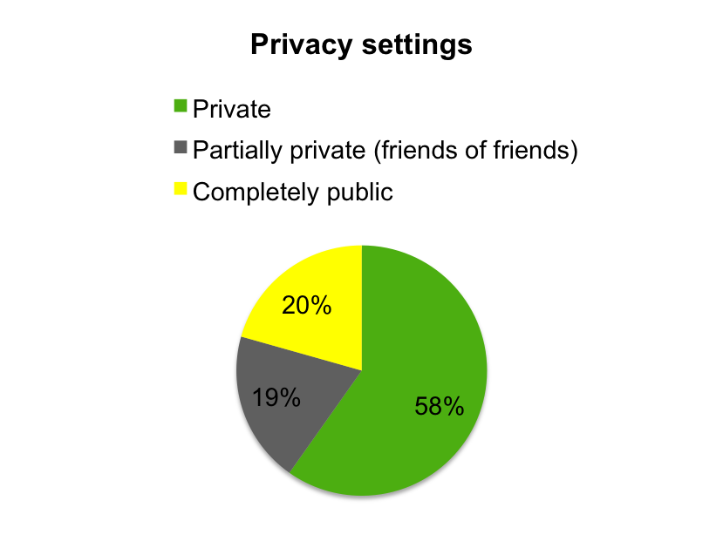
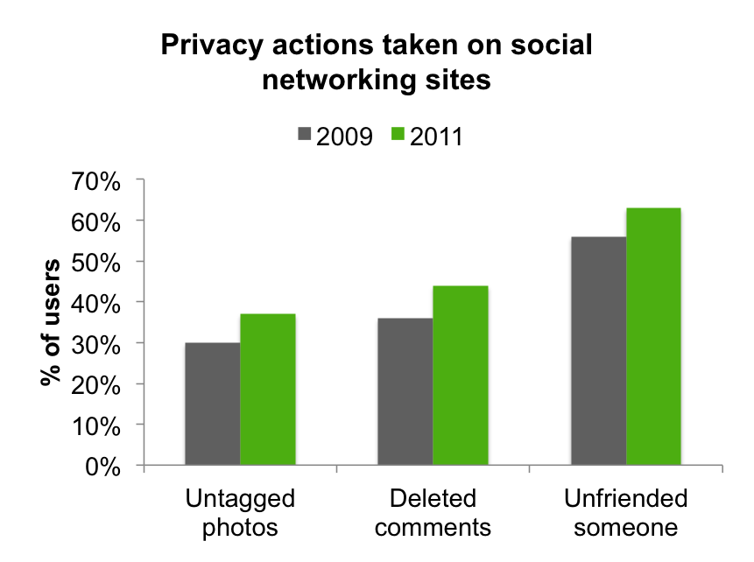
More are taking steps to manage their social network image
UPDATED
Majority of users now restrict access to their profiles and manage the information available about them
Pew Research Center via H Engage
February 2012

Slide 20
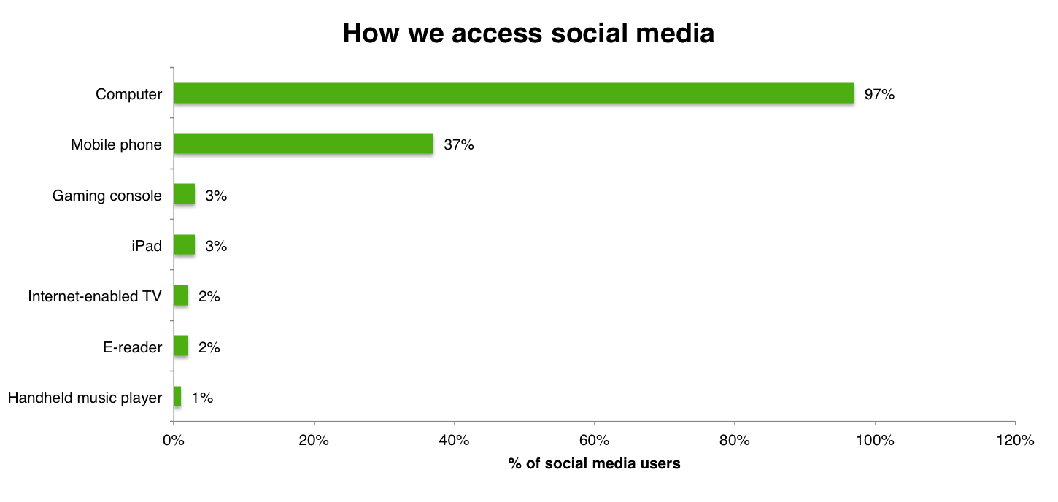
Most access social media on their computer
Computers are still the predominant way that people access social media; however, almost 2 in 5 Americans use their mobile phone
Nielsen via H Engage
May 2011

Slide 21
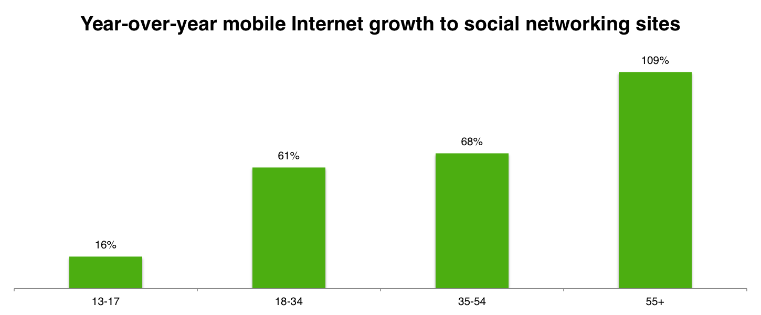
In mobile and social, older adults are catching up
Increased utilization of mobile phones and social media is especially pronounced in 55+ age segment
Nielsen via H Engage
May 2011

Slide 22
Who you know matters
57%
Increase in a person's chance of becoming obese if a friend became obese. That’s more predictive than if they shared genes associated with obesity.
25%
Increase in a person’s chance of becoming happy if a friend who lived within a mile became happy.
75%
Increase in a person’s chance of divorce if a friend or colleague divorced. The size of the effect was measurable at two degrees of separation (friend of a friend), at 33%.
Research by Nicholas Christakis

Slide 23
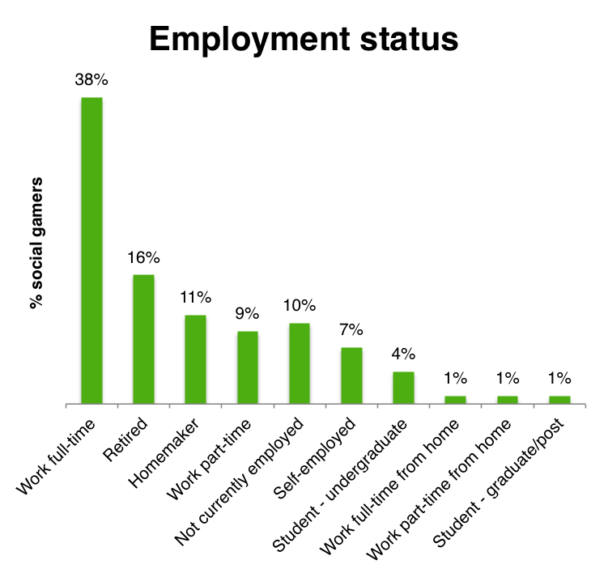
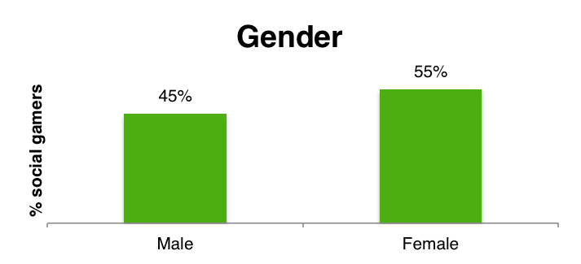
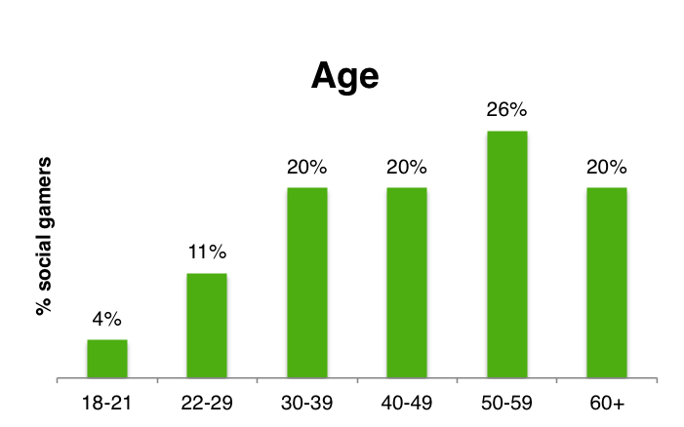
Who’s playing social games?
The average social gamer is a 43 year old woman working full-time
Information Solutions Group via H Engage
2010

Slide 24
Appendix

Slide 25
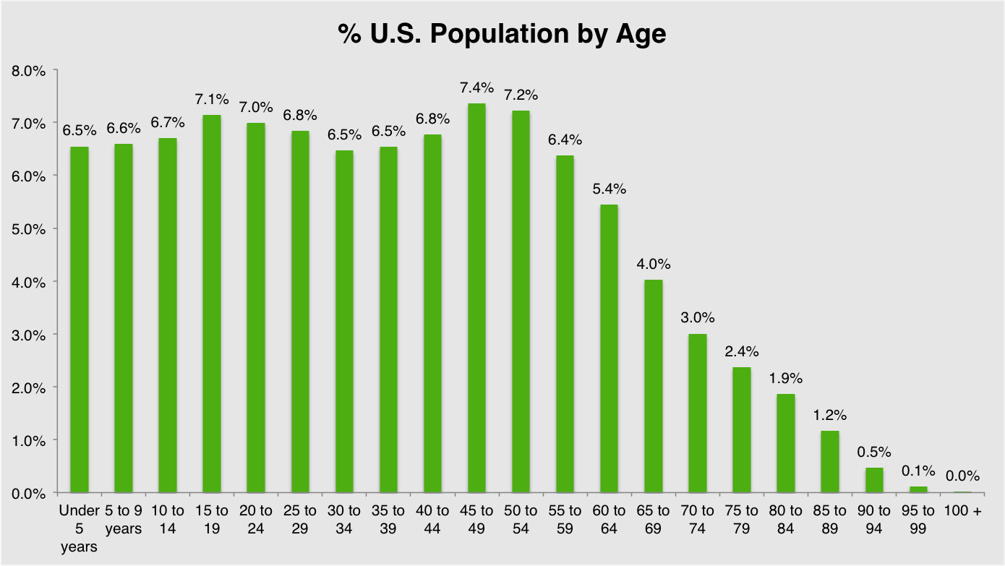
Level setting:
A look at the age of the U.S. population
U.S. Census Bureau via H Engage
2010

