Slide 1
Fast Fourier Transform (FFT) with OpenMP & OpenACC
Ryan Barber
Evan MacBride
Seth Prentice
12/2/2019
github.com/evanmacbride/parallel-fft

Slide 2
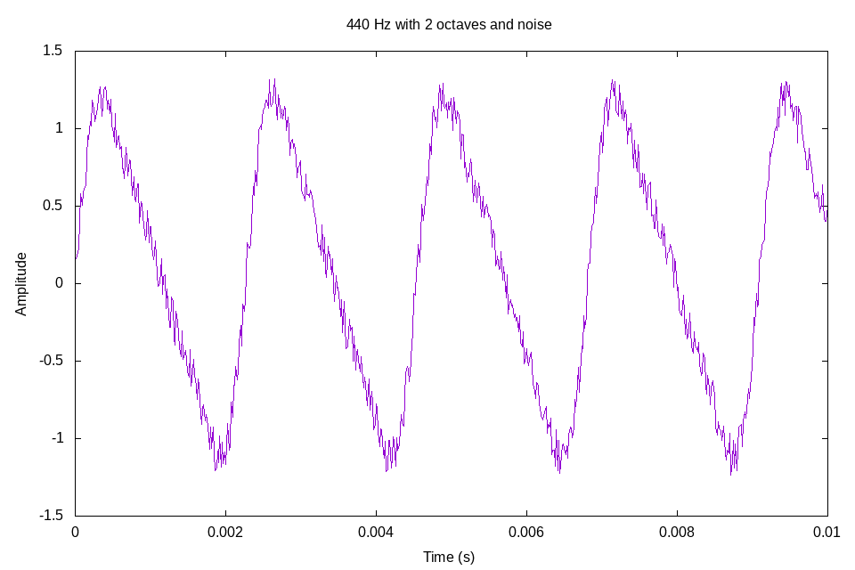
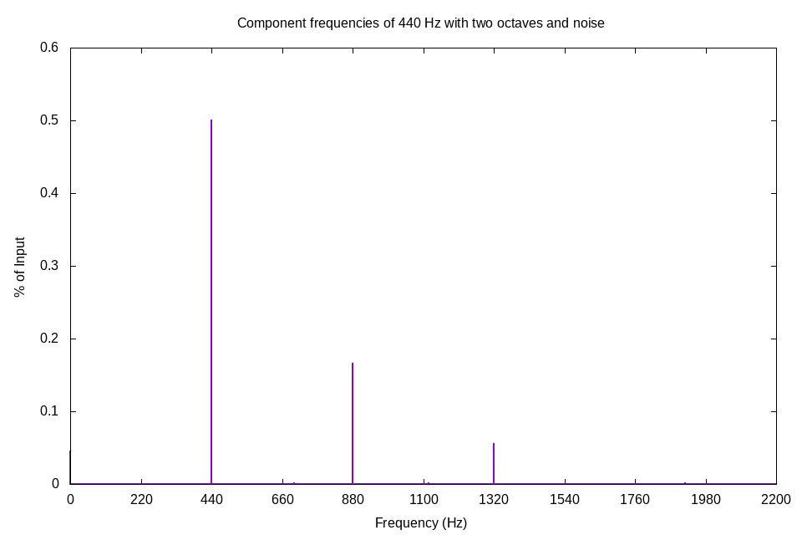
Background & Motivation
FFT takes an input wave signal and breaks it into its component frequencies
Widely studied problem with applications that include recording, pitch correction, speech recognition, and many more
Cooley-Tukey algorithm reduces complexity from O(n^2) to O(n log n)
The algorithm’s use of nested for-loops should make it a good candidate for parallelization
What kind of speedup is possible with parallelization?
Can parallelization reduce complexity towards O(n)?
Does the type of input affect runtime?
Notes:
Pictured: a 440 Hz sine wave with 2 octaves and noise added is broken down into its component frequencies of 440 Hz, 880 Hz, and 1320 Hz (with small amounts of every other frequency from the noise). Generated with gnuplot.

Slide 3
Sources
Rao, Kamisetty Ramamohan, Do Nyeon Kim, and Jae Jeong Hwang. Fast Fourier transform-algorithms and applications. Springer Science & Business Media, 2011.
Ayinala, Manohar, and Keshab Parhi. "Parallel pipelined FFT architectures with reduced number of delays." Proceedings of the great lakes symposium on VLSI. ACM, 2012.
Wang, Cheng, et al. "Parallel sparse FFT." Proceedings of the 3rd Workshop on Irregular Applications: Architectures and Algorithms. ACM, 2013.
Tsai, Wei-Ho, Yu-Ming Tu, and Cin-Hao Ma. "An FFT-based fast melody comparison method for query-by-singing/humming systems." Pattern Recognition Letters 33.16 (2012): 2285-2291.
Rekik, Siwar, et al. "Speech steganography using wavelet and Fourier transforms." EURASIP Journal on Audio, Speech, and Music Processing 2012.1 (2012): 20.
Three Dimensional Pseudo-Spectral Compressible Magnetohydrodynamic GPU Code for Astrophysical Plasma Simulation, 2013
Recursive serial code, https://rosettacode.org/wiki/Fast_Fourier_transform#C
Iterative serial code, https://www.nayuki.io/page/free-small-fft-in-multiple-languages
Rounding to the next power of 2, https://stackoverflow.com/questions/466204/rounding-up-to-next-power-of-2
Modeling a sine wave, https://stackoverflow.com/questions/203890/creating-sine-or-square-wave-in-c-sharp
Plotting component frequencies, https://www.ritchievink.com/blog/2017/04/23/understanding-the-fourier-transform-by-example/
Using managed memory with C++ vectors and OpenACC, https://stackoverflow.com/a/54027319
Notes:
Scholarly articles from preliminary presentation on the left. Practical posts and articles used in writing the code on the right

Slide 4
Approach
Create serial code to generate a variety of inputs simulating real audio signals from command line inputs for waveform type, frequency, and duration, then process inputs with FFT to derive component frequencies
Compare runtime of serial code to OpenMP implementation on 2, 4, 8, and 16 cores and to OpenACC implementations on GPU and multicores
Use C++ language, make use of profilers if possible
Compile serial and OpenMP code with g++ 7.4.0 and OpenACC code with pgc++ 19.4
Plot results with gnuplot and analyze

Slide 5
Challenges
Working with real audio from WAV files and PCM data impractical for project, simplified input to simulated audio signals
Radix-2 Cooley-Tukey requires inputs of lengths equal to a power of 2, which required a function to convert input duration
Original C language serial code source was mostly recursive and not parallelizable
Second, iterative source code in C++ was utilized
Unable to use Appentra for C++ code
C++ vectors problematic for use on GPU, managed memory and compiler optimizations were required for OpenACC GPU implementation
OpenACC multicore implementation would not compile with pgc++. It compiled but gave no speedup with g++ (even with srun, -fopenacc flag, etc.).

Slide 6
Experiments
Created an experiments.sh script to run on CISC372 VM
Each iteration ran through first the serial code, then the OpenMP implementation on 2, 4, 8, and 16 cores, and then the OpenACC implementation, each with inputs of duration 0.05s, 0.5s, 5s, 50s, and 500s
experiments.sh set to run five iterations back to back
main.cpp prints out duration and runtime, experiments.sh saves output to text files for plotting
Notes:
Input durations increase by an order of magnitude

Slide 7
Results

Slide 8
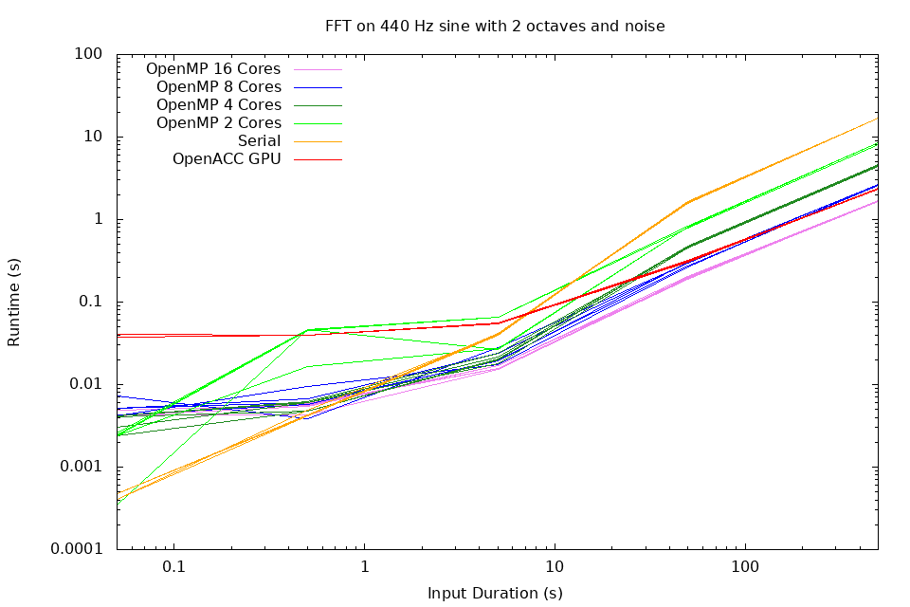
Notes:
A logarithmic plot of results for all three implementations against a range of input durations. For all but the smallest inputs, speedup for OpenMP approaches linearity to the number of cores. Constant factors made OpenACC inefficient for small inputs, but for larger inputs speedup was similar to OpenMP on 8 cores. OpenMP on 2 cores runs slower than serial on small inputs, but eventually becomes almost twice as fast. Generated with gnuplot.

Slide 9
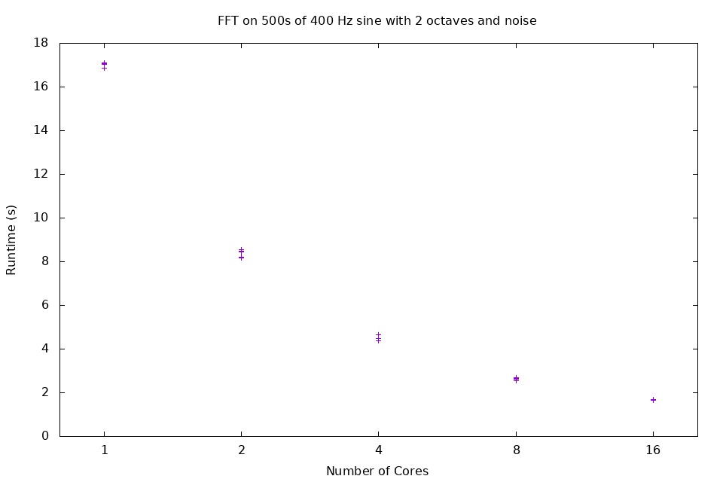
Notes:
Linear plot of runtimes for OpenMP with increasing numbers of cores and constant input duration of 500s. “1” denotes serial code iterations, not OpenMP running on a single core. Each doubling of the number of cores approximately halves the runtime. Generated with gnuplot.

Slide 10

10.11 & 7.24
OpenMP on 16 cores yielded 10.11 times speedup, OpenACC GPU yielded 7.24 times speedup (average of 5 run throughs processing 500s duration input)
Runtime to process 500s duration input reduced from 17.12s to 1.68s with OpenMP and to 2.35s with OpenACC
Rigorous experiments not performed, but waveform type and frequency appear irrelevant to runtime

Slide 11
Conclusions
github.com/evanmacbride/parallel-fft
Radix-2 Cooley-Tukey is very parallelizable with OpenMP, with speedup approaching linearity to number of cores
With an increase in the number of cores, complexity moves towards O(n)
C++ vectors (and possibly complex numbers used by algorithm) make OpenACC implementations more difficult
Further development necessary to achieve any speedup with OpenACC multicore implementation
Input type appears to be irrelevant to runtime, but optimizations for simpler waveforms could be possible
Load sharing likely not an issue

Slide 12
Inferences
CISC372 gave no speedup for OpenMP implementation when more than 16 cores were requested (srun was used)
Runtimes for serial code were almost twice as slow without srun
Runtimes could vary greatly during experiments, even when htop listed no more than two or three other users
Compilers used were g++ 7.4.0 for OpenMP and pgc++ 19.4 for OpenACC

