Slide 1
Hierarchical & N-Mixture Models

Slide 2
Learning Objectives
Understand hierarchical models
Use hierarchical models to estimate detection probability and abundance
Incorporate environmental covariates that affect detection probability and abundance

Slide 3
Hierarchical Model
Composed of a sequence of random variables where the realization of the random variable at one level being a parameter of the random variable at the next level down
X ~ f(ω)
Y ~ g(X, θ)

Slide 4
Hierarchical Model
Composed of a sequence of random variables where the realization of the random variable at one level being a parameter of the random variable at the next level down
X ~ f(ω)
Y ~ g(X, θ)

Slide 5
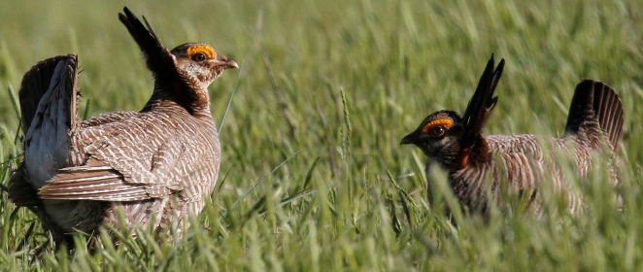

Hierarchical Models
Explicitly account for different layers of uncertainty
Count Data
$$Y\sim Poisson\left(λ\right)$$
Notes:
Linking “process” to “pattern” -> what we observe versus what is giving rise to the data

Slide 6


Hierarchical Models
Explicitly account for different layers of uncertainty
Count Data
$$Y\sim Poisson\left(λ\right)$$
Process
$$\log\left(λ\right)=β_{0}+β_{1}X+ε_{t}$$
Notes:
Linking “process” to “pattern” -> what we observe versus what is giving rise to the data

Slide 7


Hierarchical Models
Explicitly account for different layers of uncertainty
Count Data
$$Y\sim Poisson\left(λ\right)$$
Process
$$\log\left(λ\right)=β_{0}+β_{1}X+ε_{t}$$
Process Error
???
$$ε_{t}\sim N(0,σ^{2})$$
Notes:
Linking “process” to “pattern” -> what we observe versus what is giving rise to the data

Slide 8
Why use hierarchical models?
Help deal with biases
Multiple linear models layered together
Separate observation and process error

Slide 9
N-mixture Models
Measuring abundance/density
Using multiple occasions to estimate detection probability
Similar to occupancy models

Slide 10
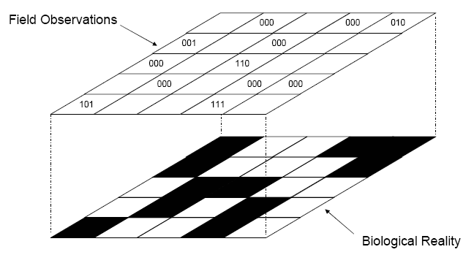
N-mixture Models
Measuring abundance/density, but using multiple occasions to estimate detection probability
000
050
000
001
000
010
000
020
100
211
000
000
111

Slide 11
Occupancy Models
Note that if we were instead using an occupancy model, these would all be 0s or 1s
000
050
000
001
000
010
000
020
100
211
000
000
111

Slide 12
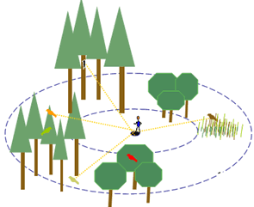
N-mixture Model
Counting # of individuals seen with repeated samples, not distance

Slide 13
Model Assumptions
Closure
No false positives or double counts
Independence of detection (p of 1 individual = p of 10 individuals)
Homogeneity of detection among individuals
Notes:
Closure violation: variability in binomial portion of model will be overstated, leading to underestimation of p and overestimation of N. Can address this using “superpopulation” (temporary emigration) ideas.
Homogeneity of detection: all individuals at site I equally likely to be detected. Different than distance sampling w/ decreasing detection away from line. However, initial simulation studies with heterogeneity in detection probability did not have large biases on estimates of N

Slide 14
N-mixture Model – single year
Data: y_{ij} (counts at site i on occasion j)
Observation process/model:
y_{ij}|N_{i} ~ Binomial(N_{i},p)
State process:
N_{i} ~ Poisson(λ_{i})

Slide 15
Detection probability: p
Probability of detecting an individual is described with a binomial distribution
Logit link function: y_{ij}|N_{i} ~ Binomial(N_{i},p)
Repeat visits allow us to estimate detection
Encounter history: 0210
logit(p_{ij})= α₀ + α₁D_{ij}

Slide 16
Abundance: N
Latent abundance
Detection-corrected counts at each survey
Log link function: N_{i} ~ Poisson(λ_{i})
Using a Poisson distribution
Common for count data
Will talk about other options in Session 2
log(λ_{i}) = β₀ + β₁x_{i}

Slide 17
Incorporating covariates
Can include covariates for both detection probability and abundance
Detection probability:
Wind speed
Cloud cover
Observer
Abundance:
Elevation
Weather
Site treatments
We’ll only work through abundance examples, but unmarked can be used for occupancy analyses as well (just need a slightly different function)

