Slide 1
Hierarchical & N-Mixture Models

Slide 2
Learning Objectives
Understand hierarchical models
Use hierarchical models to estimate detection probability and abundance
Incorporate environmental covariates that affect detection probability and abundance

Slide 3
Hierarchical Model
Composed of a sequence of random variables where the realization of the random variable at one level being a parameter of the random variable at the next level down
X ~ f(ω)
Y ~ g(X, θ)

Slide 4
Hierarchical Model
Composed of a sequence of random variables where the realization of the random variable at one level being a parameter of the random variable at the next level down
X ~ f(ω)
Y ~ g(X, θ)

Slide 5
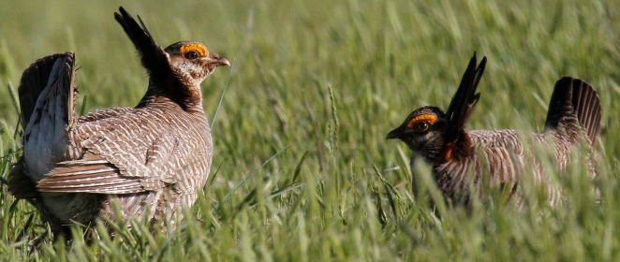

Hierarchical Models
Explicitly account for different layers of uncertainty
Count Data
$$Y\sim Poisson\left(λ\right)$$
Notes:
Linking “process” to “pattern” -> what we observe versus what is giving rise to the data

Slide 6


Hierarchical Models
Explicitly account for different layers of uncertainty
Count Data
$$Y\sim Poisson\left(λ\right)$$
Process
$$\log\left(λ\right)=β_{0}+β_{1}X+ε_{t}$$
Notes:
Linking “process” to “pattern” -> what we observe versus what is giving rise to the data

Slide 7


Hierarchical Models
Explicitly account for different layers of uncertainty
Count Data
$$Y\sim Poisson\left(λ\right)$$
Process
$$\log\left(λ\right)=β_{0}+β_{1}X+ε_{t}$$
Process Error
???
$$ε_{t}\sim N(0,σ^{2})$$
Notes:
Linking “process” to “pattern” -> what we observe versus what is giving rise to the data

Slide 8
Why use hierarchical models?
Help deal with biases
Multiple linear models layered together
Separate observation and process error

Slide 9
N-mixture Models
Measuring abundance/density
Using multiple occasions to estimate detection probability
Similar to occupancy models

Slide 10
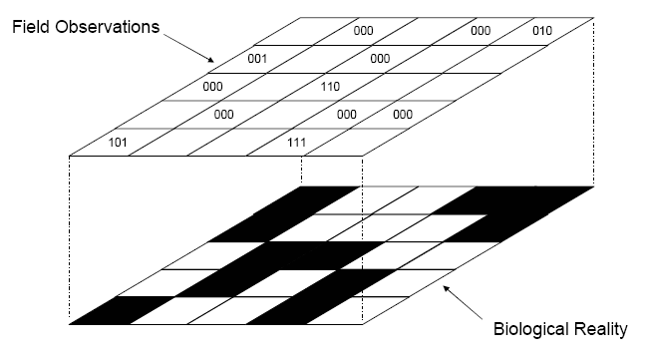
N-mixture Models
Measuring abundance/density, but using multiple occasions to estimate detection probability
000
050
000
001
000
010
000
020
100
211
000
000
111

Slide 11
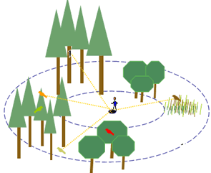
N-mixture Model
Counting # of individuals seen with repeated samples, not distance

Slide 12
Model Assumptions
Closure
No false positives or double counts
Independence of detection (p of 1 individual = p of 10 individuals)
Homogeneity of detection among individuals
Notes:
Closure violation: variability in binomial portion of model will be overstated, leading to underestimation of p and overestimation of N. Can address this using “superpopulation” (temporary emigration) ideas.
Homogeneity of detection: all individuals at site I equally likely to be detected. Different than distance sampling w/ decreasing detection away from line. However, initial simulation studies with heterogeneity in detection probability did not have large biases on estimates of N

Slide 13
N-mixture Model – single year
Data: y_{ij} (counts at site i on occasion j)
Observation process/model:
y_{ij}|N_{i} ~ Binomial(N_{i},p)
State process:
N_{i} ~ Poisson(λ_{i})

Slide 14
Detection probability: p
Probability of detecting an individual is described with a binomial distribution
Logit link function: y_{ij}|N_{i} ~ Binomial(N_{i},p)
Repeat visits allow us to estimate detection
Encounter history: 0210
logit(p_{ij})= α₀ + α₁D_{ij}

Slide 15
Abundance: N
Latent abundance
Detection-corrected counts at each survey
Log link function: N_{i} ~ Poisson(λ_{i})
Using a Poisson distribution
Common for count data
Will talk about other options in Session 2
log(λ_{i}) = β₀ + β₁x_{i}

Slide 16
Incorporating covariates
Can include covariates for both detection probability and abundance
Detection probability:
Wind speed
Cloud cover
Observer
Abundance:
Elevation
Weather
Site treatments

