Slide 1

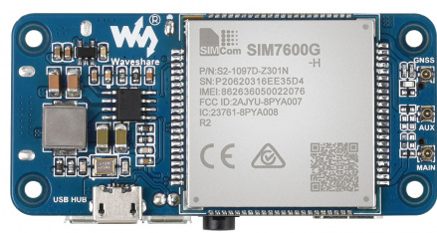
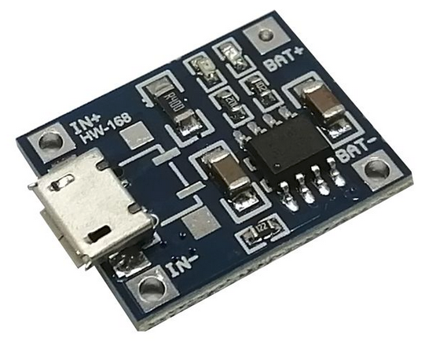
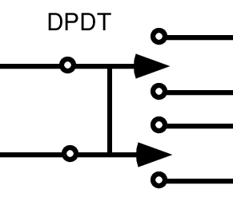
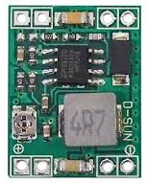

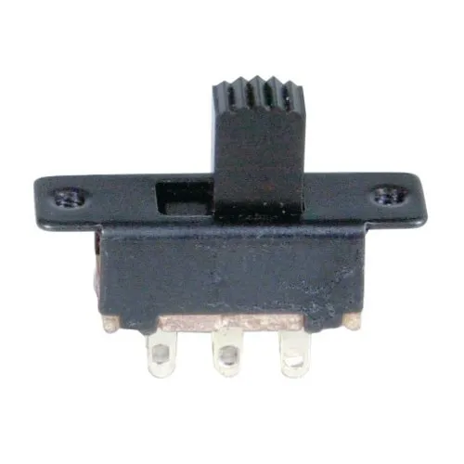

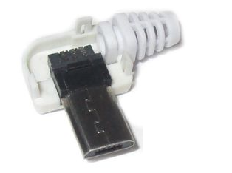

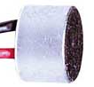
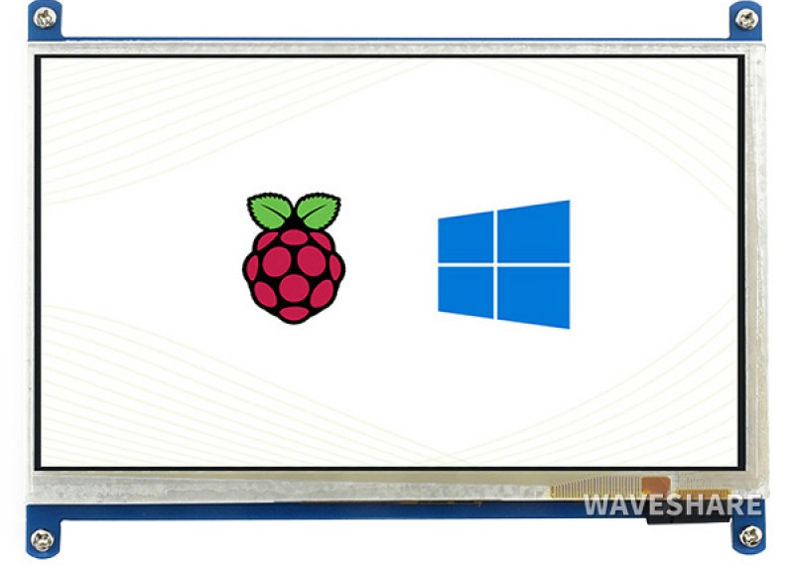
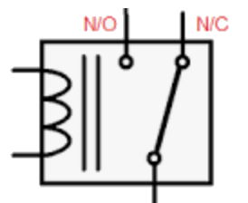
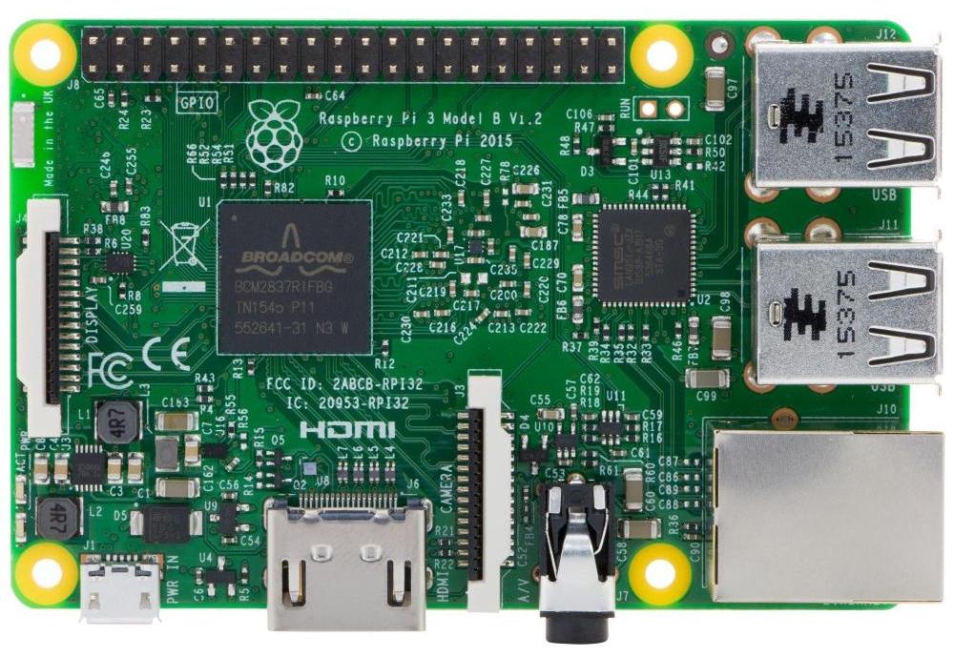
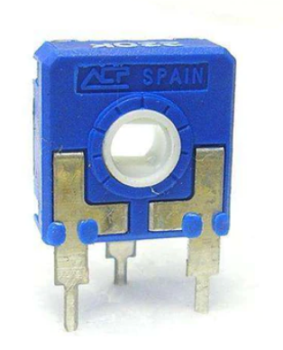
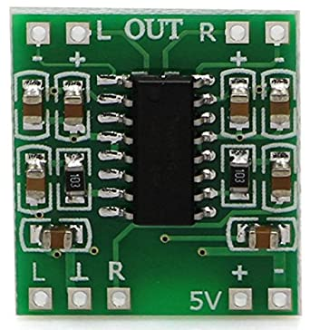
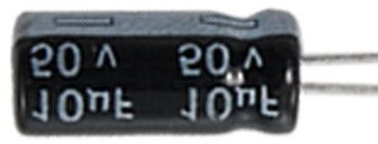
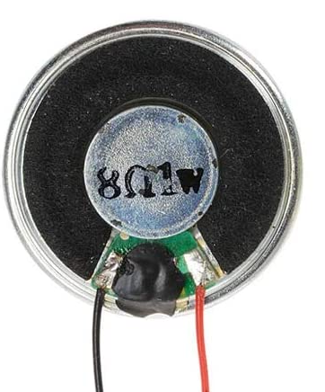

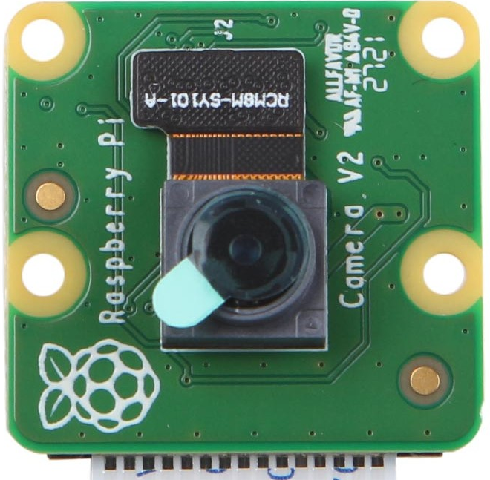
BATTERY 1
BATTERY 2
WAVESHARE 4G HAT (B)
BATTERY
CHARGER
DC/DC BUCK
CONVERTER
GPS
ANTENNA
SCREEN
LOCK
POWER
SWITCH
GSM
ANTENNA
MICRO
USB
MALE
TRRS
MIC
5V RELAY
10K POT
VOLUME
KNOB
PAM8403
AUDIO
AMP
10uF CAP
WAVESHARE HDMI TOUCH SCREEN
RASPBERRY PI 3B
SPEAKER
MICRO
USB
MALE
STEREO
PI CAMERA

