Slide 1
AI Typing Trainer
Evan Anderson

Slide 2

The Problem
Some people are slow/inaccurate at typing.

Slide 3
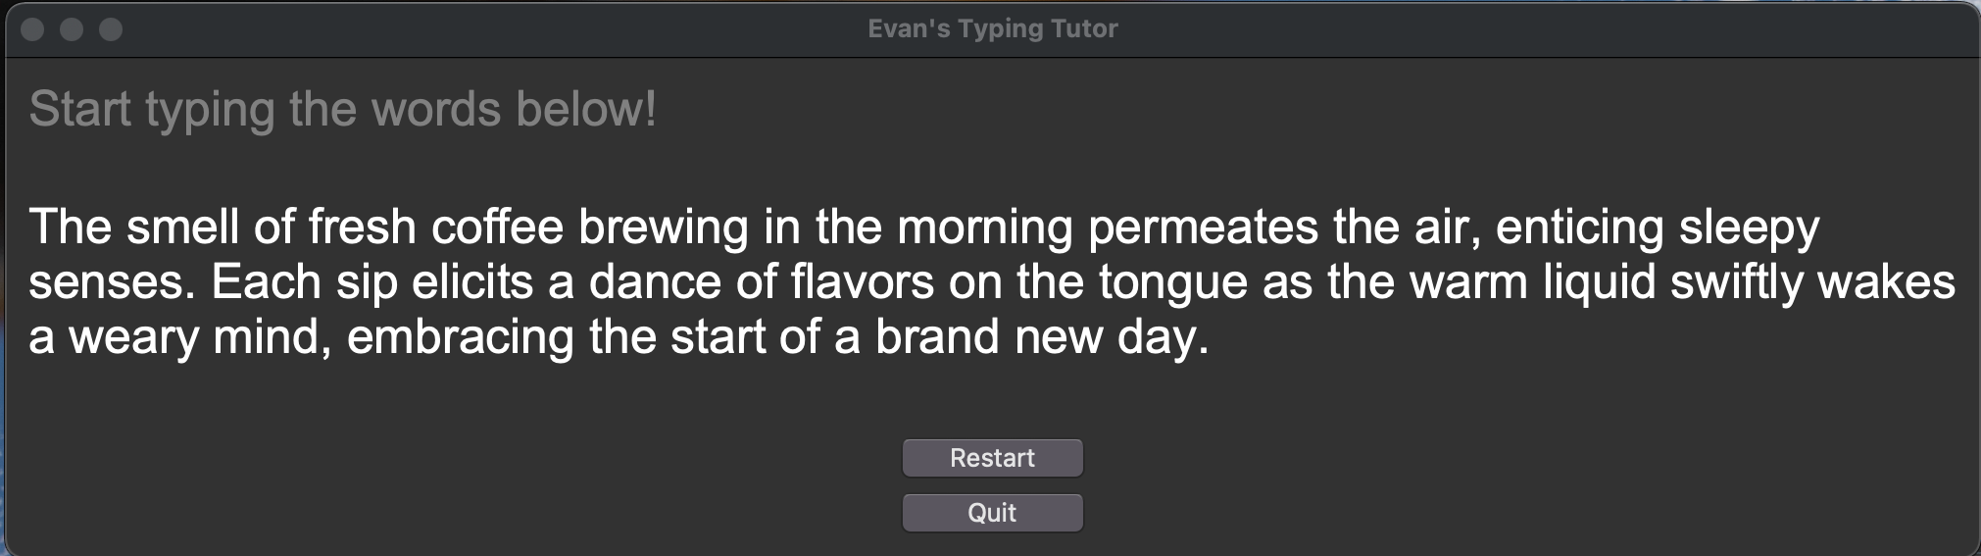
The Solution
Creating a typing trainer that uses generative AI to allow the user to practice typing new content every time. It also tracks keys the user struggles with and uses that when generating content.

Slide 4

Has it been done before?
Uses AI to generate text based on keys user struggles with, includes difficulty levels

Slide 5
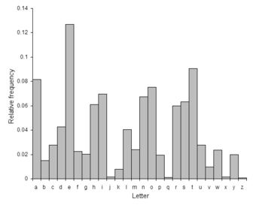
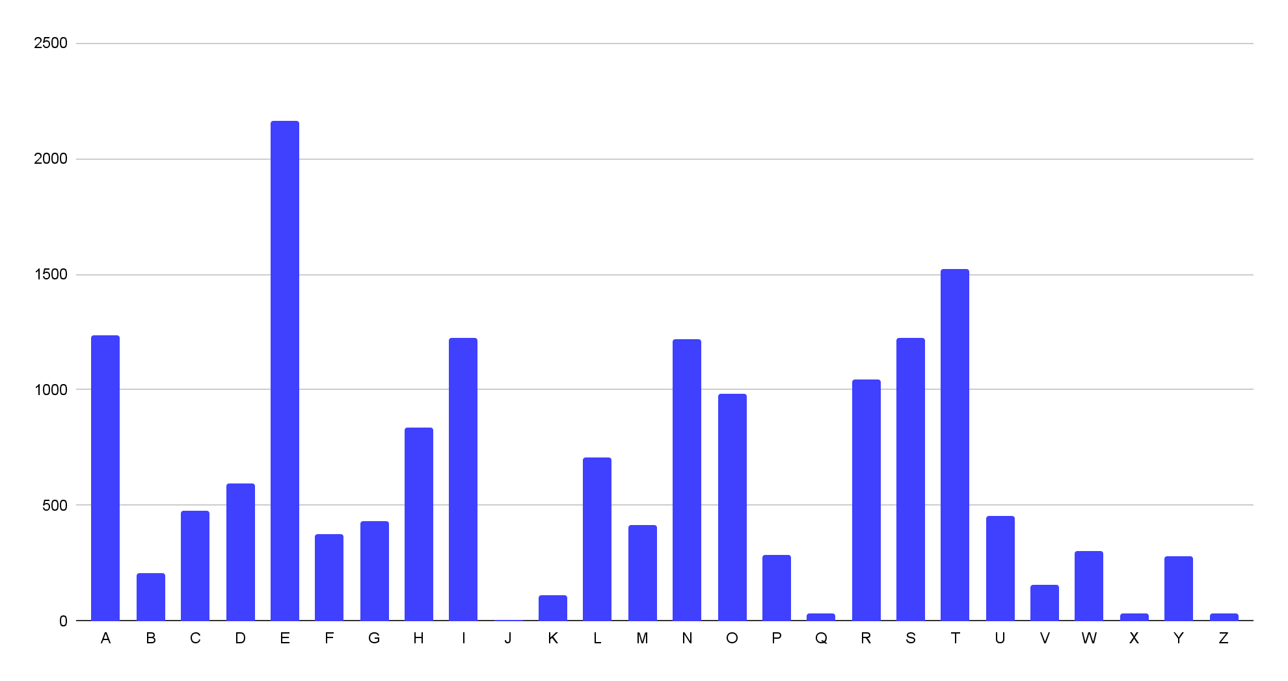
Analysis
I generated 25 paragraphs from ChatGPT to see what letters it generates most by default.
www3.nd.edu/~busiforc/handouts/cryptography/letterfrequencies.html
My own results from GPT 3.5-Turbo

Slide 6
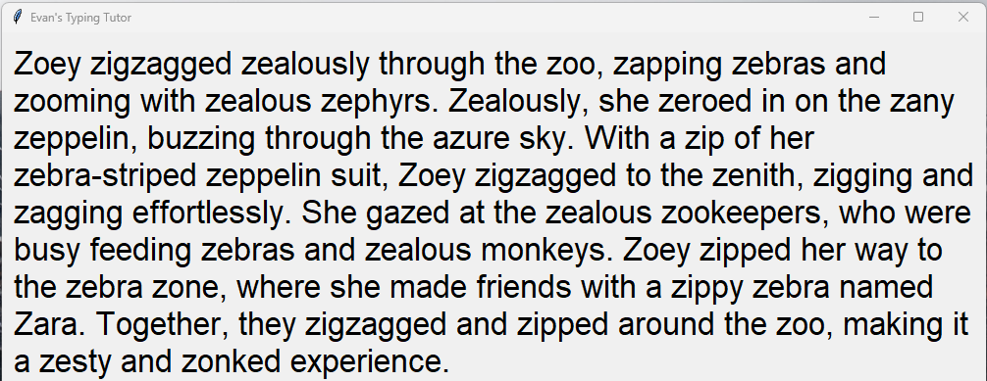
Analysis - continued
After seeing the default letter frequency, I intentionally missed the letter “Z” so ChatGPT would generate a paragraph with lots of the letter “Z”.
Text generated by GPT 3.5-Turbo when asked to include a lot of “z”s

Slide 7
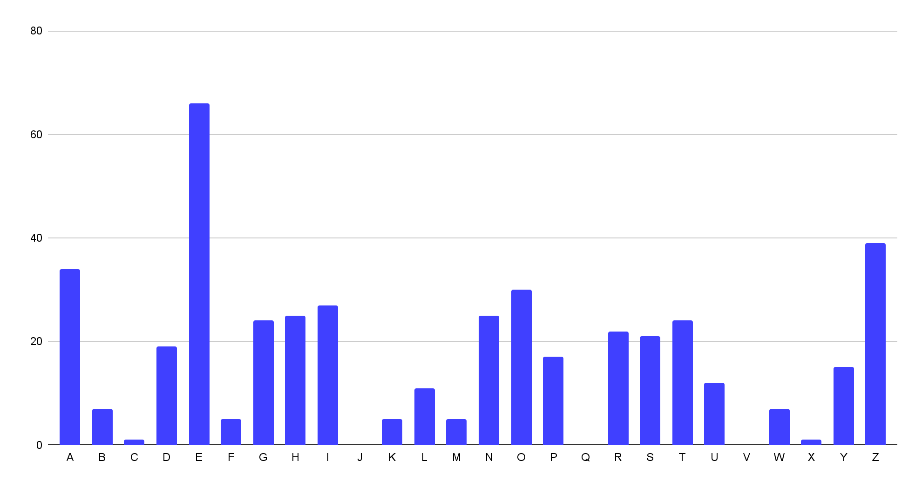
Analysis - continued
After seeing the default letter frequency, I intentionally missed the letter “Z” so ChatGPT would generate a paragraph with lots of the letter “Z”.
.2% of letters were Z
8.8% of letters were Z
Default letter frequencies from GPT 3.5-Turbo
Frequencies after asking for more of the letter “Z”

Slide 8
Demo

