Slide 2
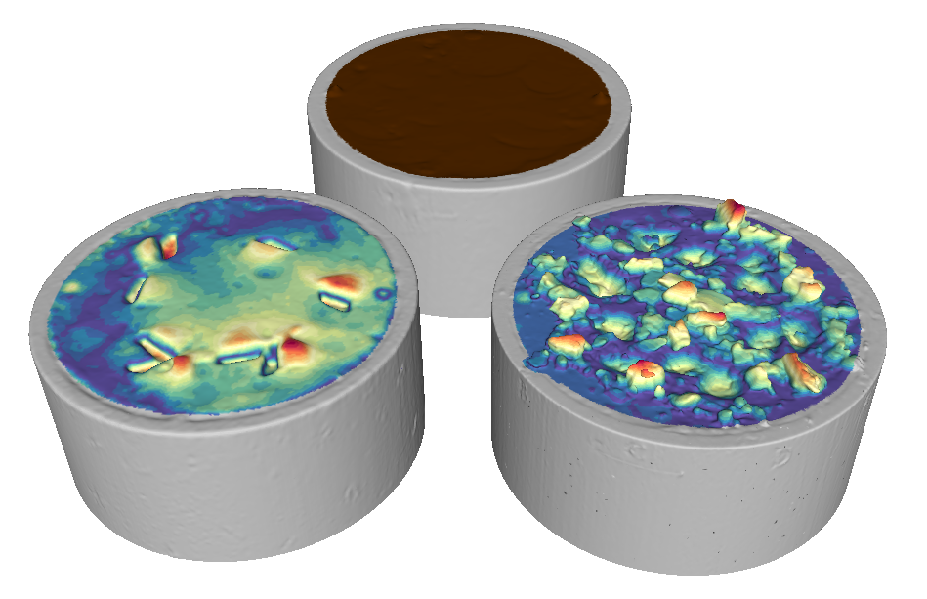
Undisturbed specimen
W= 0.11
W= 0.08

Slide 3
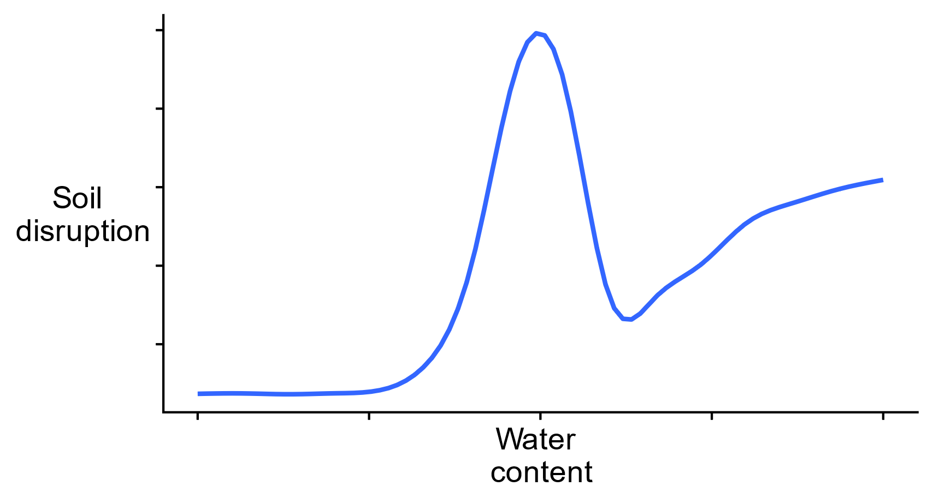
Too soft- soil deforms easily

Slide 4
Too soft- soil deforms easily
‘perfect’ moisture

Slide 5
brittle and weak
Too soft- soil deforms easily
‘perfect’ moisture

Slide 6
brittle and weak
Too soft- soil deforms easily
‘perfect’ moisture
brittle and strong

Slide 7
‘perfect’ moisture

Slide 8
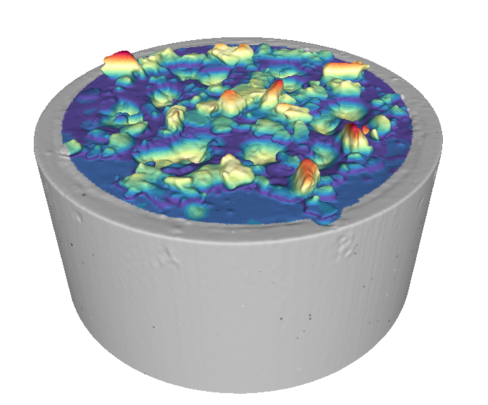
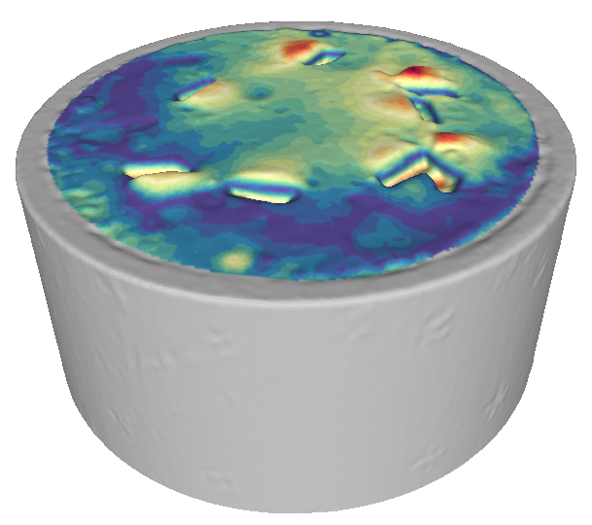
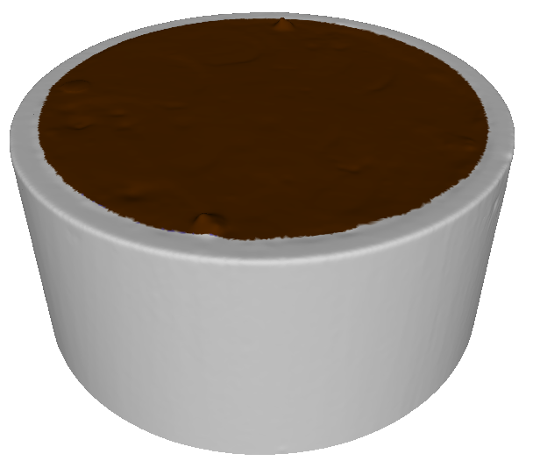
maximum deformation
Too soft- soil deforms easily
‘perfect’ moisture
no deformation
acceptable water content range
???

