Slide 1
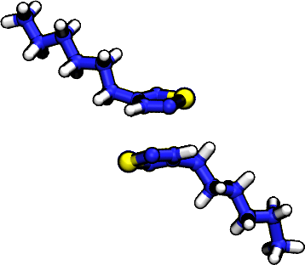
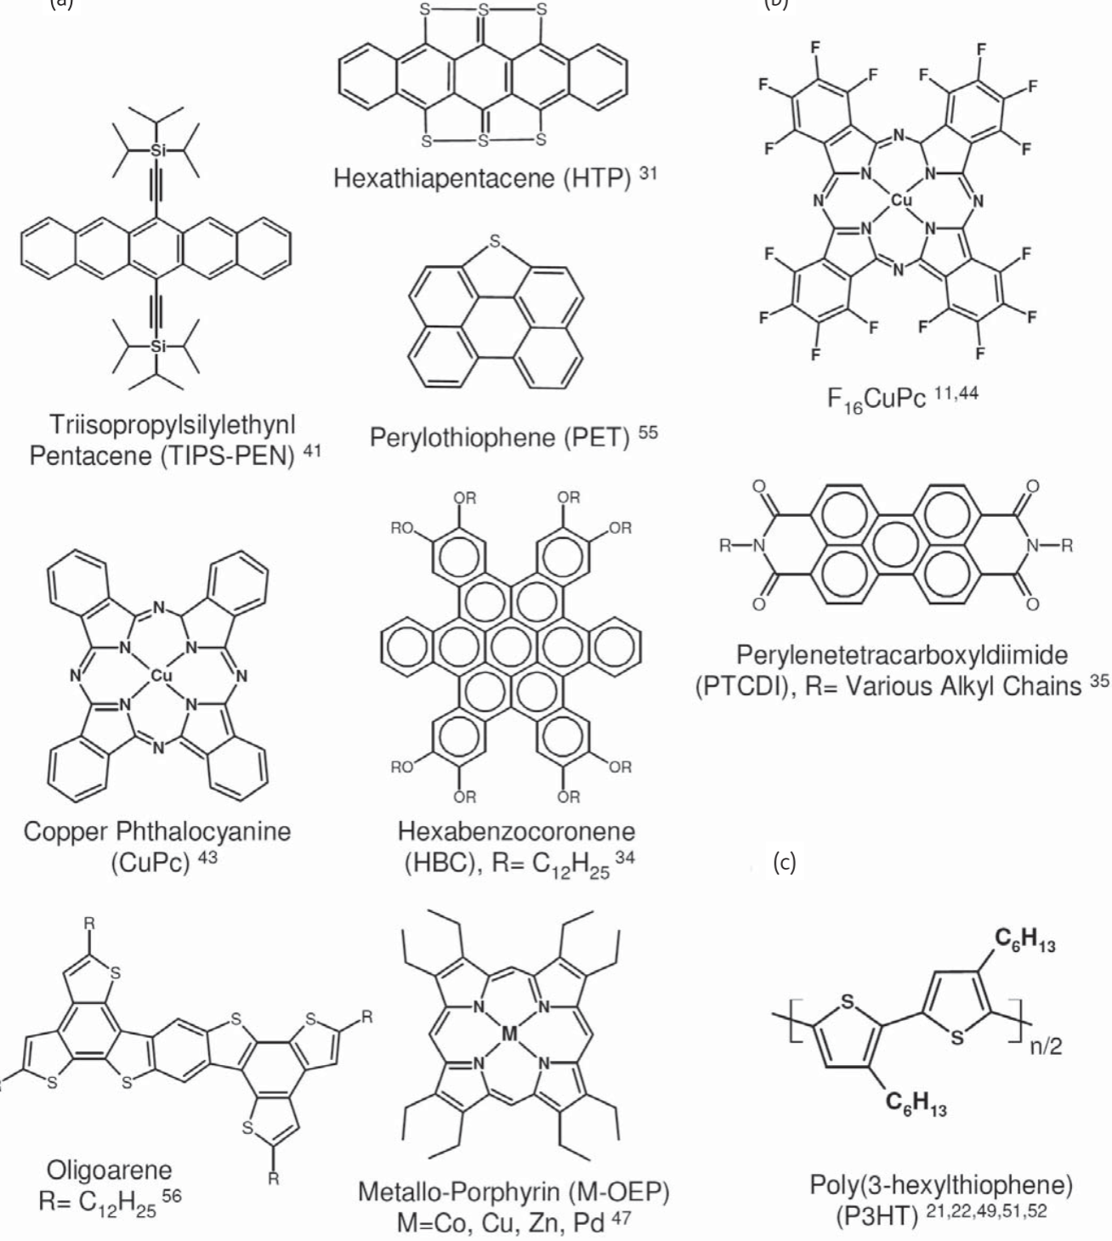
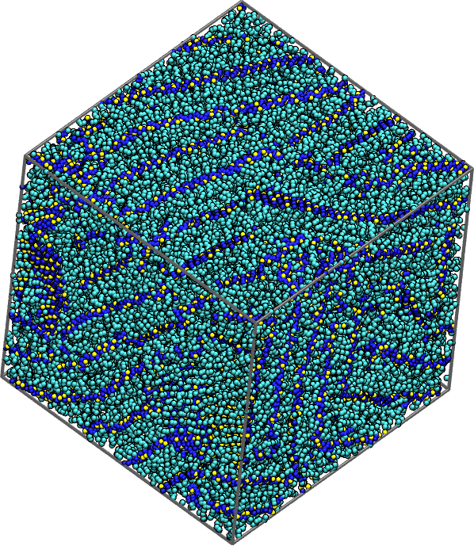
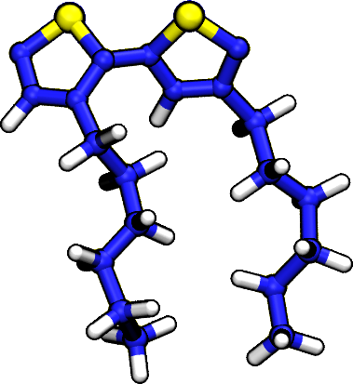
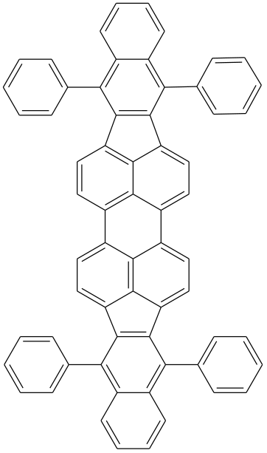
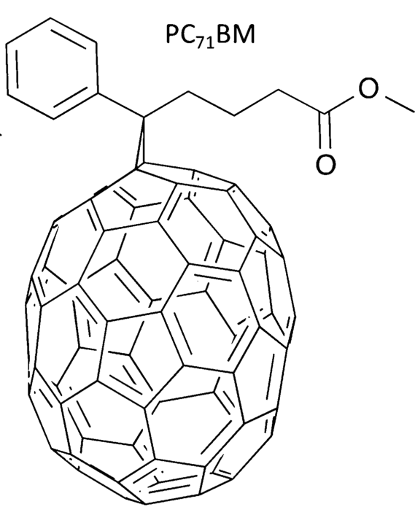
Steps to Predicting OPV Performance
Select Compounds/Processing
Predict Structure
Calculate Electronic Properties
Lots and Lots of Pairs!

Slide 2
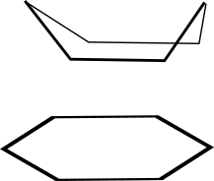
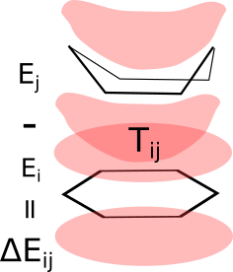
Can We Predict the Components of Rate?
Distance
Off-Set
Energy
Orientation

Slide 3
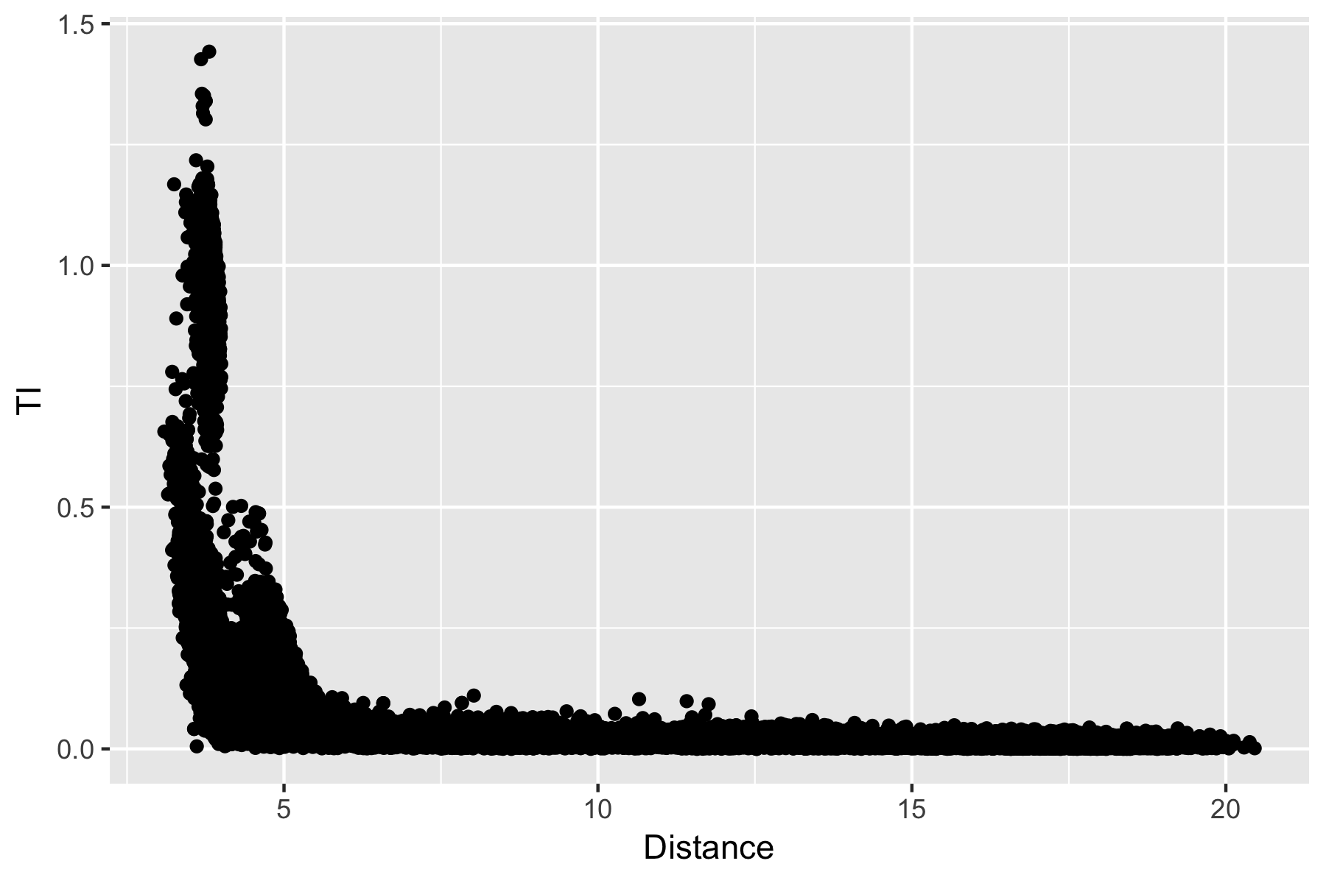
Variable Driven Model Improvement

Slide 4
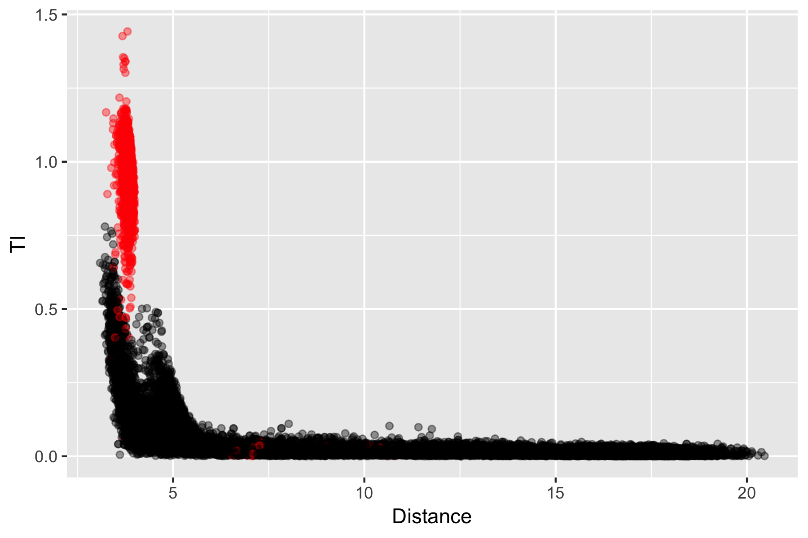
Variable Driven Model Improvement

Slide 5
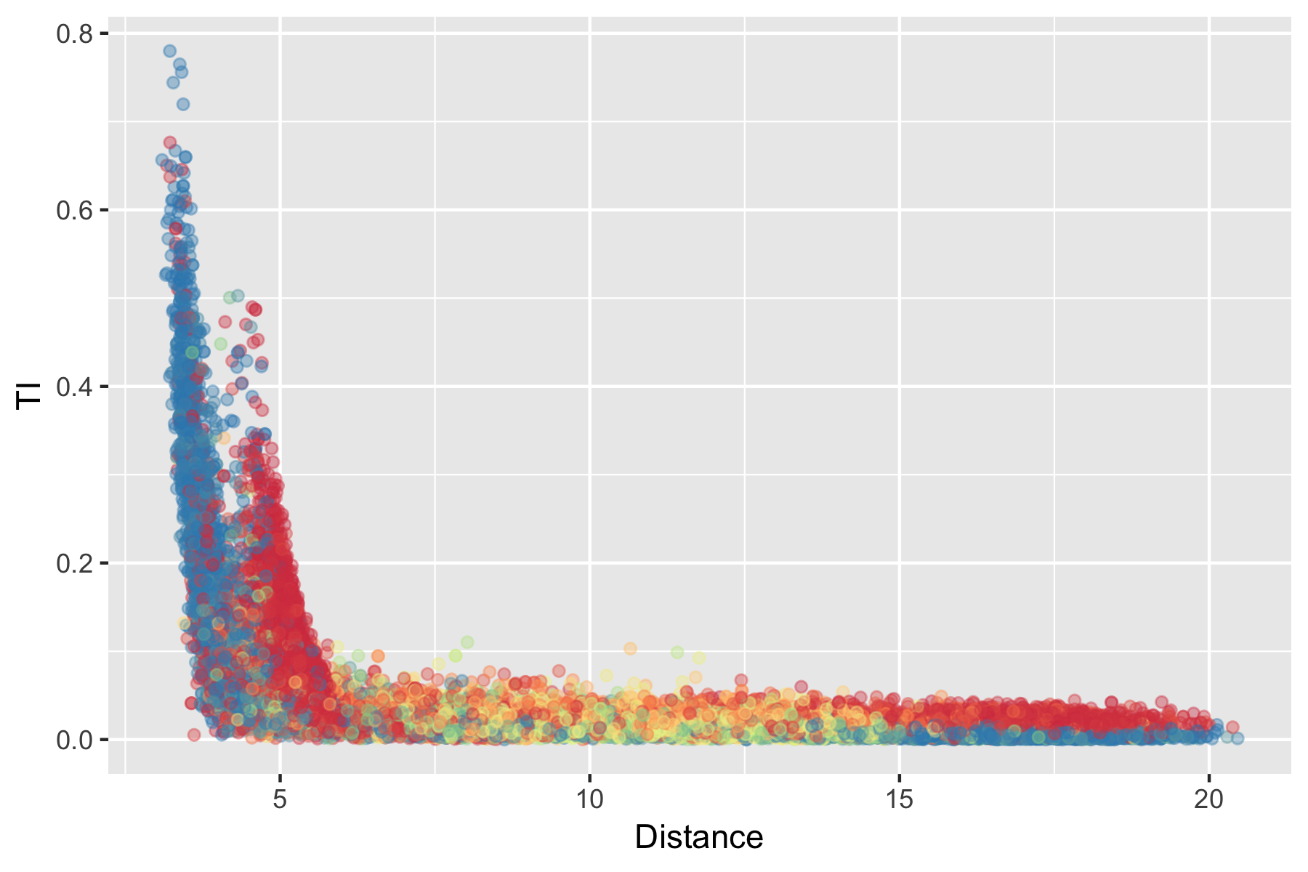
Variable Driven Model Improvement

Slide 6
Prediction Progression
Random forests outperformed
Neural nets
Linear models (splines, regression,…)
Kernel based methods

Slide 7
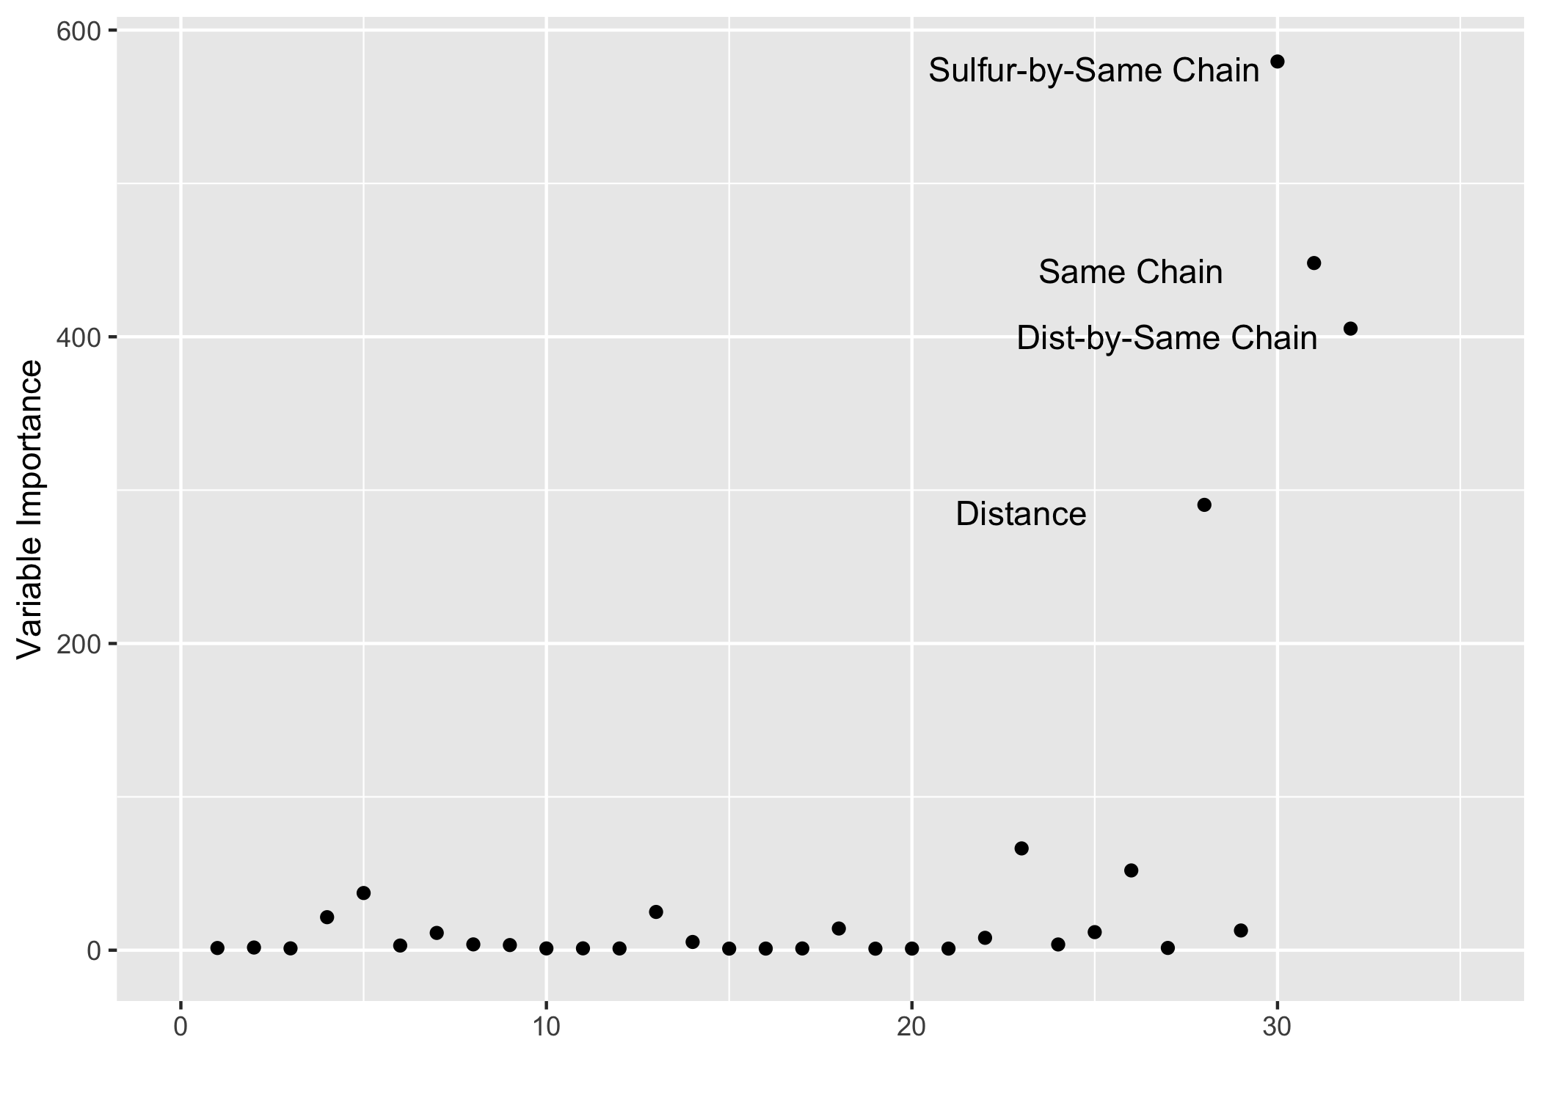
Prediction Progress
Random forests outperformed
Neural nets
Linear models (splines, regression,…)
Kernel based methods

