Slide 1
FraudFinder 2.0 Product Study
Evan Miracle

Slide 2
Agenda
Monthly Recurring Revenue (MRR)
Customer Counts and Revenue Churn
Average Revenue Per Account (ARPA) / Revenue Per Transaction (RPT)
Customer Engagement (transactions)
Risk
Customer Churn (survival)
Summary: FraudFinder2.0 is growing, but revenue is at risk
Notes:
Present topline summary
FraudFinder2.0 is growing, but that revenue is at risk
Revenue growing better than the 10% subscription increase in the early part of the time period

Slide 3
 | total revenue | growth
2010 | $12,975,758.93
2011 | $14,872,017.98 | 14.6%
2012 | $16,838,889.43 | 13.2%
up to 6/2013 | $9,123,754.76 | 8.4%
Notes:
Measured against a 10% growth line. Revenue should be increasing each month by 0.833% on average as we are utilizing a 10% per annum increase in fees.
Measured against a fitted line at resets each year to the known starting point.
Projecting the next six months as simplistic double of the revenue we’d only grow at 8.4%. This points toward a loss in customers.

Slide 4
Notes:
# of revenue subscribers
Look at refunds for products
Total mixed ecosystem of FF and FF2. FF2 getting new customers but at the expense of FF customer as they upgrade. This is as expected but the growth rate for new customers is not keeping pace. We are about 400 short of 2010 FF levels after 1.5 years and leveling off.
Refunds as proxy for lost revenue don’t like the trend upward in refund per customer. Losing higher value customers.
Total refunds is also for only half of the 2013 year.

Slide 5
Revenue per Transaction
 | 2010 | 2011 | 2012
Average RPT | $116.57 | $46.28 | $31.00
Median RPT | $0.0400 | $0.0415 | $0.0489
Average # transactions | 860291 | 1144050 | 1334759
Median # transactions | 37687 | 40783 | 41904
Active transaction customers | 1124 | 1420 | 1763
Notes:
Average Revenue Per Account.
Look at the revenue per customer in both an average and median fashion FF2. Compare against average against FF1. Median to represent growth without the effect of the large right tail. Then focus on the FF2 growth. There are negative revenue growth months which is concerning. Losing higher value customers to push the tail in.
Positive right skew on RPT pushes us to investigate at the top rank for revenue
Monthly reoccurring revenue by product / total revenue customer counts by product discounting refund customers time points. Figure not included but shows flat growth with high variability. Effects of changes in that long tail may be to blame.

Slide 6
Revenue per transaction (RPT) analysis for 2012 revealed significant number of inactive subscribers putting revenue at risk
% active in the top 100 revenue generators | 40
% inactive in the top 100 revenue generators | 60
Total Revenue | $16,838,889.43
Revenue generated top 100 | $7,271,687.59
% of revenue generated by top 100 | 43.18%
Active top 100 customers generated | $1,799,957.60
Inactive top 100 customers generated | $5,471,729.99
Represents % of total revenue | 32.49%
Notes:
Percentage from active users versus inactive for the last full year of transactions.
Summed revenue for all products held to calculate RPT against the transaction history data.
Check with sales on the subscriber list of the top 100.
Focus on these large subscribers as they hurt bottom line more when they cancel.

Slide 7
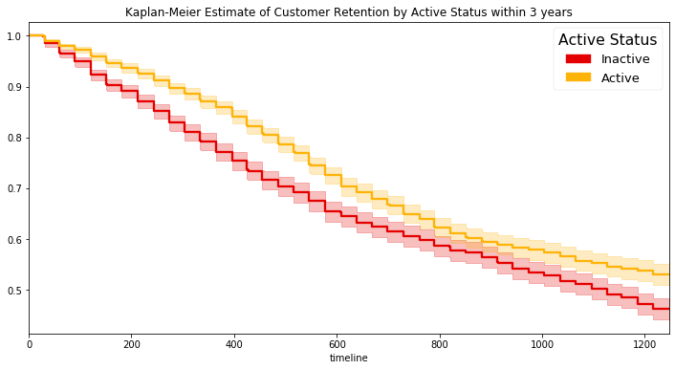
Kaplan-Meier Estimate of Customer Retention by Active Status within 3 Years Indicates FF2 Revenue from Inactive Subscribers at Elevated Risk
Inactive customers 3 times more likely to churn based on logrank hazard ratio
Confidence interval around curves shows they are significantly different until ~760 days
Notes:
For FF2 churn risk is 3 times higher in users who are inactive based on logrank test to get hazard ratio
Confidence interval around curves shows they are significantly different until ~760 days
Logrank test
Provide hazard curve explanation and logrank test
Tenure is based on derived values from revenue data. First and last positive revenue value dates by customer for FF2.
Average tenure is 833 days.
Correlation not causation but it is concerning
We can look at the transactions data directly and see it is increasing but we don't know which product accounts for the transactions
2010 -> 1124
2011 -> 1420
2012 -> 1763

Slide 8
Questions and Discussion
Notes:
Hold for questions and discussion of methods of deriving data or explanation of analysis
Possible next steps:
Pilot a different program of renewal fees to compare against current or look at first 5 years of FraudFinder to compare against behavior of FruadFidner2 adoption
Customer segmentation transaction behavior
Tracking inception and cancellation dates explicitly
Tracking transaction by month and project for added granularity
Addition of customer marketing spend to assist in determining LTV

