Slide 1



WORKSY
Casandra, Evan, Tung, Noel & Diljot

Slide 2
OUR ORIGINAL VISION
In a world where many students face challenges due to limited experience and professional networks, Worksy emerges as an indispensable solution. Worksy is committed to bridging the gap between students seeking valuable work opportunities and anyone in need of specialized services.

Slide 3


FEATURES OVERVIEW
Account - An account is an important feature in any application where you need to differentiate between users. In our application, this feature is required as there is 2 types of users; students and non-students. Only students are allowed to create posts.
Post - Posts allow users to create detailed listings for the products and services they wish to buy or sell. Users can include information such as titles, descriptions, and prices. Each post serves as a communication hub between users.
Search - The search function allows users to find a post that offers the service that they are looking for. Users are able to filter their searches by applying price ranges and categories. Along with this users are able to sort by relevance, date and price.

Slide 4


FEATURES OVERVIEW
Review - The review feature allows users to rate and comment on a posting. This gives the posting user direct feedback on their product or service. An averaged review score is displayed on each post.
Chat -The chat feature allows for one-on-one chats between users. A chat can only be created between the user who has created a post and an inquiring user. All chats can be found in one centralized location where you can view all of your ongoing chats so that they are easy to find.

Slide 5
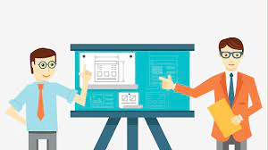
PROJECT DEMO

Slide 6
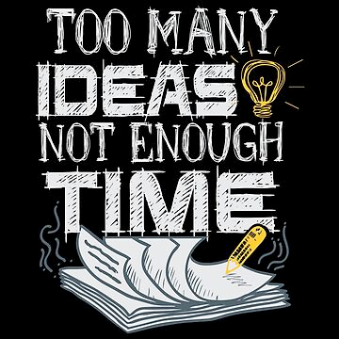
CHANGES FROM OUR INITIAL VISION
Post - Ability to add images to a post got scrapped. Posts now focus on offering a service rather than a product.
Account - User privacy settings got scrapped. Instead of having the user chose what account information can be seen, users are restricted to only be able to see a users first name and last name.

Slide 7

WHAT WENT RIGHT
Variety of Skills - We all have our strengths and weaknesses, but as a group we were able to cover all necessary skills for MERN stack development.
Initial Vision - We stuck true to our original vision for Worksy with the original proposed core features. We had a plan and succeeded in following through until the end.

Slide 8
WHAT WOULD WE DO DIFFERENTLY

Slide 9

Weekly Code Reviews
Challenges in Collaboration: different schedule in team
Benefit of Code Reviews:
Knowledge sharing and learning opportunity.
The writer of the code explains their thought process, making it easier for everyone to understand.

Slide 10

Early Sonarcloud Integration
Challenges: code smell and duplications
Benefit of Sonarcloud
Not just for security issues but also for cleaner code.
Highlights code smells and duplications.

Slide 11

What took the most time?
Using the backend APIs in the frontend because
It often resulted in time-consuming debugging
Unexpected undefined value.
Lack of typing in JavaScript
What took the least time?
Creating a design for the frontend.
Creating documentation on our project.
Notes:
So now we will discuss what took the most time to complete.
For us that was using the backend API calls in the frontend. This took the most time because we would often experience runtime errors after setting up an API call. The most frustrating issues came from unexpected undefined values. These issues tended to take extended periods to resolve as it wasn't clear what caused the issue. Due to the lack of typing in JavaScript which meant that when values were set to undefined unexpectedly the code didn't throw any errors. Instead, the results of the API call would simply not be the expected result. Then even once you had uncovered the cause the solution was often complicated by the asynchronous nature of REACT.
In contrast, the thing that took the least time to complete was the design for our front end. In our front-end design, we leveraged common design features such as accordion menus, navbars, and pop-ups to build an easy-to-understand application. Because of this not only did we produce a cohesive design but we cut down on design time by reusing components across pages.

Slide 12
What we learned about large project development
We learned how difficult is to produce accurate estimates of how long a task will take.
We also learned the importance of breaking the project down into small manageable tasks.
Lastly, we learned the importance of creating tests as you go.
Notes:
Now we will discuss what we learned about project development.
The first thing we learned was how difficult it is to accurately estimate the time needed to complete a task. In our case, we tended to underestimate the time required which caused delays in our development process.
We also learned the importance of breaking the project down into small manageable tasks. This helps with the even distribution of tasks and it helps to make the project seem doable and less intimidating.
Lastly, we learned the importance of creating tests as you go. This is important to ensure that no code regressions are introduced when new code is merged. Additionally, this helps to ensure comprehensive testing and it speeds up the test creation process as the code under test is still fresh in memory.

Slide 13
How we will apply what we learned to our next project?
Firstly, we will keep track of time estimates on each issue and we will determine these estimates by using the planning poker technique.
We will set up 10-minute daily standups.
Additionally, we will setup clear standards surrounding commenting, documenting, testing and formatting code. To help minimize technical debt.
Notes:
Finally, we will discuss how we will apply what we learned to our next project.
Firstly, we will keep track of time estimates on each issue and we will determine these estimates by using the planning poker technique. To help us keep the project on track and to help balance the workload between developers
Next, we will set up 10-minute daily standups. Where we will discuss what we have completed, what we are doing now, and any issues we are experiencing. This way we can resolve problems as early as possible and if we need to take over for someone due to illness or other unforeseen circumstances we know what they were doing and where they left off.
Additionally, we will set up clear standards surrounding commenting, documenting, testing, and formatting code. This will help us to minimize technical debt.

Slide 14

THANK YOU
Have any question?

