Slide 1
Tracing Diagrams
Lesson 33

Slide 2
Tracing Diagram Notation (One Call)
Call from Parent
Call
rule(Variable, atom)
Exit
Fail
Redo
Call Sub-rule
Exit from Sub-rule

Slide 3
Tracing Diagram Notation (Two Calls)
Variables become bound on the call process
Variable=x9
Call
rule1(Variable, y9)
Exit
Call
rule2(x9, y9)
Fail
Redo
Fail
Backtracking!
The fail of one rule is the redo of another. What is this called?

Slide 4
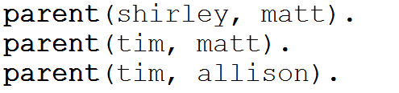
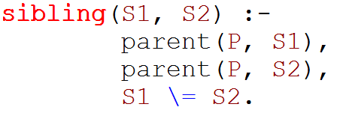
Example Using Family
sibling(matt, allison)
P=shirley
parent(P, matt)
parent(shirley, allison)
Fail and Redo

Slide 5
Example Using Family
sibling(matt, allison)
true
P=tim
parent(P, matt)
parent(tim, allison)
matt \= allison

Slide 6


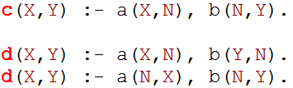
Exercises
Consider the following set of facts. Draw a trace diagram for each of the given queries
c(X,b3)
d(X,1)

