Slide 1
Functional Programming in Haskell
… and why it matters

Slide 2
Prerequisites
GHC and GHCi
https://www.haskell.org/downloads

Slide 3
What is functional programming?
A programming paradigm (way of thinking) which focuses on:
Thinking about programming as abstracting over processes instead of objects
Thinking about a program as a network of pipes in which data flows through changing until
Used to write code that is shorter, more readable, and more predictable

Slide 4
What is Haskell
A purely functional programming language, with non-strict semantics and strong static typing.
A great way to learn functional programming because it requires you to program in a functional style
Created by a team of researchers at the University of Glasgow to be used as a standard for lazy functional languages.

Slide 5
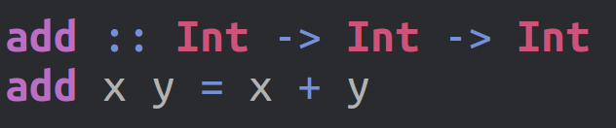

Syntax Basics

Slide 6
Functional Programming Concepts
Main concepts
Immutable Data
First Class Functions
Partial Application of Functions
Lazy Evaluation
Optional concepts
Strong Algebraic Type System
Pattern Matching
Pure Functions

Slide 7
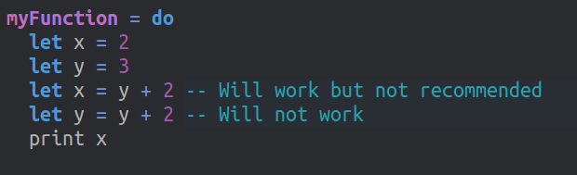
Immutable Data
By default data CANNOT be changed
Instead every function returns a new version of the old data
Once a name is bound to a value that value cannot be changed
Makes code easier to reason about.
Notes:
Add emphisis

Slide 8
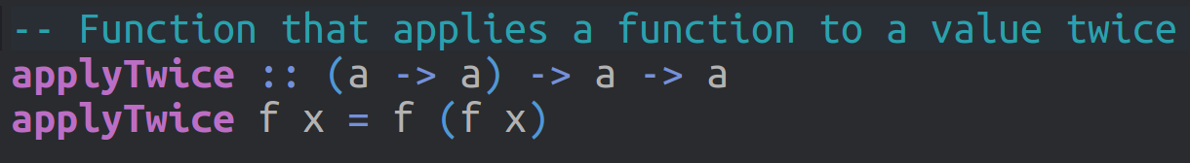
First Class Functions
Functions are data.
Functions can be saved as variables
Functions can be passed as arguments to other functions

Slide 9
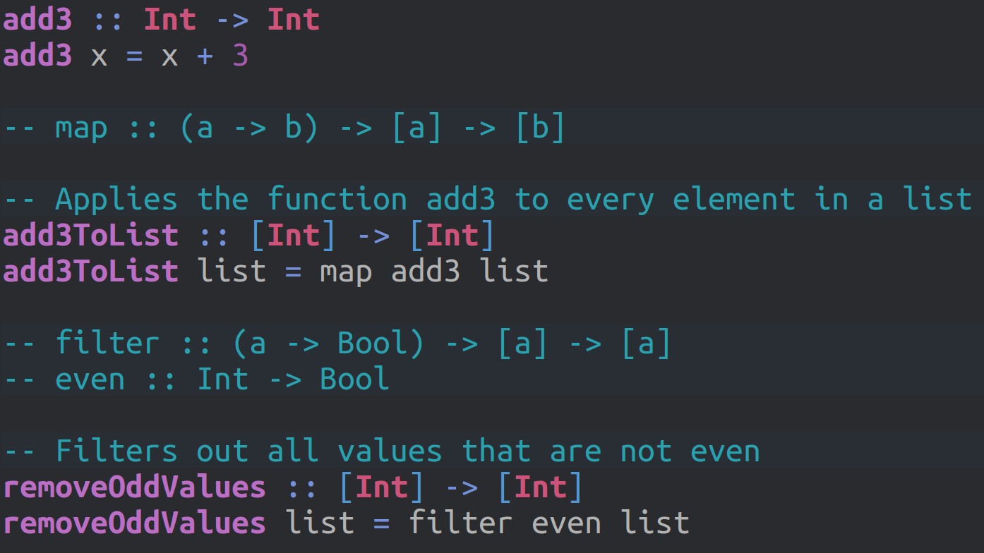
First Class Functions
Notes:
Add transition to add emphisis to the arguments as other functions line, as well as remove words for emphasis (removoe “just as any other data”)
Emphasise that map is a function

Slide 10
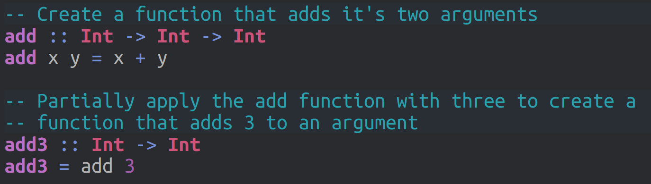
Partial Application
Since functions are data, functions can also return other functions.
In fact every function that takes more than one argument is partially applied
Usually used to pass partially applied functions to other functions
Notes:
Show code example of add function that is partially applied (Maybe introduce type signatures earlier as a clarification)

Slide 11
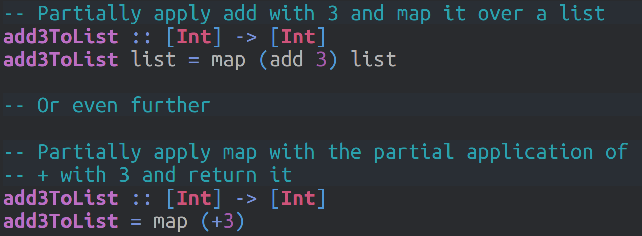
Partial Application
Usually used to pass partially applied functions to other functions
We could simplify our add3ToList function from earlier with partial application

Slide 12
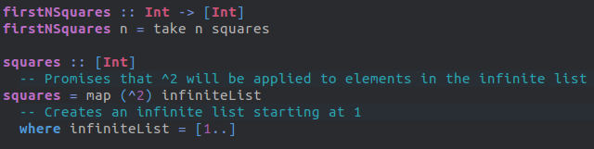
Lazy Evaluation
By default things in haskell are only evaluated when it is absolutely necessary
Increase performance when working with large amounts of data
Allows for infinite collections

Slide 13
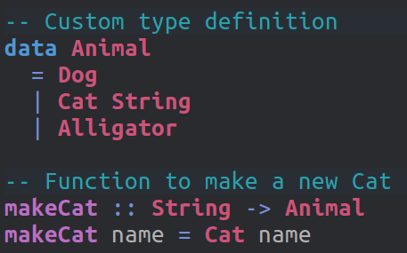
Algebraic Type System
Allows most errors to be caught during compile time.
The signature of a function can tell you exactly what it does
Type signatures won’t lie to you!

Slide 14
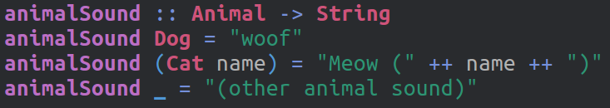
Pattern Matching
Pattern matching allows a function to run different bodies of code based on its input.
Allows for more concise and readable code

Slide 15
Pure Functions
Haskell enforces functional purity which means by default functions can have no side effects
Including IO, Randomness, Mutable State, and anything that touches the outside world
This ensures referential transparency allowing haskell to make a lot of optimizations
Referential transparency means that a function can be replaced with it’s result at any time without changing the value
Only impure functions can call other impure functions creating a plague of side effects

Slide 16
Making the Card game of War in Haskell
Github: https://github.com/evanrupert/haskell-presentation

