Slide 1
Welcome to the experiment! Please read the instructions carefully.
In this experiment, you will perform two tasks at a video-game casino. The entire experiment will take somewhere between 1 hour 20 minutes and 1 hour 50 minutes. We expect the first task will take about 30 minutes, the second task will take about 40 minutes, and the two sets of instructions in total will take about 20 minutes.
In order to proceed to the first task, you will need to pass an instruction quiz.

Slide 2
We’ll now provide instructions for the first task.
In this task, you will make decisions about which slot machines to play at a casino.
Following some decisions, you will receive a banknote that will either cause you to gain or lose points.
Banknotes with positive point values cause you to gain points. Banknotes with negative point values cause you to lose points.
At the end of the task, the computer will randomly pick four decisions that you made.
Your bonus will be proportional to the average number of points received on these decisions. This average can be either positive or negative. The more negative this average is, the smaller your bonus payment will be. The more positive this average is, the larger your bonus payment will be.

Slide 3
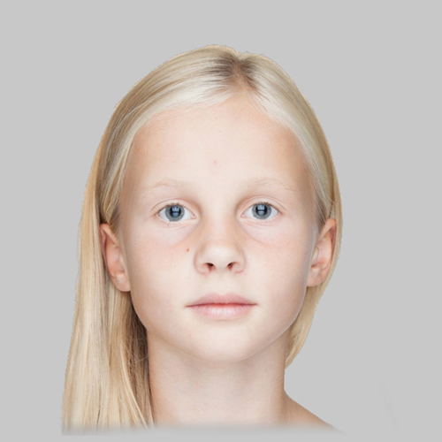
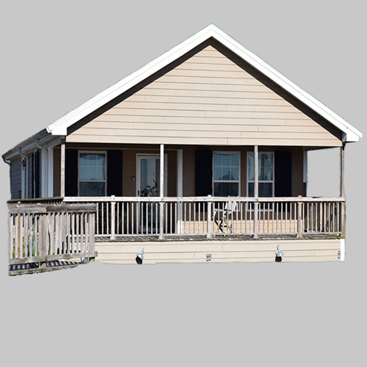

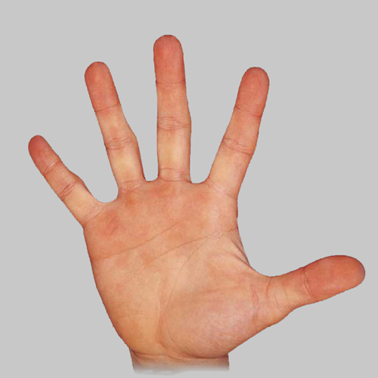
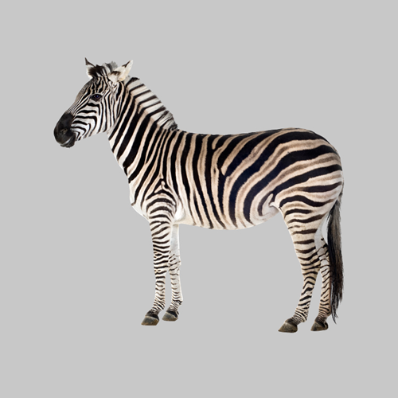

SCISSORS Banknote
BANKNOTES:
GIRL Banknote
HOUSE Banknote
The casino in this task uses two types of banknotes (shown on the right).
Collecting one of these banknotes on a given game will cause you to either gain or lose points (the point value will displayed instead of “XX”).
The casino also has four types of slot machines.
When you play a slot machine you will get one of the two banknotes.
XX
XX
SLOT MACHINES:
BUTTERFLY
Machine
HAND
Machine
ZEBRA
Machine
PEPPER
Machine

Slide 4
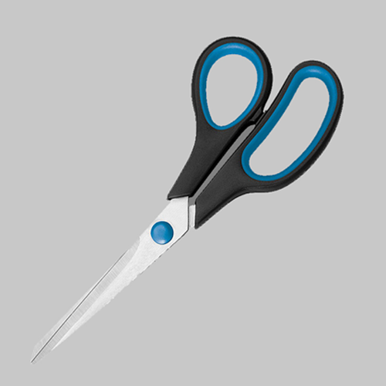
BANKNOTES:
SCISSORS Banknote
HOUSE Banknote
The casino you will visit uses two types of banknotes (shown on the right).
Collecting one of these banknotes on a given game will cause you to either gain or lose points (the point value will displayed instead of “XX”).
The casino also has four types of slot machines.
When you play a slot machine you will get one of the two banknotes.
XX
XX
SLOT MACHINES:
BUTTERFLY
Machine
HAND
Machine
ZEBRA
Machine
PEPPER
Machine

Slide 5
BANKNOTES:
SCISSORS Banknote
GIRL Banknote
The casino you will visit uses two types of banknotes (shown on the right).
Collecting one of these banknotes on a given game will cause you to either gain or lose points (the point value will displayed instead of “XX”).
The casino also has four types of slot machines.
When you play a slot machine you will get one of the two banknotes.
XX
XX
SLOT MACHINES:
BUTTERFLY
Machine
HAND
Machine
ZEBRA
Machine
PEPPER
Machine

Slide 6
Each slot machine can lead to either of the two banknotes, however, the chances that a given slot-machine provides a given banknote are different for the different slot machines.
Making good decisions in the task will require learning from your experience the chances that each slot machine tends to produce either banknote.
The chances that a given slot machine provides a given banknote will not change over the course of the task.
?
?
XX
XX
?
?
XX
XX

Slide 7
Each slot machine can lead to either of the two banknotes, however, the chances that a given slot-machine provides a given banknote are different for the different slot machines.
Making good decisions in the task will require learning from your experience the chances that each slot machine tends to produce either banknote.
The chances that a given slot machine provides a given banknote will not change over the course of the task.
?
?
XX
XX
?
?
XX
XX

Slide 8
Each slot machine can lead to either of the two banknotes, however, the chances that a given slot-machine provides a given banknote are different for the different slot machines.
Making good decisions in the task will require learning from your experience the chances that each slot machine tends to produce either banknote.
The chances that a given slot machine provides a given banknote will not change over the course of the task.
?
?
XX
XX
?
?
XX
XX

Slide 9
The task will have two types of games.
For the first type of game, you’ll be presented with a slot machine. You must press 1 to play the machine. Then the machine will provide you with a bank note.
The banknotes on these games will not have any points.
As an attention check, you will sometimes be asked to report which slot machine you just played or which banknote you just received. To do this you will use the number keys (1,2,3 or 4). Your correctness on these questions will affect your bonus payment.
Let’s practice a few of these games.

Slide 10
PRACTICE
Some trials starting with some slot machine. Ask some quiz questions about what was just seen.

Slide 11
Hypothetical game 1:
Great job!
In the second type of game, you’ll make a choice between two slot machines. Press 1 to choose the machine on the LEFT and 2 to choose the machine on the RIGHT.
The slot machine that you chose will then provide a banknote. The chances of a given slot machine providing either banknote will be the same for both types of games and will not change over the task.
Before you decide, you’ll be shown the number of points that either banknote would provide if it were collected on that game (two example games are shown on the right). This will be different for each game.
To get the largest bonus, you must make decisions that maximize collection of positive points and minimize collection of negative points.
Let’s practice a few of these games.
10
0
This screen from a hypothetical game shows that for this game, collecting the SCISSORS banknote would add 10 points and collecting the GIRL banknote would add 0 points to your collection.
Hypothetical game 2:
-10
-5
This screen from a hypothetical game shows that for this game, collecting the SCISSORS banknote would take away 10 points and collecting the GIRL banknote take away 5 points from your collection.

Slide 12
Hypothetical game 1:
Great job!
In the second type of game, you’ll make a choice between two slot machines. Press 1 to choose the machine on the LEFT and 2 to choose the machine on the RIGHT.
The slot machine that you chose will then provide a banknote. The chances of it providing either banknote will be the same as it is for other type of game that you just played.
Before you decide, you’ll be shown the number of points that either banknote would provide if it were collected on that game (two example games are shown on the right). This will be different for each game.
To get the largest bonus, you must make decisions that maximize collection of positive points and minimize collection of negative points.
Let’s practice a few of these games.
10
0
This screen from a hypothetical game shows that for this game, collecting the SCISSORS banknote would add 10 points and collecting the HOUSE banknote would add 0 points to your collection.
Hypothetical game 2:
-10
-5
This screen from a hypothetical game shows that for this game, collecting the SCISSORS banknote would take away 10 points and collecting the HOUSE banknote take away 5 points from your collection.

Slide 13
Hypothetical game 1:
Great job!
In the second type of game, you’ll make a choice between two slot machines. Press 1 to choose the machine on the LEFT and 2 to choose the machine on the RIGHT.
The slot machine that you chose will then provide a banknote. The chances of it providing either banknote will be the same as it is for other type of game that you just played.
Before you decide, you’ll be shown the number of points that either banknote would provide if it were collected on that game (two example games are shown on the right). This will be different for each game.
To get the largest bonus, you must make decisions that maximize collection of positive points and minimize collection of negative points.
Let’s practice a few of these games.
10
0
This screen from a hypothetical game that for this game, collecting the GIRL banknote would add 10 points and collecting the HOUSE banknote would add 0 points to your collection.
Hypothetical game 2:
-10
-5
This screen from a hypothetical game that for this game, collecting the GIRL banknote would take away 10 points and collecting the HOUSE banknote take away 5 points from your collection.

Slide 14
PRACTICE
Some choice trials, no choice time limits.

Slide 15
Great work. The task will have interleaved blocks between the first type of game and the games you just played.
Before we begin, you’ll need to pass a quiz on the instructions. Getting a question wrong will require you to re-start the instructions (you will not have to re-do the practice games though).

Slide 16
Great work! We’ll now continue to the second task.
In this task you’ll play a different game at the same casino.
This game will use the same two banknotes as before but will also have a third type of banknote (shown on the right).
It will use the same four slot machines as the last task.
On each decision, you’ll collect one of these banknotes.
As before, at the end of this task, the computer will randomly select four decisions that you made.
Your bonus will be based on the average number of points you collected on these four decisions.
Banknotes in this task:
GIRL Banknote
XX
SCISSORS Banknote
XX
HOUSE Banknote
XX

Slide 17
On each game you will be presented with one of the slot machines that were in the previous task.
Now, you can choose either to play the slot machine or to reject it.
Playing (key 1) a slot machine will produce either the SCISSORS or GIRL banknote.
The chances of a given slot machine producing either of these two banknotes will be the same as it was in the previous task. These chances will not change over the course of the task.
You can also reject a slot machine (key 2). If you reject a slot machine, you will always get the HOUSE banknote.
For each slot machine:
If you play:
GIRL Banknote
SCISSORS Banknote
XX
OR
XX
Chances of GIRL or SCISSORS depend on which slot machine is played.
If you reject:
HOUSE Banknote
XX
Rejecting always leads to the HOUSE banknote.

Slide 18
On each game you will be presented with one of the slot machines that were in the previous task.
Now, you can choose whether to play the slot machine or to reject it.
Playing (key 1) a slot machine will produce either the SCISSORS or HOUSE banknote.
The chances of a given slot machine producing either of these two banknotes will be the same as it was in the previous task. These chances will not change over the course of the task.
You can also reject a slot machine (key 2). If you reject a slot machine, you will always get the GIRL banknote.
For each slot machine:
If you play:
HOUSE Banknote
SCISSORS Banknote
XX
OR
XX
Chances of HOUSE or SCISSORS banknotes depend on which slot machine is played.
If you reject:
GIRL Banknote
XX
Rejecting always leads to the GIRL banknote.

Slide 19
On each game you will be presented with one of the slot machines that were in the previous task.
Now, you can choose whether to play the slot machine or to reject it.
Playing (key 1) a slot machine will produce either the GIRL or HOUSE banknote.
The chances of a given slot machine producing either of these two banknotes will be the same as it was in the previous task. These chances will not change over the course of the task.
You can also reject a slot machine (key 2). If you reject a slot machine, you will always get the SCISSORS banknote.
For each slot machine:
If you play:
HOUSE Banknote
SCISSORS Banknote
XX
OR
XX
Chances of HOUSE or GIRL banknotes depend on which slot machine is played.
If you reject:
SCISSORS Banknote
XX
Rejecting always leads to the SCISSORS banknote.

Slide 20
Before each decision to play or reject a slot machine, you will be shown the point value of each banknote for that game (example on the right).
You must pay attention to these screens in order to make choices that lead you to maximize collection of positive points and minimize collection of negative points.
To get used to the timing, let’s just practice a few presentations of the point values of each banknote. Here, you’ll just be presented with the point values of each bank note and then you’ll be asked what one of their point values is.
Hypothetical game :
72
48
8
This screen from a hypothetical game shows that for this game, if you PLAY the slot machine, you will either get the SCISSORS banknote and collect 72 points or the GIRL banknote and collect 8 points. If you reject the slot machine, you’ll get the HOUSE banknote and collect 48 points.

Slide 21
Practice

Slide 22
Great. As an attention check, there will be a few games like this in the task. For these, you’ll have to report the point value of a given banknote.
Let’s now practice a few actual task games. For these, after seeing the point value of each banknote, you will be presented with a slot machine.
Press ‘1’ to play the slot machine or ‘2’ to reject it.
After this, based on your choice, you’ll get a banknote and either collect or lose points.

Slide 23
Practice real choice trials

Slide 24
Great work!
As before, your bonus will be affected both by the total number of points you collect as well as your performance on attention check questions. In terms of collecting banknotes, banknotes with positive point values add their points to your collection. Bank notes with negative point values take away points.
You’ll need to pass a quiz on the instructions in order to move onto the task.
Getting a question wrong will require you to re-read the instructions.

