Slide 1
Welcome to the experiment! Please read the instructions carefully.
In this experiment, you will perform two tasks at a video-game casino. The entire experiment will take somewhere between 70 and 90 minutes. We expect the first task will take about 25 minutes, the second task will take about 35 minutes, and the two sets of instructions in total will take about 15 minutes.
In order to proceed to the first task, you will need to pass an instruction quiz.

Slide 2
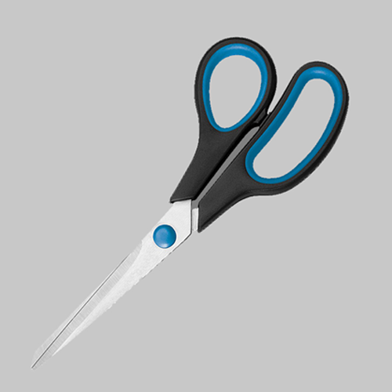
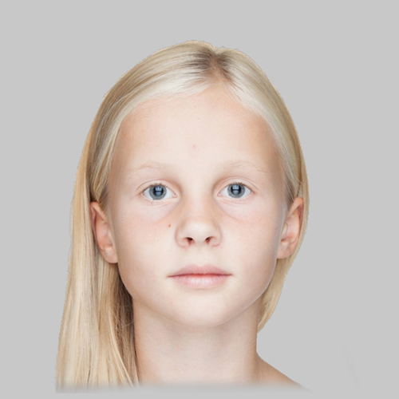

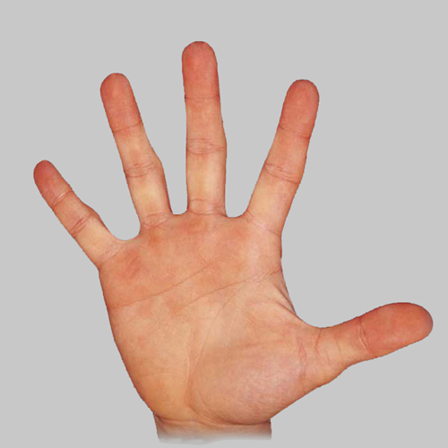
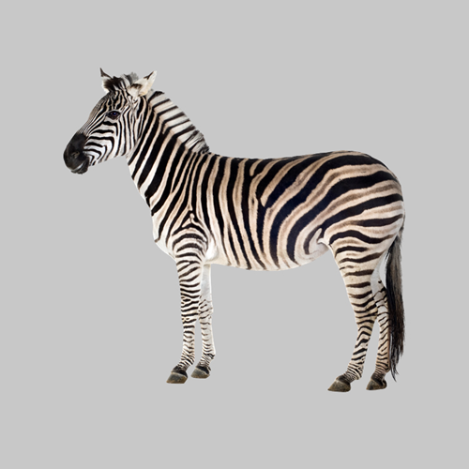

BANKNOTES:
SCISSORS Banknote
GIRL Banknote
We’ll now provide instructions for the first task.
The casino you will visit uses two types of banknotes (shown on the right).
The casino also has four types of slot machines.
When you play a slot machine you will get one of the two banknotes.
SLOT MACHINES:
BUTTERFLY
Machine
HAND
Machine
ZEBRA
Machine
PEPPER
Machine

Slide 3
The purpose of this task is for you to learn which slot machines tend to lead to which banknotes.
Each slot machine can lead to either of the two banknotes, however, the chances that a given slot-machine provides a given banknote are different for the different slot machines.
The chances that a given slot machine provides a given banknote will not change over the course of the task.
?
?
XX
XX
?
?
XX
XX

Slide 4
The task will have two types of games.
For the first type of game, you’ll be presented with a slot machine. You must press 1 to play the machine. Then the machine will provide you with a bank note.
As an attention check, you will sometimes be asked to report which slot machine you just played or which banknote you just received. To do this you will use the number keys (1,2,3 or 4). Your correctness on these questions will affect your bonus payment.
Let’s practice a few of these games.

Slide 5
PRACTICE
Some trials starting with some slot machine. Ask some quiz questions about what was just seen.

Slide 6
Great job!
In the second type of game, you’ll be quizzed on which of two slot-machines is more likely to lead to one of the banknotes.
You’ll be shown one of the banknotes as well as two of the slot machines. You’ll need to use the number keys to answer which of the two slot machine is more likely to lead to the banknote being shown.
Your correctness on these questions will also affect your bonus.

Slide 7
The task will have interleaved blocks between playing the slot machines and the quiz questions.
Before we begin, you’ll need to pass a quiz on the instructions. Getting a question wrong will require you to re-start the instructions (you will not have to re-do the practice games though).

Slide 8
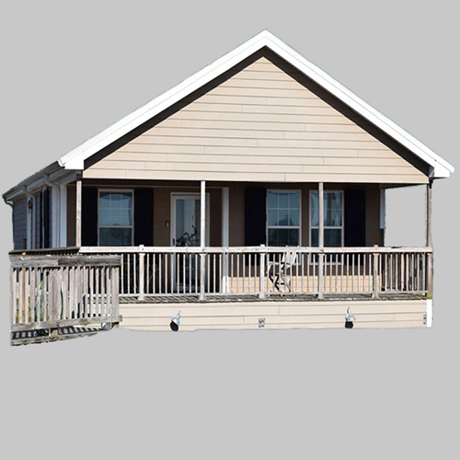
Great work! We’ll now continue to the second task.
In this task you’ll play a different game at the same casino.
This game will use the same two banknotes as before but will also have a third type of banknote (shown on the right).
It will use the same four slot machines as the last task.
On each decision, you’ll collect one of these banknotes.
Banknotes in this task:
GIRL Banknote
XX
SCISSORS Banknote
XX
HOUSE Banknote
XX

Slide 9
In this task each banknote will have either positive or negative points attached to it (displayed in place of the XX).
Banknotes with positive point values will cause you to gain points. Banknotes with negative point values will cause you to lose points.
At the end of the task, the computer will randomly pick four decisions that you made.
Your bonus will be proportional to the average number of points received on these decisions. This average can be either positive or negative. The more negative this average is, the smaller your bonus payment will be. The more positive this average is, the larger your bonus payment will be.
GIRL Banknote
XX
SCISSORS Banknote
XX
HOUSE Banknote
XX

Slide 10
On each game in this task you will be presented with one of the slot machines that were in the previous task.
Now, you can choose either to play the slot machine or to reject it.
Playing (key 1) a slot machine will produce either the SCISSORS or GIRL banknote.
The chances of a given slot machine producing either of these two banknotes will be the same as it was in the previous task. These chances will not change over the course of the task.
You can also reject a slot machine (key 2). If you reject a slot machine, you will always get the HOUSE banknote.
For each slot machine:
If you play:
GIRL Banknote
SCISSORS Banknote
XX
OR
XX
Chances of GIRL or SCISSORS depend on which slot machine is played.
If you reject:
HOUSE Banknote
XX
Rejecting always leads to the HOUSE banknote.

Slide 11
Before each decision to play or reject a slot machine, you will be shown the point value of each banknote for that game (example on the right).
You must pay attention to these screens in order to make choices that lead you to maximize collection of positive points and minimize collection of negative points.
To get used to the timing, let’s just practice a few presentations of the point values of each banknote. Here, you’ll just be presented with the point values of each bank note and then you’ll be asked what one of their point values is.
Hypothetical game :
72
48
8
This screen from a hypothetical game shows that for this game, if you PLAY the slot machine, you will either get the SCISSORS banknote and collect 72 points or the GIRL banknote and collect 8 points. If you reject the slot machine, you’ll get the HOUSE banknote and collect 48 points.

Slide 12
Practice

Slide 13
Great. As an attention check, there will be a few games like this in the task. For these, you’ll have to report the point value of a given banknote.
Let’s now practice a few actual task games. For these, after seeing the point value of each banknote, you will be presented with a slot machine.
Press ‘1’ to play the slot machine or ‘2’ to reject it.
After this, based on your choice, you’ll get a banknote and either collect or lose points.

Slide 14
Practice real choice trials

Slide 15
Great work!
As before, your bonus will be affected both by the total number of points you collect as well as your performance on attention check questions. In terms of collecting banknotes, banknotes with positive point values add their points to your collection. Bank notes with negative point values take away points.
You’ll need to pass a quiz on the instructions in order to move onto the task.
Getting a question wrong will require you to re-read the instructions.

