Slide 1
Welcome to the MEG instruction and training session!
Completion of this training task is necessary in order to participate in the MEG experiment. Additionally, your ability to participate in the MEG experiment will be depend on your performance on this practice session. It is important that you try your best.
The entire practice session should take about 45 minutes. You will be compensated £5.00 for completing it, with an opportunity for a bonus of up to £2.00 depending on your performance. This is in addition to what you will be paid should you complete the MEG experiment.

Slide 2
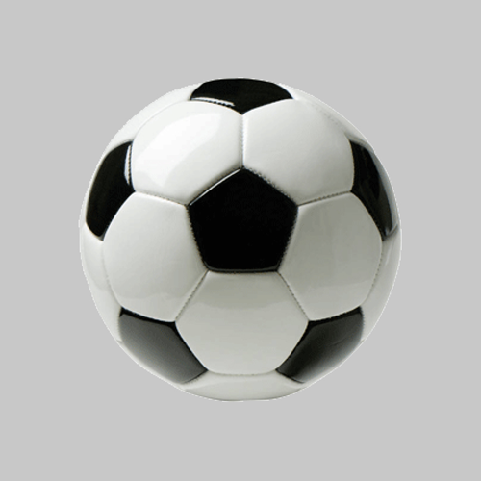
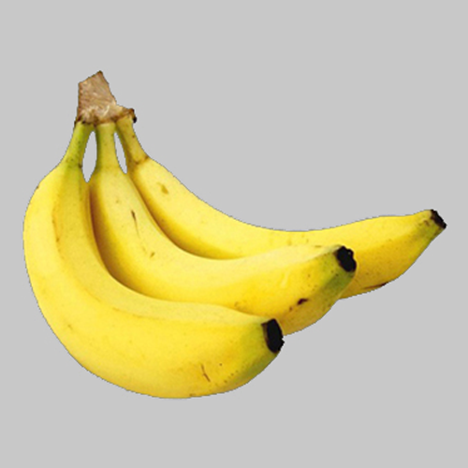
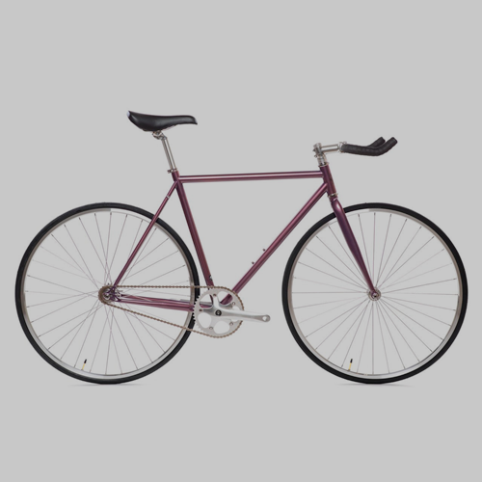
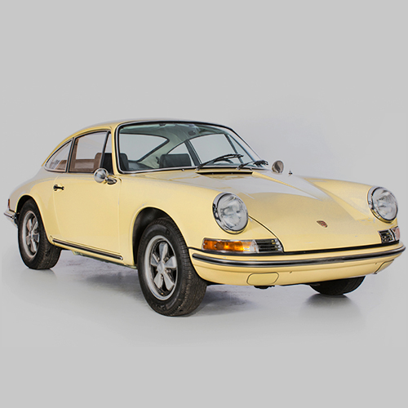
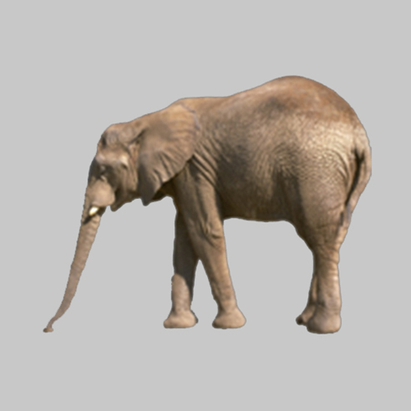
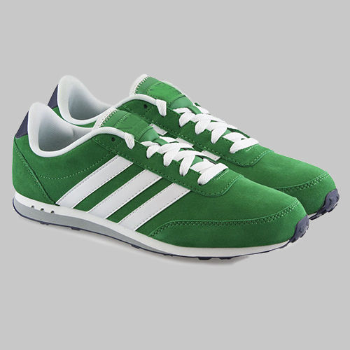
BANKNOTES:
BALL Banknote
BANANA Banknote
In this task, you will visit a video-game casino.
The casino you will visit uses two types of banknotes (shown on the right).
The casino also has four types of slot machines.
Playing a slot machine provides one of the two banknotes.
SLOT MACHINES:
BICYCLE
Machine
CAR
Machine
ELEPHANT
Machine
SNEAKERS
Machine

Slide 3
Each slot machine can lead to either of the two banknotes, however, the chances that a given slot-machine provides a given banknote are different for the different slot machines.
The purpose of the first task is for you to learn the chances each slot machine provides either of the banknotes.
On the next slide we will show you a schematic that displays the chances of each slot machine providing either banknote. Please study this schematic. You will then have a chance to play each of the slot machines a number of times to gain additional experience with these probabilities. In the main gamble task, the banknotes will provide points. However, in this task they will not have any points, as the purpose is just for you to learn how they relate to the different slot-machines.
After another presentation of the schematic, you will take a quiz in which you will be shown a given slot machine and a given banknote. You will be required to press a number key to indicate the chances that that slot machine would provide that banknote.
We will repeat this quiz 14 times so that you will be able to fully learn the chance that each slot machine providing either banknote. Intermittently you will have a number of chances to study the map and play the slot machines.
Your bonus for this task as well as your ability to participate in the MEG task will be depend on the total number of quiz questions you answer correctly. Please try to get as many questions correct as you can.

Slide 4
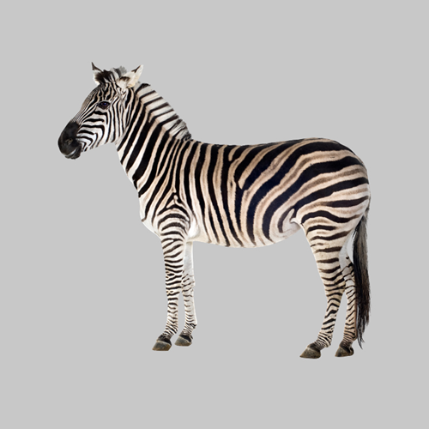
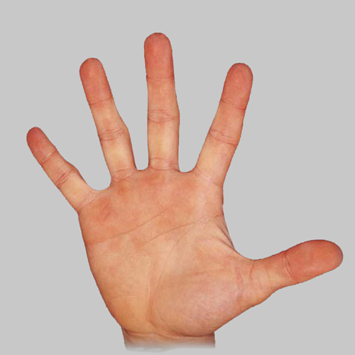
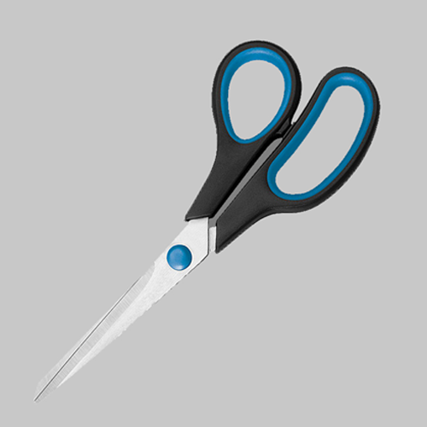
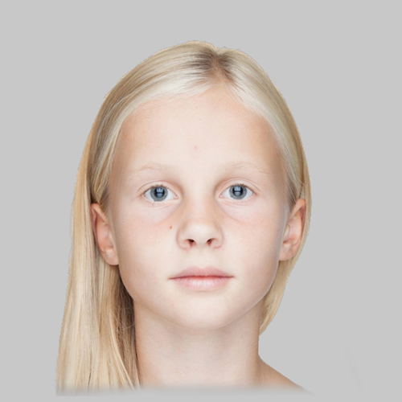
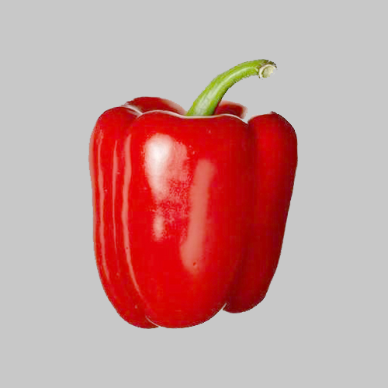
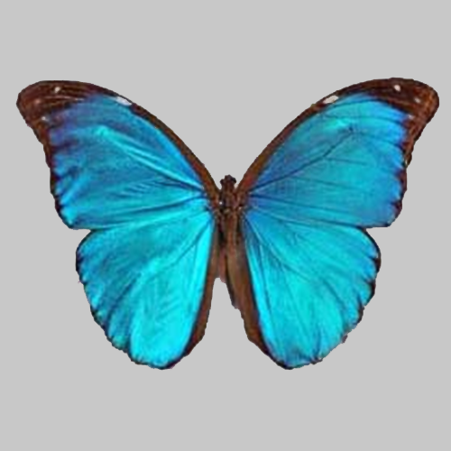
This schematic shows the chances that each slot machine provides either banknote.
Please study it. When you are ready press Next to take a quiz.
20%
80%
40%
60%
60%
40%
80%
20%

Slide 5
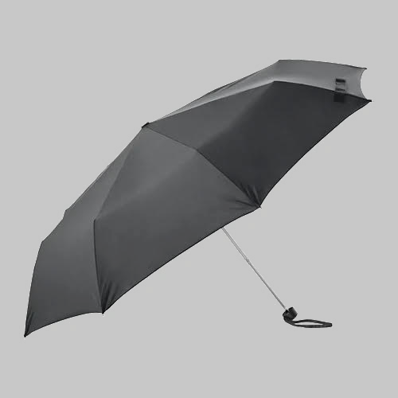
Great work! We’ll now continue to the main task.
In this task you’ll play a game at the casino.
This game will use the same two banknotes you just saw before but will also have a third type of banknote (shown on the right).
It will use the same four slot machines as the last task.
On each decision, you’ll collect one of these banknotes.
Banknotes in this task:
BALL Banknote
XX
BANANA Banknote
XX
UMBRELLA Banknote
XX

Slide 6
In this task each banknote will have either positive or negative points attached to it (displayed in place of the XX).
Banknotes with positive point values will cause you to gain points. Banknotes with negative point values will cause you to lose points.
At the end of the task, the computer will randomly pick four decisions that you made.
Your bonus will be proportional to the average number of points received on these decisions. This average can be either positive or negative. The more negative this average is, the smaller your bonus payment will be. The more positive this average is, the larger your bonus payment will be.
Banknotes in this task:
BALL Banknote
XX
BANANA Banknote
XX
UMBRELLA Banknote
XX

Slide 7
On each game in this task you will be presented with one of the slot machines that were in the previous task.
Now, you can choose either to play the slot machine or to reject it.
Playing (key 1) a slot machine will produce either the BALL or BANANA banknote.
The chances of a given slot machine producing either of these two banknotes will be the same as what you were just tested on. These chances will not change over the course of the task.
You can also reject a slot machine (key 2). If you reject a slot machine, you will always get the UMBRELLA banknote.
For each slot machine:
If you play:
BALL Banknote
BANANA Banknote
XX
OR
XX
Chances of GIRL or SCISSORS depend on which slot machine is played.
If you reject:
UMBRELLA Banknote
XX
Rejecting always leads to the UMBRELLA banknote.

Slide 8
Before each decision to play or reject a slot machine, you will be shown the point value of each banknote for that game (example on the right).
You must pay attention to these screens in order to make choices that lead you to maximize collection of positive points and minimize collection of negative points.
To get used to the timing, let’s just practice a few presentations of the point values of each banknote. Here, you’ll just be presented with the point values of each bank note and then you’ll be asked what one of their point values is.
Hypothetical game :
72
48
8
This screen from a hypothetical game shows that for this game, if you PLAY the slot machine, you will either get the BALL banknote and collect 72 points or the BANANA banknote and collect 8 points. If you reject the slot machine, you’ll get the UMBRELLA banknote and collect 48 points.

Slide 9
Practice

Slide 10
Great. As an attention check, there will be a few games like this in the task. For these, you’ll have to report the point value of a given banknote.
Let’s now practice a few actual task games. For these, after seeing the point value of each banknote, you will be presented with a slot machine.
Press ‘1’ to play the slot machine or ‘2’ to reject it.
After this, based on your choice, you’ll get a banknote and either collect or lose points.

Slide 11
Practice real choice trials

Slide 12
Great work!
Your bonus (and overall performance) will be affected both by the total number of points you collect as well as your performance on attention check questions. In terms of collecting banknotes, banknotes with positive point values add their points to your collection. Bank notes with negative point values take away points.
You’ll need to pass a quiz on the instructions in order to move onto the task.
Getting a question wrong will require you to re-read the instructions.

Slide 13
Info on MEG task
Great work. You’ve completed the training session.
The MEG task will include the components that you just completed, however will use different banknotes and slot-machines.
It will also include a first part, where you will just be required to complete a task where you attend to each of the task images, one at a time, that will last about 30 minutes. This will allow us to record how your brain responds to each of the task images.
Following this, you will learn and be quizzed on the chances that each slot machine produces either banknote. This will be the same as it was in what you just completed.
Then you will complete the gamble task. It will be about 4 times as long as the task you just completed.

