Slide 2
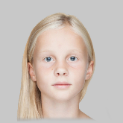
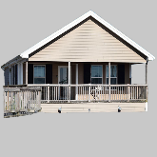
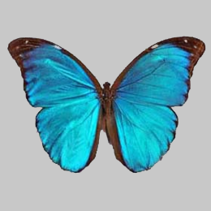
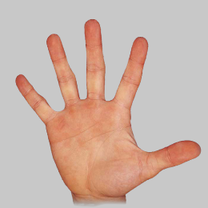
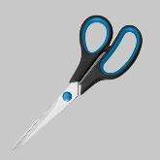
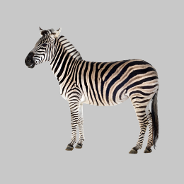
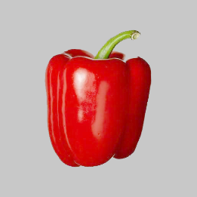
Welcome to the MEG experiment!
Today we will use the following slot-machines and banknotes.
Please take a moment to go over which images are banknotes and which are slot-machines. Then press 4 to continue.
SLOT MACHINES:
BANKNOTES:
BUTTERFLY Machine
HAND Machine
GIRL Banknote
HOUSE Banknote
XX
XX
SCISSORS Banknote
ZEBRA Machine
PEPPER Machine
XX

Slide 3
We will now start the first task.
Here, on each trial, we will show you either one of the slot-machines or one of the banknotes.
When you see the image of the slot-machine or the banknote, please think its name (e.g. “GIRL” for the GIRL banknote, “HAND” for the HAND Machine).
You will then be quizzed on which you were presented with. You will see two names appear on the screen. One of the names will be the name of the banknote or slot-machine just saw. You must select this name.
Use key 1 to select the name on the LEFT or key 2 to select the name on the right
You will only have half a second to respond, so you must think of the name while the image is on the screen and then respond as fast as you can.
You will complete 5 blocks of this task, each lasting about 5 minutes. Your accuracy on this task will affect your bonus payment.
Press 4 when you are ready to begin.

Slide 4
Great work. We will now continue with the task that you completed yesterday.
In this task playing a SLOT machine will always provide the GIRL or SCISSORS banknotes. Rejecting will always provide the house banknote.
You’ll now have a chance to repeatedly study and be quizzed on the chances that each slot machine produces either banknote.
We’ll complete 12 rounds of studying and then quizzing.
When you are ready to start, press 4.
For each slot machine:
If you play:
GIRL Banknote
XX
OR
XX
Chances of GIRL or SCISSORS depend on which slot machine is played.
If you reject:
HOUSE Banknote
XX
Rejecting always leads to the HOUSE banknote.

Slide 5
Great work. We’ll now continue onto the main task.
The task will consist of 8 rounds, each lasting about 7 minutes.
For each game, remember to press ‘1’ to play the slot machine or ‘2’ to reject it.
Try to make decisions that will collect the greatest positive points and the fewest negative points.
Press 4 when you are ready to begin the first round.

