Slide 1
Welcome to the experiment! Please read the instructions carefully.
In this experiment, you will perform two tasks at a video-game casino. The entire experiment will take about an hour.
You will receive a base-pay of £8.50 with a possible bonus of 0 - £3, depending on your choices and response times.

Slide 2
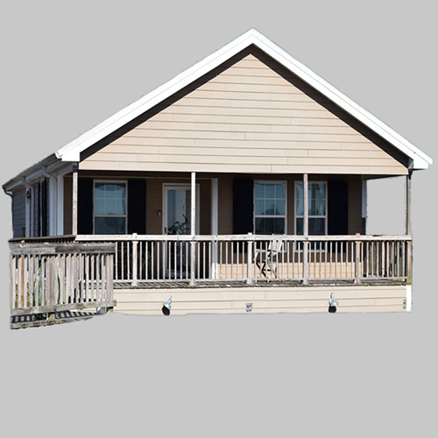
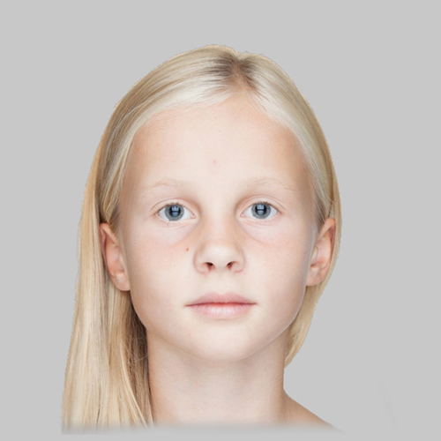

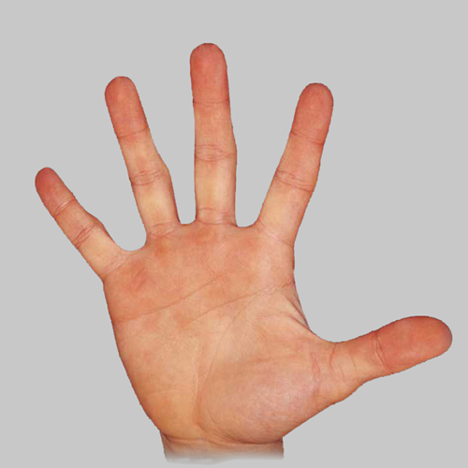
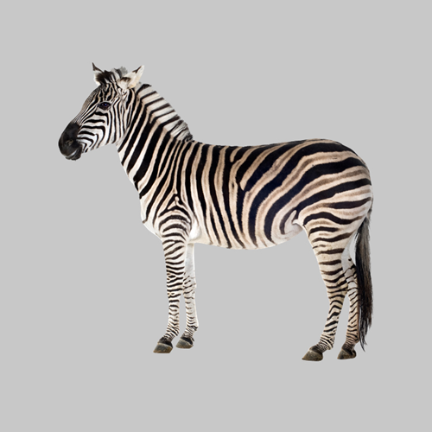

BANKNOTES:
House Banknote
GIRL Banknote
We’ll now provide instructions for the first task.
The casino you will visit uses two types of banknotes (shown on the right).
The casino also has four types of slot machines.
Playing a slot machine provides one of the two banknotes.
SLOT MACHINES:
BUTTERFLY
Machine
HAND
Machine
ZEBRA
Machine
PEPPER
Machine

Slide 3
Each slot machine can lead to either of the two banknotes, however, the chances that a given slot-machine provides a given banknote are different for the different slot machines.
The purpose of this first task is for you to learn the chances each slot machine provides either of the banknotes.
On the next slide we will show you a schematic that displays the chances of each slot machine providing either banknote. Please study this schematic.
You will then have the chance to pay each slot machine a number of times, by pressing ‘1’. After each play, you will observe which banknote that play produced.
After playing each machine, you’ll take a quiz in which you will be shown a given banknote and two slot machines. You’ll need to use the number keys to report which slot machine is more likely to lead to that banknote.
We will repeat this quiz (along with study opportunities) 3 times so that you will be able to fully learn the chance of each slot machine providing either banknote. (Note the third time you won’t play the slot machines). Your bonus for this task will be proportional to the total number of quiz questions you answer correctly. Please try to get as many questions correct as you can.

Slide 4
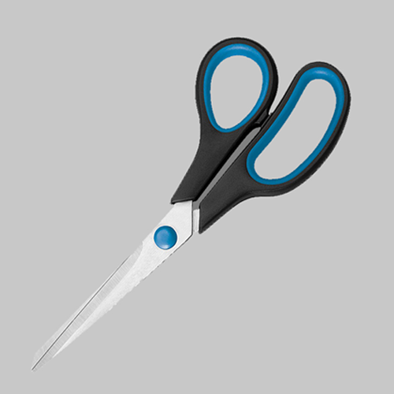
Great work! We’ll now continue to the second task.
In this task you’ll play a game at the casino.
This game will use the same two banknotes you just saw before but will also have a third type of banknote (shown on the right).
It will use the same four slot machines as the last task.
On each decision, you’ll collect one of these banknotes.
Banknotes in this task:
GIRL Banknote
XX
SCISSORS Banknote
XX
HOUSE Banknote
XX

Slide 5
In this task each banknote will have either positive or negative points attached to it (displayed in place of the XX).
Banknotes with positive point values will cause you to gain points. Banknotes with negative point values will cause you to lose points.
At the end of the task, the computer will randomly pick four decisions that you made.
Your bonus will be proportional to the average number of points received on these decisions. This average can be either positive or negative. The more negative this average is, the smaller your bonus payment will be. The more positive this average is, the larger your bonus payment will be.
GIRL Banknote
XX
SCISSORS Banknote
XX
HOUSE Banknote
XX

Slide 6
We’ll now present the structure of each game.
On each game in this task you will be presented with one of the slot machines that were in the previous task.
Now, you can choose either to play the slot machine or to reject it.
Playing (key ‘1’) a slot machine will produce either the House or GIRL banknote.
The chances of a given slot machine producing either of these two banknotes will be the same as what you were just tested on. These chances will not change over the course of the task.
You can also reject a slot machine (key ‘2’). If you reject a slot machine, you will always get the Scissors banknote.
For each slot machine:
If you play:
GIRL Banknote
House Banknote
XX
OR
XX
Chances of GIRL or House depend on which slot machine is played.
If you reject:
Scissors Banknote
XX
Rejecting always leads to the Scissors banknote.

Slide 7
Before each decision to play or reject a slot machine, you will be shown the point value of each banknote for that game (example on the right).
You must pay attention to these screens in order to make choices that lead you to maximize collection of positive points and minimize collection of negative points.
Hypothetical game :
72
48
8
This screen from a hypothetical game shows that for this game, if you PLAY the slot machine, you will either get the HOUSE banknote and collect 72 points or the GIRL banknote and collect 8 points. If you reject the slot machine, you’ll get the SCISSORS banknote and collect 48 points.

Slide 8
Let’s now practice a few actual task games. For these, after seeing the point value of each banknote, you will be presented with a slot machine.
Press ‘1’ to play the slot machine or ‘2’ to reject it.
Note that you can only press a key once a prompt appears at the bottom of the screen. This will occur about a half-second following the slot machine appearing.
After your key press, based on your choice, you’ll get a banknote and either collect or lose points.

Slide 9
Practice real choice trials

Slide 10
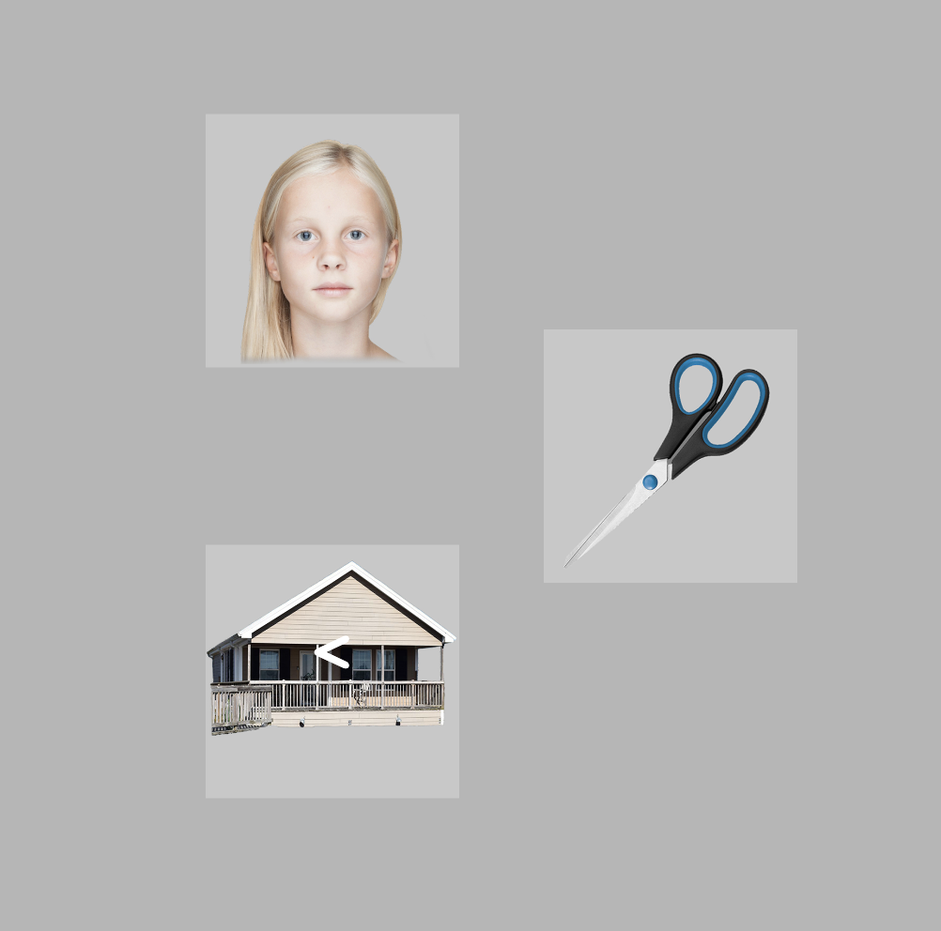
Great work!
There is one additional part of the task.
Sometimes right after the slot machine comes on the screen, instead of a prompt appearing to let you make a choice, the slot machine will disappear.
You’ll see all 3 outcome images.
One outcome images will have an arrow-head symbol.
You will need to press an arrow key as fast as you can to indicate the direction of the arrow symbol.
Press the left-arrow key if the arrow symbol is ‘<‘.
Press the right-arrow key if the symbol is ‘>’.
Which outcome picture the symbol appears over is not important.
It is important to make this press as fast as you can. Your time to make this press will be limited.
A portion of your bonus will be determined both by your correctness in reporting the arrow direction as well as how fast you make a response on these trials!
Let’s now practice a few of these trials.
On this screen, you would need to press the left-arrow key as fast as you can, to indicate that the symbol ‘<‘ is appearing on the house image.

Slide 11
Great work! Note that in the actual task, text will be removed and you will not be told whether your answer was correct or not.
Your bonus for the the whole experiment task will be affected both by the number of points you collect (on randomly selected trials) as well as your speed and accuracy on the arrow recognition questions. In terms of collecting banknotes, banknotes with positive point values add their points to your collection. Bank notes with negative point values take away points.
You’ll need to pass a quiz on the instructions in order to move onto the task.
Getting a question wrong will require you to re-read the instructions.

Slide 12
Before starting the experiment, we would like you to complete a short questionnaire.
Please try to answer as accurately as you can.

