Slide 1
Welcome to the MEG instruction and training session!
Completion of this training task is necessary in order to participate in the MEG experiment. Additionally, your ability to participate in the MEG experiment will be depend on your performance on this practice session. It is important that you try your best.
The entire session should take about 60 minutes.

Slide 2
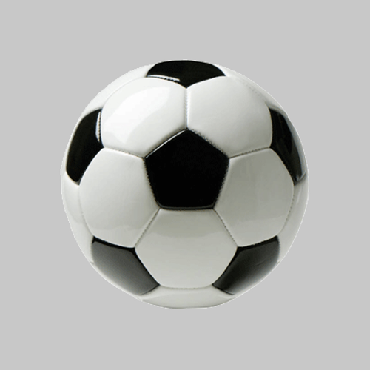
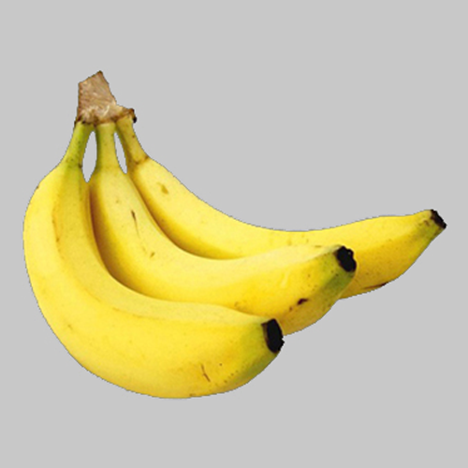
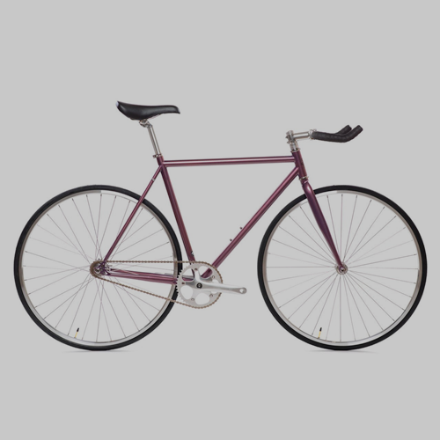
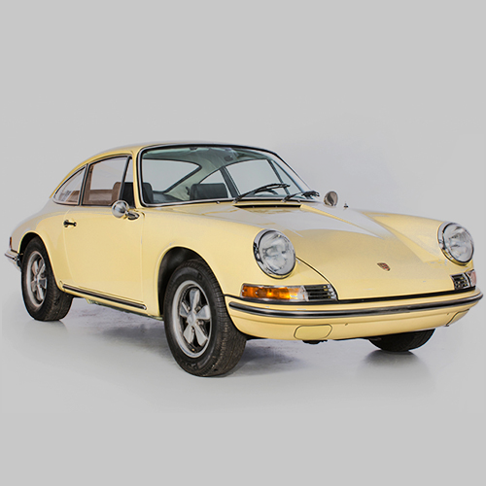
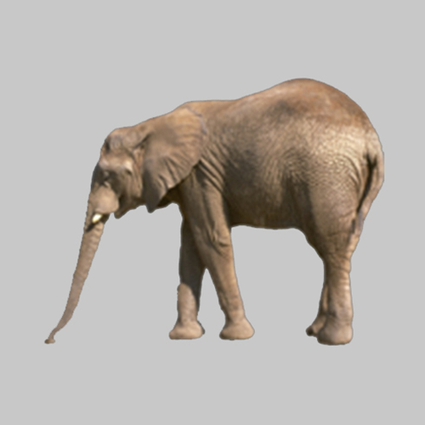
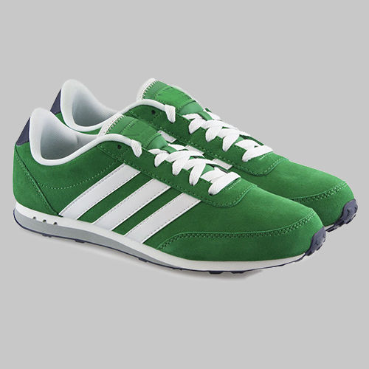
BANKNOTES:
BALL Banknote
BANANA Banknote
In this task, you will visit a video-game casino.
The casino you will visit uses two types of banknotes (shown on the right).
The casino also has four types of slot machines.
Playing a slot machine provides one of the two banknotes.
SLOT MACHINES:
BICYCLE
Machine
CAR
Machine
ELEPHANT
Machine
SNEAKERS
Machine

Slide 3
Each slot machine can lead to either of the two banknotes, however, the chances that a given slot-machine provides a given banknote are different for the different slot machines.
The purpose of the first task is for you to learn the chances each slot machine provides either of the banknotes.
In the upcoming task, for each slot-machine, you’ll be exposed to the chances that a slot-machine leads to either banknote. Then you’ll have the chance to play that slot-machine a number of times. There will be some attention check questions interspersed here. Your correctness on these will contribute toward your bonus.
After seeing the outcome chances for each slot-machine and playing each slot-machine, you’ll be asked a number of quiz questions about the chances each slot-machine leads to each outcome. Your correctness on these quiz questions will contribute toward your bonus.
We will complete 4rounds of this. Your bonus as well as your ability to participate in the MEG task will depend on the total number of quiz questions you answer correctly as well as your answers to attention check questions. Please try to get as many questions correct as you can.

Slide 4
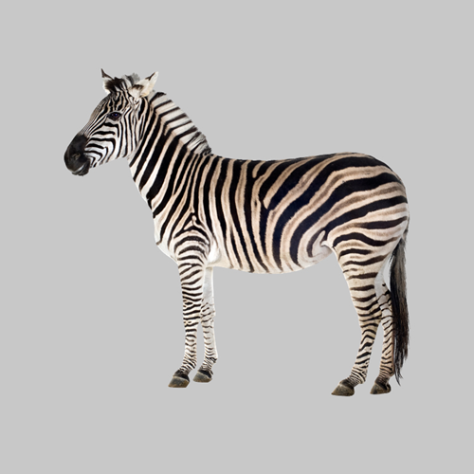
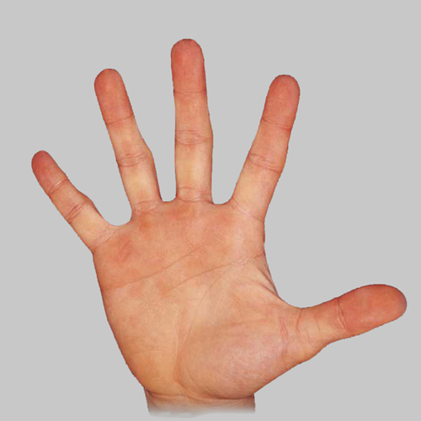
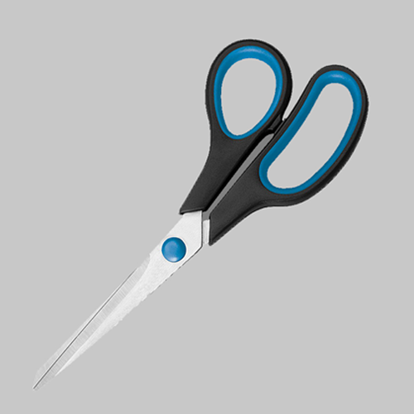
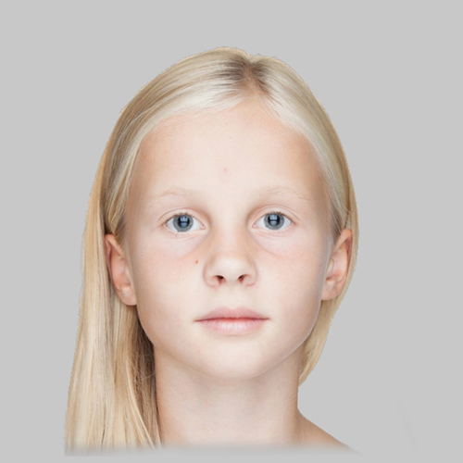
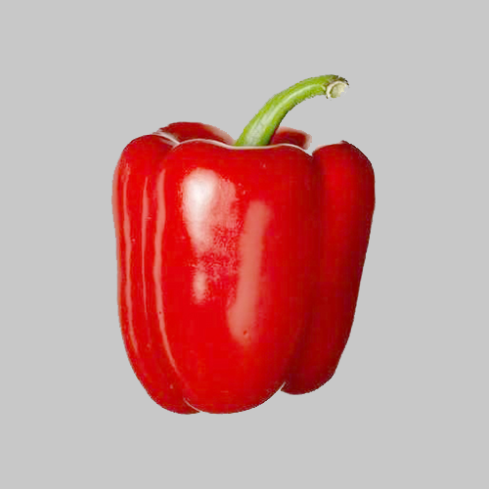
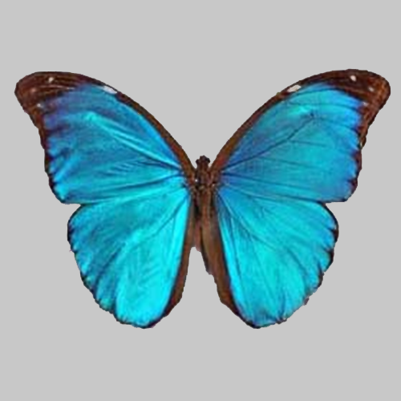
This schematic shows the chances that each slot machine provides either banknote.
Please study it. When you are ready press Next to take a quiz.
20%
80%
40%
60%
60%
40%
80%
20%

Slide 5
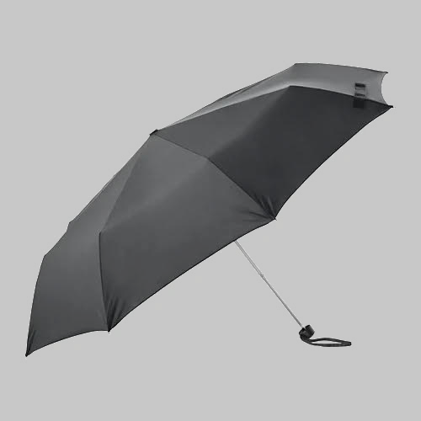
Great work! We’ll now continue to the main task.
In this task you’ll play a game at the casino.
This game will use the same two banknotes you just saw before but will also have a third type of banknote (shown on the right).
It will use the same four slot machines as the last task.
On each decision, you’ll collect one of these banknotes.
Banknotes in this task:
BALL Banknote
XX
BANANA Banknote
XX
UMBRELLA Banknote
XX

Slide 6
In this task each banknote will have either positive or negative points attached to it (displayed in place of the XX).
Banknotes with positive point values will cause you to gain points. Banknotes with negative point values will cause you to lose points.
The task today will be split into 2 rounds. At the end of the task the computer will randomly choose one decision from each round.
Your bonus will be proportional to the average number of points received on these decisions. This average can be either positive or negative. The more negative this average is, the smaller your bonus payment will be. The more positive this average is, the larger your bonus payment will be.
Banknotes in this task:
BALL Banknote
XX
BANANA Banknote
XX
UMBRELLA Banknote
XX

Slide 7
On each game in this task you will be presented with one of the slot machines that were in the previous task.
Now, you can choose either to play the slot machine or to reject it.
Playing (key 1) a slot machine will produce either the BALL or BANANA banknote.
The chances of a given slot machine producing either of these two banknotes will be the same as what you were just tested on. These chances will not change over the course of the task.
You can also reject a slot machine (key 2). If you reject a slot machine, you will always get the UMBRELLA banknote.
For each slot machine:
If you play:
BALL Banknote
BANANA Banknote
XX
OR
XX
Chances of GIRL or SCISSORS depend on which slot machine is played.
If you reject:
UMBRELLA Banknote
XX
Rejecting always leads to the UMBRELLA banknote.

Slide 8
Before each decision to play or reject a slot machine, you will be shown the point value of each banknote for that game (example on the right).
You must pay attention to these screens in order to make choices that lead you to maximize collection of positive points and minimize collection of negative points.
To get used to the timing, let’s just practice a few presentations of the point values of each banknote. Here, you’ll just be presented with the point values of each bank note and then you’ll be asked what one of their point values is.
Hypothetical game :
72
48
8
This screen from a hypothetical game shows that for this game, if you PLAY the slot machine, you will either get the BALL banknote and collect 72 points or the BANANA banknote and collect 8 points. If you reject the slot machine, you’ll get the UMBRELLA banknote and collect 48 points.

Slide 9
Practice

Slide 10
Great. As an attention check, there will be a few games like this in the task. For these, you’ll have to report the point value of a given banknote.
In the MEG task, answering these attention check questions correctly is extremely important. At the end of the task, the computer will select one round at random. For each attention check question you answer wrong on this round, you will lose 50 pence from your bonus.
Let’s now practice a few actual task games. For these, after seeing the point value of each banknote, you will be presented with a slot machine.
Press ‘1’ to play the slot machine or ‘2’ to reject it.
After this, based on your choice, you’ll get a banknote and either collect or lose points.

Slide 11
Practice real choice trials

Slide 12
Great work!
Your bonus (and overall performance) will be affected both by the points you collect as well as your performance on attention check questions. In terms of collecting banknotes, banknotes with positive point values add their points to your collection. Bank notes with negative point values take away points.
You’ll need to pass a quiz on the instructions in order to move onto the task.
Getting a question wrong will require you to re-read the instructions.

Slide 13
Info on MEG task
Great work. You’ve completed the training session.
The MEG task will include the components that you just completed, however will use different banknotes and slot-machines.
It will also include a first part, where you will just be required to complete a task where you attend to each of the task images, one at a time, that will last about 30 minutes. This will allow us to record how your brain responds to each of the task images.
Following this, you will learn about and be quizzed on the chances that each slot machine produces either banknote. This will be the same as it was in what you just completed.
Then you will complete the gamble task. However, it will consist of 8 rounds instead of 2.
Your bonus for the MEG task will be between 0 and £20. The computer will select one decision from each of the 8 rounds. The average of these 8 choices will constitute your bonus.
In the MEG task, the computer will also select a round at random and each attention check question that you answered incorrectly in that round will reduce your bonus by 50p.
Please email the experimenter (e.russek@ucl.ac.uk) to let him know you have finished the task and also with any questions you might have.

Slide 14
Questionnaires
One of the goals of this study is to relate signals in the brain, observed during decisions, to aspects of emotional state and disposition. We hope that in this way, this research might be useful for better understanding mental health.
In this regard, we would like you to fill out some questionairres, related to your emotional state and disposition.
You are free to skip any question that you would like (by selecting ‘I would prefer to not answer’). However, we hope you will answer as many questions as you can.
Should any of the questions bring up emotional distress, please write down the number of the MIND helpline listening service: (0300 123 3393 , www.mind.org.uk ) , which can provide support for emotional distress.

