Slide 1
Welcome to the experiment!
This experiment will require you to press buttons on your keyboard repeatedly, sometimes with your pinky, applying varying amounts of physical effort. If you have any history of any sort of hand injury or pain with typing (e.g. which could make either fast button pressing or stretching your hand uncomfortable) please do not complete this task.
Thank you for participating. For your completion of the task, you will receive at least £3.25 with a potential bonus between 0 and £2.00
Please read the instructions carefully. You will need to pass a quiz before starting the task.
In this experiment, you will play a game in which you will act as a knight that must travel between different trees in order to collect points. You will play 6 rounds of the game in total, each lasting about 2.5 minutes.
In each round, your goal will be to collect as many points as you can. At the end of the experiment, the computer will pick one round at random and your bonus will be proportional to the total number of points you collected during that round.

Slide 2
We’ll now explain how a round works. In order to travel to a new tree, each round will have a key you must press repeatedly (the ‘TRAVEL key’), as well as a set of other keys you must persistently hold down (the ‘hold-down keys’), in order to move rightward on the screen.
Additionally, each round will have a different key (the ‘HARVEST key’) that you must press repeatedly in order to collect points when you are at a tree.
Prior to each round, you will be informed of the travel keys and the harvest key for that round.

Slide 3
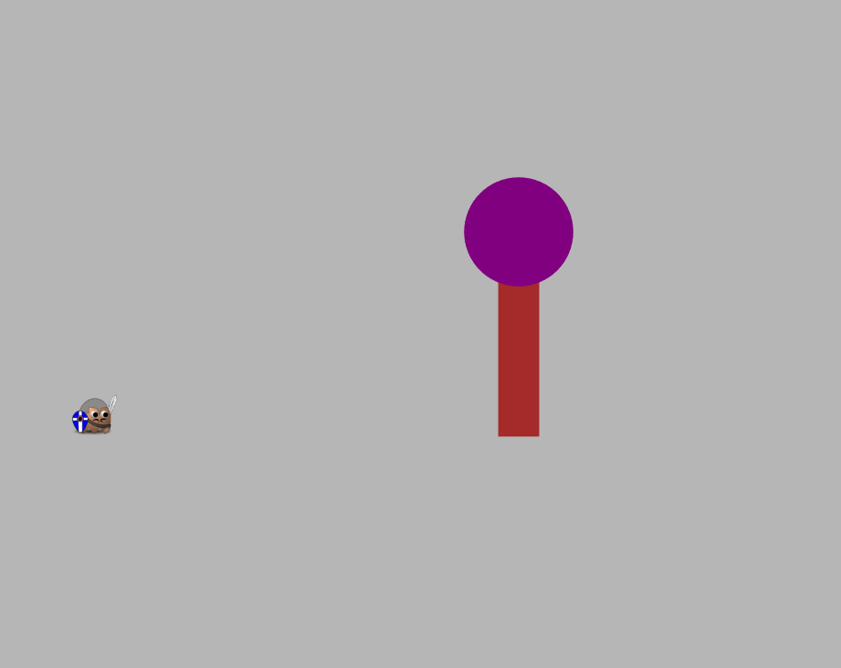
Each round will start with you on the left side of the screen and a tree some distance ahead of you.
In order to travel toward the tree, you will need to repeatedly press the travel key (pressing up and down repeatedly), while steadily holding down the hold-down keys. Which key you must press and which keys you must keep down will change between rounds.
When you successfully are pressing down the hold-down keys, you will see a floor appear below your character in orange.
You will need to press the travel key up and down repeatedly in order to move toward the tree. Pressing the travel key will only move you forward if the hold-down keys are also being pressed down (and the floor is visible). These keys should be pressed down once and then held down for the duration of multiple travel key presses.
The speed with which you travel to the tree will depend on how fast you repeatedly press the travel key while keeping the hold-down keys pressed down.
A Tree
You
Repeatedly pressing the travel key while holding down the hold-down keys will move you toward the tree.

Slide 4
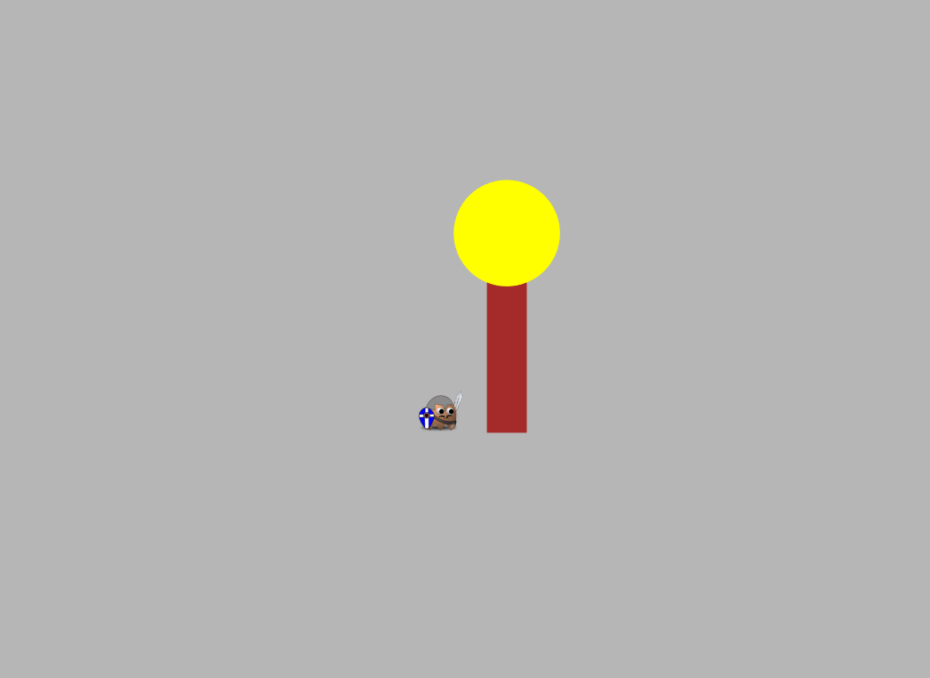
Once you reach the tree, its top will turn yellow.
You can then collect points at the tree by repeatedly pressing the HARVEST key (you will not need to steadily hold down any keys to harvest). This will cause points (represented as red numbers) to fall from the tree and be collected.
At first, the tree will give some number of points. However, as you press more, the tree will run out of points and will give fewer and fewer with each press.
The speed with which points fall from the tree will be determined by how fast you repeatedly press the HARVEST key.
The tree’s top will turn yellow when you reach it.
Repeatedly entering the harvest key when you’re at a tree will cause points to fall.
The number of points will tend to decrease with each press.
85
90
100

Slide 5
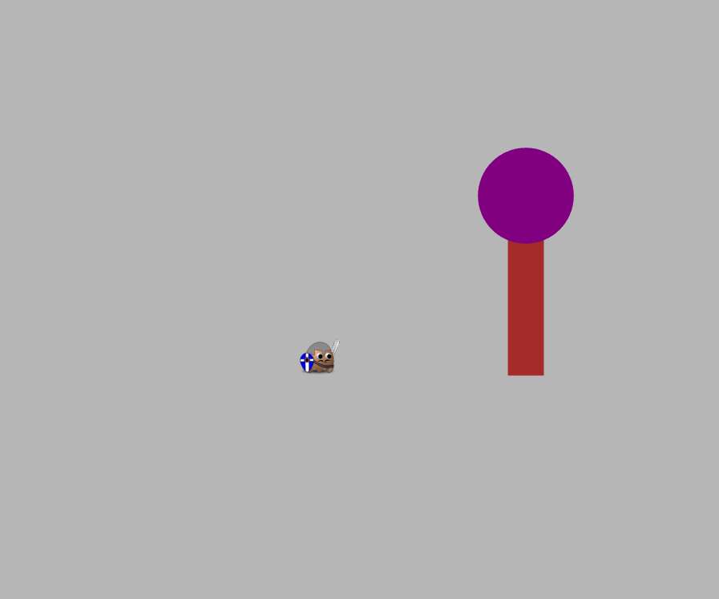
While at a tree, at any point in time, you can choose to leave the tree and head to a new tree by entering the TRAVEL key.
When you do this the current tree will disappear and a new tree will appear, some distance in front of you.
You will then repeat the process of traveling to this new tree by pressing down the hold-down keys and repeatedly pressing up and down the travel-key.
When you harvest from a new tree, its points will at first be high, but will gradually decrease with more presses.
This process of traveling to a tree and then harvesting from it until you leave will continue for the entire round.
After entering the TRAVEL sequence, a new tree will appear, to which you can travel.

Slide 6
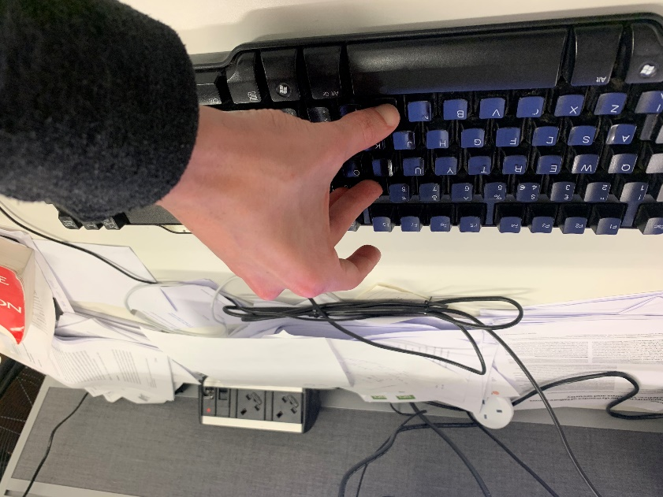
For all the rounds, for a particular travel key, hold-down keys, and harvest key, we will inform you which fingers you should use for each key. It is very important that you use those particular fingers to press those particular keys.
Let’s try a short practice round, which will last 1 minute. For this round, in order to travel, you will need to repeatedly press the ‘F’ key (left index), while keeping the following keys held-down (see photo on right): ‘9’ (with right middle) ‘0’ (with right ring), ‘M’ (with right thumb).
To HARVEST you will press ‘U’ (right index). To collect points when you are at a tree, you will need to press this repeatedly. You will not need to hold down any keys while you press this.
When you are ready to begin, press NEXT.
Picture of fingers on hold-down keys to travel for this round. While these keys are held down, with these specific fingers, you can travel by repeatedly tapping the ‘f’ key with your left index.

Slide 7
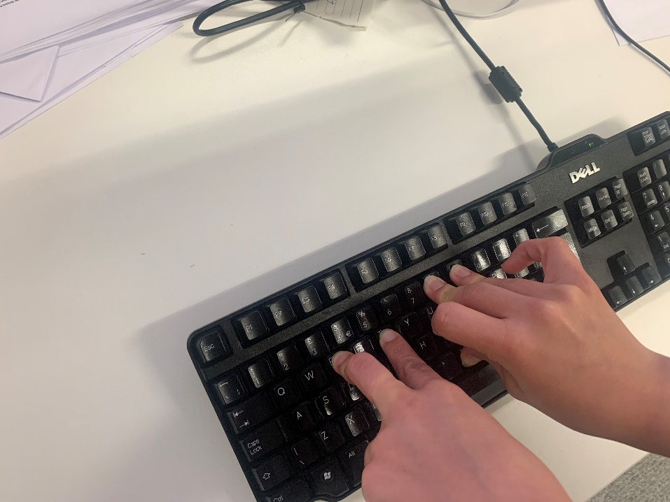
Let’s practice another round now with the other travel key and hold-down keys.
For this round, in order to travel, you will need to repeatedly press the ‘A’ key (left pinky), while keeping the following keys held-down: ‘E’ (left middle) ‘T’ (left index), ‘9’ (right middle), ‘0’ (right ring), ‘M’ (right thumb).
To HARVEST you will again press ‘U’ (right index). To collect points when you are at a tree, you will need to press this repeatedly. You will not need to hold down any other keys.
When you are ready to begin, press NEXT.
Picture of fingers on hold-down keys to travel for this round. While these keys are held down, with these specific fingers, you can travel by repeatedly tapping the ‘a’ key with your left pinky.

Slide 8


Great work.
You will complete 6 rounds of the task. Each round will take place in a different environment.
Environments differ in two ways.
The first way they differ is in the difficulty of traveling.
In HARD environments the TRAVEL key will A (left pinky), with hold-down keys: ‘E’ (left middle) ‘T’ (left index), ‘9’ (right middle), ‘0’ (right ring), ‘M’ (right thumb).
In EASY environments, the TRAVEL key will be F (left index), with hold-down keys 9, 0, M (right middle, ring, thumb).
The harvest key will always be ‘u’.
The second way they differ is in terms of the point richness of the trees.
In HIGH point richness environments, new trees will start out providing around 120 points.
In MEDIUM point richness environments, new trees will start out providing around 90 points.
In LOW point richness environments, new trees will start out providing around 60 points.
HARD environments - To travel in this type of environment, hold down these keys, with these fingers and repeatedly tap ‘A’ with your left pinky.
EASY environments keys. To travel in this type of environment, hold down these keys, with these fingers and repeatedly tap ‘F’ with your left index finger.

Slide 9
Each round in the task will last 2.5 minutes.
Prior to each round, you will be informed as to the type of environment in which the round will take place.
The total number of points that you collect in a round will be affected both by how quickly you press the keys (pressing faster will earn you more points), as well as how long you decide to harvest from a tree as its points decrease.
Before you begin, you will need to pass a quiz on the instructions.
Either answering a question wrong, or answering ‘I don’t know’, will require you to re-read the instructions. However, you will not need to re-do the practice round.
Press NEXT to begin the quiz.

