Slide 1
Welcome to the experiment! Thank you for participating. For your participation you will receive at least £3.25 with a potential bonus between 0 and £2.
Please read the instructions carefully. You will need to pass a quiz before starting the task.
In this experiment, you will play a game in which you will act as a knight that must travel between different trees in order to collect points. You will play 12 rounds of the game in total, each lasting 90 seconds.
In each round, your goal will be to collect as many points as you can. At the end of the experiment, the computer will pick one round at random and your bonus will be proportional to the total number of points you collected during that round.

Slide 2
We’ll now explain how a round works. Each round will have two key sequences that you will need to use. Each sequence will be composed of four keyboard keys that you must press in order, repeatedly.
Pressing one sequence (the ‘TRAVEL’ sequence) will cause you to move rightward on the screen, toward a tree. Pressing the other sequence (the ‘HARVEST’ sequence) will cause you to collect points when you are at a tree.
Prior to each round, you will be informed of either sequence.

Slide 3
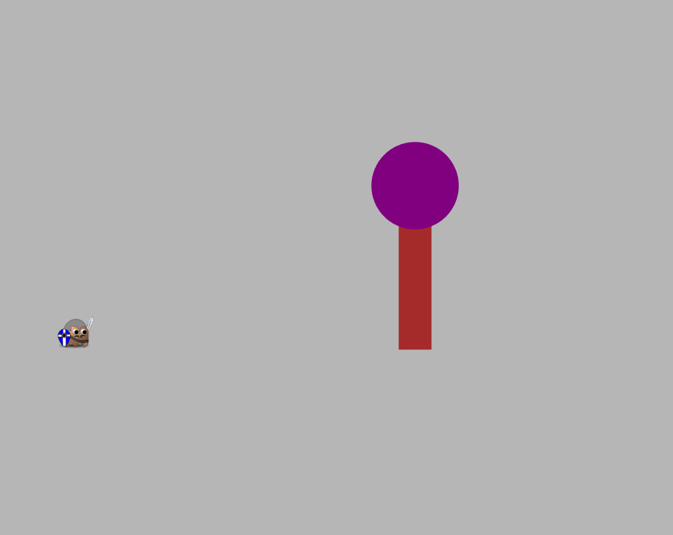
Each round will start with you on the left side of the screen and a tree some distance ahead of you.
You will need to press the TRAVEL sequence to move toward the tree. You will have to enter the four keys in the TRAVEL sequence in order, possibly many times, in order to reach the tree.
The speed with which you travel to the tree will depend on how fast you repeatedly enter the sequence.
A Tree
You
Entering the four-key travel sequence repeatedly will move you toward the tree.

Slide 4
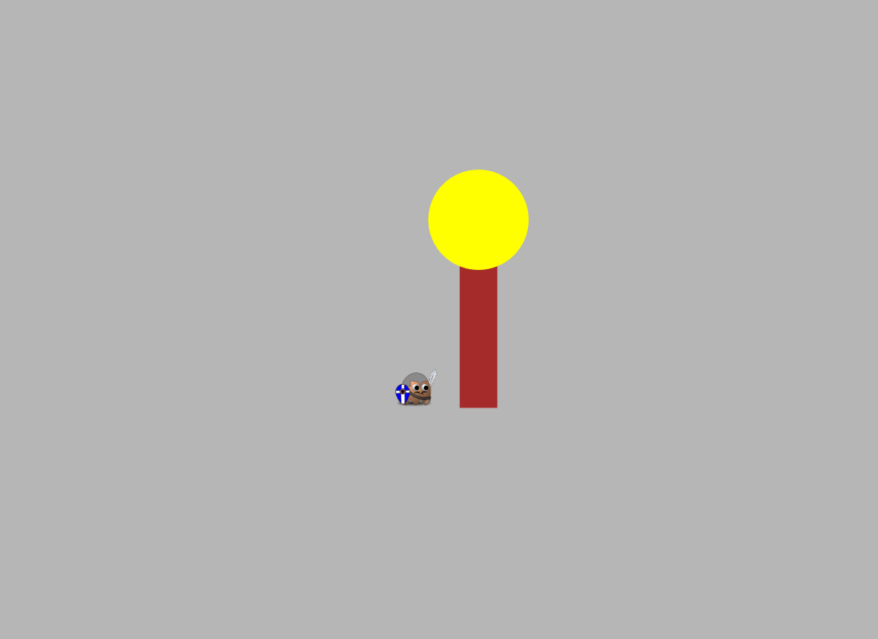
Once you reach the tree, its top will turn yellow.
You can then collect points at the tree by entering the HARVEST sequence. You will need to enter the four keys in HARVEST sequence in order, repeatedly. Entering the Harvest sequence will cause points (represented as red numbers) to fall from the tree and be collected.
At first, the tree will give lots of points (around 100). However, as you press more, the tree will run out of points and will give fewer and fewer with each press.
The speed with which points fall from the tree will be determined by how fast you repeatedly enter the HARVEST sequence.
The tree’s top will turn yellow when you reach it.
Entering the harvest sequence when you’re at a tree will cause points to fall.
The number of points will tend to decrease with each press.
85
90
100

Slide 5
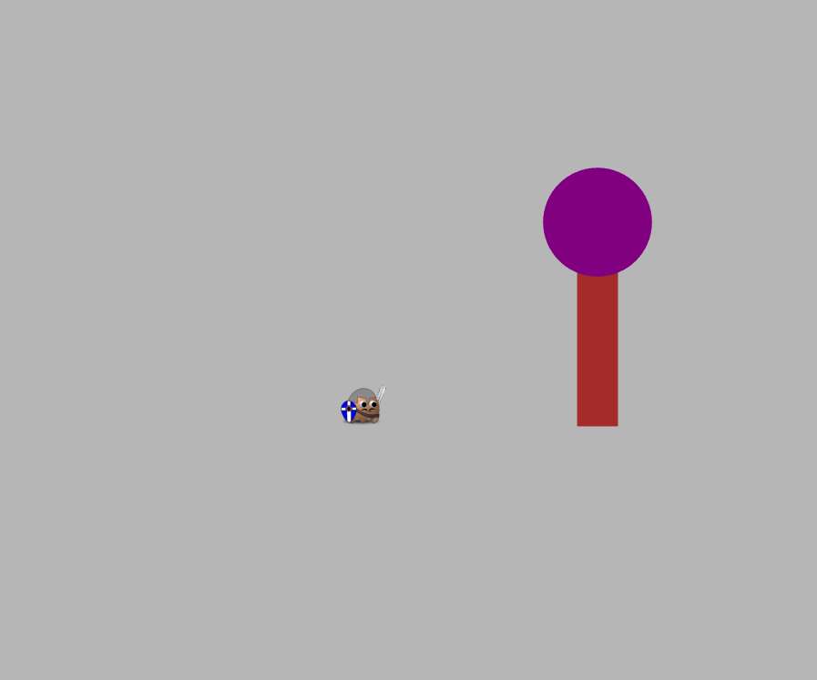
While at a tree, at any point in time, you can choose to leave the tree and head to a new tree by entering the TRAVEL sequence.
When you do this the current tree will disappear and a new tree will appear, some distance in front of you.
You will then repeat the process of traveling to this new tree.
When you harvest from a new tree, its points will at first be high (around 100), but will gradually decrease with more presses.
This process of traveling to a tree and then harvesting from it until you leave will continue for the entire round.
After entering the TRAVEL sequence, a new tree will appear, to which you can travel.

Slide 6
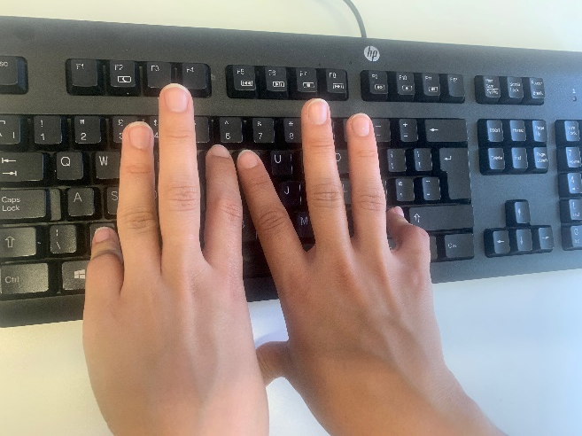
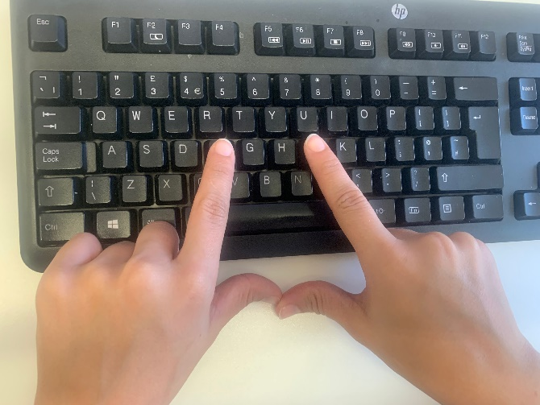
Let’s now complete a practice round that will last 45 seconds.
For this round the TRAVEL sequence will be Z -> / -> T -> Y. When pressing this, please enter ‘Z’ with your left pinky, ‘/’, with your right pinky, ‘T’ with your left index finger, and ‘Y’ with your right index finger. To travel, you will need to press these keys in order, repeatedly.
The HARVEST sequence will be F -> J -> F -> J. Please press ‘F’ with your left index finger and ‘J’ with your right index finger. To collect points when you are at a tree, you will need to press these keys in order, repeatedly.
When you are ready to begin, press NEXT.
Travel sequence hand position
Harvest sequence hand position

Slide 7

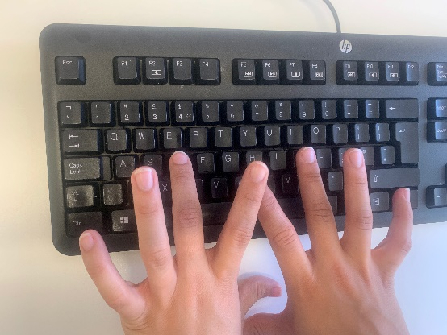

Great work.
Before each round you will be informed of the TRAVEL and HARVEST sequences. These may be different between the different rounds.
The HARVEST sequence will always be F -> J -> F -> J. You should enter this sequence by pressing ‘F’ with your left index finger and ‘J’ with your right index finger.
The TRAVEL sequence will sometimes be D -> K -> D -> K. When you enter this sequence press D with your left middle finger and K with your right middle finger.
Other times the TRAVEL sequence will be Z -> / -> T -> Y. When you enter this sequence, press Z with your left pinky, / with your right pinky, T with your left index finger and Y with your right index finger.
Harvest sequence hand position
Travel sequence 1 hand position
Travel sequence 2 hand position

Slide 8
Each round in the task will last 90 seconds.
The total number of points that you collect in a round will be affected both by how quickly you enter the sequences, as well as how long you decide to harvest from a tree as its points decrease.
Before you begin, you will need to pass a quiz on the instructions.
Either answering a question wrong, or answering ‘I don’t know’, will require you to re-read the instructions. However, you will not need to redo the practice round.
Press NEXT to begin the quiz.

